Slide 1



COMPREHENSIVE AUDIT & ANALYSIS FOR EFFECTIVE DIGITAL PRESENCE
By Nithya B

Slide 2

I CHOOSE WIPRO COMPANY

Slide 3
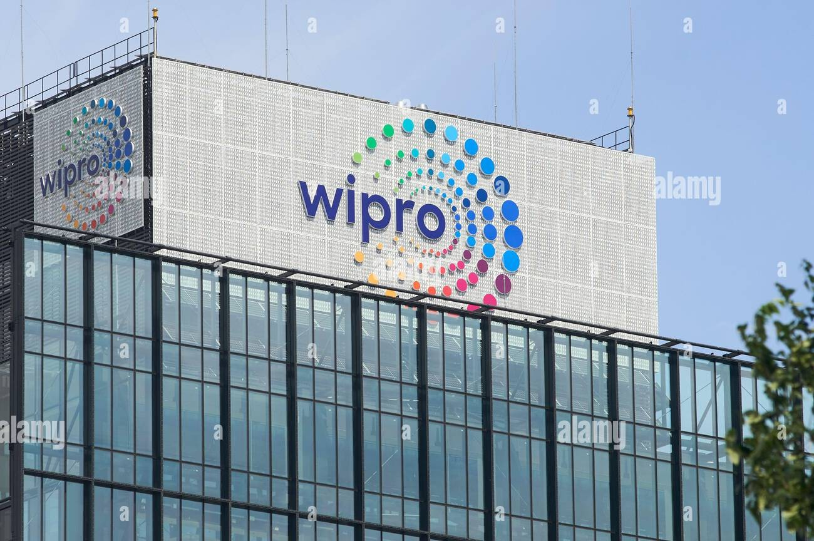
ABOUT THE COMPANY
Founded: 1945 by M.H. Hasham Premji
Headquarters: Bengaluru, Karnataka, India .
Global presence: Operations in over 60 countries.
Employees: 233,346 (as of March 2025).
Leadership: Rishad Premji (Executive Chairman), Srini Pallia.
It offers a wide portfolio of solutions including cloud services, cybersecurity, data & analytics, digital transformation, engineering, consulting, and business process outsourcing

Slide 4

WEBSITE Audit Report

Slide 5

Purpose of Audit
This audit evaluates performance, SEO, design, accessibility, and content strategy to highlight strengths and areas of improvement.
Design and user experience
strengths
Modern, professional design aligned with brand identity.
Clear navigation and structured menus.
Strong use of visuals and case studies.
weakness
Some pages are text-heavy, reducing scan ability
Calls-to-action (CTAs) could be more prominent..

Slide 6
Recommendations
Enhance CTA visibility with contrasting colours.
Simplify text blocks with bullet points.
Improve accessibility with alt-text for all images.

Slide 7
Performance Analysis
The performance score is 70/100 which places it in moderate yellow range for a desktop view.
For mobile view the score is 43 placing it in the red zone indicating poor performance.
Page Speed: Homepage loads moderately fast but could be optimized further for mobile users.
Recommendations
Minify CSS(cascading style sheets)/JS(Java script files)
Compress images and leverage next-gen formats (WebP /AVIF).
Implement better caching and CDN distribution.

Slide 8
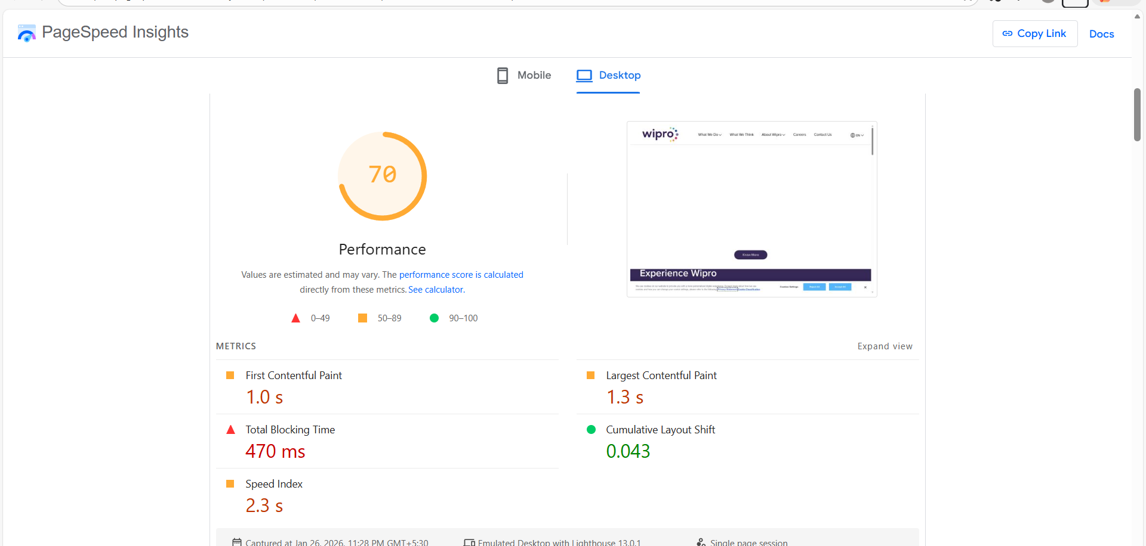
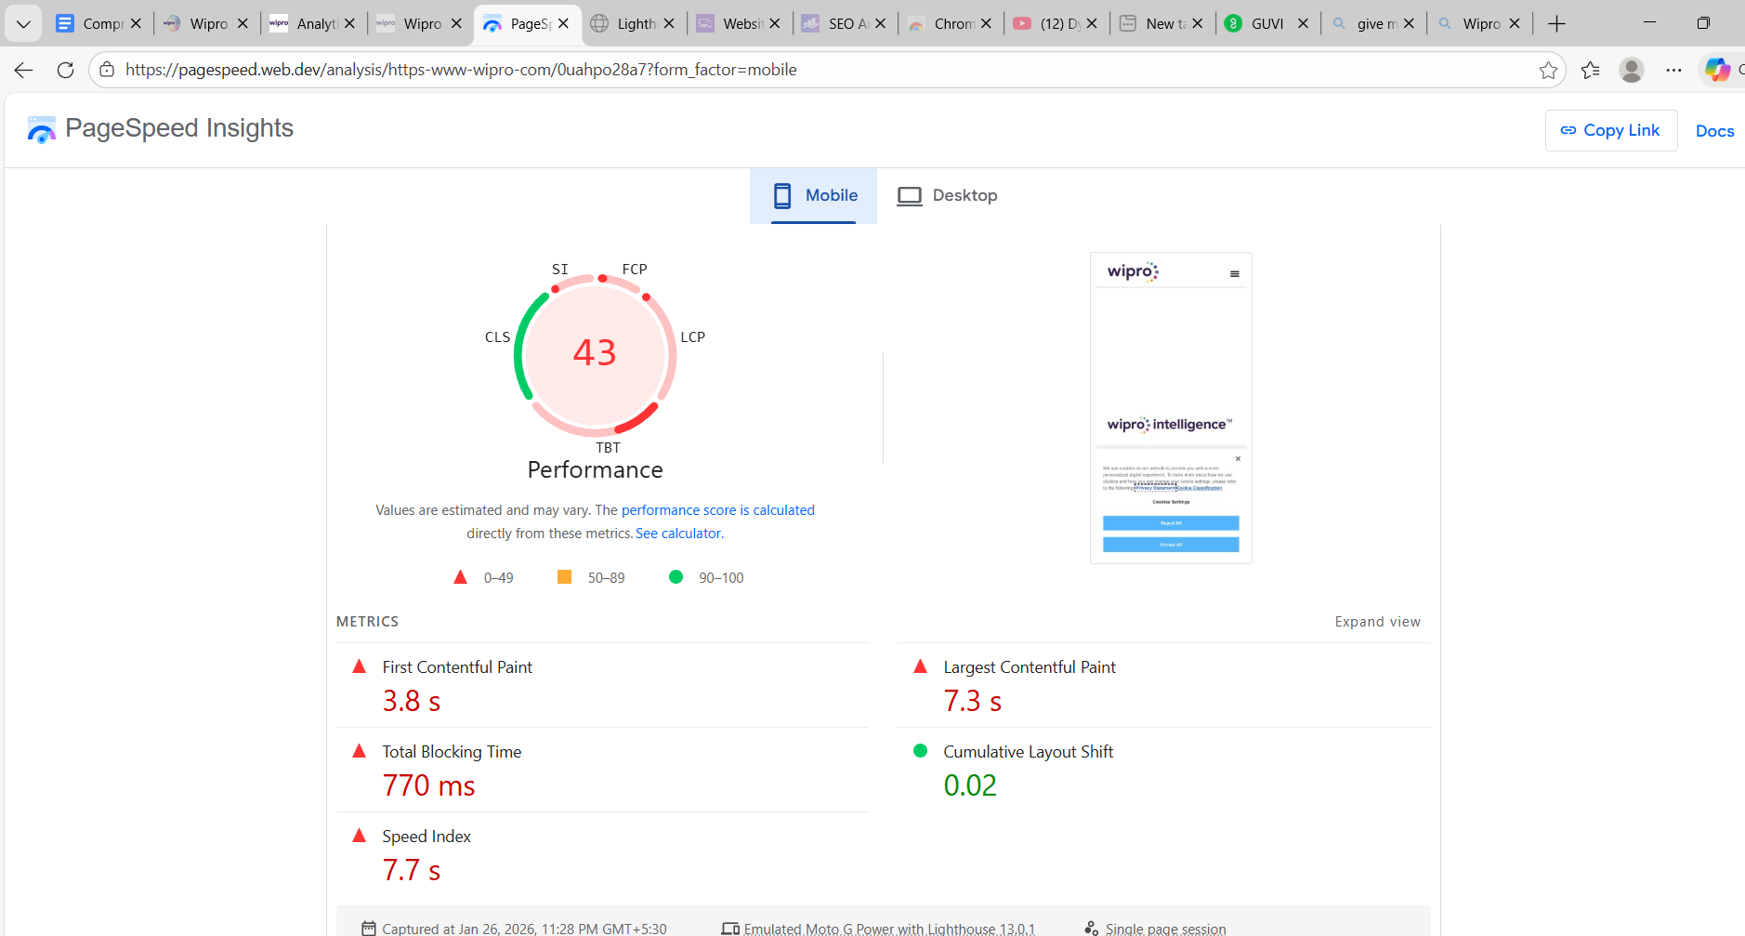

Slide 9
SEO Audit
On-Page SEO:
Titles and meta descriptions are present but could be more keyword-rich.
Headings (H1/H2) structured well but some pages lack optimized keywords and H1 is absent in 3 pages.
Technical audit
HTTPS enforced across the site.
XMLsitemap and robots.txt are correctly implemented.
Mobile-friendly design verified.

Slide 10
Off page seo
Strong domain authority due to brand recognition.
Backlink profile is robust but could expand with thought-leadership content.
Recommendations
Optimize meta tags with industry-specific keywords.
Improve internal linking for deeper pages.
Expand blog content for long-tail keyword targeting.

Slide 11
Content strategy
Strengths
Strong emphasis on AI, consulting, and innovation.
Case studies and reports add credibility.
Weakness
Blog/news section could be more frequently updated.
Limited interactive content (videos, infographics).
Recommendations
Increase publishing frequency of thought-leadership articles.
Add multimedia content for engagement.
Localize content for regional audiences.

Slide 12
Recommendations to align with traditional vs
digital marketing goals.
1) Integrated Brand message
Ensure slogans, visuals, and tone are same
across both offline and online channels.
2) Connect the online & offline gap
We need to create brand awareness in offline
medias sharing QR codes & url’s so that it impacts the
Digital engagement and conversion ratio.
3) Customer loyalty
Blend physical events with digital follow-ups by using emails & retargeting ads so that customers attend it.
4) Campaign launch
Launch campaigns offline which makes the customers curious and deepen their engagement in online presence.
.

Slide 13
Website creation
I created a simple E-commerce website for a clothing store with a brand name Nithya’s boutique. My url for the site is https://ntyacool23.wixsite.com/kanchisarees
The site contains a basic home page , about ,gallery, contact ,shop and blog pages under the more option.
I concentrated on selling two products the Kanchi silk and organza sarees in by website.

Slide 14
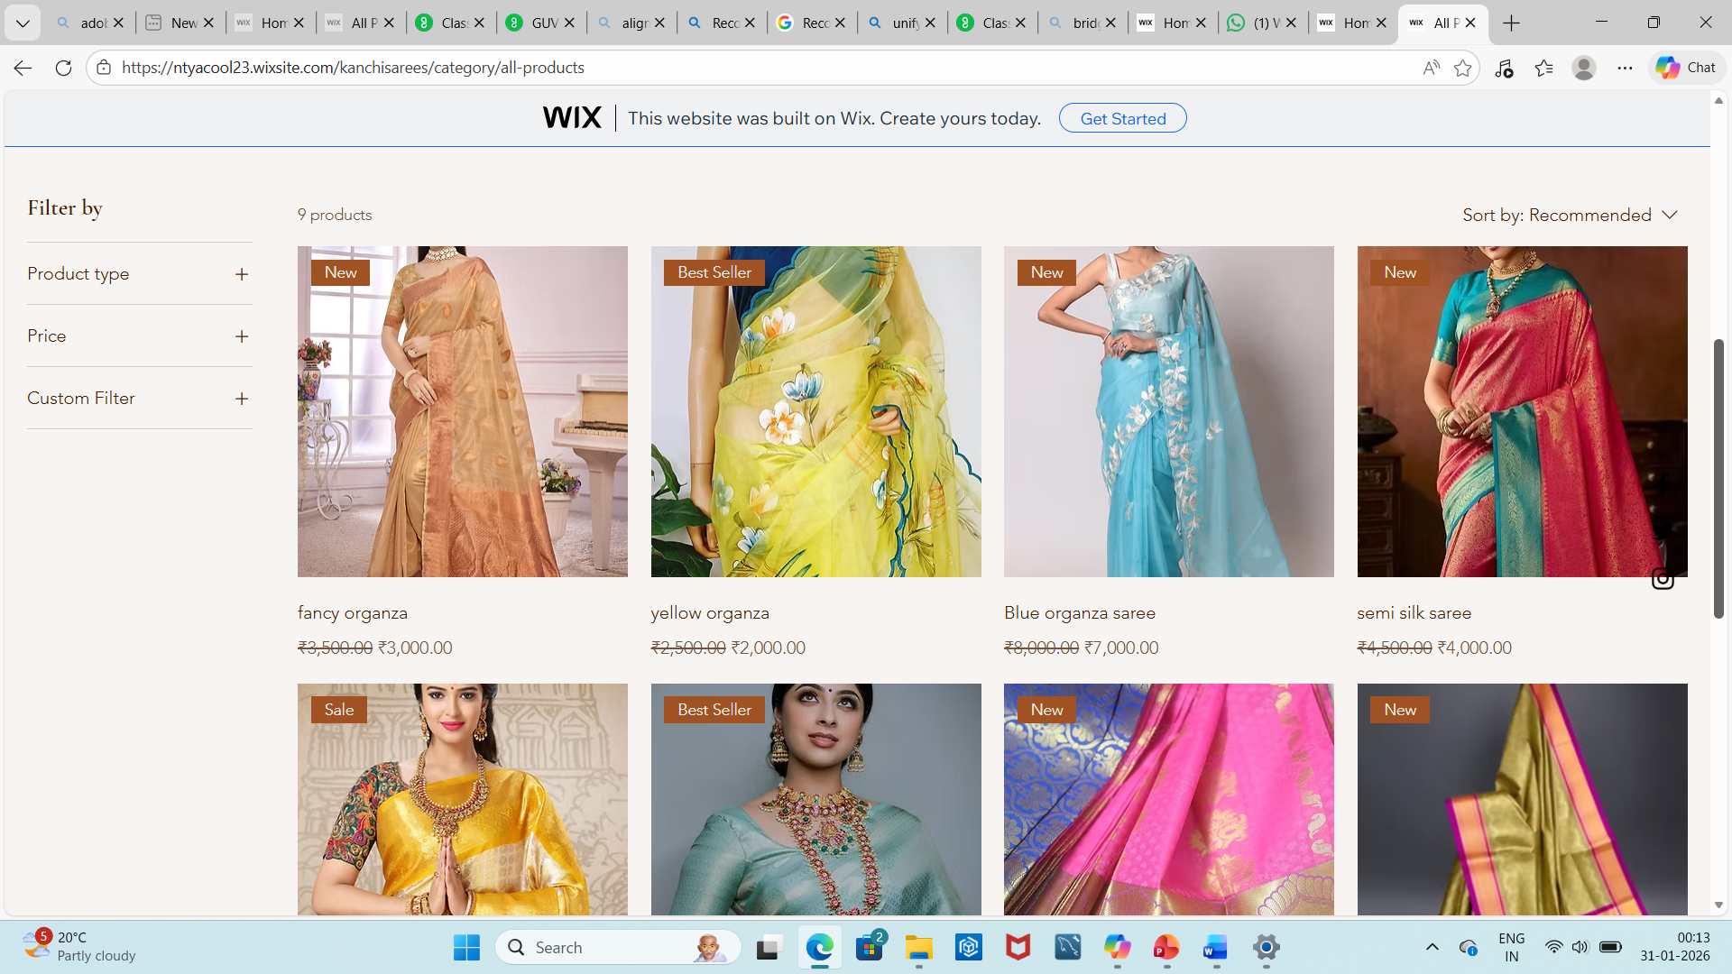
THANK YOU

Slide 15
THANK YOU

