Slide 1

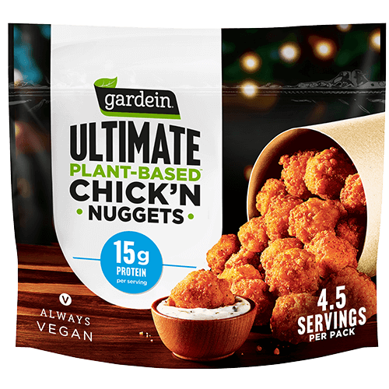

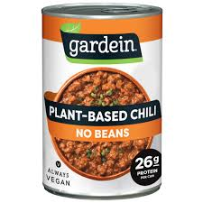
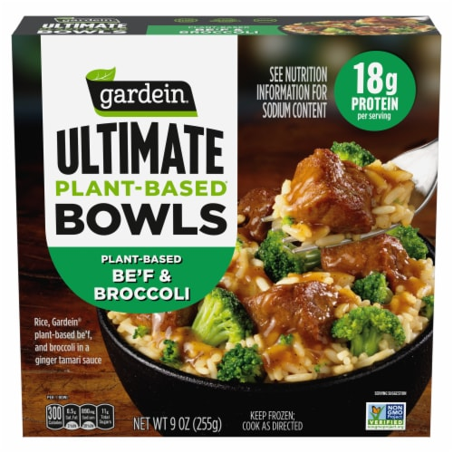
MEATLESS MOMENTUM: DATA DRIVEN STRATEGIES​

Slide 2
MEET OUR GREAT TEAM
Amritha Raj AXR230027 Mourlaye Traore MXT230013
Ragunath Natarajan RXN230005 Nithyashree Balaji NXB220014
Shreya Reddy Maranganti SXM220259 Puneeth Kumar Reddy Panjam PXP230043
Krishna Vaishnav Katta KXK230043
G
R
O
U
P
8

Slide 3

INTRODUCTION
A major player in the food industry with over 100 diverse brands, Conagra has a long-standing reputation for quality and innovation.
Conagra is committed to sustainability and reducing its environmental impact, aligning with global trends towards more eco-friendly food choices.
Gardein is a leading brand within Conagra's portfolio, specializing in plant-based meat substitutes that closely mimic traditional meat in taste and texture.
The plant-based food sector is experiencing rapid growth, driven by consumer demand for healthier and more sustainable food options.

Slide 4
OBJECTIVE
HOW?
Identify key regions with high growth potential and implement data-driven strategies to increase Gardein's presence, revenue, and brand loyalty in these markets.
Utilize data analytics to uncover consumer trends, preferences, and market dynamics, enabling Conagra to make informed decisions and unlock future growth potential in the meat substitutes category.
WHY?
By implementing these strategies, we aim to empower Gardein's growth in the meat substitute market, leading the market expansion, capitalizing on emerging trends, and solidifying Gardein's position as a top choice for consumers seeking meat alternatives.
WHAT?
Develop and implement targeted strategies to drive overall market growth, focusing specifically on increasing Gardein's market share and revenue.

Slide 5
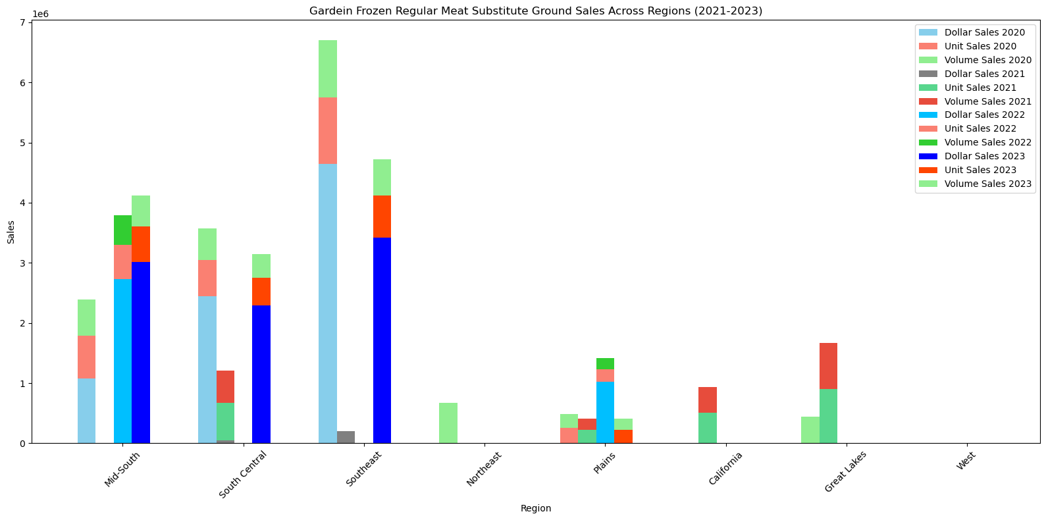
EXECUTIVE SUMMARY
Expand Gardein's frozen range in high-demand regions like the Southeast and South Central.
Introduce new frozen flavors and variants to cater to diverse preferences.
Prioritize "Price per Unit Feature Only" for pricing strategies.
Use strategic promotions or discounts (display only) to boost sales.
Focus on understanding regional consumer preferences for sustained growth.

Slide 6
Product Form Diversification: Gardein should expand into new forms like Patty, Nugget, Link, Strip, and Breakfast Sausage, with additional flavors and varied package sizes.
Packaging and Product Innovation: Introducing transparent packaging and using coloring agents to mimic real meat could attract more consumers.
Distribution Expansion: Focus on increasing distribution for successful products like Nugget, Link, and Strip, which currently have limited reach.
Pricing Strategy Optimization: Adjust pricing based on competitive trends, especially in the Patty form, to improve market share and profitability.
Fast-Food Partnerships: Explore collaborations with fast-food brands to boost brand visibility and sales, akin to the Impossible-Burger King partnership.
Streamline Product Portfolio: Remove underperforming products to focus on high-demand offerings and improve overall efficiency.
Brand | Distinct count of form in 2023 | Total unique products offered in 2023 | % Dollar sales in 2023 | % Dollar sale per unique product
MORNINGSTAR FARMS | 20 | 73 | 30 | 0.41
BEYOND | 12 | 30 | 16 | 0.53
GARDEIN | 22 | 57 | 15 | 0.26
IMPOSSIBLE | 9 | 25 | 19 | 0.76

Slide 7
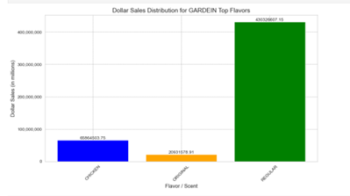
Regional Strategy and Tailored Product Innovation: Strengthen Gardein's presence in the Northeast and West by enhancing marketing and distribution, while introducing new chicken-flavored products and limited-edition flavors tailored to these regions.
Flavor Popularity and Regional Insights: While Regular flavor is the top seller, Chicken flavor's rising sales suggest a growing opportunity. The success of Chicken flavor in the Southeast region highlights a prime area for targeted marketing efforts.
Predictive Model Findings: A prediction model using key factors (price per unit, units sold, and year) shows a 93% variance explanation for dollar sales, highlighting its utility in sales forecasting.

Slide 8
CONCLUSION
Region-Focused Marketing: To boost sales, Gardein should implement region-specific marketing strategies that cater to local consumer preferences, increasing brand recognition and market share.
Innovate with New Products: Gardein can stay competitive by diversifying its product offerings, introducing new and unique flavors to attract a wider customer base.
Leverage Strategic Partnerships: Forming partnerships with other brands, retailers, or influencers can enhance Gardein's marketing reach, driving higher sales and supporting growth.

Slide 9
THANK YOU

