Slide 1


Slide 2
Problem Statement
A consumer finance company specializes in lending various types of loans to urban customers. When the company receives a loan application, the company has to make a decision for loan approval based on the applicant’s profile.
Two types of risks are associated with the bank’s decision:
If the applicant is likely to repay the loan, then not approving the loan results in a loss of business to the company
If the applicant is not likely to repay the loan, i.e. he/she is likely to default, then approving the loan may lead to a financial loss for the company
The company wants to understand the driving factors (or driver variables) behind loan default, i.e. the variables which are strong indicators of default. The company can utilize this knowledge for its portfolio and risk assessment.

Slide 3
Anaysis of the data
Problem statement understanding
Understanding the data
Data imputation
Data cleaning
Outlier treatment
Data Analysis

Slide 4
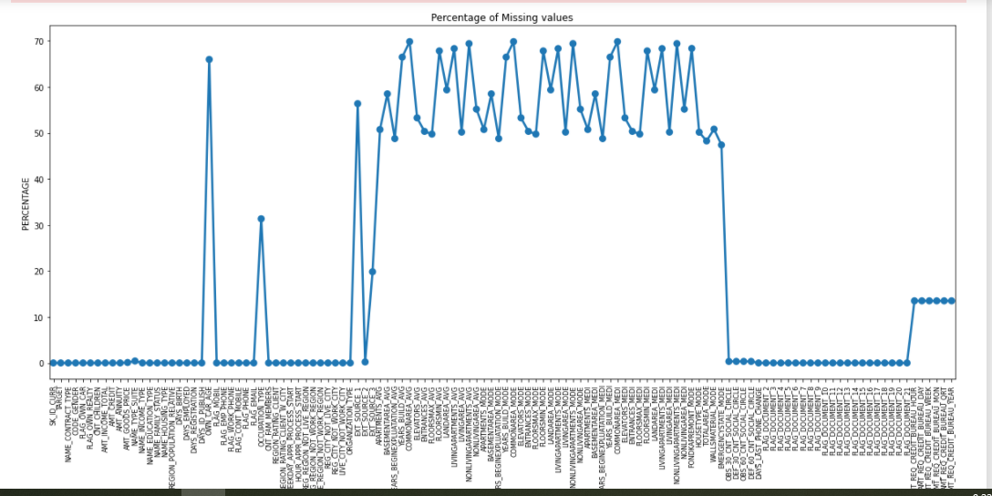
Null values in application data set

Slide 5
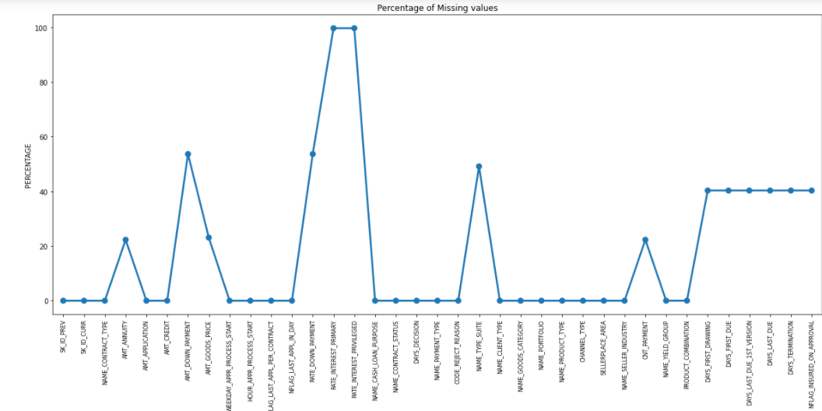
Null values for previous application data

Slide 6
Before analysis we will be doing outlier treatment. 1.Mean= when there is no outlier and the data is numerical. 2.Median = when the data is numerical and we have outliers. 3. Mode = when the data is catogorical.

Slide 7
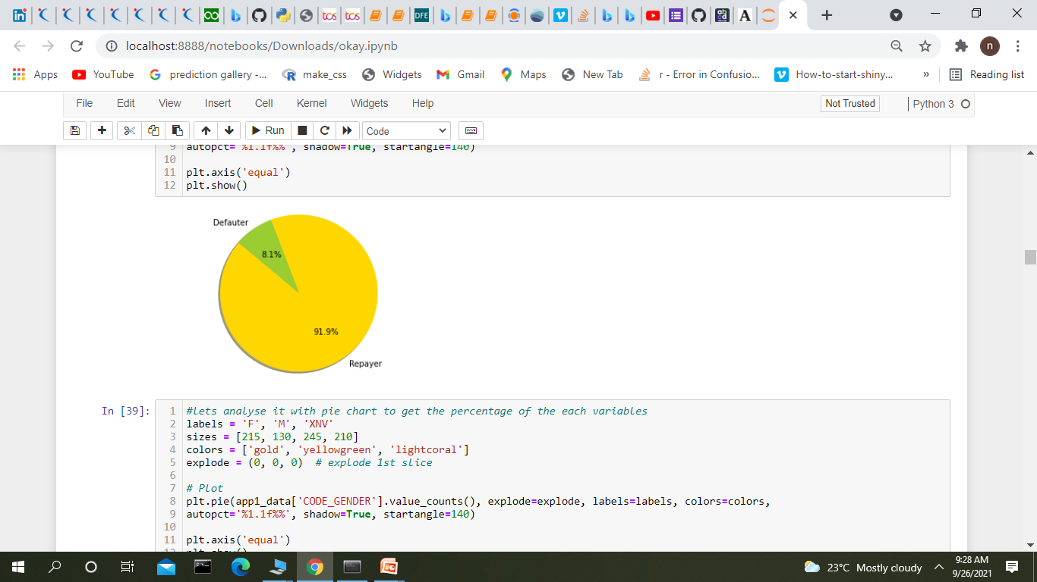
Data Imbalance
Ratios of imbalance for Repayer and Defaulter in Percentage is: 91.9 and 8.1
Ratios of imbalance for Repayer Vs Defaulter is: 11.39 :1 (approx.)

Slide 8
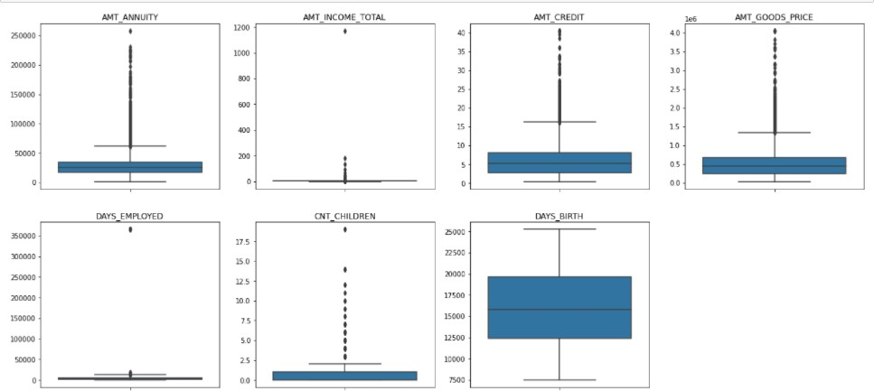
OUTLIERS ANALYSIS
INFERENCE:-
AMT_ANNUITY, AMT_CREDIT, AMT_GOODS_PRICE,CNT_CHILDREN have some number of outliers.
AMT_INCOME_TOTAL has huge number of outliers which indicate that few of the loan applicants have high income when compared to the others.
DAYS_BIRTH has no outliers which means the data available is reliable.
DAYS_EMPLOYED has outlier values around 350000(days) which is around 958 years which is impossible and hence this has to be incorrect entry.
We can see the stats for these columns below as well.

Slide 9
Univariate Analysis

Slide 10
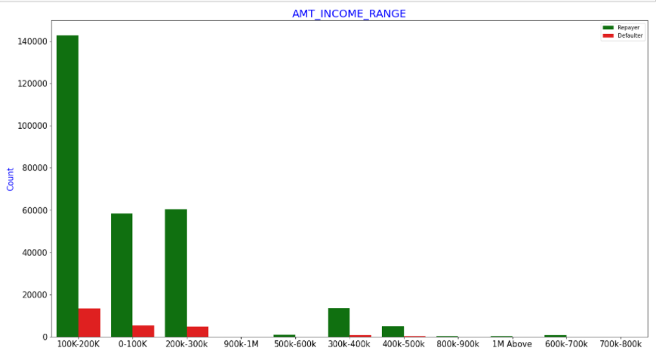
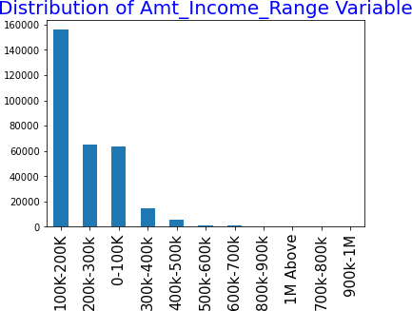
Amount Income Range
Majority of the applicants have salary between 100-200K
Application with Income less than 300,000 has high probability of defaulting
Applicant with Income between 700-800k are less likely to
default
INFERENCE:-
Applicants with Income more than 700,000 are less likely to default

Slide 11
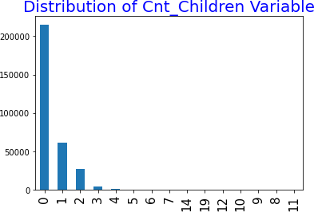
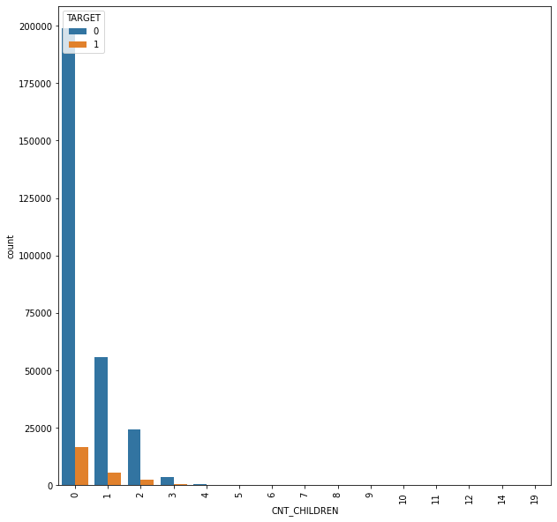
Count of Children
Most of the applicants do not have children. Very few clients have more than 3 children
INFERENCE:-
Applicants with zero to two children tend to repay the loans

Slide 12
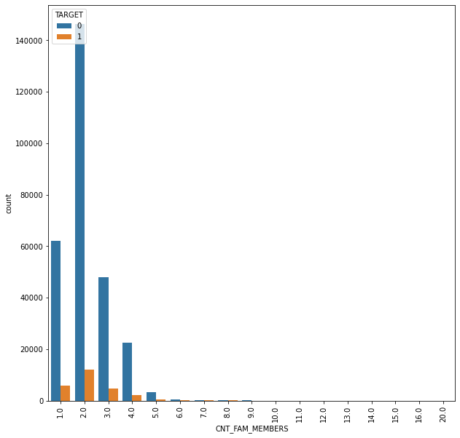
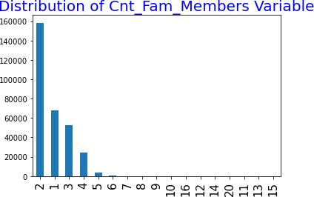
COUNT OF FAMILY MEMBERS
Majority of the clients have 2 family members
Inference: Applicants who have higher family members (>=11) have higher default rate and their applications can be rejected

Slide 13
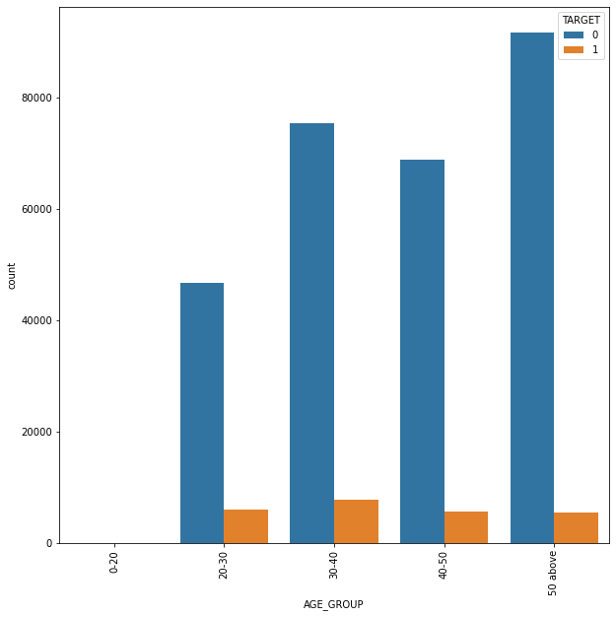
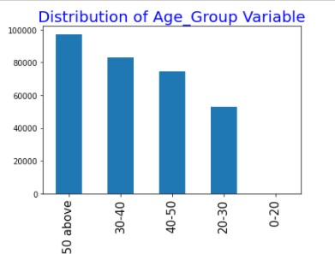
AGE GROUP
Majority of the clients are of age more than 50
INFERENCE:-
Applicants above age of 50 have low probability of defaulting, hence there applications can be approved. Young applicants who are in age group of 20-40 have higher probability of defaulting.

Slide 14
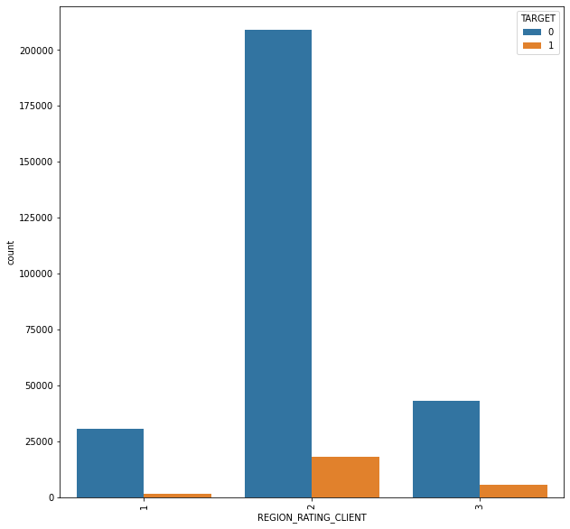
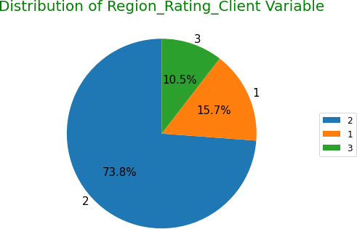
REGION RATING
- Most of the applicants are living in Region_Rating 2 place.
Region Rating 3 has the highest default rate (11%) , fol1owed by 2( around 8%) and 1(around 5%)
Applicant living in Region_Rating 1 has the lowest probability of defaulting, thus safer for approving loans
Inference:-
Applicants who live in areas with Region Rating 1 are safe borrowers

Slide 15
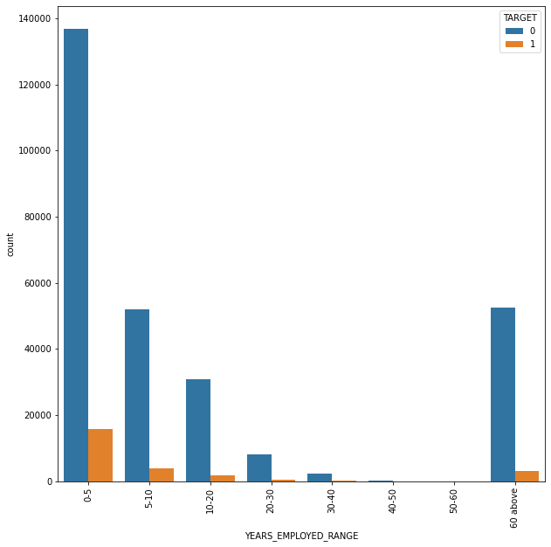
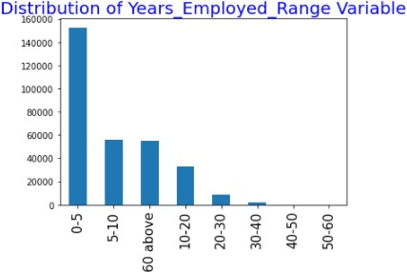
YEARS EMPLOYED
Majority of the applicants have been employed in between 0-5 years
Majority of the applicants have been employed in between 0-5 years. The defaulting rating of this group is also the highest which is 10%
With increase of employment year, defaulting rate is gradually decreasing with people having 40+ year experience having less than 1% default rate
INFERENCE:-
Applicants with 40+ year experience having less than 1% default rate

Slide 16
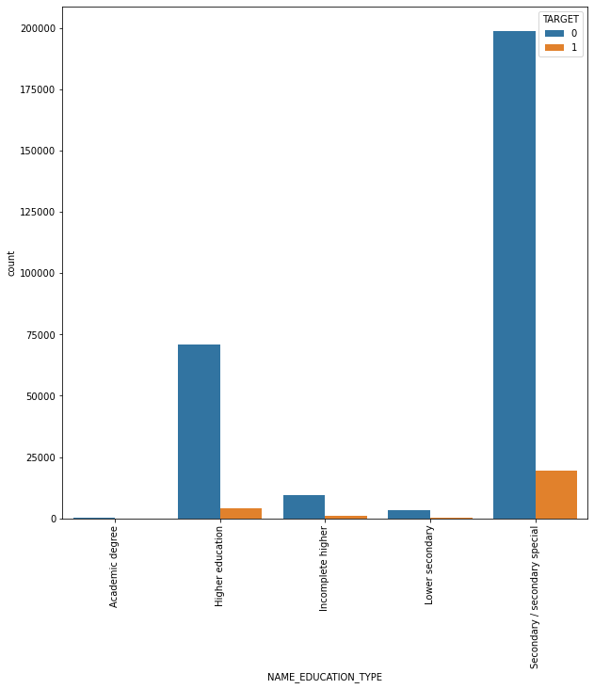
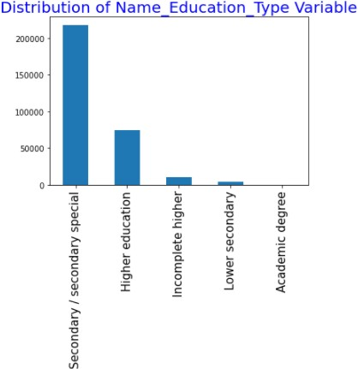
EDUCATION TYPE
Majority of the clients have Secondary / secondary special education, followed by clients with Higher education. Only a very small number having an academic degree
The Lower secondary category, although rare, have the largest rate of defaulters (11%).
The people with Academic degree have the lowest defaulting rate(around 2%).
Inference:-
Applicants who are Academic degree holder have lower default rate

Slide 17
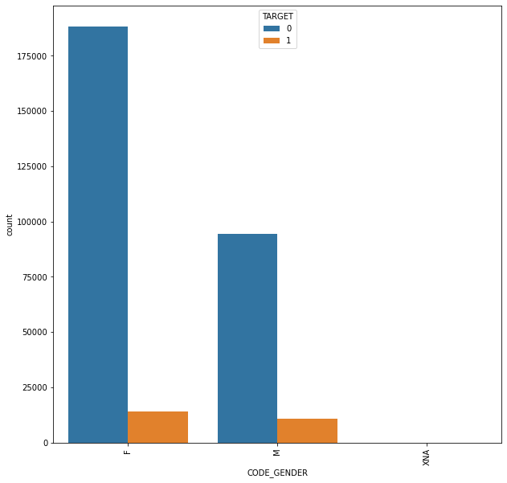
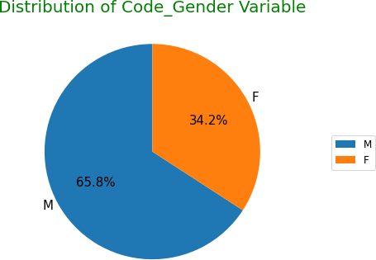
GENDER CODE
Inferences:
The number of female clients is almost double the number of male clients. Based on the percentage of defaulted credits, males have a higher chance of not returning their loans (approx 10%), comparing with women (~7%)

Slide 18
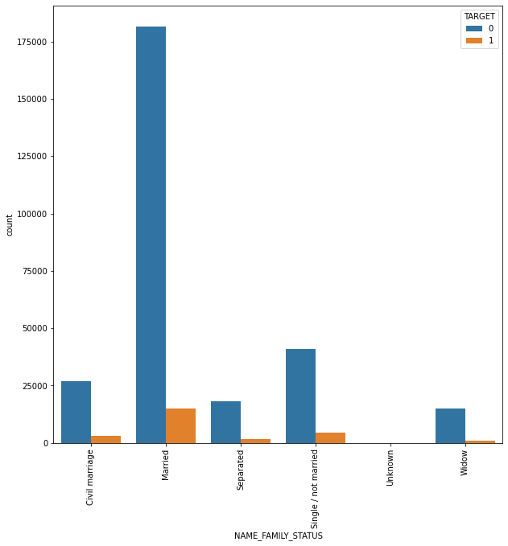
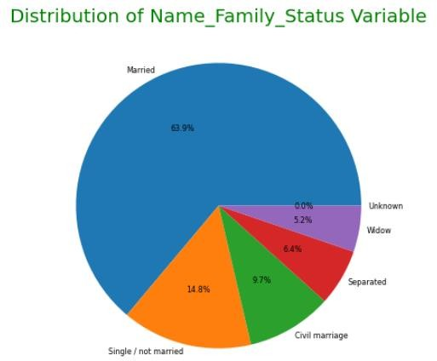
FAMILY/MARITIAL STATUS
Most of the people who have taken loan are married, followed by Single/not married and civil marriage
In terms of percentage of not repayment of loan, Civil marriage has the highest percent of not repayment (10%), with Widow the lowest (exception being Unknown).
Inference
Applicants in civil marriage or who are single have higher default rate

Slide 19
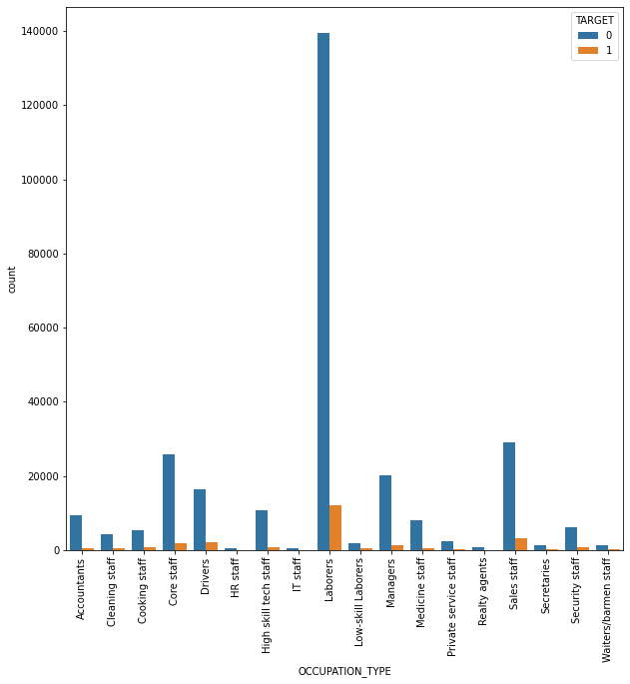
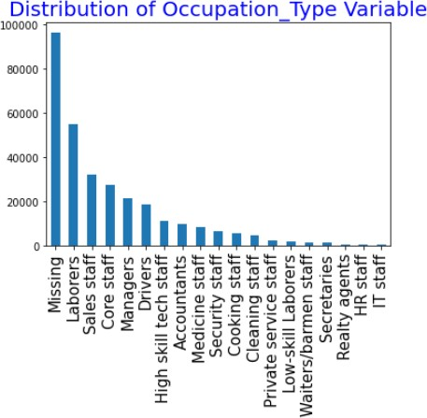
OCCUPATION TYPE
The category with highest percent of not repaid loans are Low- skill Laborers (above 17%), followed by Drivers and Waiters/barmen staff, Security staff, Laborers and Cooking staff.
Inference:- Applicants who are Low-skill Laborers, Drivers and Waiters/barmen staff, Security staff, Laborers and Cooking staff as the default rate is huge.
Most of the loans are taken by people whose Occupation is "Missing" in the dataset followed by Laborers, Sales staff. IT staff take the lowest amount of loans.

Slide 20
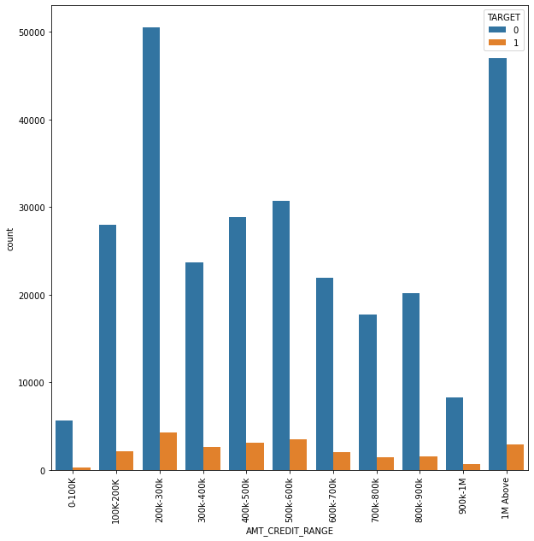
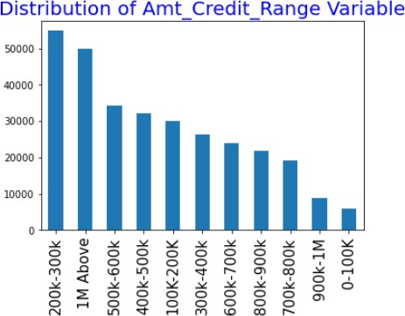
CREDIT AMOUNT
Majority of the Loan amount is between 200-300K
Inference:-
Applicants with Income more than 700,000 are less likely to default
More than 80% of the loan provided are for amount less than 900,000 People who get loan for 300-600k tend to default more than others.

Slide 21
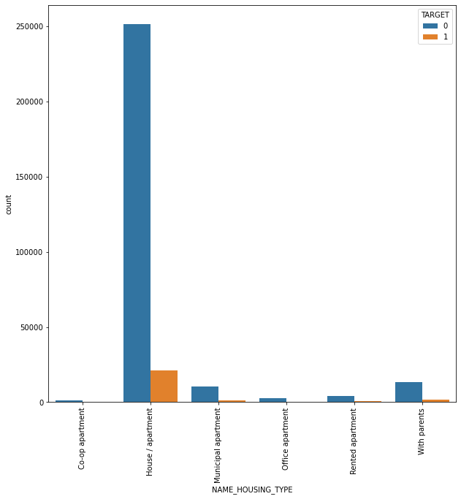
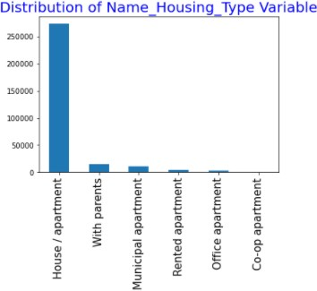
HOUSING TYPE
Majority of people live in House/apartment
People living in office apartments have lowest default rate
- People living with parents (around 11.5%) and living in rented apartments(> 12%) have higher probability of defaulting
Inference:
High number of loan applications are from the category of people who live in Rented apartments & living with parents and hence offering the loan would mitigate the loss if any of those default

Slide 22
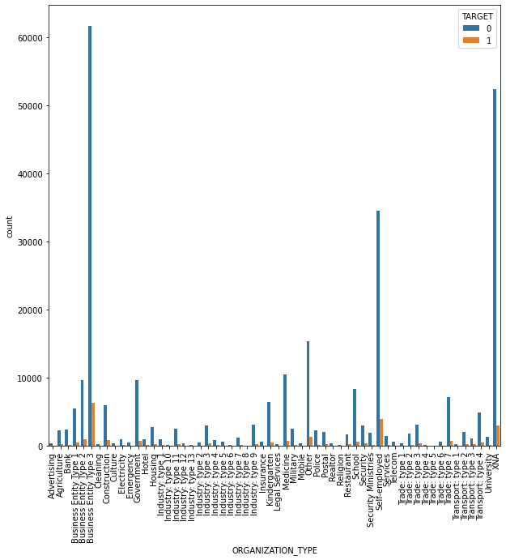
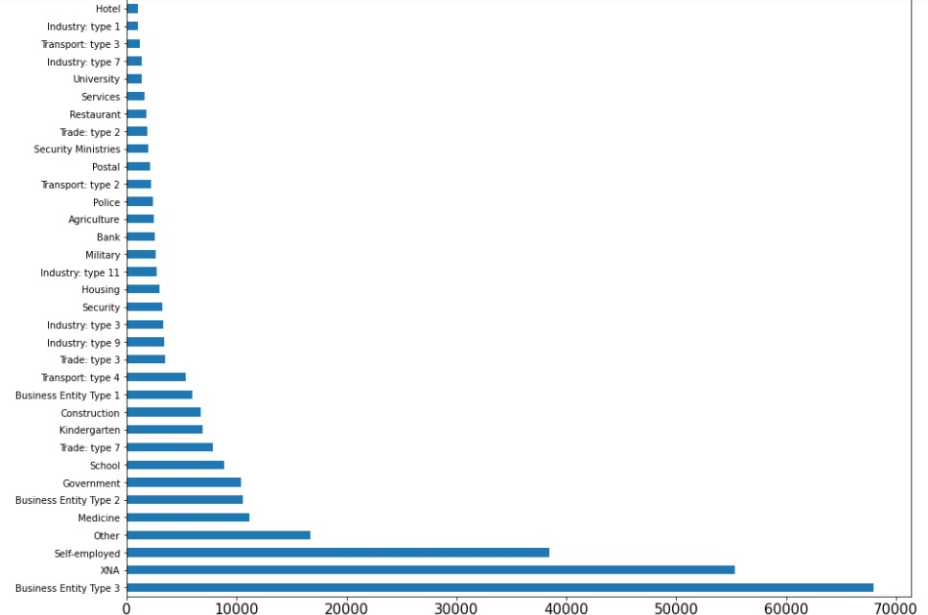
ORGANIZATION_TYPE
Inferences:
Most of the applications for loan are from people working in Business Entity Type 3 organization
Organizations with highest percent of loans not repaid are Transport: type 3 (around 16%), Industry: type 13 (13.5%), Industry: type 8 (around
Self employed people have relative high defaulting rate (10%), and thus should be thoughly scrutized before being approved for loan or provide
For a very high number of applications, Organization type information is unavailable(XNA)
It can be seen that following category of organization type has lesser defaulters thus safer for providing loans:
Trade Type 4
Industry type 122%).

Slide 23


Slide 24
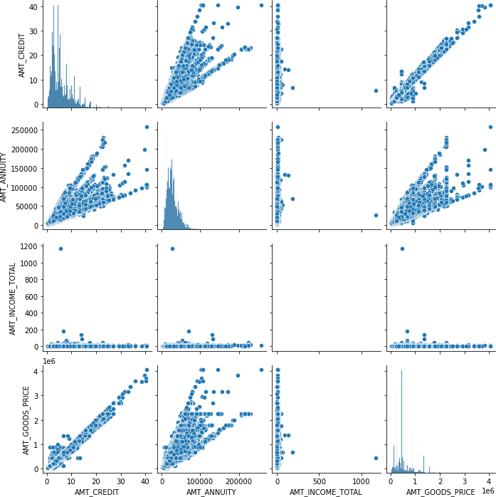
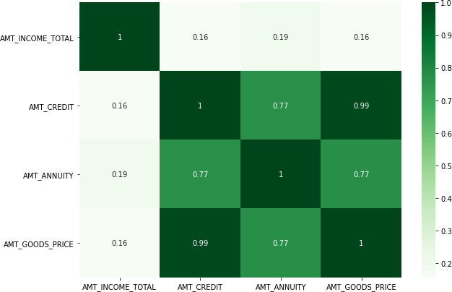
AMT_CREDIT, AMT_ANNUITY, AMT_INCOME_TOTAL ,
AMT_GOODS_PRICE
Inferences:
Very high correlation between AMT_CREDIT and AMT_GOODS_PRICE - Applicants owning goods of high value can take loans of higher amounts.

Slide 25
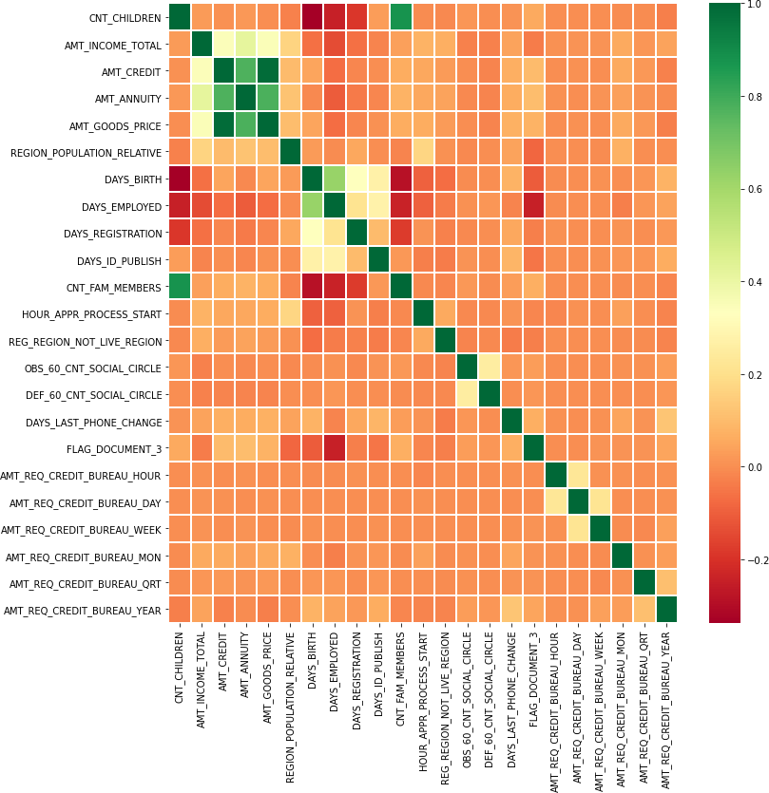
Multivariate (Numeric Columns)
Inferences:
Correlating factors amongst re-
payers:
Credit amount is highly correlated with
amount of goods price loan annuity
total income
We can also see that re-payers have high correlation in number of days employed.

Slide 26
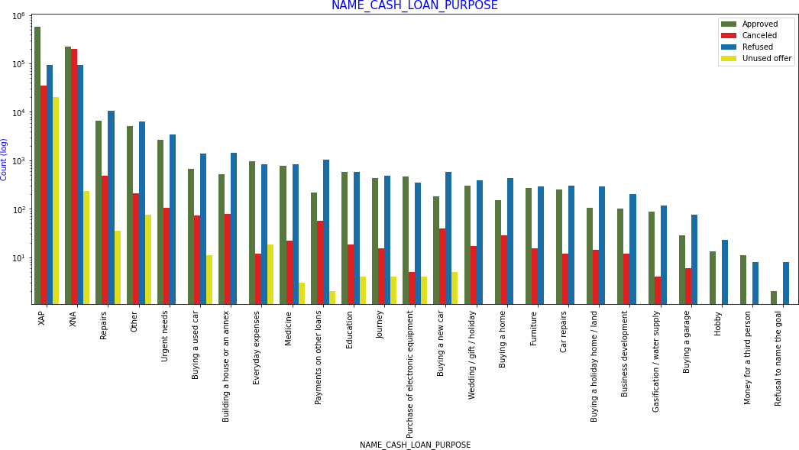
NAME_CASH_LOAN_PURPOSE

Slide 27

Summary

Slide 28
Inferences: Clients who have average of 0.13 or higher DEF_60_CNT_SOCIAL_CIRCLE score tend to default more and hence client's social circle has to be analysed before providing the loan. #Conclusions After analysing the datasets, there are few attributes of a client with which the bank would be able to identify if they will repay the loan or not. The analysis is consised as below with the contributing factors and categorization: #Decisive Factors for an applicant to be Re-payer, hence applications can be approved AMT_INCOME_TOTAL:Applicants with Income more than 700,000 are less likely to default CNT_CHILDREN: Applicants with zero to two children tend to repay the loans. DAYS_BIRTH: Applicants above age of 50 have low probability of defaulting. DAYS_EMPLOYED: Applicants with 40+ year experience having less than 1% default rate NAME_CASH_LOAN_PURPOSE: Loans bought for Hobby, Buying garage are being repayed mostly. NAME_EDUCATION_TYPE: Academic degree has less defaults. NAME_INCOME_TYPE: Student and Businessmen have no defaults. ORGANIZATION_TYPE: Applicants with Trade Type 4 and 5 and Industry type 8 have defaulted less than 3%. REGION_RATING_CLIENT: Applicants who live in areas with Region Rating 1 are safe borrowers. #Decisive Factors for an applicant to be a potential Defaulter, hence application can be rejected AMT_GOODS_PRICE: When the credit amount goes beyond 3M, there is an increase in defaulters. CODE_GENDER: Male applicants have relatively higher default rate CNT_CHILDREN : Applicants who have children equal to or more than 9 default 100% and hence their applications can to be rejected. CNT_FAM_MEMBERS: Applicants who have higher family members (>=11) have higher default rate and their applications can be rejected. DAYS_BIRTH: Avoid young applicants who are in age group of 20-40 as they have higher probability of defaulting DAYS_EMPLOYED: Applicants who have less than 5 years of employment have high default rate. NAME_EDUCATION_TYPE: Applicants with Lower Secondary, Secondary education and incomplete higher education have higher default rate NAME_FAMILY_STATUS : Applicants in civil marriage or who are single have higher default rate NAME_INCOME_TYPE: Applicants who are either at Maternity leave or Unemployed have higher default rate. OCCUPATION_TYPE: Applicants who are Low-skill Laborers, Drivers and Waiters/barmen staff, Security staff, Laborers and Cooking staff as the default rate is huge

Slide 29
ORGANIZATION_TYPE: Organizations with highest percent of loans not repaid are Transport: type 3 (16%), Industry: type 13 (13.5%), Industry: type 8 (12.5%) and Restaurant (less than 12%). Self-employed people have relative high defaulting rate, and thus should be avoided to be approved for loan or provide loan with higher interest rate to mitigate the risk of defaulting. REGION_RATING_CLIENT: Applicants who live in areas with Region Rating as 3 has highest defaults. #Decisive attributes for an potential defaulters who can be considered for loan with higher interest to mitigate any default risk to prevent business loss: AMT_CREDIT: Applicants who get loan for 300-600k tend to default more than others and hence having higher interest specifically for this credit range would be ideal. AMT_INCOME: Since 90% of the applications have Income total less than 300,000 and they have high probability of defaulting, they could be offered loan with higher interest compared to other income category CNT_CHILDREN : Applicants who have 4 to 8 children have a very high default rate and hence higher interest should be imposed on their loans. CNT_FAM_MEMBERS :Applicants with family members between 8 to 10 have a very high default rate and hence higher interest should be imposed on their loans. NAME_CASH_LOAN_PURPOSE: Loan taken for the purpose of Repairs seems to have highest default rate. A very high number applications have been rejected by bank or refused by client in previous applications as well which has purpose as repair or other. This shows that purpose repair is taken as high risk by bank and either they are rejected, or bank offers very high loan interest rate which is not feasible by the clients, thus they refuse the loan. The same approach could be followed in future as well. NAME_HOUSING_TYPE: High number of loan applications are from the category of people who live in Rented apartments & living with parents and hence offering the loan would mitigate the loss if any of those default. #More suggestions: 90% of the previously cancelled client have actually repayed the loan. Recording the reason for cancellation which might help the bank to determine and negotiate terms with these repaying customers in future for increase business opportunity. 88% of the clients who were refused by bank for loan earlier have now turned into a repaying client. Hence documenting the reason for rejection could mitigate the business loss and these clients could be contacted for further loan

Slide 30


