Slide 1
EMPLOYEE DATA ANALYSIS USING EXCEL
STUDENT NAME: NITHYASHREE.B
REG. NO.: 312209495
DEPARTMENT: B.COM BANK MANAGEMENT
COLLEGE: ANNA ADARSH COLLEGE FOR WOMEN

Slide 2
PROJECT TITLE
EMPLOYEE PERFORMANCE
ANALYSIS USING EXCEL

Slide 3
AGENDA
Problem Statement
Project Overview
End User
Our Solution and Proposition
Dataset Description
Modelling Approach
Results and Discussion
Conclusion

Slide 4
PROBLEM STATEMENT
Analyzing and evaluating the performance of
employees over the past years to identify strengths,
areas for improvement, and overall trends that can
inform strategic HR decisions.

Slide 5
PROJECT OVERVIEW
It aims to develop a comprehensive framework for evaluating
employee performance. The scope includes analyzing job
responsibilities, goals, and key performance indicators. A
combination of quantitative and qualitative approaches will be
used to assess performance. The expected outcome is accurate
performance assessments and targeted development plans.
This will enable data-driven decision-making to enhance
organizational efficiency.

Slide 6
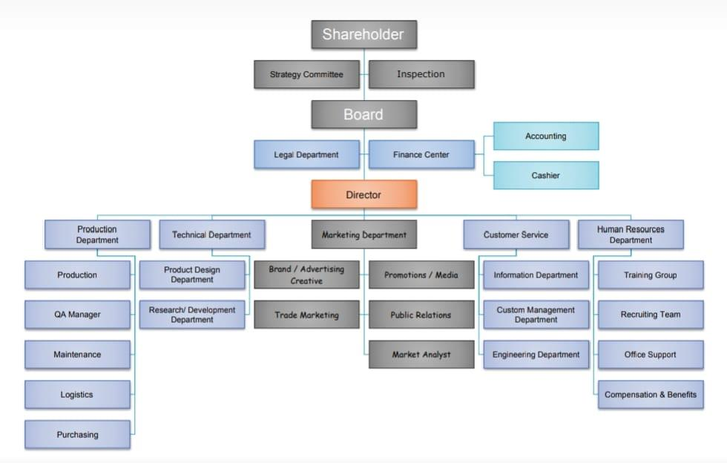
WHO ARE THE END USERS ?

Slide 7
Our solution and its value
proposition
• Conditional formatting-missing
• Filter-remove
• Formula-performance
• Pivot-summary
• Graph-data visualization

Slide 8
DATASET DESCRIPTION
• Employee dataset from Kaggle
• 26-features
• We selected 9-features
Employee ID number
Employee name
Employee type
Performance level
Gender
Employee rating number

Slide 9
THE “WOW” IN OUR SOLUTION
Using this formula we have measured the
performance level of employees working in an
organization
Performance level = IF(Z2>=5,"VERY HIGH",Z2>=
4,"HIGH",Z2>=3,"MED","TRUE","LOW“)

Slide 10
MODELLING
• Data collection
-Download the employee dataset from Kaggle
-After the download, an Excel sheet will open
-In that sheet, we have employee data details which have 26 features
• Features collection
-We are selecting 9-features for our project
-In that feature, we have employee ID, employee name, employee type, gender,
performance level, and employee rating.
• Data cleaning
-In this method, we clear the empty rows or columns in the sheet
-By selecting the empty rows and clearing them using a conditional formatting tool

Slide 11
• Performance level
-Here, we calculate the performance of the employees
-By using a formula we can calculate the performance
-Using IF formula: =IF(Z2>=5, "VERY HIGH", Z2>=4, "HIGH", Z2>=3, "MED",
"TRUE", "LOW“)
• Pivot table
-After creating the performance level, click on the pivot table icon
-In that, an application will appear as a row, column, fields
-Select the required items and click ok
-Then using the details create a graph
• Summary
-Using this method, we can know the performance level of the employees through
the graph

Slide 12
RESULTS
Employee Performance Analysis

Slide 14
CONCLUSION
Effective employee performance analysis has far-reaching benefits, including
better resource allocation, enhanced accountability, improved succession
planning, increased employee retention, data-driven promotions, skills gap
identification, enhanced employee experience, strategic alignment,
competitive benchmarking, and continuous improvement. Accurate
performance assessments enable targeted development initiatives, improved
employee engagement, and a culture of constructive feedback, ultimately
leading to a high-performing culture that supports the organization's overall
mission and objectives.

