Slide 1
Analysing CO₂ Emissions in the United States
Using Python
Nithya Sathya Kumar
Contact:endeavorels.nithyask@gmail.com

Slide 2

Why Did I Choose This Project / Dataset?
Climate change is a critical global issue, and CO₂ emissions are a major contributor.
The CO₂ emissions dataset from Kaggle gave me a chance to explore how different states, sectors, and fuel types contribute to the bigger climate picture.
The project allowed me to examine how emissions vary across states, sectors, fuel types, and over time.

Slide 3

Goal

Slide 4
Who’s Emitting What? Exploring CO₂ Emissions Across the U.S
A data-driven look at how CO₂ emissions differ by state, sector, and fuel type from 1970–2021
This study aims to understand the following:
🌍 Map emissions across U.S. states
🏭 Identify key contributors — by sector and fuel type
📈 Analyze trends over the last five decades

Slide 5
Approach

Slide 6


Approach
🧹 Data Cleaning & Preprocessing
Removed rows labeled "United States" (national aggregates)
Focused on "All Fuels" to avoid duplication and simplify the analysis
Checked for missing values — none found
Analysed for Residential CO₂ Emissions Trends in Selected States
Mapped full state names to 2-letter abbreviations for mapping
Renamed sector and fuel labels for clarity
Analysis Approach
Grouped and summed emissions by:
State — to compare regional impact
Sector — to identify top contributing industries
Fuel Type — to understand energy source impact

Slide 7
Result

Slide 8
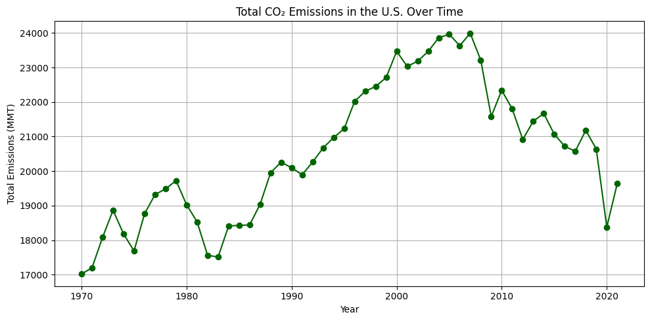
Total CO₂ Emission in the U.S over time
There is a steady increase from the early 1970s to the early 2000s, peaking around 2007–2008.
There is a noticeable drop around 2020, likely caused by the COVID-19 pandemic, when travel and industrial activity were reduced.
The slight rise in 2021 may reflect the resumption of normal activities.

Slide 9
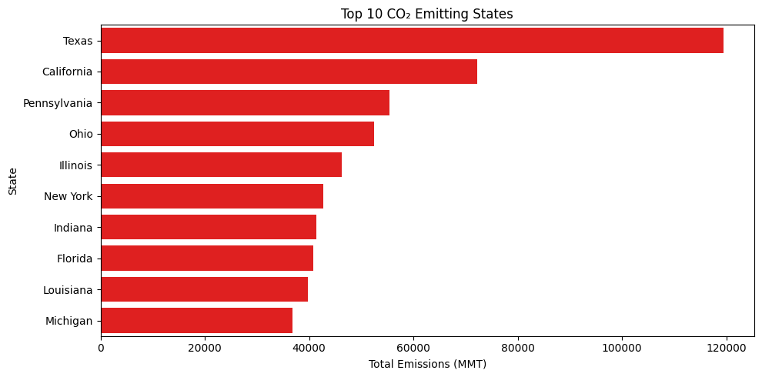
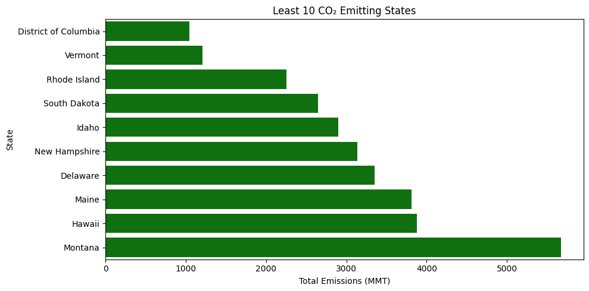
Top 10 and least 10 CO₂ Emitting states
Texas is by far the largest CO₂ emitter, followed by California, Pennsylvania and others.
The least 10 emitting states include Montana, Hawaii, Maine, and Vermont.

Slide 10
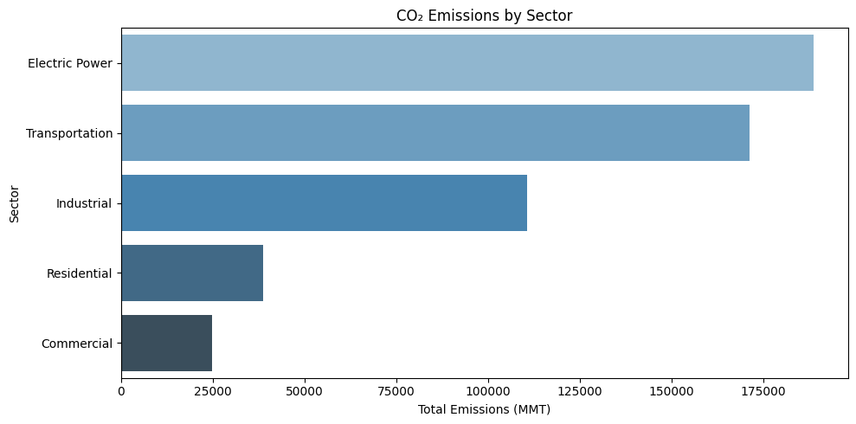
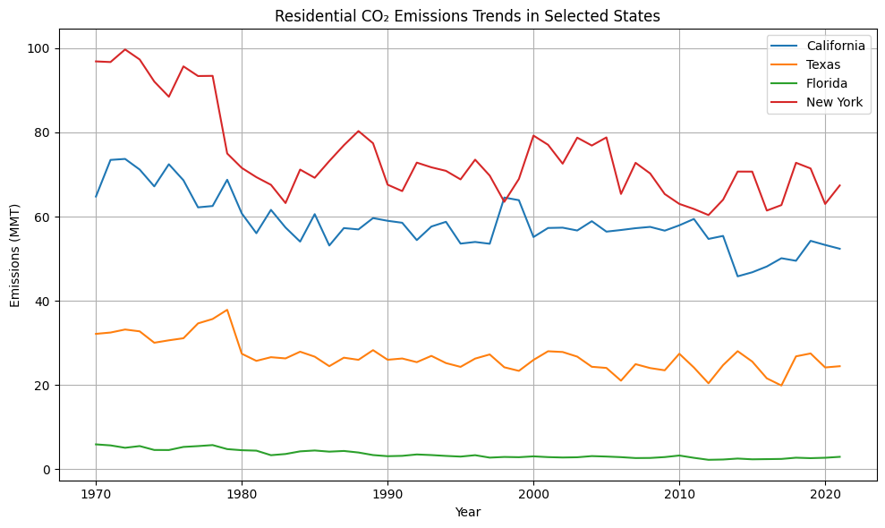
CO₂ Emission by Sector

Slide 11
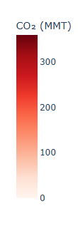
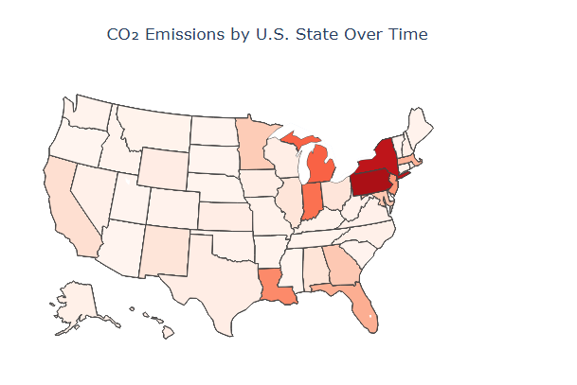
About the Code for Country map
The Country map visualization was created with inspiration from a notebook on Kaggle by Arshman Khalid, titled “Daily Weather EDA (Magic)”.
I adapted the plotting technique to suit my dataset on CO₂ emissions by U.S. state, using similar mapping logic but applying it to environmental data.
Daily Weather EDA (Magic)”. https://www.kaggle.com/code/arshmankhalid/daily-weather-eda-magic#Count-Plot-of-Weather-Records-by-Countries

Slide 12
Conclusion
CO₂ emissions have decreased slightly in recent years, but major states (e.g., Texas, California) continue to contribute heavily.
The residential sector contributes significantly to total emissions, highlighting the role of everyday energy use.
These findings can support public awareness, policymaking, and energy efficiency initiatives.
Link to GitHub: https://github.com/Nithyask-source/ReDI-CO2-Emission-Project

Slide 13
Challenges and How I Overcame Them
Challenges
KeyError issues caused by case sensitivity and slight differences in naming
Data filtering and grouping techniques
AI Tools
I took help of ChatGPT to help me learn few concept, debugging code ;)

Slide 14
Future improvements
Use forecasting methods to predict future CO₂ trends
Build an interactive dashboard

Slide 15
Any Questions

Slide 16
Thanks a lot!

