Slide 1
EMPLOYEE DATA ANALYSIS USING EXCEL
STUDENT NAME :NITHYA SREE Y.R
REGISTER NO :312204597,B801C16C2D9F72899F54343E5AA44E97
DEPARTMENT :COMMERCE
COLLEGE : K.C.S. KASI NADAR COLLEGE OF ARTS & SCIENCE

Slide 2
PROJECT TITLE
EMPLOYEE ANALYSIS ACCORDING TO DEPARTMENT

Slide 3
AGENDA
1.Problem statement
2.Project overview
3.End users
4.Our solution and proposition
5.Dataset description
6.Modelling approach
7.Results and discussion
8.conclusion

Slide 4

PROBLEM STATEMENT
Employee management system is an application based system, having two applications developed, one for employers to manage employee details and another for employees to mark their attendance. Every organization whether government or private uses an information system to store data of their staff.
Keywords : attendance, employee management, payroll, salary calculation.
HR Employee data analysis :
Total of per day rate of employee.
Average total of hourly rate.

Slide 5
PROJECT OVERVIEW
Its subsections will turn the attention to the method for resolving the problem, the programming environments used for developing the system and the implementation of the operations performed upon the database
TABELS
CONDITIONAL FORMATING
PIVOT CHART – LINE CHART , PIE CHART
SUM FORMULAS
SLICERS

Slide 6
WHO ARE THE END USERS?
Human resources department
Sales department
Research and development

Slide 7
OUR SOLUTION AND IT S VALUE PROPOSITION
COMPREHENSIVE DATA MANAGEMENT :
DATA ORGANIZATION
DATA INTEGRATION
SCENERIO ANALYSIS :
USED TO ANALYSE DIFFERENT SITUATION
ADVANCE ANALYTICAL TOOLS :
FORMULAS AND FUNCTIONS
PIVOT TABLES
USER- FRIENDLY INTERFACE :
ACCESSIBILITY
EASE OF USE
VISUAL REPRESENTATION :
CHARTS AND GRAPHS

Slide 8
DATASET DESCRIPTION
DATA OVERVIEW :
The use of data analysis on candidate and employee issues to understand their effects on business goals and evaluated the effectiveness of HR initiatives.
DATA FIELD :
Employee ID
Age
Department
Educational field
Gender
Hourly rate
Marital status
Per day rate

Slide 9
MODELLING
Data cleaning.
Creating table.
.Creating pivot chart.
.Creating dashboard.
Inserting pivot chart in dashboard.
Inserting formulas in dash board to make interaction.
Creating interactive dashboard by putting all together elements.

Slide 10
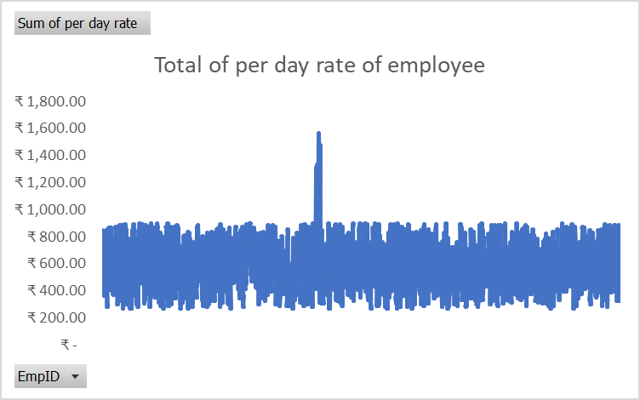
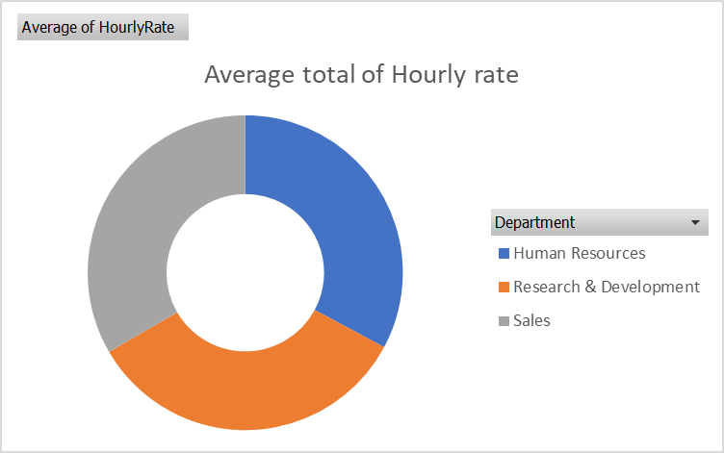
RESULT

Slide 11
CONCLUSION :
Employee management system is an application based system, having two applications developed, one for employers to manage employee details and another for employees to mark their attendance. Every organization whether government or private uses an information system to store data of their staff. However, in India it is found that many small scale industries use pen and paper to keep a record.

