Slide 1

Parallel K-Means
CS6068 Parallel Computing Project Presentation
Fall 2018
Nithyasri Babu (M12506236)

Slide 2

K-Means Clustering Algorithm
Unsupervised Learning Algorithm
Popular for simplicity and correctness
Computation Intensive Due to Distance Calculations
Increase in any of the 3 parameters contributing to Time complexity will increase time taken to run the program
Time Complexity:
O(NKT)
N = Number of Data Points
K = Number of Clusters to form
T = Number of Iterations to final clusters
Space Complexity:
O(((m+k)*n)+n)
m = Number of data points
k = Number of Clusters
n = Number of features

Slide 3

Flow Chart for Sequential Implementation of K-Means
Choose K Centroids Randomly
Calculate Distance for Each Datapoint with Each Centroid
The Green Boxes are the parts I am to Parallelize
Assign Datapoint to closest Centroid’s Cluster
Clusters same as last Iteration
Clusters Converged – K Centroids & each datapoint assigned to 1 cluster
Re-compute Centroids = Mean(Datapoints of a single cluster)

Slide 4
Sequential K-Means Implementation
Steps:
Pick K centroids randomly
Compute Distance between each data point with k centroids
Assign Cluster based on the minimum distance from the centroid
If Clusters are not the same as previous iteration:
Recompute Centroids with new cluster Assignments
Repeat from Step 2
If no, End Process
Parallel Distance
Computation

Slide 5
Flow Chart for Parallel Implementation of K-Means
Choose K Centroids Randomly
Split Data to Number of Processors available
N/CPU count
Create pool of Processes to run split data separately
Launch Pool with multiple processes
Calculate Distance and Assign Cluster
Calculate Distance and Assign Cluster
Combine Results for separate processes – Cluster Assignments
Clusters same as last Iteration
Clusters Converged – K Centroids & each datapoint assigned to 1 cluster
Re-compute Centroids = Mean(Datapoints of a single cluster)

Slide 6
Implementation Specifics
Python
Using the Multiprocessing module, in-built with python
Pool() will launch given number of processes with find_cluster function on multiple processors
Data Partitions created for cpu_count
Load is shared by all CPU Processors
Faster than sequential for large inputs

Slide 7
System & Testing
Intel® Xeon® W-2123 CPU @ 3.60GHz Processor
16.0 RAM
64-Bit Windows Operating System
Wholesale Customer Data: 440 Data points × 8 Attributes
Wine Quality Data: 4898 Data points x 12 Attribute

Slide 8
Performance Analysis

Slide 9
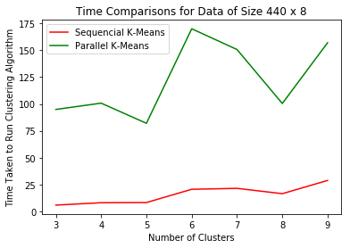

Wholesale Customer Data
440 x 8
Wine Quality Data
4898 x 8

Slide 10
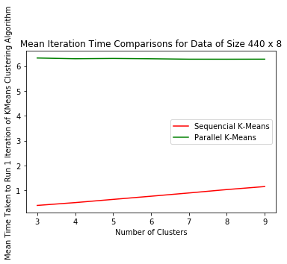
Wholesale Customer Data
440 x 8
Wine Quality Data
4898 x 8

Slide 11
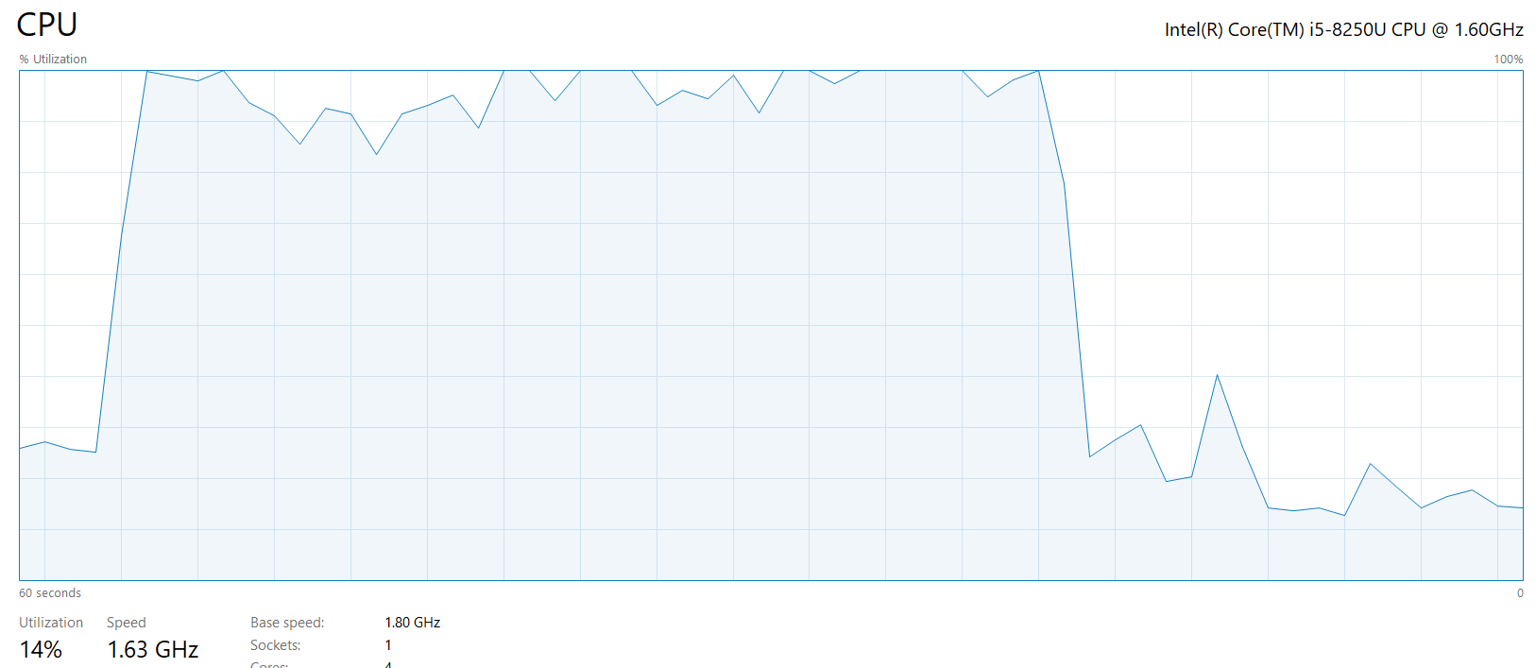
CPU Utilization = 100 %

