Slide 1
Project Title : Car Price Prediction Project
By: Niti Marodia

Slide 2
Problem Statement:
With the covid 19 impact in the market, we have seen lot of changes in the car market. Now some cars are in demand hence making them costly and some are not in demand hence cheaper. One four clients works with small traders, who sell used cars. With the change in market due to covid 19impact, our client is facing problems with their previous car price valuation machine learning models. So, they are looking for new machine learning models from new data. We have to make car price valuation model.

Slide 3
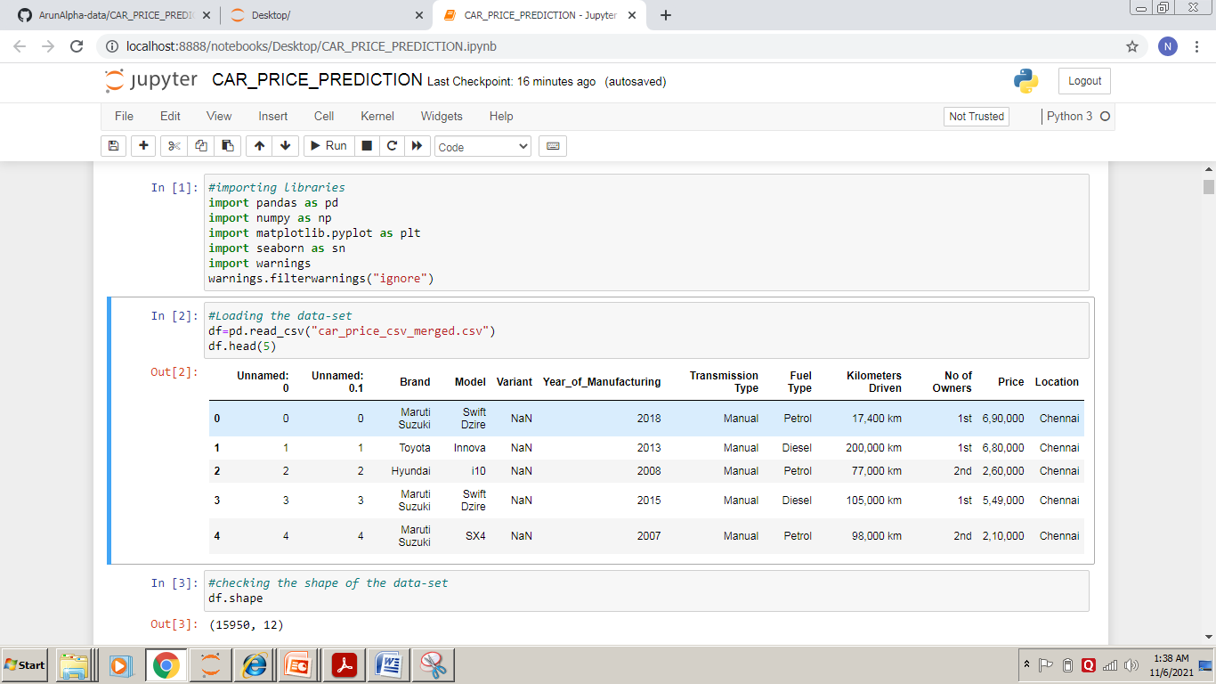
Loading Necessary libraries And Dataset:

Slide 4
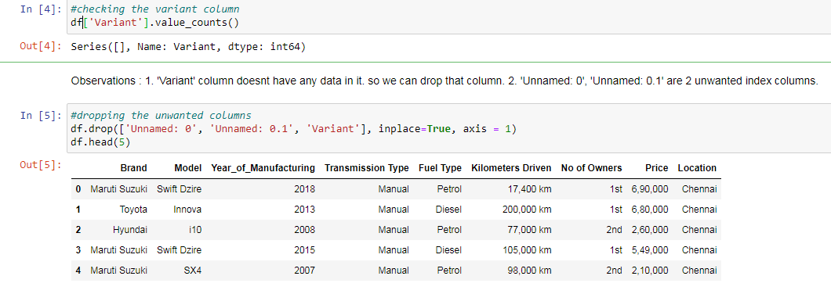
Data Cleaning :

Slide 5
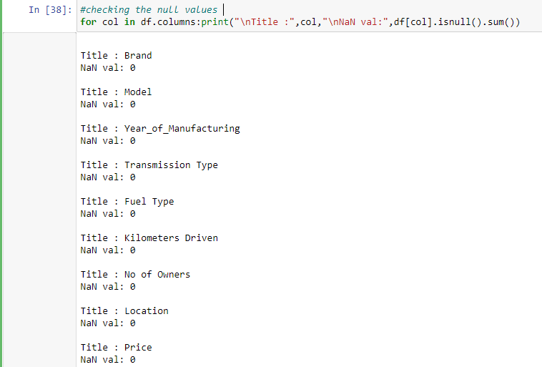
Handling the Null Values :

Slide 6
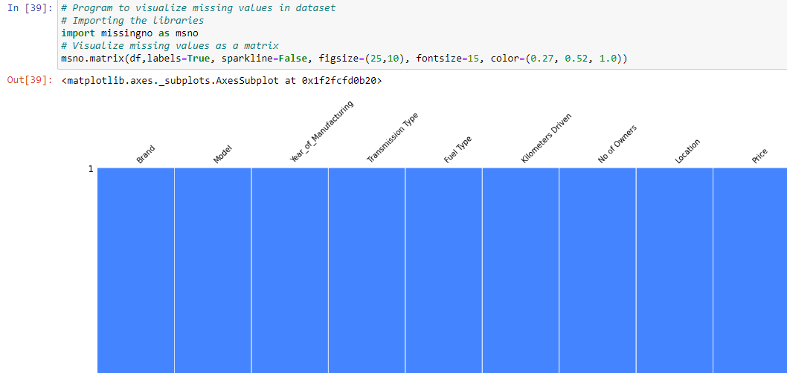

Slide 7
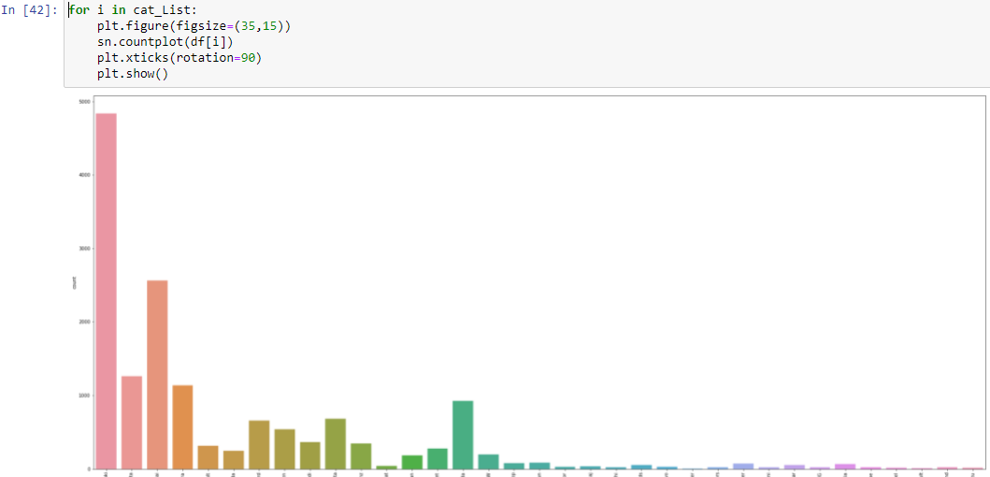
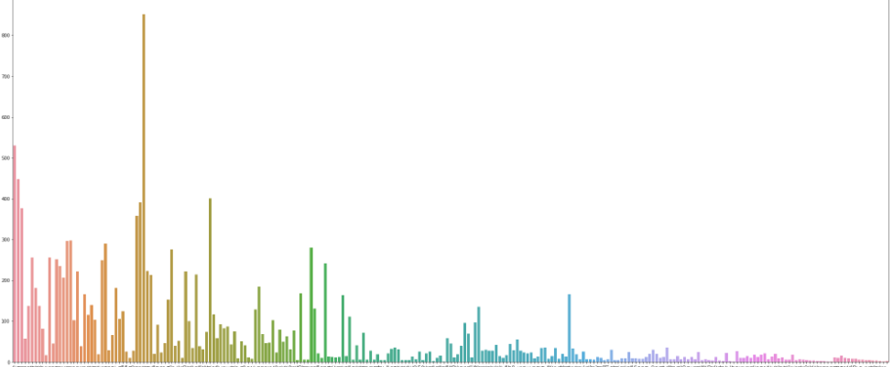
DATA VISUALIZATION : Uni-Variate Analysis

Slide 8
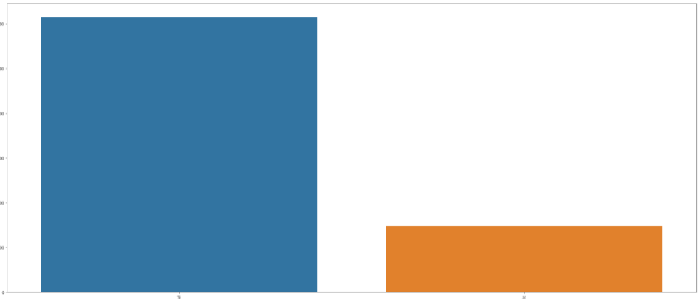
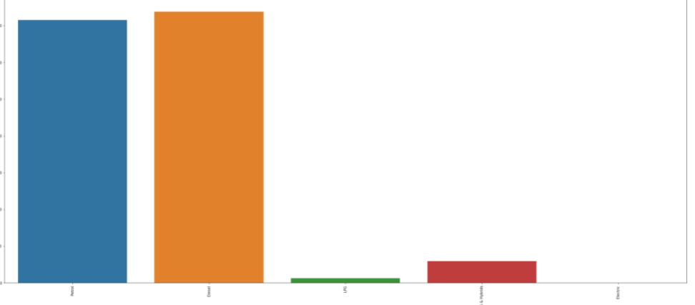
Univariate-Analysis

Slide 9
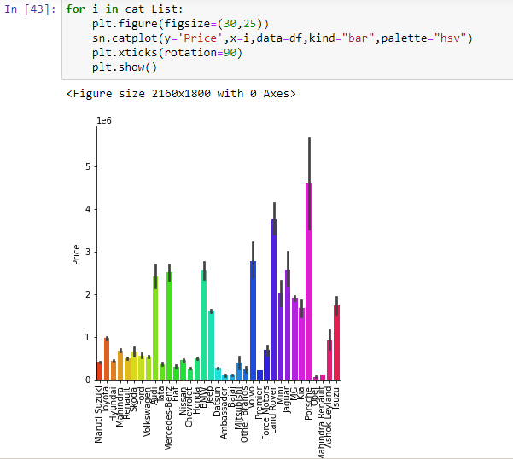
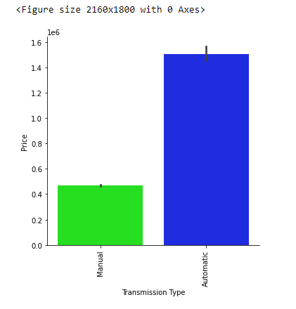
BI-VARIATE ANALYSIS:

Slide 10
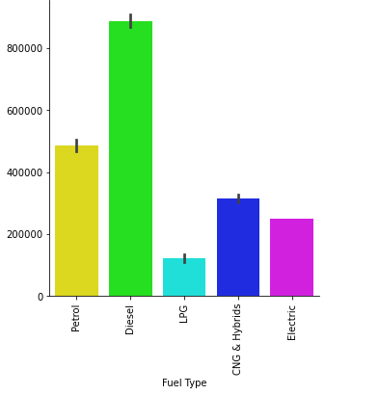
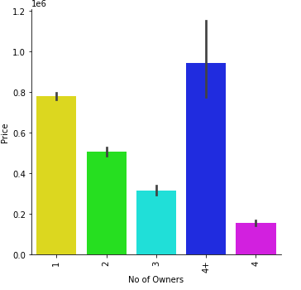
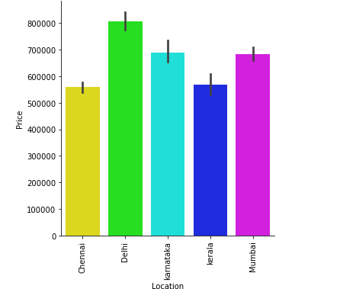

Slide 11

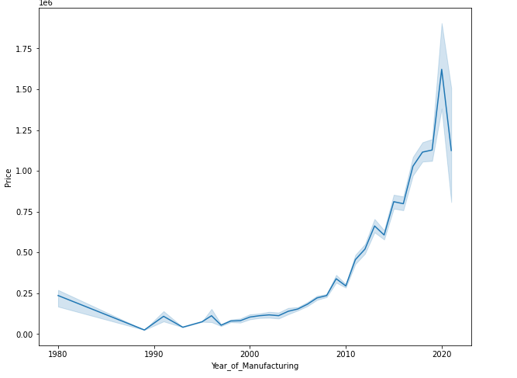
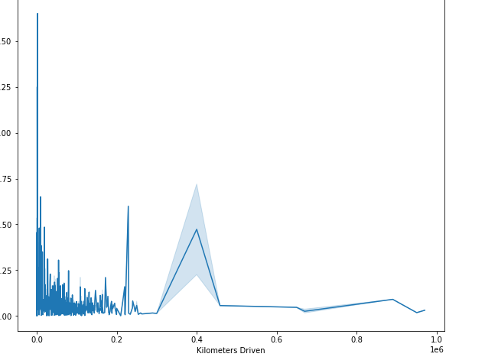

Slide 12
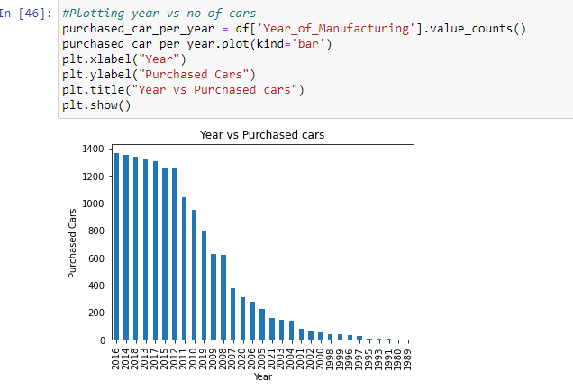
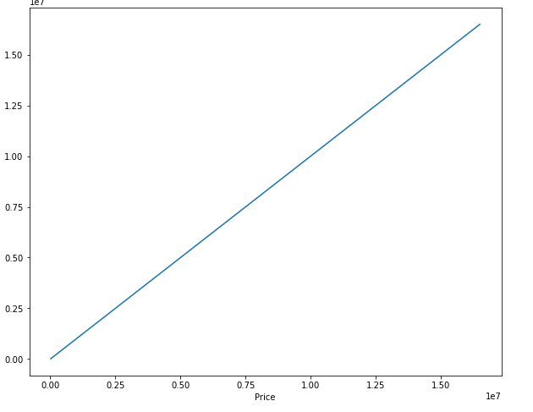

Slide 13
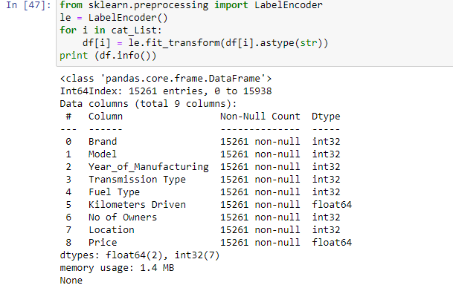
Now we will use Label Encoder to change catagorical values to Numerical values. LabelEncoder

Slide 14
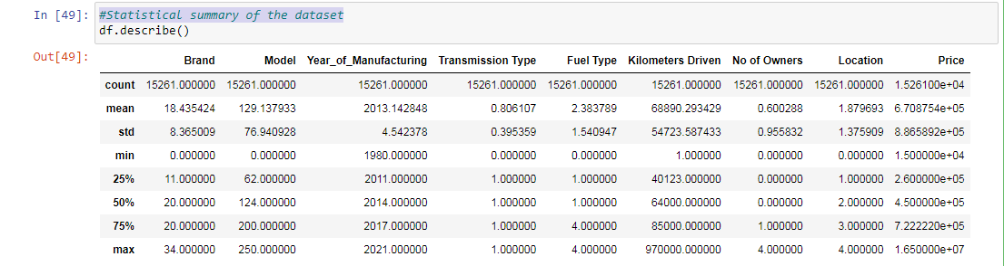
Statistical summary of the dataset:

Slide 15
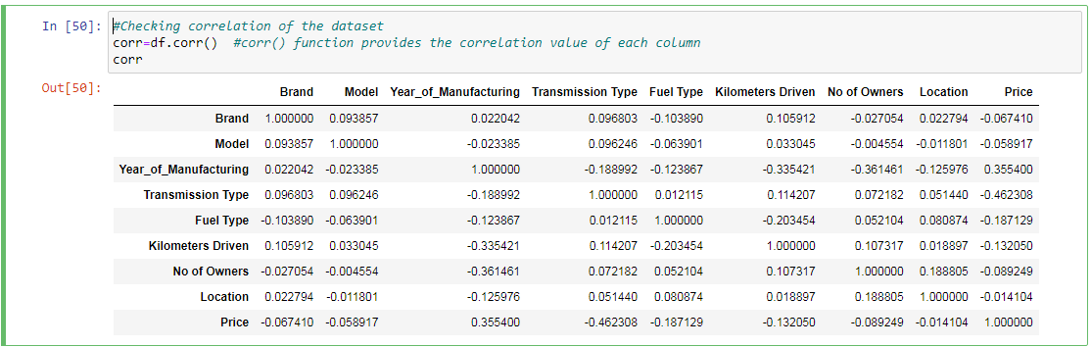
Checking correlation :

Slide 16

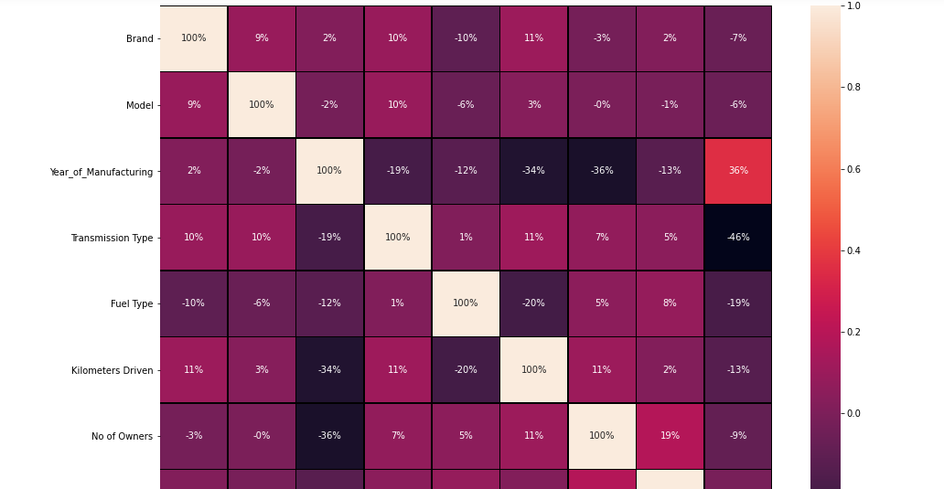

Slide 17
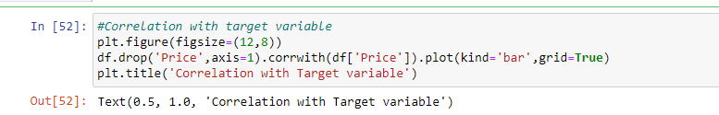
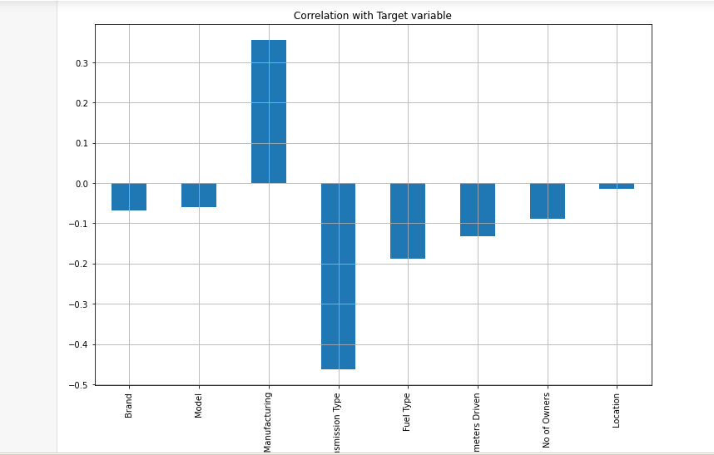

Slide 18
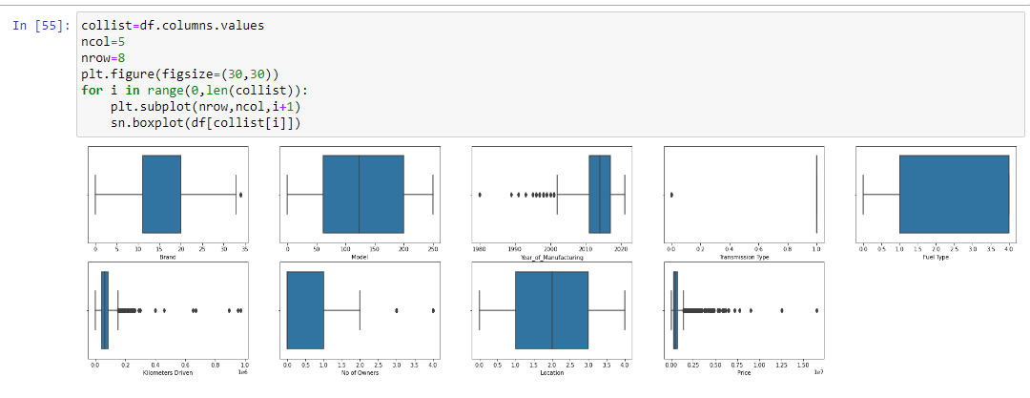
Checking outliers :

Slide 19
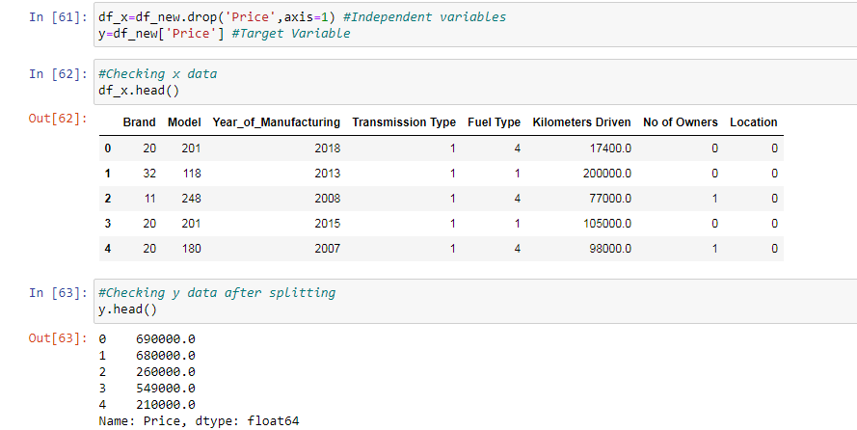
Preparing dataset for model training :

Slide 20
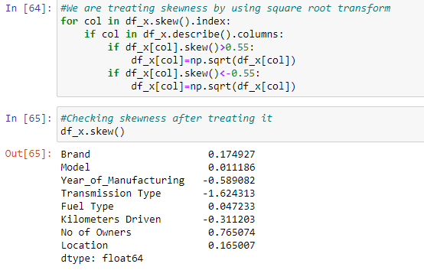
Treating skewness :

Slide 21
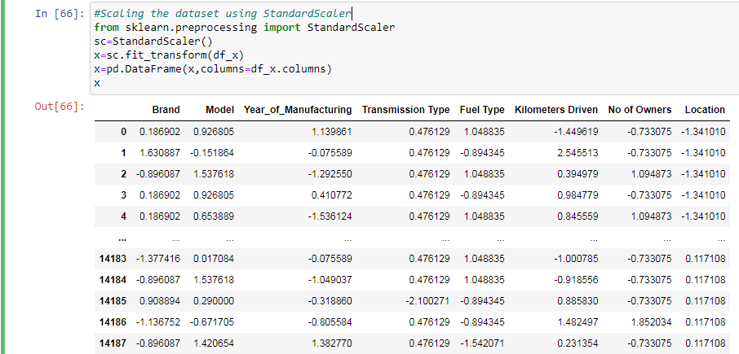
Scaling the dataset using Standard Scaler:

Slide 22
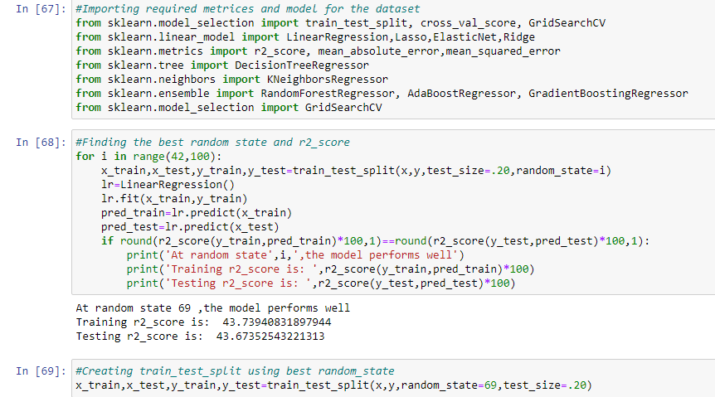
Model Building :

Slide 23
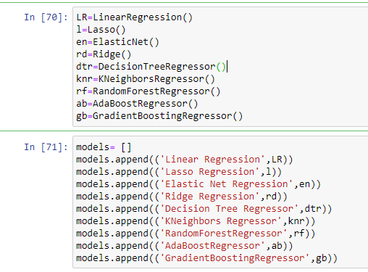
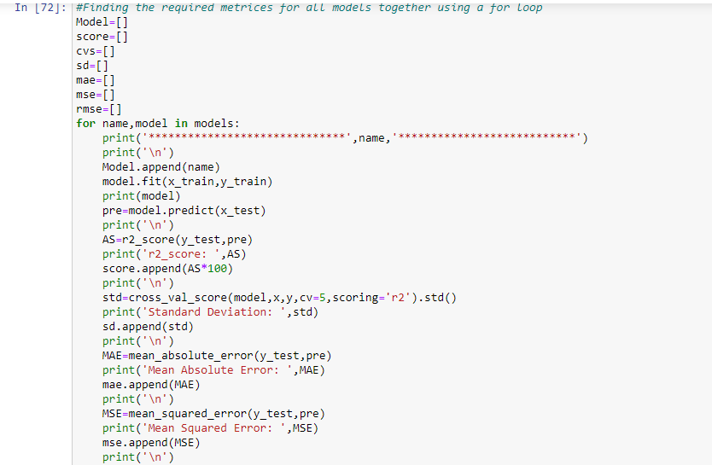
Finding the best model :

Slide 24
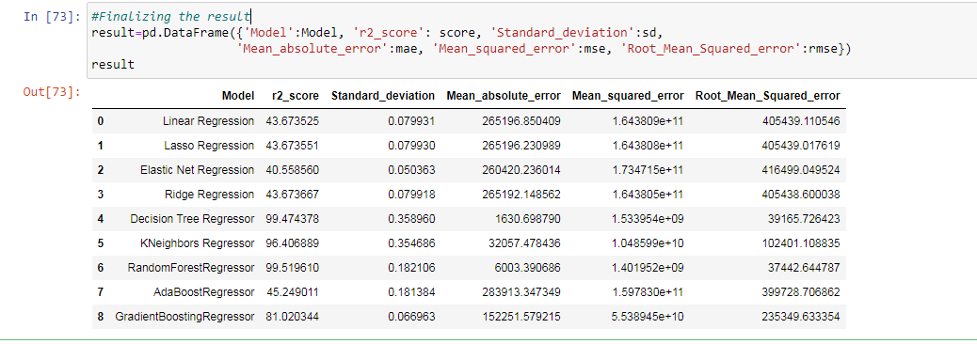

Slide 25
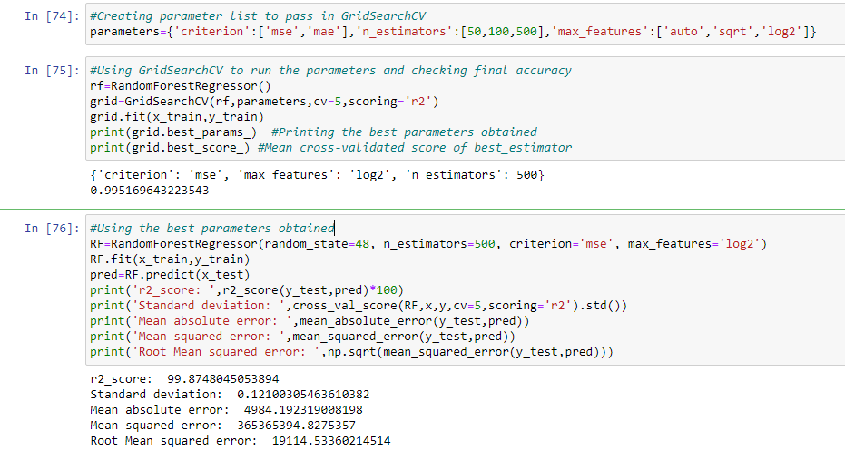
Hyper parameter Tuning : Random Forest Regressor

Slide 26
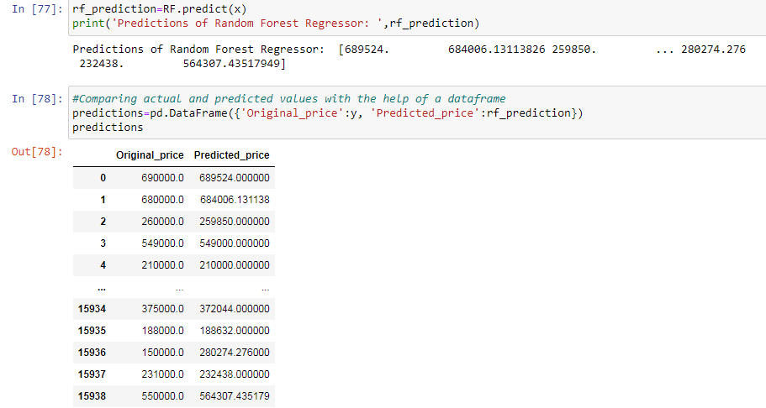
Finalizing the model :

Slide 27
CONCLUSION:
The increased prices of new cars and the financial incapability of the customers to buy them,Used Car sales are on a global increase. Therefore, there is an urgent need for a Used Car Price Prediction system which effectively determines the worthiness of the car using a variety of features. The proposed system will help to determine the accurate price of used car price prediction.

