Slide 1

Artificial Intelligence and Machine Learning Project-(Fake News Detection Machine)
Team Details:
Divyanjali Singla (2210990296)
Mugdha (2210990585)
Nitika Bansal (2210990623)
Payal Dhiman (2210990647)
Chitkara University Institute of Engineering and Technology,
Chitkara University, Punjab

Slide 2
INTRODUCTION
The problem of fake news refers to the dissemination of false or misleading information presented as legitimate news. This misinformation can have a significant impact on individuals, societies, and even global events. So we make FAKE NEWS DETECTION MACHINE to overcome these problems.

Slide 3
OBJECTIVES
Developing a Robust Model
Enhancing Detection Techniques
Training on Diverse Datasets
Optimizing Performance Metrics
Integration with Real-Time Monitoring

Slide 4
METHODOLOGY
Data Collection and Preprocessing
Exploratory Data Analysis (EDA)
Data Preparation
Feature Extraction
Model Training and Evaluation
Manual Testing

Slide 5
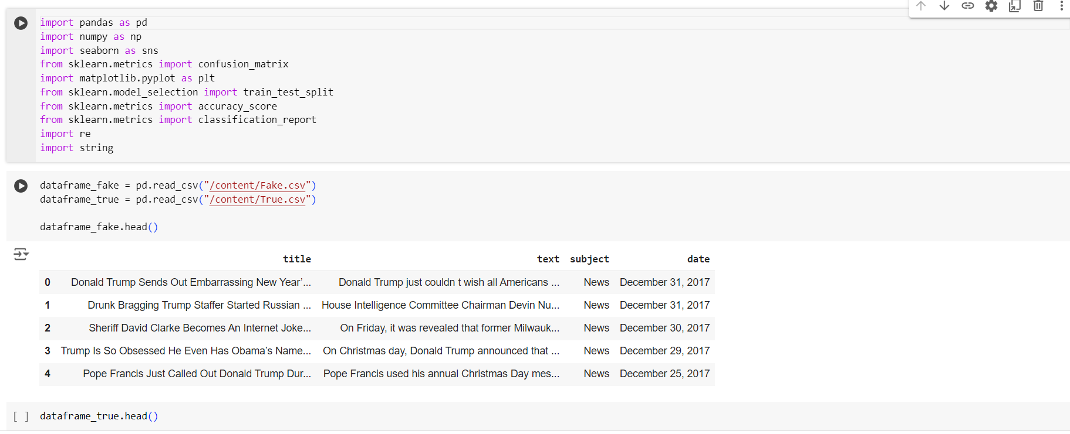
WORKFLOW

Slide 6
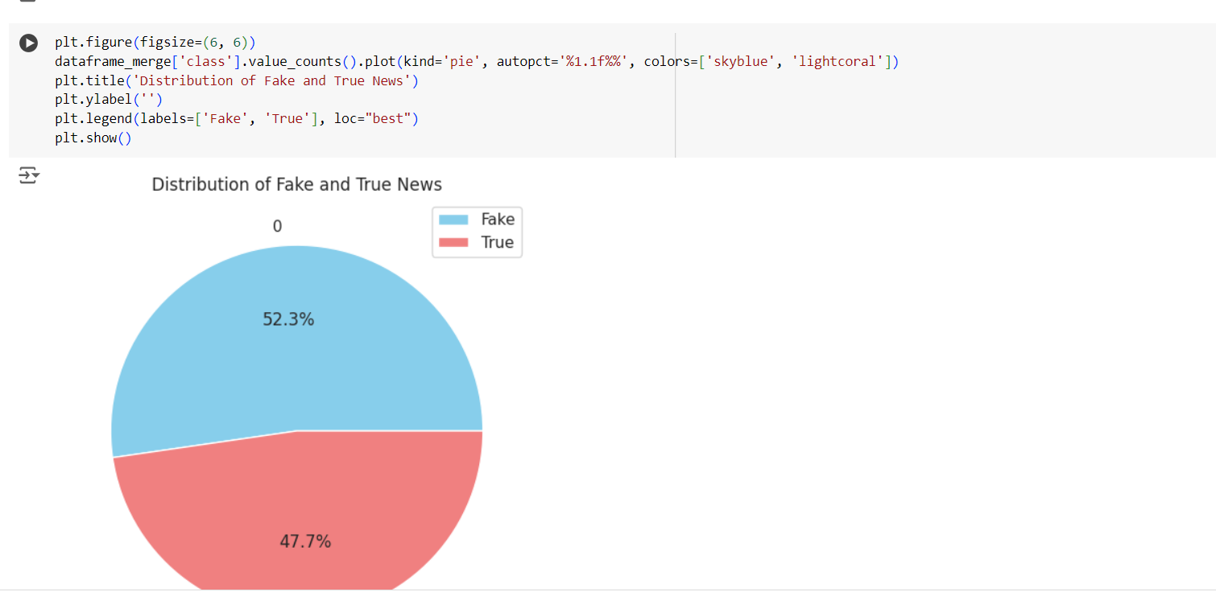

Slide 7
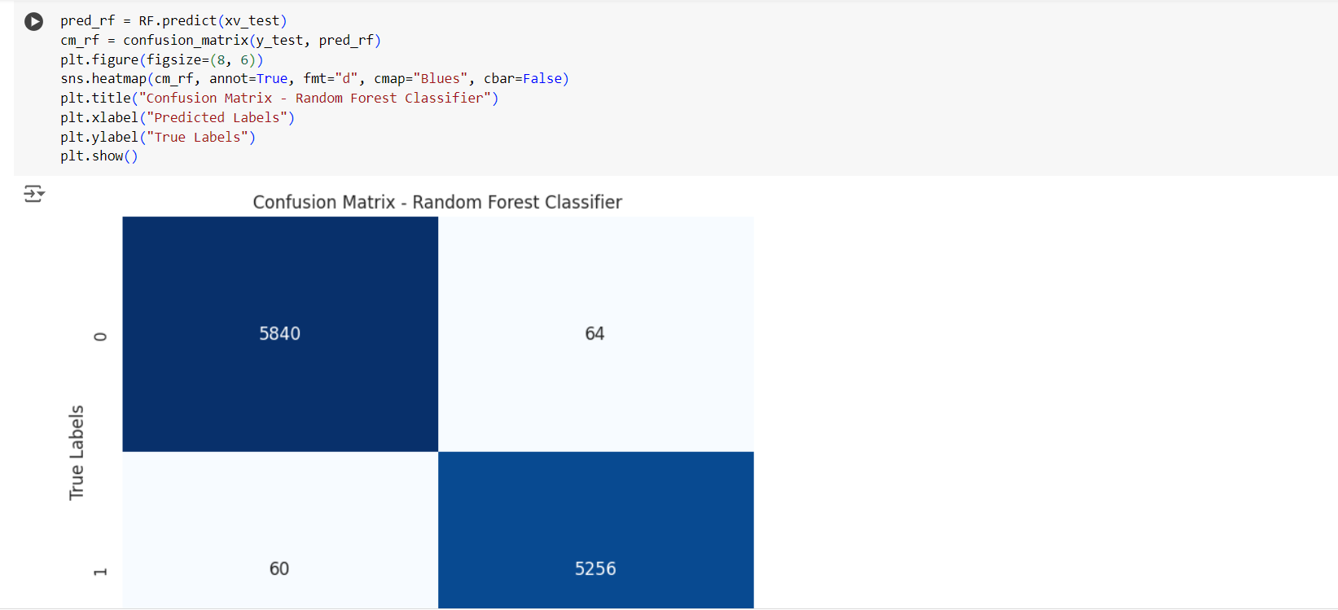

Slide 8
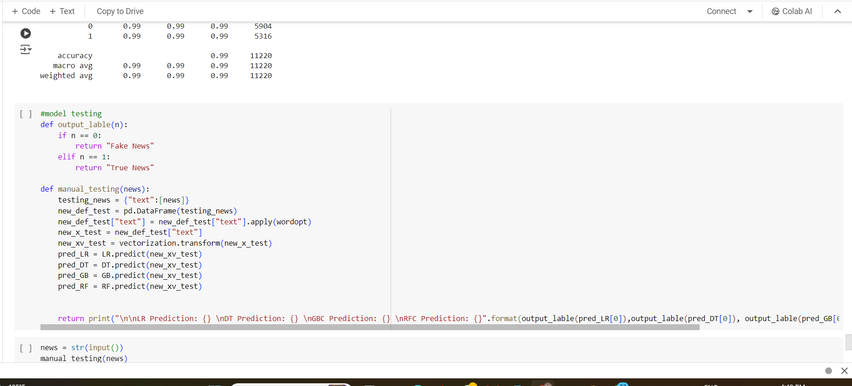

Slide 9
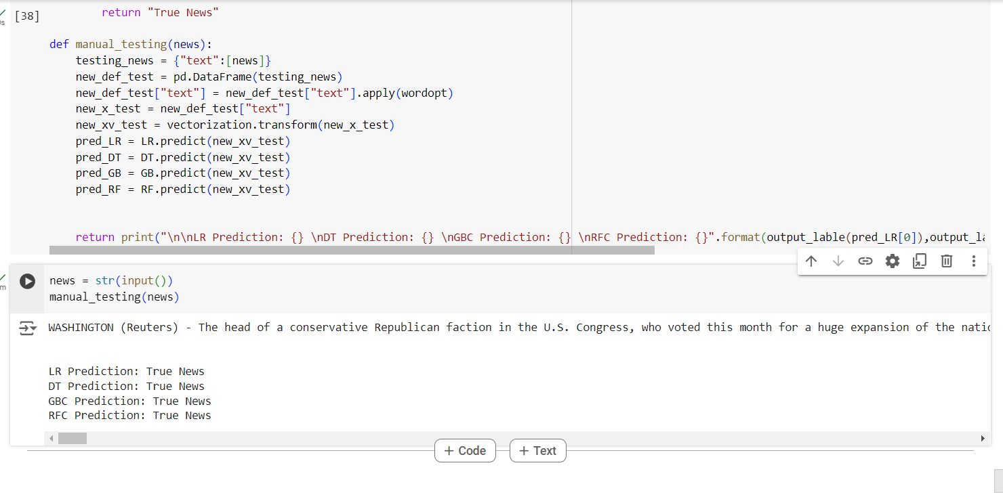
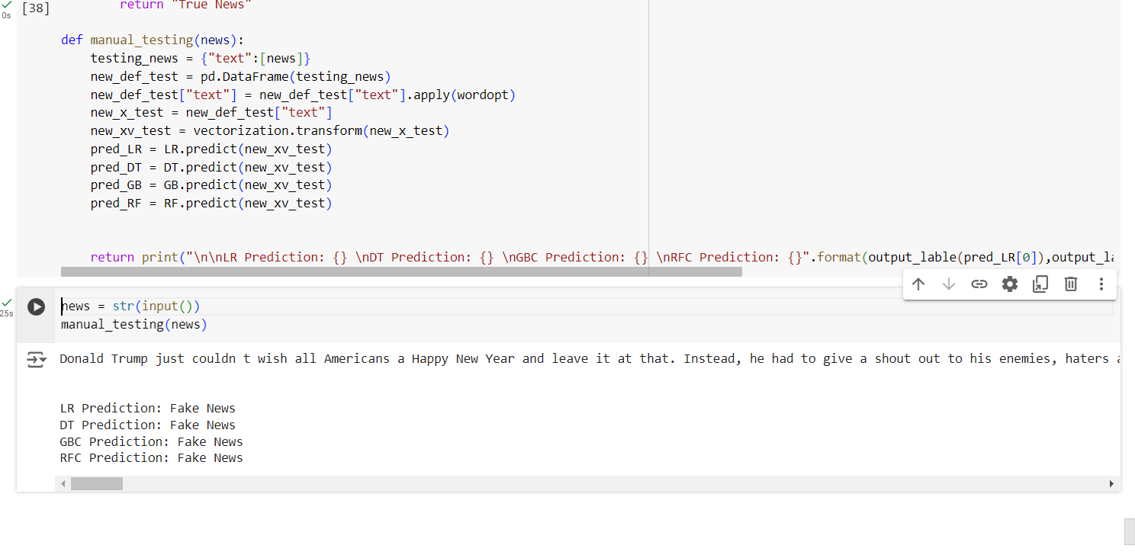
RESULT

Slide 10
CHALLENGES AND LIMITATION
Data Quality and Availability
Generalization Across Domains
Interpretability and Explainability
Continuous Adaptation

Slide 11
CONCLUSION
The project successfully developed a fake news detection model using machine learning and AI techniques. The model demonstrated promising accuracy and performance metrics in distinguishing between fake and real news articles. The project contributes to the broader goal of fostering a more informed and resilient society in the face of fake news challenges. Continued research, collaboration, and education are vital in addressing the complexities of fake news and promoting a trustworthy information ecosystem.

Slide 12
THANK
YOU

