Slide 1
Project Presentation of CO-OP Project At Industry
On
Technology – Driven Solutions for Autism Support: Enhancing Intervention and Inclusion
Submitted by:
Nitika Bansal 2210990623
Manya 2210990561
Akriti 2210991220
Supervised By
Prof. (Dr.) Monika Aggarwal
Department of Computer Science and Engineering,
Chitkara University, Punjab

Slide 2
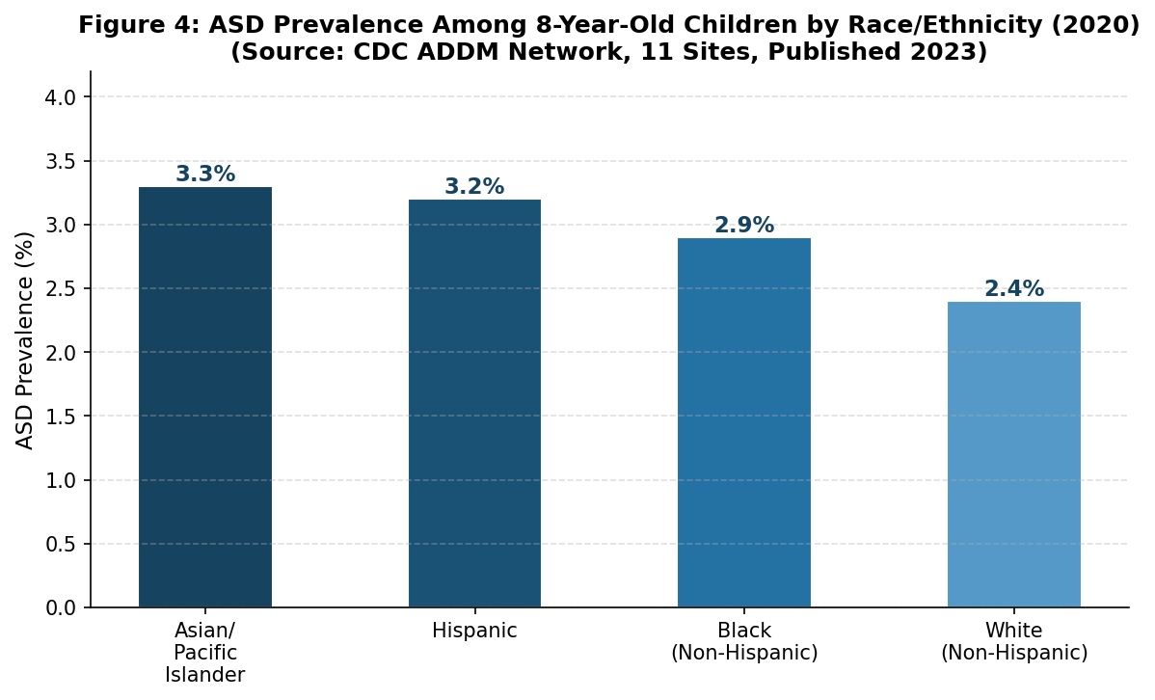
The Global Challenge of ASD
1 in every 31 child is identified with autism disorder as per CDC 2022. Autism Spectrum Disorder involves complexities in speech, social interactions, and repetitive behaviours. Traditional therapies (Behavioral, Speech) are essential but often complicated, expensive, and resource-heavy, creating a significant support gap in developing regions.
2

Slide 3
Core Technological Pillars
AI Systems: Machine learning for early diagnostics and behavior analysis.
Immersive VR: Safe virtual spaces for social interaction and skill training.
Mobile AAC: Digital communication aids for minimally verbal individuals
Wearables: Physiological monitoring to predict and manage meltdowns.

Slide 4
AI & Predictive Diagnostics
Early & Accurate Diagnostics: AI analyzes facial expressions, eye-gaze, and vocal patterns to identify ASD indicators in infants as early as six months with up to 100% accuracy.
Biomarker Analysis: Deep learning models and genetic mapping (HMM) estimate symptom severity and calculate
development probabilities based on family history.
Proactive Monitoring: AI integrates with wearable sensors to monitor physiological data like heart rate, predicting and
managing behavioral meltdowns before they happen.
Objective Intervention: Provides clinicians and caregivers with unbiased, real-time data to create highly personalized and effective treatment plans.

Slide 5

Virtual & Augmented Reality
VR provides a risk-free environment for practicing social scripts, classroom behavior, and peer interaction. It reduces social anxiety and allows for skill generalization that often surpasses traditional clinical role-playing.
Social robots act as objective communicators, facilitating turn-taking and eye-tracking tasks with high engagement.

Slide 6
Empowering Communication: Mobile AAC
Symbol-Based Systems: Pictorial applications significantly improve expressive skills in minimally verbal children.
Adaptive Learning: Apps tailored to unique sensory profiles maintain higher attention levels than traditional classes.
Caregiver Integration: Mobile tools empower parents to act as "co-therapists" in home-based intervention models.
Key Outcome
Individualized visual stimuli and speech generation tools bridge the gap between home and clinical environments.

Slide 7
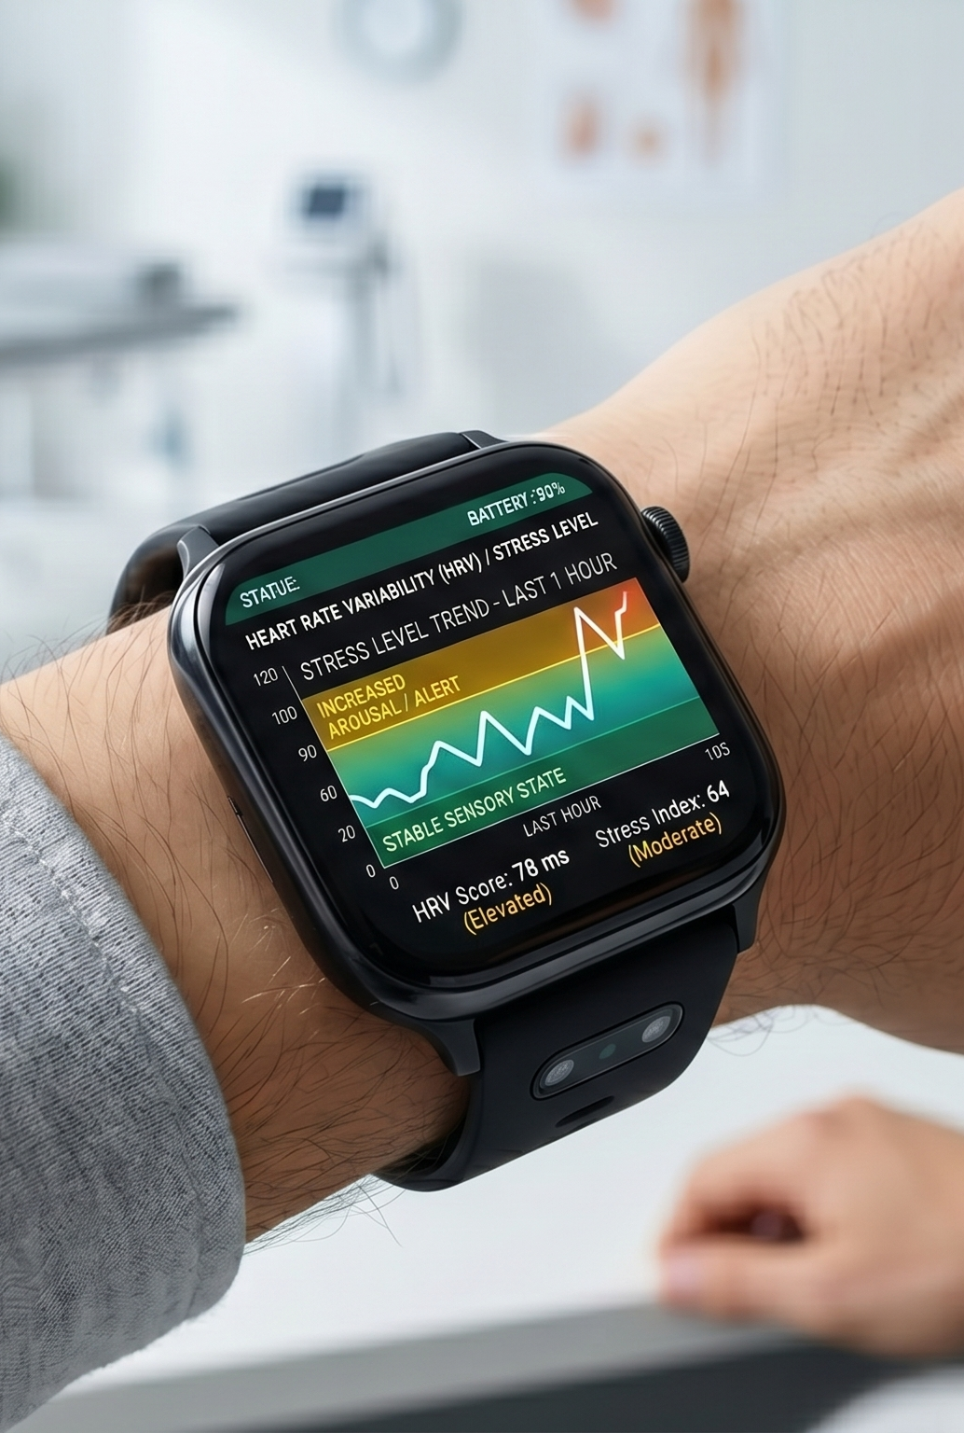
Wearable Monitoring
Wearable sensors monitor heart rate variability (HRV) and skin conductance to track cardiovascular arousal levels. Machine learning algorithms analyze this data to predict behavioral dysregulation and meltdowns before they occur.
This allows caregivers to implement proactive interventions, improving the safety and quality of life for the individual.

Slide 8
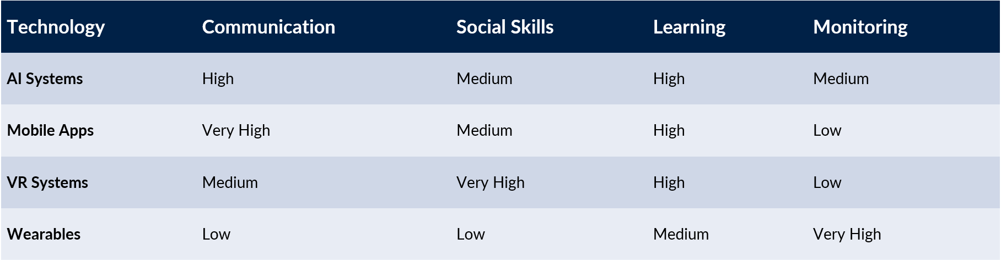
Comparative Solution Matrix
Mobile Apps lead in communication, VR in social skills, and Wearables in monitoring. Because no single tool covers all needs, an integrated approach is essential for the best intervention results.

Slide 9
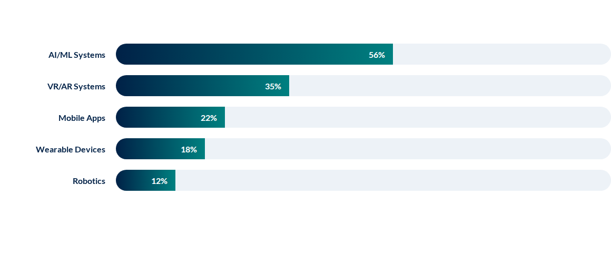
Research Focus Distribution (2018-2024)

Slide 10
The Roadmap to Integrated Support
Intervention
Daily Support
Hybrid Ecosystem
Early Screening
AI-driven predictive analytics for diagnosis in infancy.
VR and AR immersive social skill training programs.
Mobile AAC and wearables for real-time aid.
Integrated cloud-based personalized healthcare solutions.

Slide 11
Thank You
11

