Slide 1
Data Analysis and Visualisation -Data Analyst Jobs In USA
Nitika
Ext ID : x178710

Slide 2
Limitation and Assumption
The results only reflect the outcome at the time the dataset was published, which is presumed to be July 2020. Seasonal variation is disregarded (not a time-series data).
The salary estimates come from Glassdoor, which may not reflect the actual salaries.
The dataset is assumed to reflect the traits of the actual job market.

Slide 3
Objective
What kind of jobs get higher salaries? (Job Title)
What kind of companies pay more? (by Rating, by cities, by Sector etc)
Does job location matter to salaries?
Average salary in top companies.
Number of jobs available in state or city

Slide 4
Used a CSV file available on kaggle.com
Link : https://www.kaggle.com/andrewmvd/data-analyst-jobs
Contains more than 2000 job listing for data analyst positions.
Data Description

Slide 5
CSV file have 16 columns named as:
Data Description
Size
Rating
Industry
Sector
Revenue
Easy Apply
Type of ownership
Competitors
Unnamed
Job Title
Job Description
Company Name
Salary Estimate
Location
Headquarters
Founded

Slide 6
Tools & Library

Slide 7
Pip3 : for package installation
SQLite3 : for data storage
MatplotLib : for Plotting graphs
Numpy : For data manipulation
CSV module : For reading csv file
Kaggle : to download the dataset

Slide 8
Data Cleaning

Slide 9
Columns
Removed column : unnamed, Job Description, Revenue
Salary Estimate
Location
Rows
Replaced ‘-1’, ‘0’ etc unknown value with ‘None’
Converted Salary from ‘str’ to ‘int’.
Removed string ‘Glassdoor Est’ from salary.
Removed ratings from company name.
Converted ratings from ‘str’ to ‘float’
Removed ‘employee’ string from size.
Min Salary
Max Salary
City
State
Store data in SQLite.

Slide 10
Data Analysis

Slide 11
Tier 1 Analysis
Number of Data Analyst Jobs In USA : 2251
Number of company currently open for hiring : 80
Average Salary for Data Analyst Jobs in USA : 72,106 USD
Minimum Salary for Data Analyst Jobs in USA : 24,000 USD
Maximum Salary for Data Analyst Jobs in USA : 1,90,000 USD

Slide 12
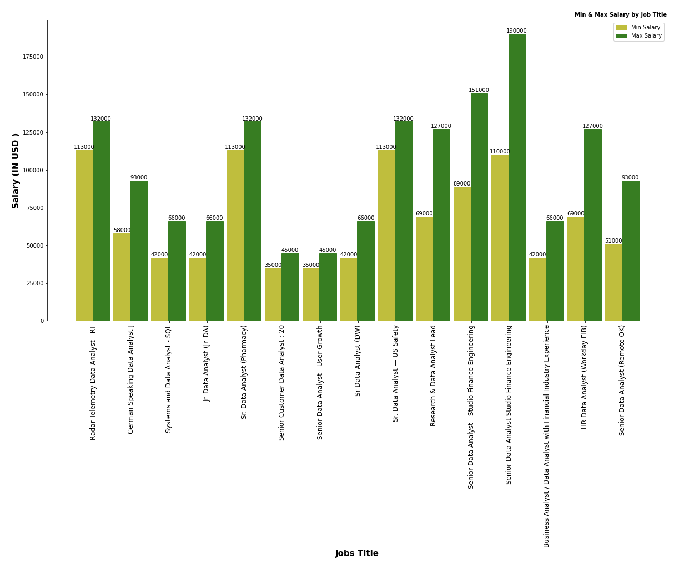
Tier 2 Analysis
Minimum & Maximum Salary By Job Title

Slide 13
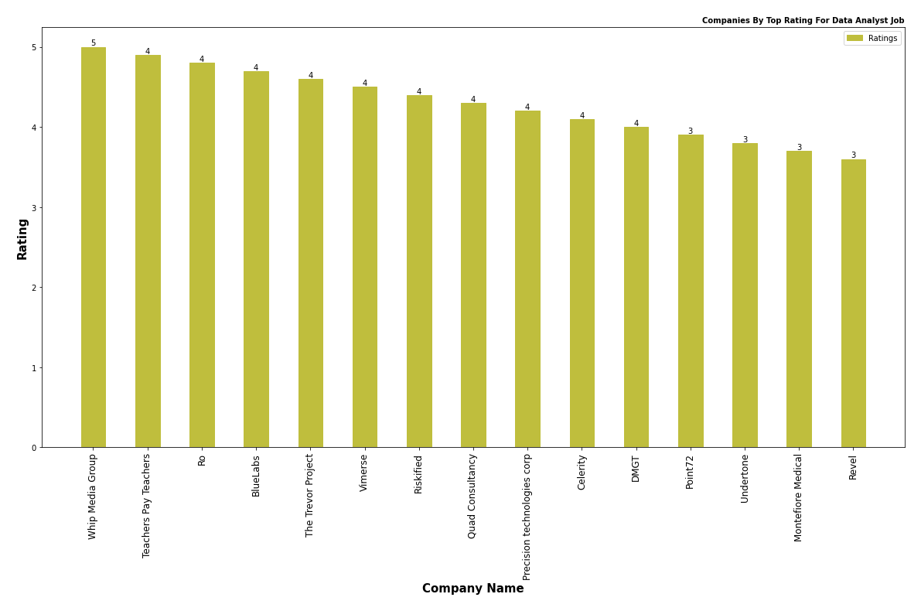
Tier 2 Analysis
Company By Top Ratings

Slide 14
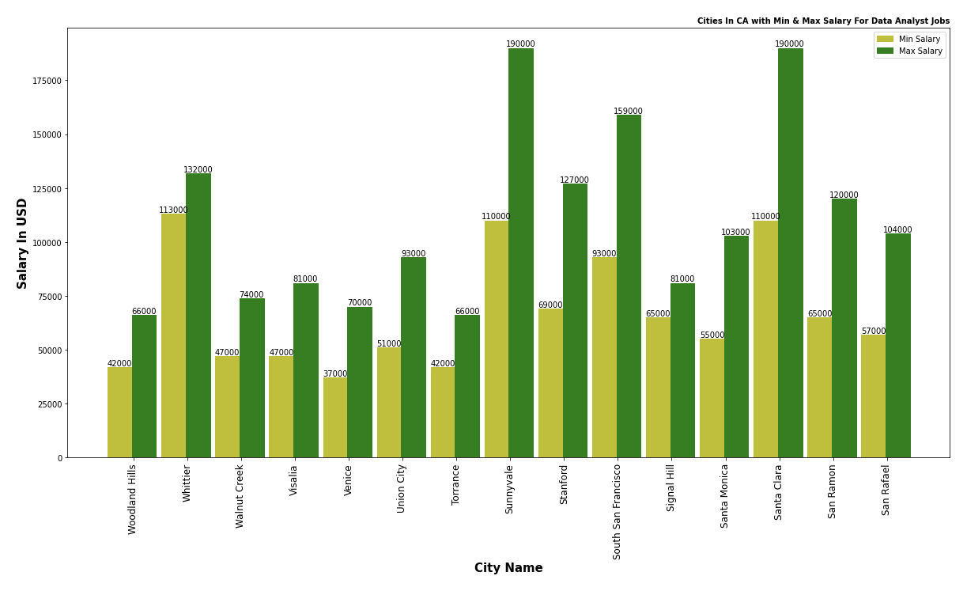
Tier 2 Analysis
Cities In CA with Min and Max Salary for Data Analyst Job

Slide 15
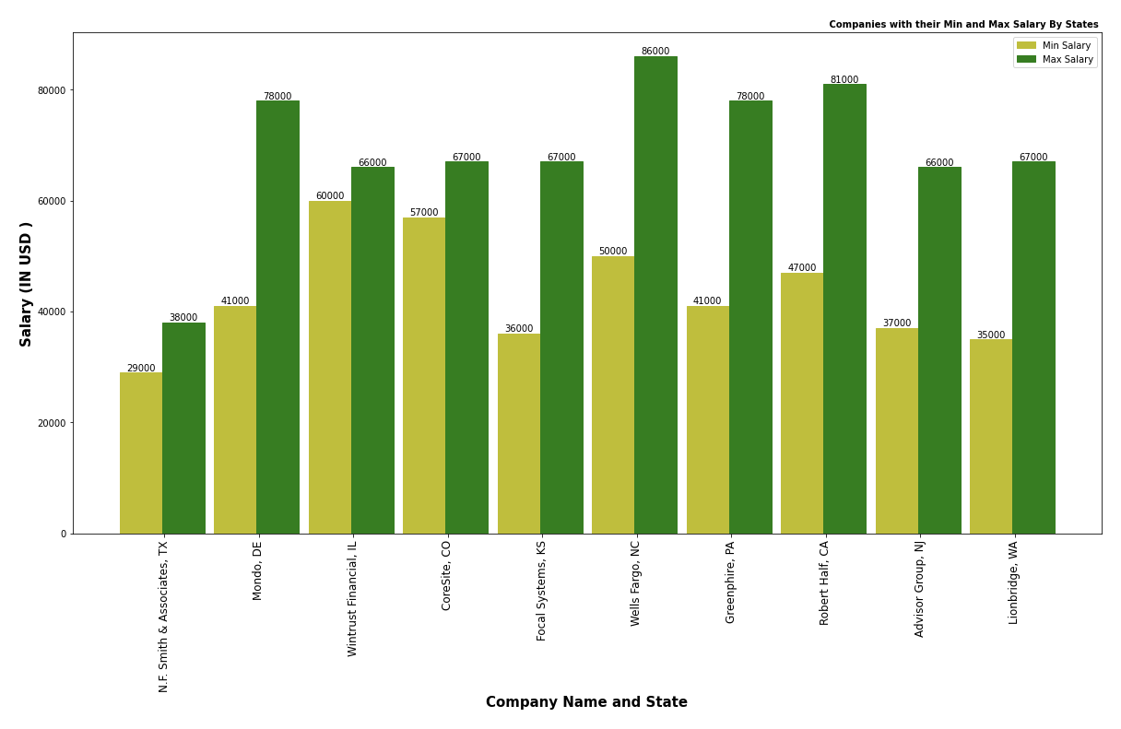
Tier 2 Analysis
Companies Min and Max Salary By States

Slide 16
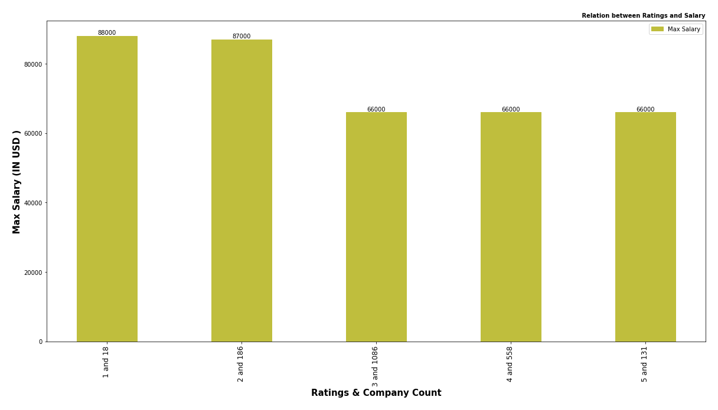
Tier 3 Analysis
Is Salary given is directly proportional to ratings?

Slide 17
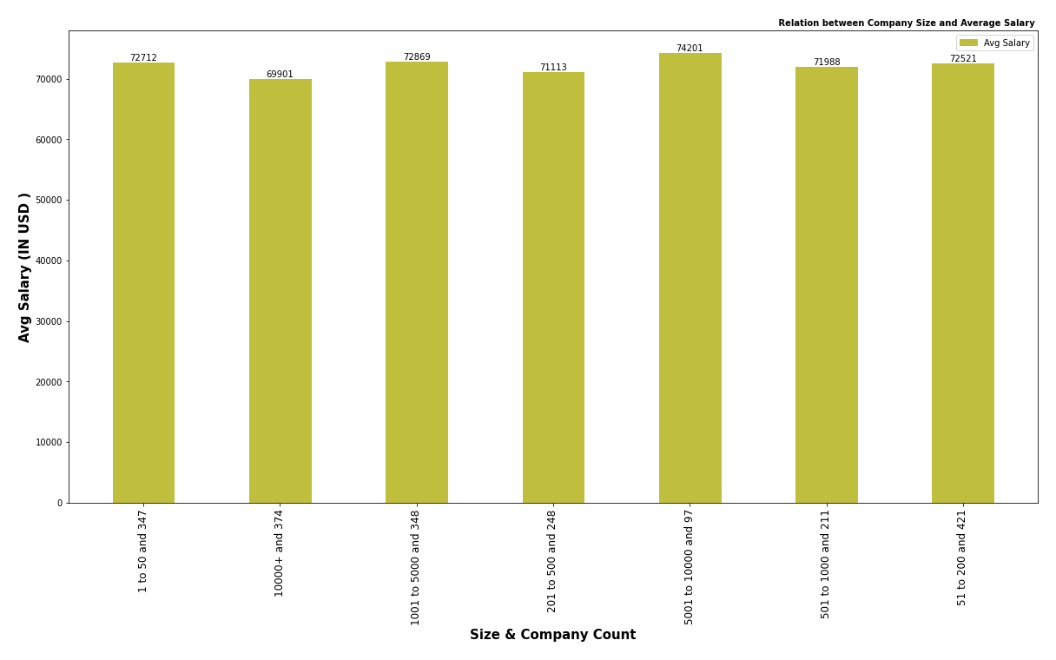
Tier 3 Analysis
Is Size of the company directly proportional to the salary?

Slide 18
Improvement & Enhancement
Job Description Columns have a huge amount of text data which is not included in this analysis ,but we can use this for future analysis.
For Revenue Column , we can split it into maximum and minimum revenue for further analysis, this can also be included in future analysis.

Slide 19
Thank You
😊

