Slide 1
INTRODUCTION: SOLIDITY PROGRAMMING
Presenters: Jafar Bakhshaliyev, Nitika Sharma, Chaitanya Valluri, Rick Nguyen

Slide 2
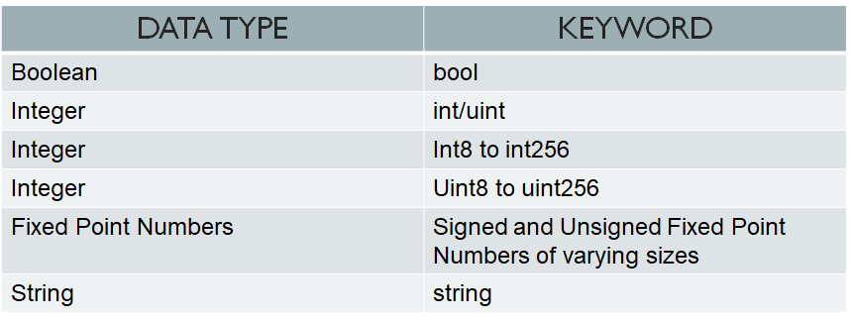
DATA VALUE TYPES

Slide 3
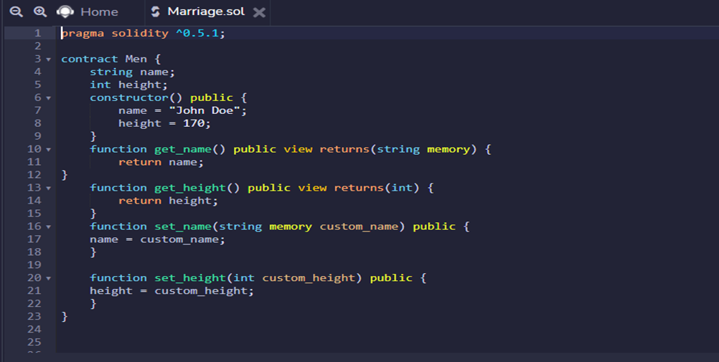
CONTRACT, OBJECTS AND DATA TYPES

Slide 4
DATA REFERENCE TYPES
MAPPING
ARRAYS
STRUCT

Slide 5
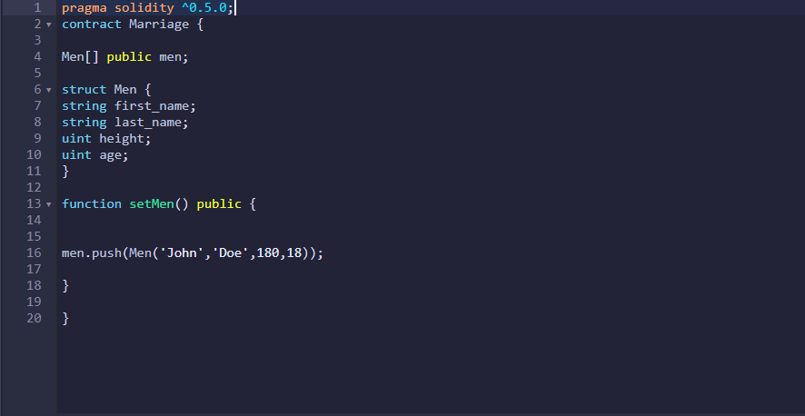
USING ARRAYS AND STRUCTS IN A SMART CONTRACT

Slide 6

MAPPING
Mapping act as hash tables, which consist of key types and corresponding value type pairs. Below is the syntax to declare a mapping type.

Slide 7
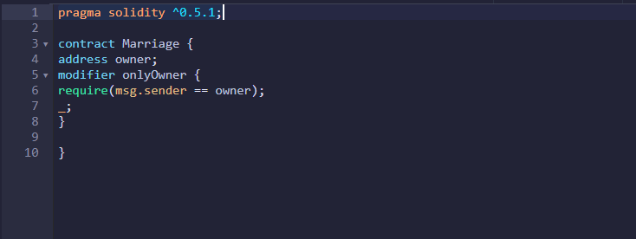
MODIFIER

Slide 8
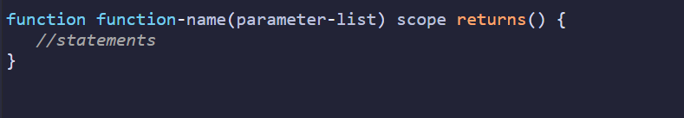
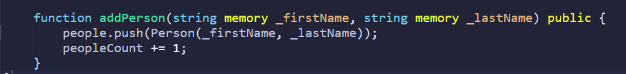
How to write function?
A function is a group of reusable code which can be called anywhere in your program. This eliminates the need of writing the same code again and again.
Notes:
We define the function by using the function keyword, followed by a unique function name, a list of parameters (that might be empty), and a statement block surrounded by curly braces
Push is used to call an array to add a new item and we put an instance of this person structure. We can create Person as a new instance and pass new attribute and then reference them by ID

Slide 9
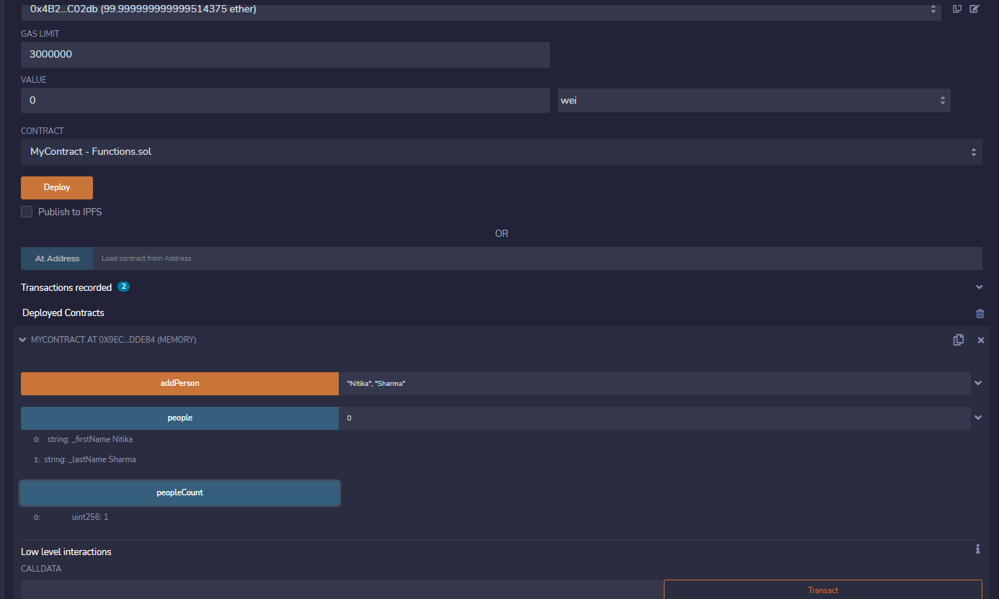
How to write function? - Output

Slide 10
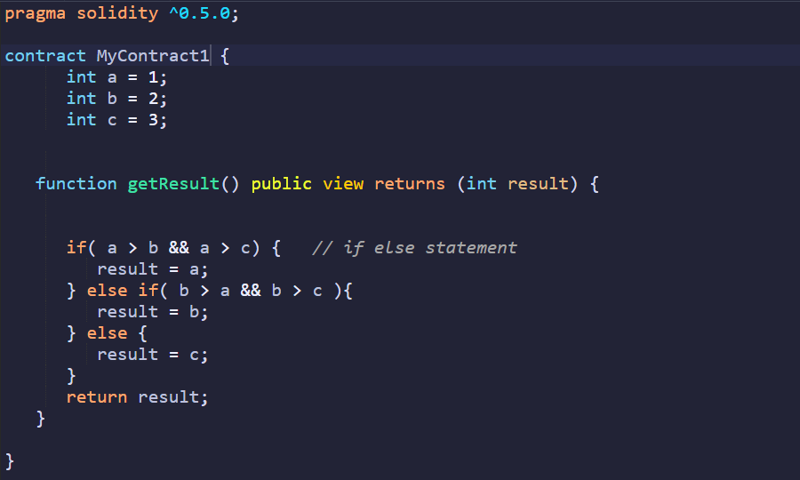
If Statement
Notes:
'if...else' statement is the next form of control statement that allows Solidity to execute statements in a more accurate way by providing conditions. It’ similar to the If else statements in different programming languages.
https://www.geeksforgeeks.org/what-is-hashing-in-solidity/

Slide 11
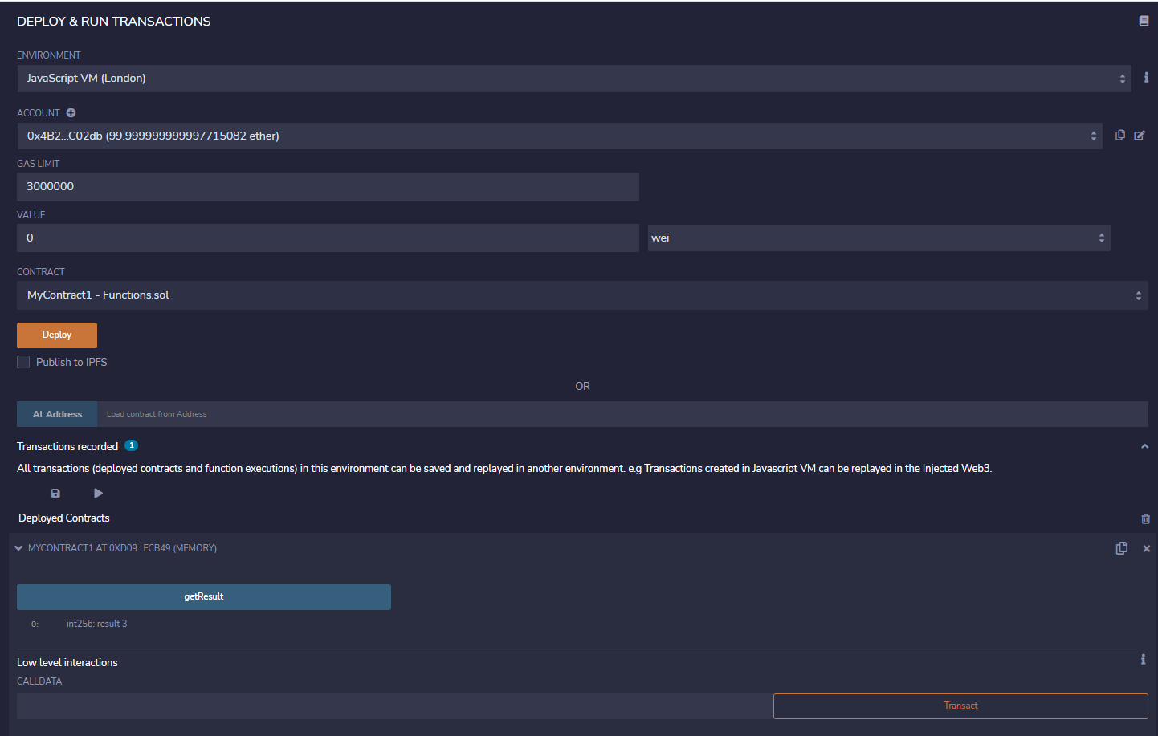
If Statement- Output
Notes:
The output is 3

Slide 12
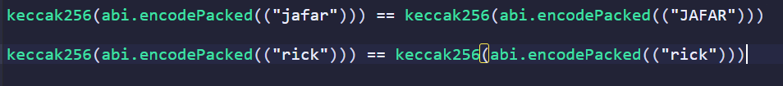
Hash Code Checking
A cryptographic hash function is an algorithm that takes an arbitrary amount of data as input and produces the enciphered text of fixed size. It means that it’s case sensitive.
Notes:
https://www.tutorialspoint.com/solidity/solidity_if_else_if_statement.htm

Slide 13
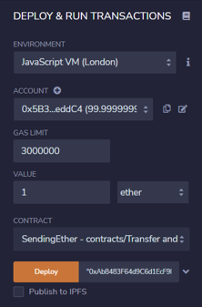
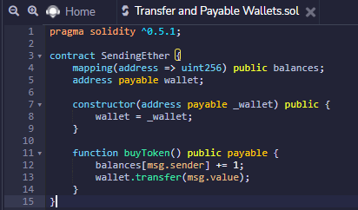
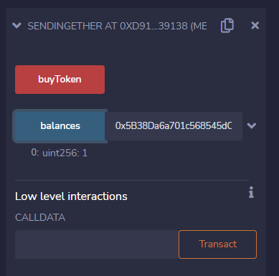

How to Transfer Ether to Payable Wallets

Slide 14
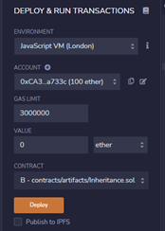
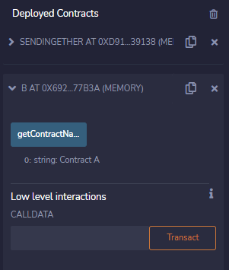
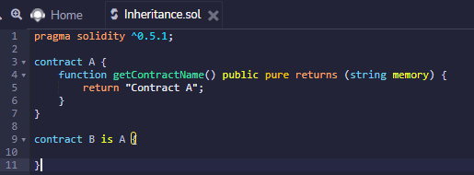
How to Inherit Contracts

Slide 15
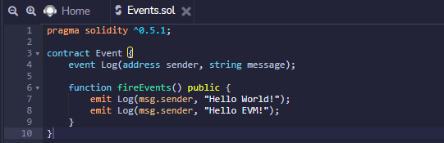
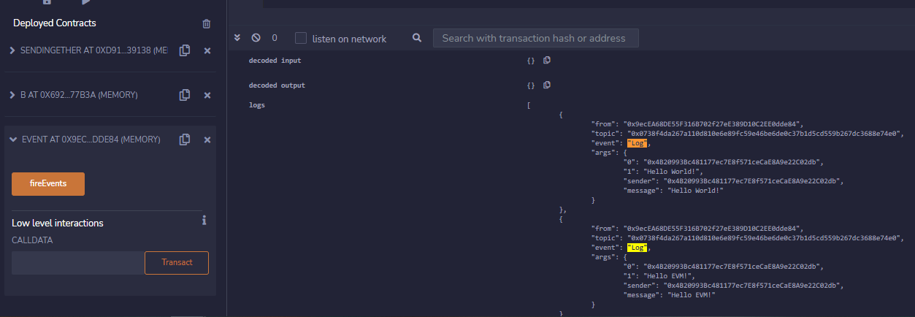
How to Record Events

Slide 16
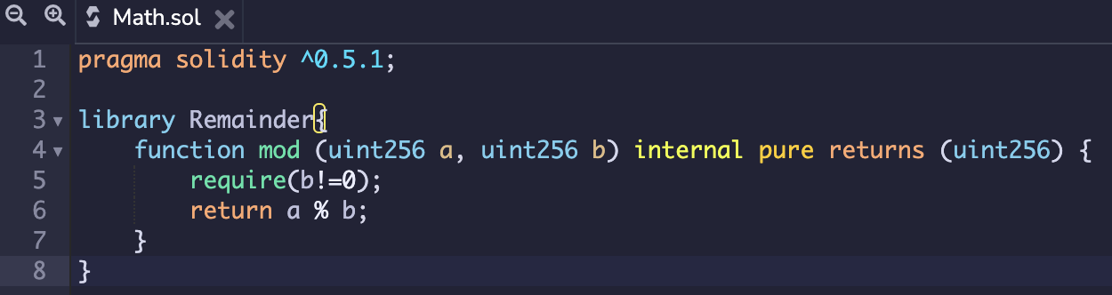
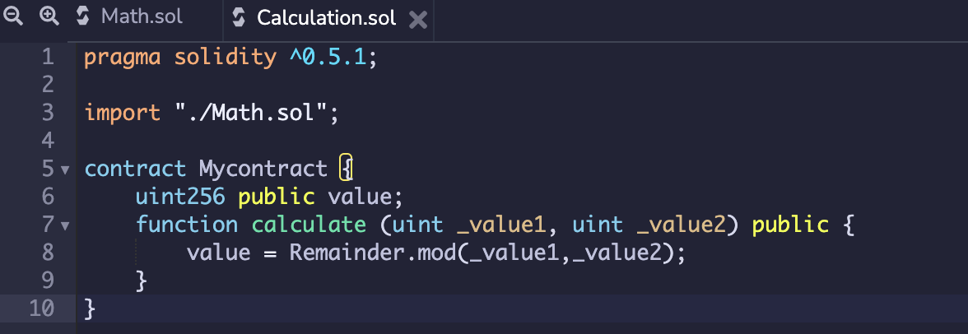
LIBRARY AND IMPORTING IT TO ANOTHER FILE

Slide 17
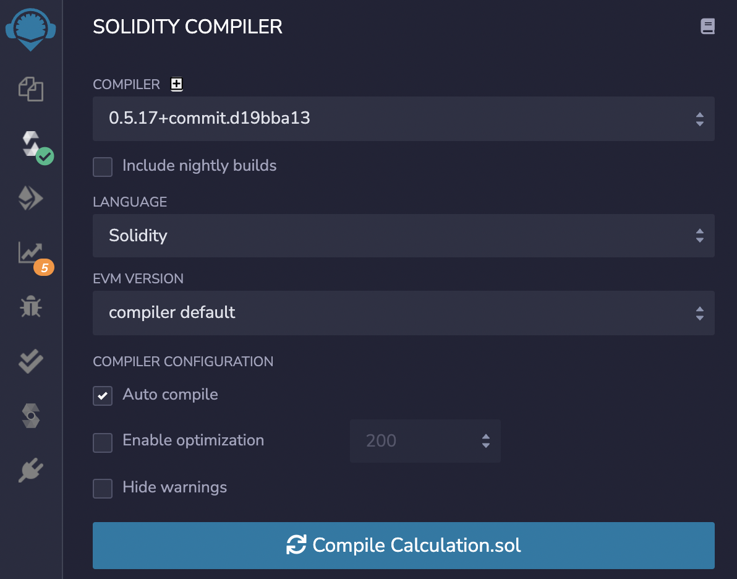
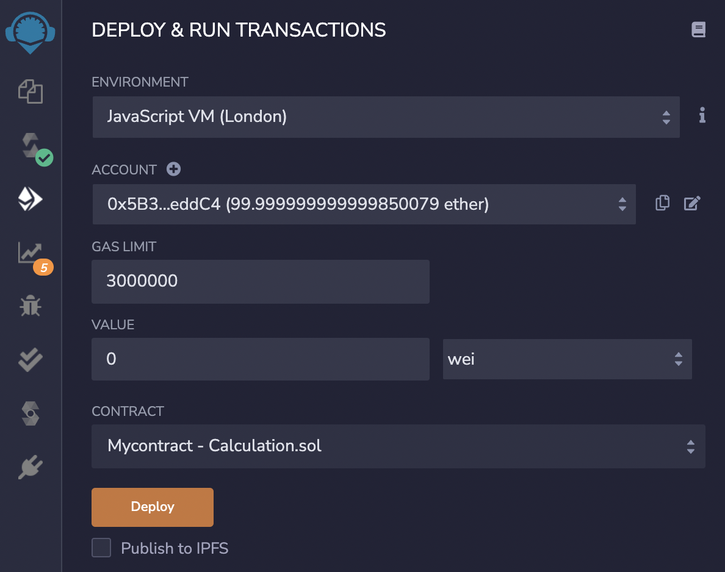
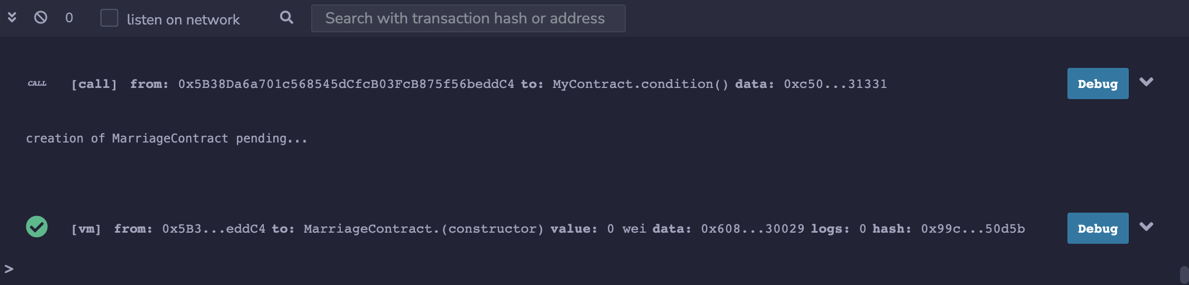
COMPILING FILE AND DEPLOYING CONTRACT

Slide 18
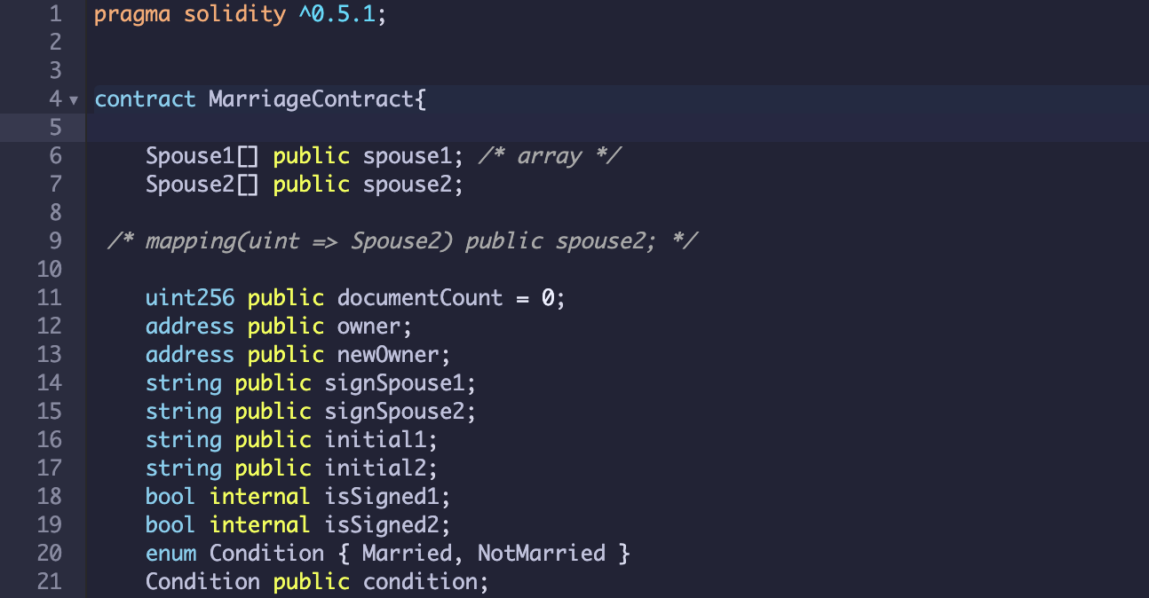
REVIEW: BASIC SMART CONTRACT DEVELOPMENT AND DATA TYPES

Slide 19
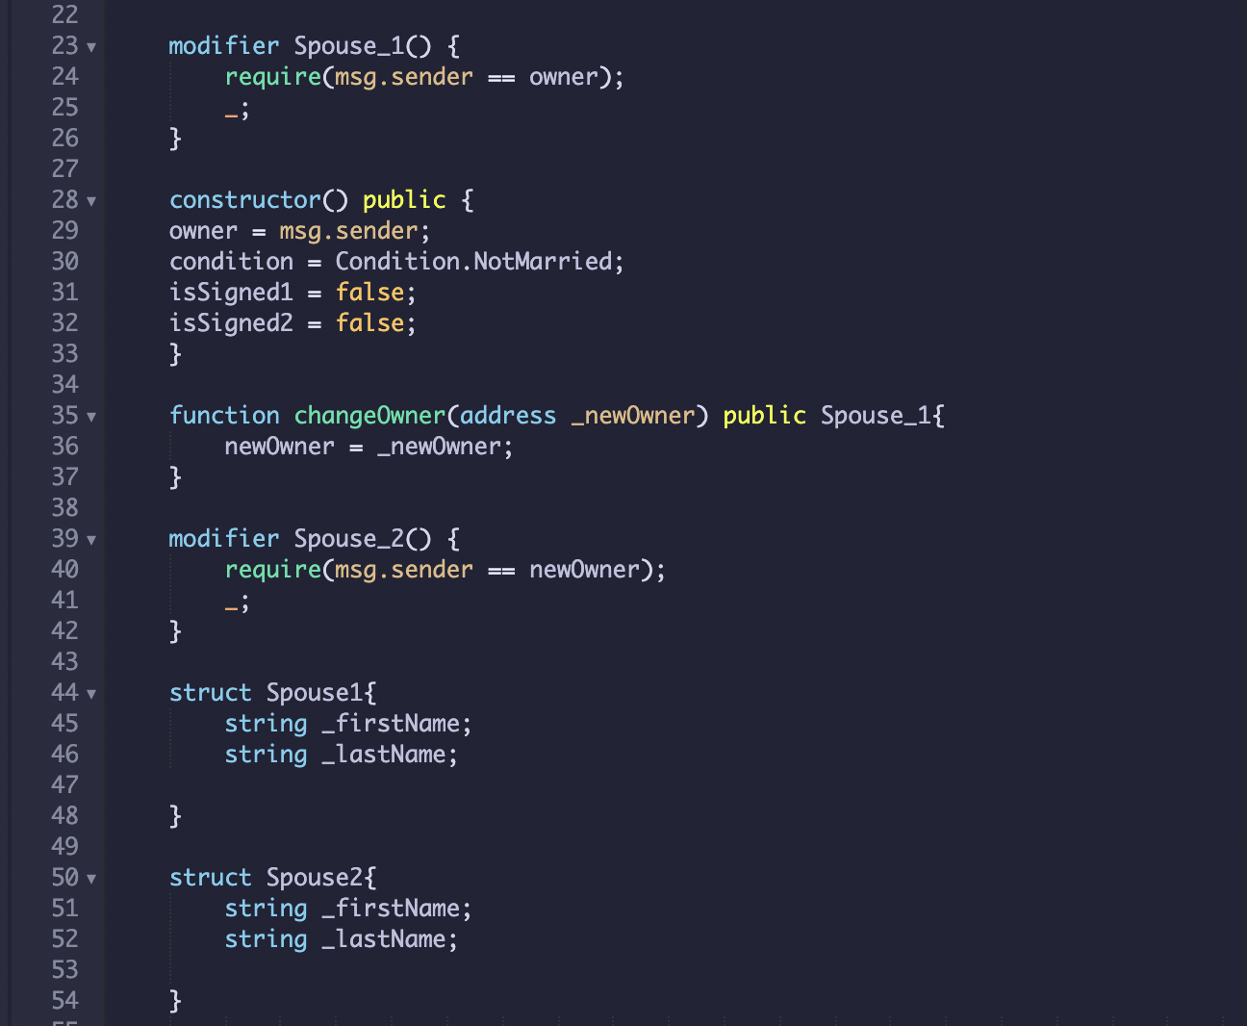
REVIEW: DATA STRUCTURES, FUNCTIONS AND THEIR VISIBILITY INCLUDING MODIFIERS

Slide 20
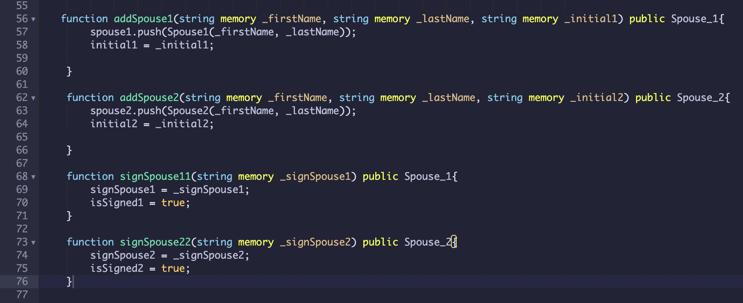
REVIEW: ESSENTIAL FUNCTIONS FOR MARRIAGE CONTRACT

Slide 21
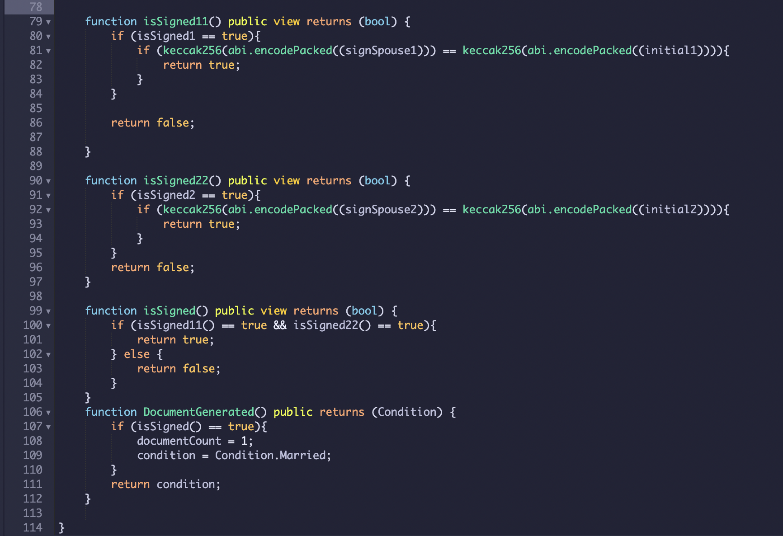
REVIEW: IF STATEMENT, HASH AND BOOLEAN TYPES

Slide 22
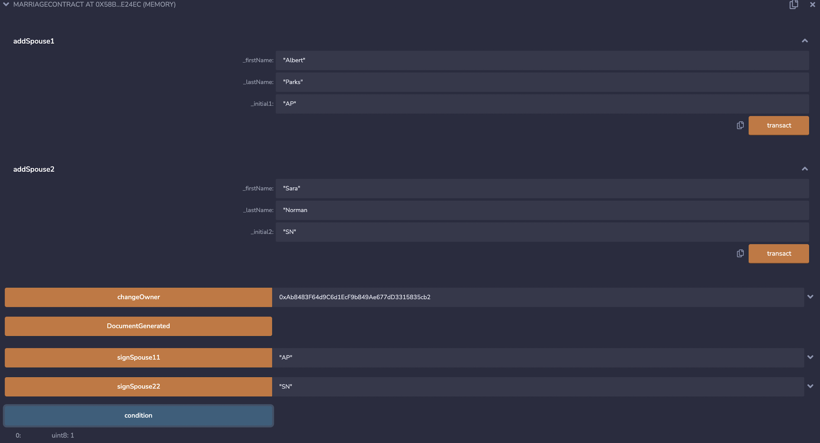
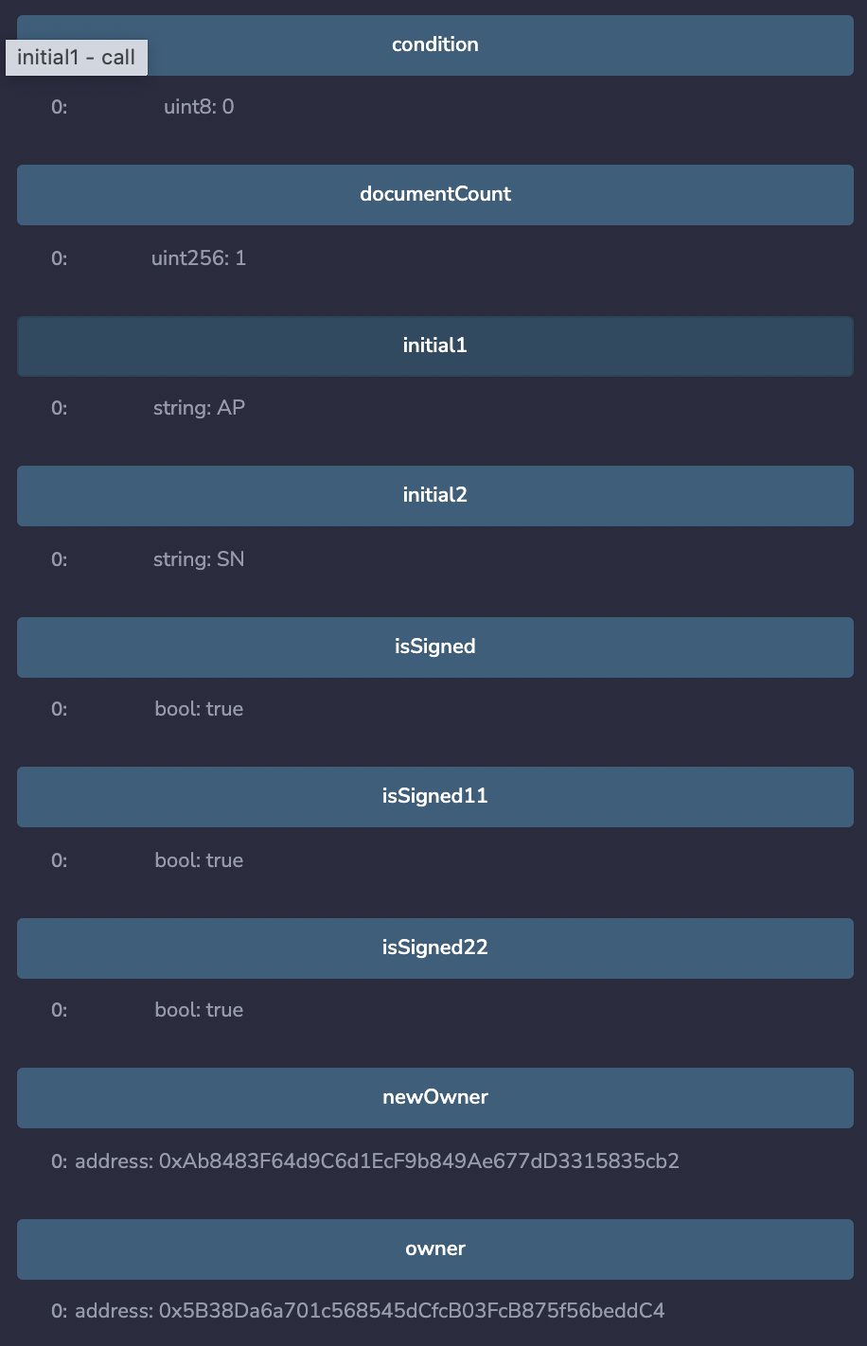
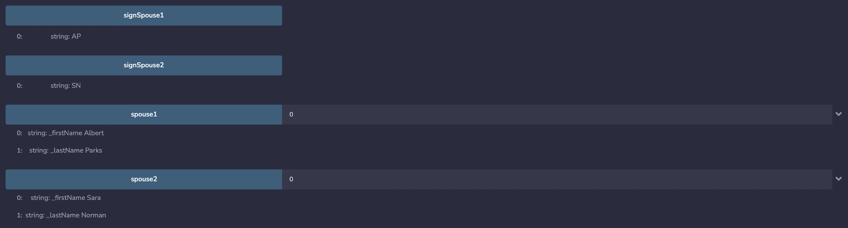
OUTPUT FROM MARRIAGE CONTRACT

