Slide 1

















PLAYSTORE APPS
SQL CASE STUDY
Presented by - DISHA VARSHNEY

Slide 2
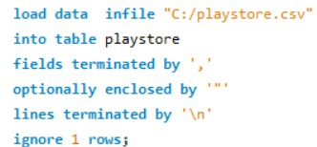
ETL - EXTRACT TRANSFORM LOAD
Data fetch - Kaggle
Data was uncleaned . Performed data-cleaning on Python
After the data was cleaned, tried to load the data to MySQL Workbench but the data was failed to import.
Performed below SQL query and loaded the data into table “playstore”

Slide 3
ABOUT THE SCHEMA
Database - projects Table - playstore Total entries after cleaning - 9360
Columns
id App
Category Rating Reviews Size Installs Type Price
Content Rating
Genres
Last Updated Current Ver Android Ver
DataType INT TEXT TEXT DOUBLE INT TEXT INT TEXT DOUBLE TEXT TEXT TEXT TEXT TEXT

Slide 4
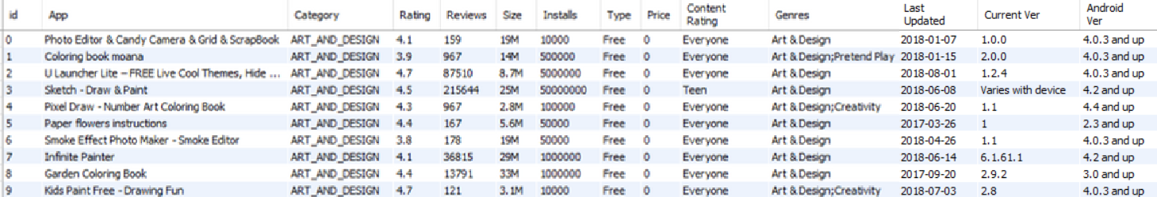
DATA VIEW
select * from playstore

Slide 5
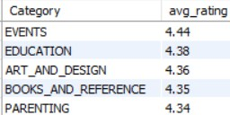
ANSWERING THE QUESTIONS
1 -You're working as a market analyst for a mobile app development company. Your task is to identify the most promising categories (TOP 5) for launching new free apps based on their average ratings.
select
Category,
round(AVG(Rating),2) as "avg_rating" from playstore
where Type="Free" group by 1
order by 2 desc limit 5;

Slide 6












ANSWERING THE QUESTIONS
2. As a business strategist for a mobile app company, your objective is to pinpoint the three categories that generate the most revenue from paid apps. This calculation is based on the product of the app price and its number of installations
select Category,
round(sum (Price*Installs), 2) as "revenue" from playstore
where Type="Paid" group by 1
order by 2 desc limit 3

Slide 7
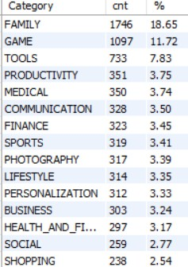

ANSWERING THE QUESTIONS
3 - As a data analyst for a gaming company, you're tasked with calculating the percentage of games within each category. This information will help the company understand the distribution of gaming apps across different categories
select
Category, count(*) as "cnt",
round(count(*) *100/ (select count(*) from playstore) ,2) as "%" from playstore
group by 1 order by 2 desc
( Used a subquery here )

Slide 8
ANSWERING THE QUESTIONS
4 - As a data analyst at a mobile app-focused market research firm you’ll recommend whether the company should develop paid or free apps for each category based on the ratings of that category.
with t1 as
(select
Category, round(avg(rating),2) as "Paid" from playstore
where type="Paid" group by 1),
t2 as
(select
Category, round(avg(rating),2) as "Free" from playstore
where type="Free" group by 1)
( Made 2 ctes first )

Slide 9
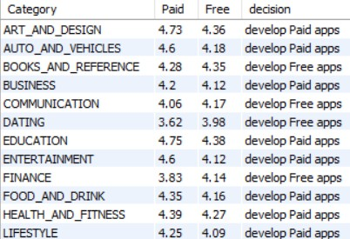
ANSWERING THE QUESTIONS
select *,
case
when k.Paid>k.Free then "develop Paid apps" else "develop Free apps"
end as "decision" from
(select
a.Category, Paid, Free from t1 a
inner join t2 b
on a.Category=b.Category) k
( Used a subquery. First this subquery will be executed and then the above query )

Slide 10
ANSWERING THE QUESTIONS
5 - Suppose you're a database administrator your databases have been hacked and hackers are changing price of certain apps on the database, it is taking long for IT team to neutralize the hack, however you as a responsible manager don’t want your data to be changed, do some measure where the changes in price can be recorded as you can’t stop hackers from making changes
create table play as select * from playstore;
( Creating a duplicate table to perform updates on, as a hacker )
create table price_changelog ( app VARCHAR(255),
old_price decimal(10,2), new_price decimal(10,2), operation_type varchar(25), operation_date timestamp
);
( Creating a table where updates done by hackers will be recorded ))

Slide 11
ANSWERING THE QUESTIONS
Everytime the hackers update the original data, this trigger will be executed and all the updated data can be recorded in the table “price_changelog”
DELIMITER //
CREATE TRIGGER price_change_hack AFTER UPDATE
ON play
FOR EACH ROW BEGIN
INSERT INTO price_changelog(app, old_price, new_price, operation_type, operation_date) VALUES (NEW.app, OLD.price, NEW.price, 'update', CURRENT_TIMESTAMP);
END // DELIMITER ;;

Slide 12
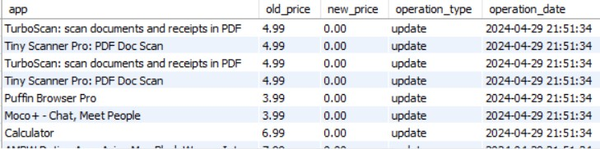
ANSWERING THE QUESTIONS
I tried to update the table “play” as a hacker to check if the updated data is stored in “price_changelog”
update play set price=0
where Type="Paid"
select * from price_changelog

Slide 13
ANSWERING THE QUESTIONS
6 - Your IT team have neutralized the threat; however, hackers have made some changes in the prices, but because of your measure you have noted the changes, now you want correct data to be inserted into the database again.
drop trigger price_change_hack; update play as a
join price_changelog b on a.App=b.App
set a.price=b.old_price;
select * from play where Type="Paid"
(Checking)

Slide 14

ANSWERING THE QUESTIONS
7 - As a data person you are assigned the task of investigating the correlation between two numeric factors: app ratings and the quantity of reviews.
set @x=(select avg(Rating) from playstore) set @y=(select avg(Reviews) from playstore);
(Setting the variables)
with cte as (select *,
(rat*rat) as "sqr_x", (rev*rev) as "sqr_y" from
(select
Rating,
(Making a cte)
(Extracting the result from subquery)
round((Rating-@x),2) as 'rat',
Reviews, round((Reviews-@y),2) as "rev" from playstore) k
)

Slide 15
ANSWERING THE QUESTIONS
select
@numerator:=sum(rat*rev), @deno_1:=sum(sqr_x), @deno_2:=sum(sqr_y)
from cte;
(Setting the variables)
select
round(@numerator/sqrt(@deno_1*@deno_2),2) as "corr_coefficient";

Slide 16
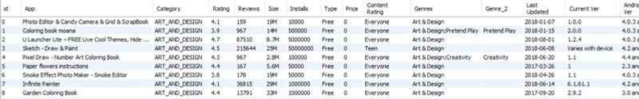
ANSWERING THE QUESTIONS
8 - Your boss noticed that some rows in genres columns have multiple genres in them, which was creating issue when developing the recommender system from the data he/she assigned you the task to clean the genres column and make two genres out of it, rows that have only one genre will have other column as blank.
ALTER TABLE playstore
ADD COLUMN Genre_2 VARCHAR(255) AFTER Genres
(Adding a new column)
UPDATE playstore SET Genre_2 = CASE
(Updating the newly added columm)
WHEN Genres = SUBSTRING_INDEX(Genres, ";", -1) THEN “” ELSE SUBSTRING_INDEX(Genres, ";", -1)
END
select * from playstore
( Viewing the updated table)

Slide 17

ANSWERING THE QUESTIONS
9 -Your senior manager wants to know which apps are not performing as par in their particular category, however he is not interested in handling too many files or list for every category and he/she assigned you with a task of creating a dynamic tool where he/she can input a category of apps he/she interested in and your tool then provides real-time feedback by displaying apps within that category that have ratings lower than the average rating for that specific category.
(Creating a stored procedure)
CREATE DEFINER=`root`@`localhost` PROCEDURE
`check_app_performance`(IN input_category VARCHAR(255))
BEGIN
DECLARE avg DECIMAL(10,2);
select average into avg from
(select Category, avg(Rating) as "average" from playstore group by 1) t
where Category=input_category; select * from playstore
where Category=input_category and Rating<@avg; END
(Calculating the average rating for that particular category)
(Retrieving those apps whose rating is lower than avg_rating of that particular category )

Slide 18
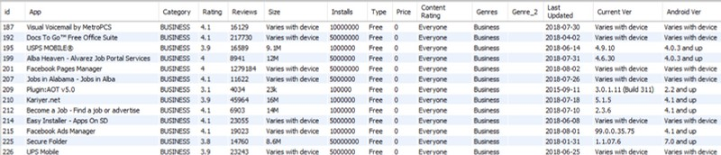
ANSWERING THE QUESTIONS
call check_app_performance('business')

Slide 19
ANSWERING THE QUESTIONS
10 - Calculate the average rating of apps in each category, where the rating is adjusted based on the number of installations. The adjustment factor is defined as the square root of the number of installations. Write a user- defined function to calculate the adjusted rating, and then use it to find the average adjusted rating for each category.
(Creating a user-defined function)
CREATE DEFINER=`root`@`localhost` FUNCTION `adjusted_rating`(rating varchar(10), installations int) RETURNS float
DETERMINISTIC BEGIN
declare adjusted_rating float;
set adjusted_rating=rating/SQRT(installations); RETURN adjusted_rating;
END

Slide 20
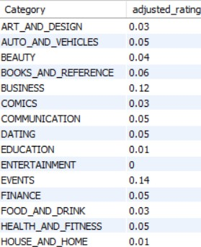
ANSWERING THE QUESTIONS
select Category,
ROUND(AVG(adjusted_rating(Rating, Installs)),2) as "adjusted_rating" from playstore
GROUP BY 1

