Slide 1
FPGA Temperature Regulation using PID Control in VHDL
David Paquette

Slide 2
Goal
Regulate the temperature of the FPGA using on board temperature sensor and external DC fan
User selectable desired temperature
View the current and desired temperature on an external display
Collect current temperature and current fan speed on an external computer

Slide 3

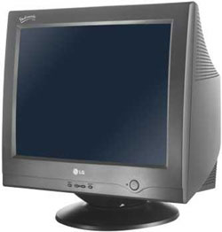
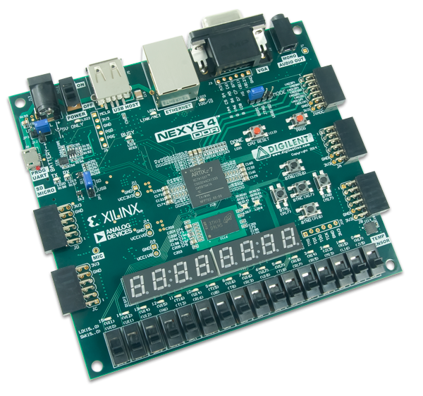
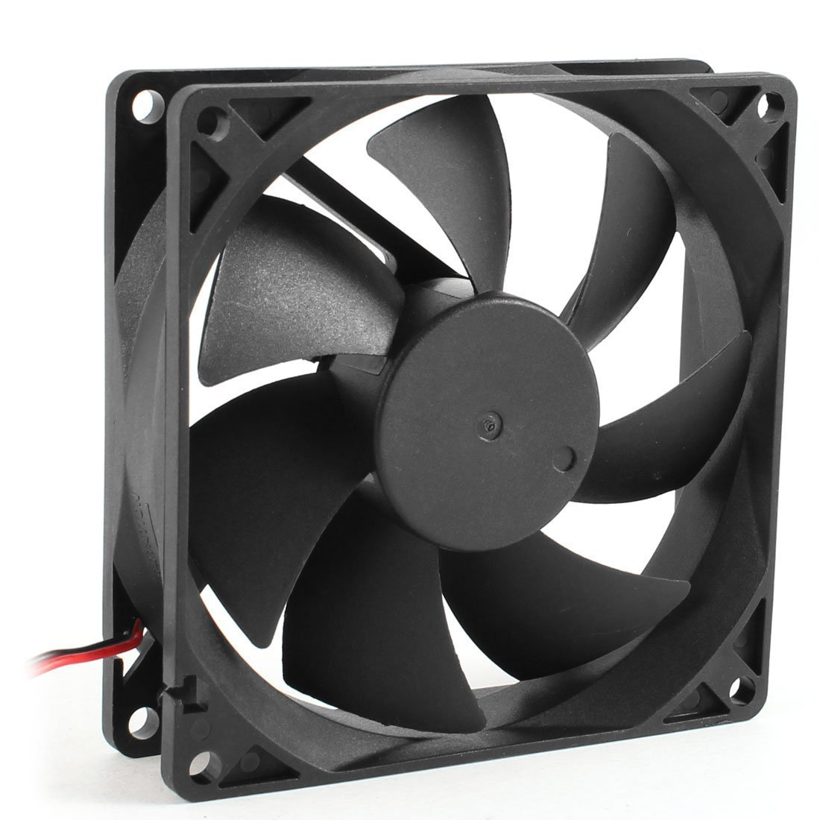
I/O Data Flow
UART
VGA
Temperature Sensor
PWM
Push Buttons
On board I/O

Slide 4
High-Level VHDL Architecture
BRAM WB
Temperature Control Master
VGA WB
Set point control
Clock Divider
MemWrite WB
PID Control
Temp Sensor
PWM Interface
Values2
Serial
OnePress
Filter
Char8x12 LUT
Dec 2ascii
FPGA Monitor
UART
library
Debouncer

Slide 5
Internal Data Flow

Slide 6
Temperature Sensor Module
clk
FPGAMonitor
Temperature
Sensor Module
ADC Code
Temperature(˚C)
rst
Analog digital converter code to temperature
Used XADC temperature sensor to measure the FPGA temperature
For now, truncated temperature at 8 bits.
Can measure in 1˚C increments
Derived from
k=Boltzmann’s constant
T = temperature (K)
q=charge on an electron
Voltage is sampled by the 12-bit ADC to produce an ADC Code
Equations found in Xilinx XADC user guide

Slide 7
Temperature Selection Module
Increment set point
Outputs the user’s desired temperature
Set by using the push button pad on the FPGA
One press and debouncer state machine used
Decrement set point
Btn=1
Btn=1
start
One press
No press
Btn=0
Btn=0
One press state machine

Slide 8
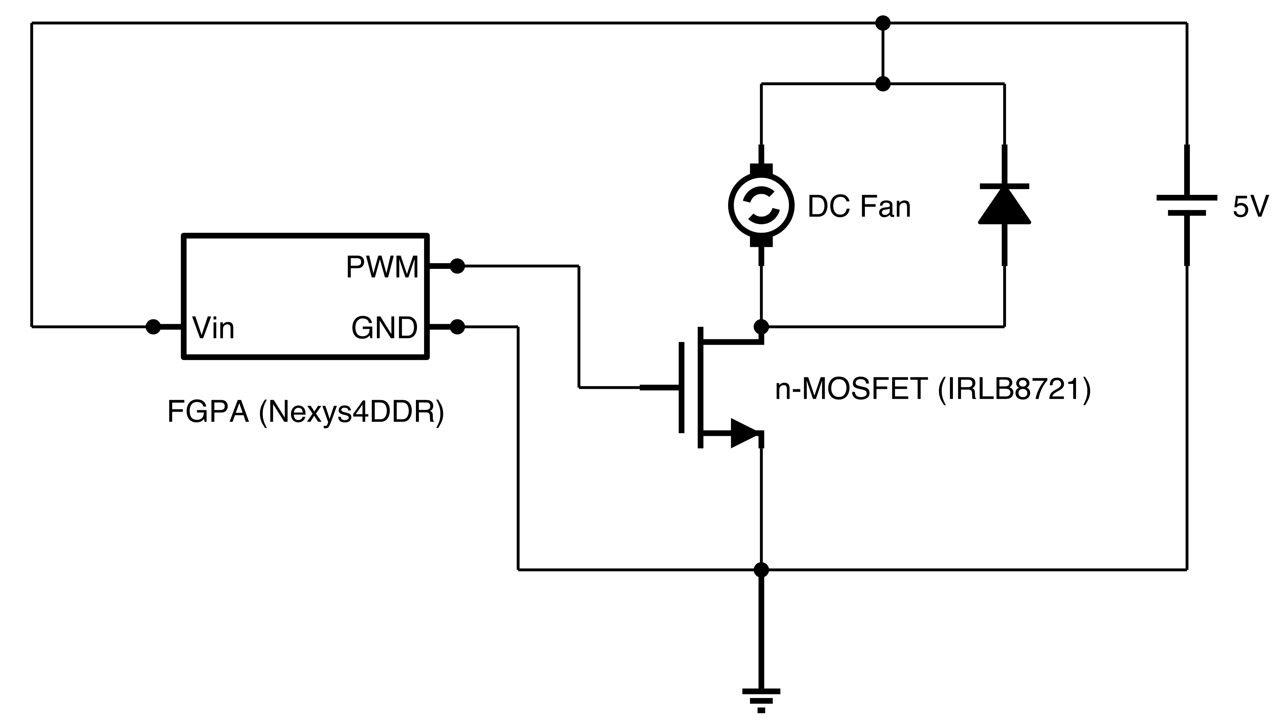
DC Motor Control Module
3.3V to 5V PWM DC Motor Driver
Desired Fan Speed (%)
Wait for rising edge clock
Increment counter
counter < (desired fan speed)
Pmod digital output high is 3.3V
DC motor is controlled with 0 to 5V
DC motor functions in PWM frequency range 100Hz to 600Hz (from testing)
yes
no
Output = 1
Output = 0
Duty Cycle % to PWM

Slide 9
UART Serial Module
start
clk
ack_o
rst
UART Library
dat_in[8]
Send Temp
Send Comma
rx
ack_o=1
stb_i
ack_o=1
Diagram of UART library¹
(only relevant ports shown)
Send fan speed
Send newline
ack_o=1
X
0x2C
X
0x0A
wait
ack_o=1
Serial format used for sending data.
‘X’ is an 8-bit value (Current temperature and fan speed).
0x2C is ASCII for a comma (,)
0x0A is ASCII for a newline (\n)
counter=10ms
State machine for interfacing with UART library
Each state asserts the stb_i pin on entry and de-asserts it on exit.
1 http://bytebash.com/2011/10/rs232-uart-vhdl

Slide 10
VGA BRAM Display Module
InitMem
Start
Current and desired temperature are written to BRAM over Wishbone
VGA module reads pixel data from BRAM over Wishbone
row=39
Write to Mem
Get Pixel Data
line<11
ack_i=1
BRAM Writer State Machine
cT=XX
dT=XX
Decimal to two digit ASCII conversion
Display format

Slide 11
Digital PID Controller Module
Wait for rising edge clock
= measured temperature
e =desiredT – currentT
= desired temperature
= fan speed
sum += e
= 10ms
Safety Checks
Added windup protection to prevent integral term from becoming too large
Added output bounds checking to prevent fan speed from being set over 100% or under 0%
changeE = e -previousE
newFanSpeed = Kp*e+Ki*e*T+Kd*changeE/T
Simplified PID control

Slide 12
System Identification
Open loop unit step response (no control)
Set fan to 60% after 5 seconds and
Captured temperature data through serial port
Used the system identification tool box in MATLAB to estimate the discrete open loop transfer function
Sampling rate of 10ms
Open loop transfer function

Slide 13
Controller Design and Results
Closed loop response
Set point=34
Set point=32
Used MATLAB’s PID toolbox to estimate closed loop gains
Tested gains on FPGA (worked well)
Settling time of about 15 seconds
To avoid using decimals, Kp and Ki are set as 303 and 123, then the controller output is divided by 100

Slide 14
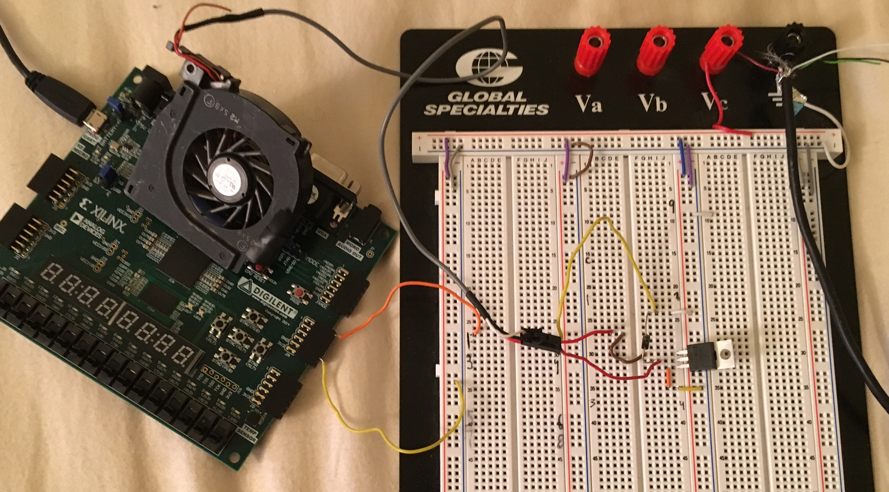
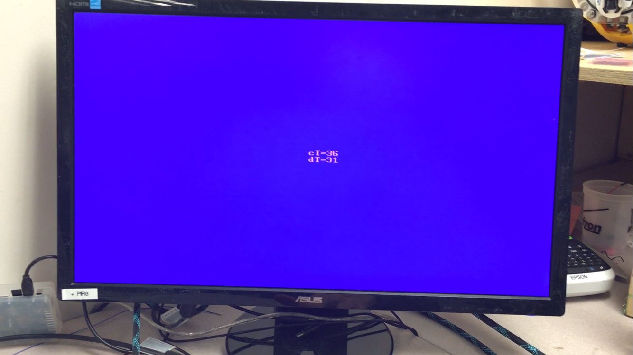
Implemented Circuit and Display
Completed PWM DC motor driver circuit
VGA display format

Slide 15
Remaining Work
Add module to generate heat, for testing controller response under varying conditions
Limit desired temperature to reasonable range
Display fan speed on VGA
Move communication between fan, PID controller, temperature sensor, buttons and serial port to wishbone bus

Slide 16
Questions

