Slide 1
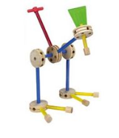
Second Day Slides Boot Camp for Digital Systems Education Running generated RTL thru Vivado
Jim Brakefield jim.brakefield@ieee.org
IEEE Computer Society
Notes:
Tinker toy construction embodies the generation/design of objects from simple uniform components

Slide 2
Preliminaries
Classroom provided by St. Mary’s University
Funding provided by a grant from the IEEE Computer Society as part of their Emerging Technologies program
I’m Jim Brakefield, jim.brakefield@ieee.org
Today’s web site: https://events.vtools.ieee.org/m/316786
Slides only, Flash drives have full set of files (20MB)
Also at https://github.com/jimbrake/FPGA_Boot_Camp
Introduction to FPGA video: https://www.youtube.com/watch?v=EVy4KEj9kZg

Slide 3
Not quite free
Using the grant money to buy an FPGA board for each student (and lunch), the idea being that way each student can spend more time on the board.
Those that have good jobs or otherwise flush, can write a check for $100 to:
IEEE Lone Star Section Chapter c/o James Brakefield, 1214 Vista Del Rio, San Antonio, TX 78216
In return for the “free” FPGA board, you e-mail a progress report periodically to jim.brakefield@ieee.org
Part of the grant is to determine the viability of this approach to FPGA education, hence need feedback.

Slide 4
Today’s agenda
What’s on the FPGA board
FPGA parts (LUTs, Block RAM, DSP, IO, fabric)
Review of digital logic & binary
Summary of VHDL/Verilog
Summary of constraint files
Do a Vivado project

Slide 5
Today’s agenda
Who hasn’t got Vivado installed?
Have a disk drive & flash drive with install files
Will take 30+minutes
Who hasn’t generated VHDL or Verilog from their schematic?
A picture of everyone with their FPGA board

Slide 6
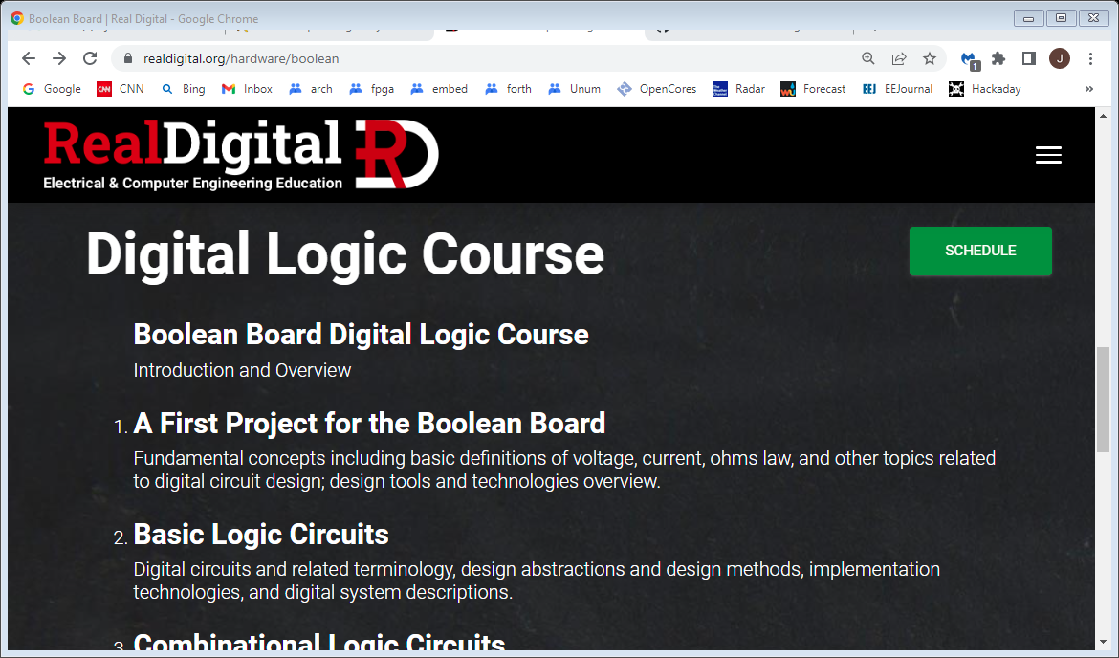
Basic Digital tutorials https://www.realdigital.org/hardware/boolean

Slide 7
What do FPGA tools do?
Much goes on behind the scenes
Circuit is optimized (logic simplification)
unused stuff is pruned, if no outputs then all pruned
Circuit is mapped into FPGA primitives
Circuit wired up with FPGA routing resources
Bit file generated that configures the chip
Error checking especially missing semicolons
Reports on timing, resources used, error messages
Schematic viewer will show chip details

Slide 8
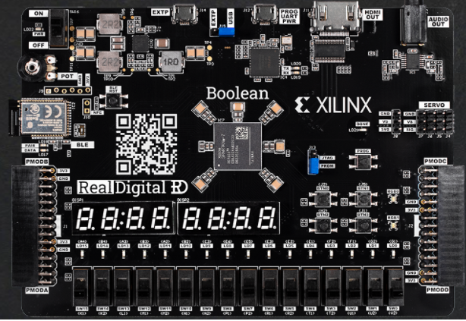
Boolean board $69/$79
Notes:
Uses AMD/xilinx tools(vivado). The staggered IO holes is deliberate, will hold and connect headers without soldering. HDMI video out. Available with or without Bluetooth LE.

Slide 9
Boolean Board background
RealDigital.org
Educational mission
Very well done courseware, uses hyper links
Board uses AMD/xilinx Spartan-7 FPGA
50K logic cells (33K 6-LUTs)
2.8M bits of block RAM (300K bytes)
One of the least expensive FPGA boards with full user IO, also servo headers & potentiometer
Notes:
If time & budget allows will do the course with the DE10-Lite board (in the fall).

Slide 10
Downloading vivado
https://www.xilinx.com/support/download.html
https://www.xilinx.com/support/installer/installer-info-general.html
Use the web installer (212MB) and only install for Spartan-7 devices. Full install is a 74GB tar.gz file!!
Will still take time (~2hrs) and 44GB download!
Takes 71GB of disk space!! ☹
Follow RealDigital Boolean Board instructions at https://www.realdigital.org/doc/1fd3322461ac4bcc1fcd6bcc6c5907ec
Can add additional FPGA devices later
Hundreds of video tutorials (use help button)
Notes:
Took 3 hours total at 100Mb/sec download speed. Did not turn off anti-virus protection.

Slide 11
RTL (Register Transfer Language)
Separates design into combinatorial (logic) and sequential (registers).
For simple designs use a single clock
Boolean Board clock input is 100MHz
Digital will generate slower clocks
Registers update on rising edge clock

Slide 12
Side by side VHDL and Verilog
Digital generates both
RealDigital’s treatment:
https://www.realdigital.org/downloads/e06bddc63669cbc91ae981df18bcf3c5.pdf
Side by side System-Verilog & VHDL:
Digital Design and Computer Architecture, Harris & Harris, 2nd ed. Also ARM and RISC-V editions
Highly recommended, goes from transistors to PCs
Also: https://www.fpga4student.com/2017/08/verilog-vs-vhdl-explain-by-example.html

Slide 13
Side by side VHDL and Verilog cont’d
Clive “Max” Maxfield’s books:
The Design Warrior's Guide to FPGAs, 2004
FPGAs: World Class Designs, 2009
Electrical Engineering: Know It All, 2011
covers the entire field, chapters are written by others

Slide 14
FPGA References
Three Ages of FPGAs: A Retrospective…, Steve Trimberger, Proc. IEEE v103#3p318, 2015
www.cpe.virginia.edu/grads/pdfs/January%202016/VLSI.pdf
https://www.youtube.com/watch?v=4ntXSyOhlBY
Xilinx Part Family History, John Lazzaro,
www-inst.eecs.berkeley.edu/~cs294-59/fa10/resources/Xilinx-history/Xilinx-history.html
Altera History, corporate, http://www.fundinguniverse.com/company-histories/altera-corporation-history/
www.altera.com/about/company/history.html
Low cost FPGA boards
https://www.joelw.id.au/FPGA/CheapFPGADevelopmentBoards
Open source IP https://opencores.org/projects

Slide 15
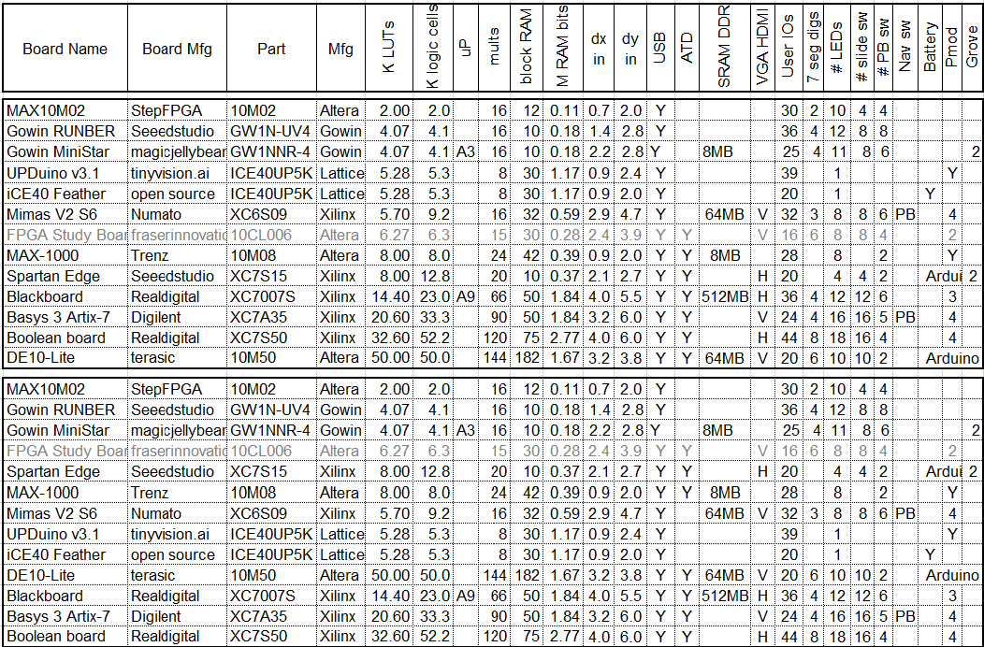
FPGA board rankings
Top version sorted by LUT count, bottom version by block RAM bit count
This listing is only a sample of the hundreds of boards available.
Notes:
The spreadsheet at https://events.vtools.ieee.org/m/306653 has a sheet of boards, with old prices, sorted by FPGA family. Also a sheet sorted by shape. ATD: analog to digital converter. LUT: logic lookup table. Block RAM: typically dual ported, adjustable aspect ratio.

Slide 16
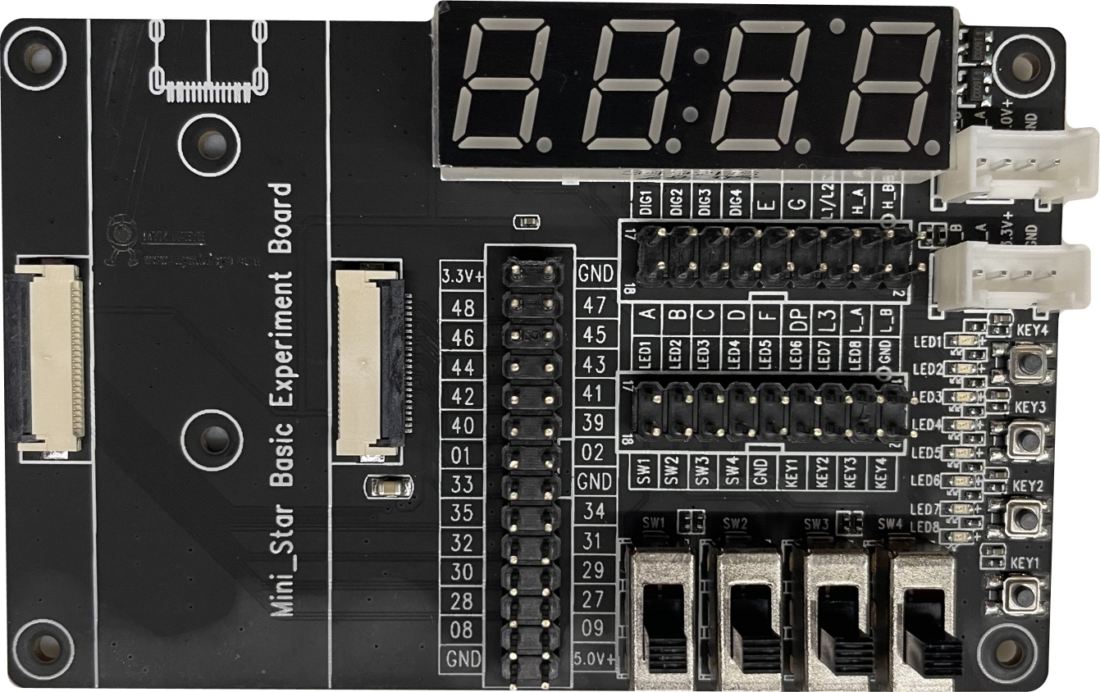
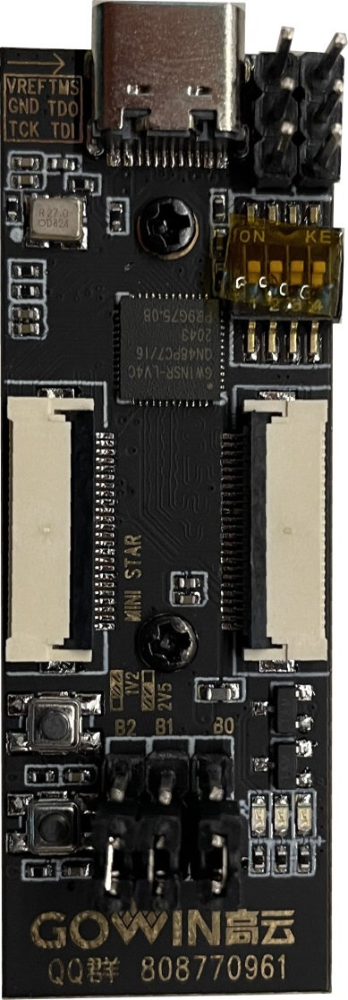
MiniStar experiment kit $69 Gowin FPGA with ARM Cortex M3
Notes:
A low cost board/FPGA with Cortex M3. Available at Amazon for $69. 4K LUTs, 8MB SRAM. Kit Has connection cables. 4 slide & 4 DIP switches, 6 PB, 12 LED, 2 Grove connectors, and the four digit 7-segment display.

Slide 17
In conclusion
It is thought that ownership of an FPGA board will lead to greater usage and knowledge. As opposed to shared laboratory equipment.
Oriented towards a beginner’s board at low cost. Lots of switches, LEDs etc. eliminate need for discrete components and their fragile wiring.
Future class dates and registration links at: https://events.vtools.ieee.org/m/316279
Next class registration link (for those that missed): https://events.vtools.ieee.org/m/317075

Slide 18
Interactive digital simulation
Schematic editor and simulator
Provides an intermediate step before RTL (Register Transfer Logic) and full FPGA tools.
Requires nothing beyond a PC.
Requires Java
Totally interactive
Generates VHDL or Verilog RTL files
Generates constraint file for vivado (xilinx FPGA tool)

Slide 19
“Digital” logic simulator
Web site: https://github.com/hneemann/Digital/
Authored by: Helmut.Neemann@mosbach.dhbw.de
Open source, although other simulators available
Modified to support the Boolean board
BASYS3.config renamed to Boolbd.config
BASYS3_IO.dig renamed to Boolbd.dig
And pin assignments updated
And PMOD pins moved to Boolbd_pmod.dig
In the subdirectory examples/hdl
Boolbd.* files are read only

Slide 20
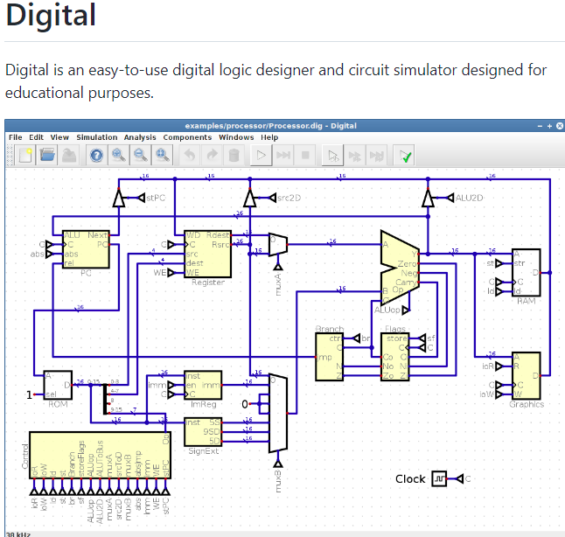
Github Digital https://github.com/hneemann/Digital/
Scroll down to “Download and Installation”
and click
Is 12MB zip file
22MB unzipped

Slide 21
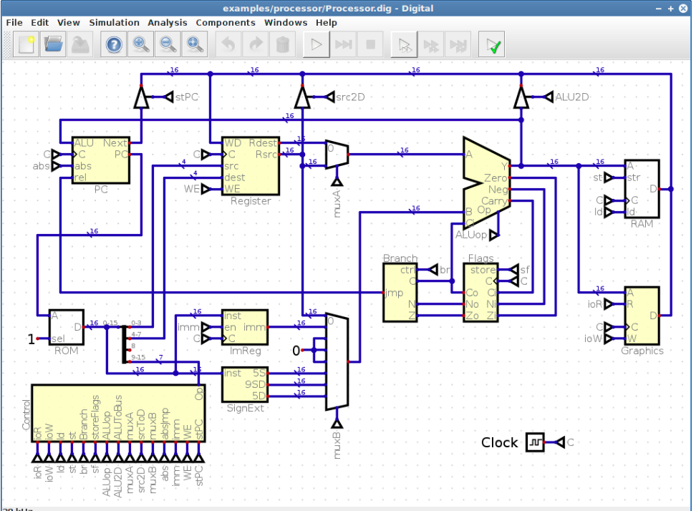
High res github.com/hneemann/Digital
Notes:
Note: Clock references, bus width indicators, tri-states not used in FPGAs & right click on icon to see/set data width.
From examples/processor/Processor.dig. https://github.com/hneemann/Assembler has it’s assembler.

Slide 22
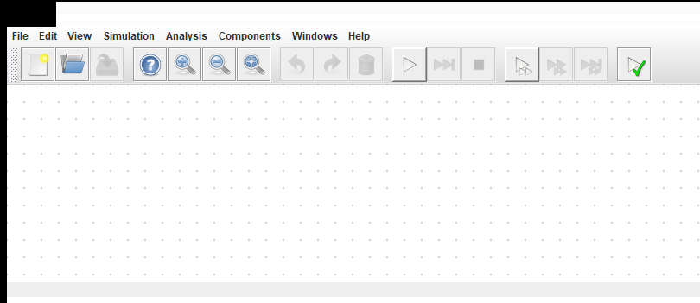
Unzip into convenient directory
At the top level there should be Digital.exe, Digital.jar & Digital_noD3D.exe
Click the Digital.exe (on windows)

Slide 23
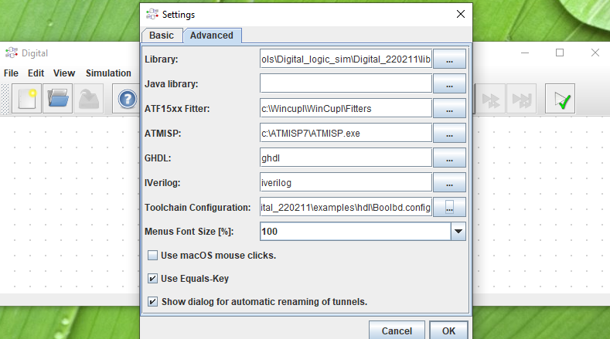
Configure for Boolean Board
Go to Edit Settings Advanced
Specify Toolchain Configuration file
From examples/hdl select Booleanbd.config
Notes:
To un-configure erase the Toolchain Configuration entry. *.config file has new menu item name (Boolbd) on line 2.

Slide 24
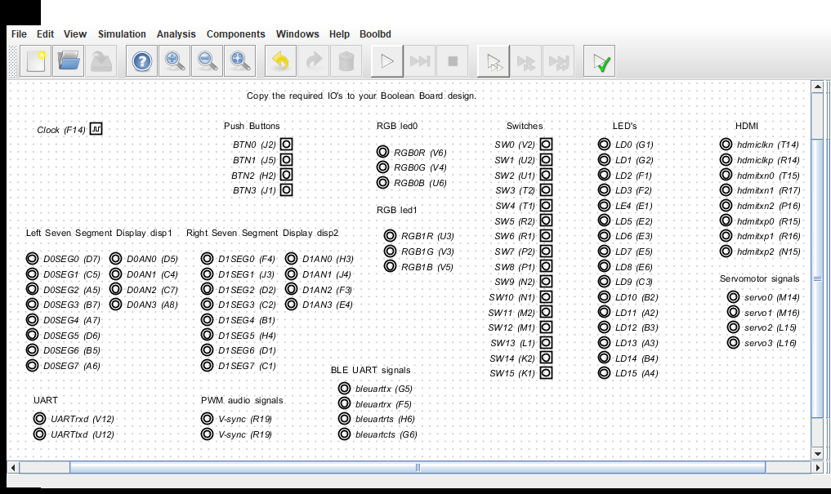
Digital with additional menu item always starts with last schematic, here the Boolean board IO pins
Notes:
This is write protected, save to new file to edit. A starting point for you FPGA board design: prune and add circuits!

Slide 25
Wikipedia basic logic circuits
Full adder https://en.wikipedia.org/wiki/Adder_(electronics)
Multiplexer https://en.wikipedia.org/wiki/Multiplexer
ALU https://en.wikipedia.org/wiki/Arithmetic_logic_unit
Has easy to understand VHDL source code
Barrel shifter https://en.wikipedia.org/wiki/Barrel_shifter
Wallace tree multiplier https://en.wikipedia.org/wiki/Wallace_tree
Synchronous binary up counter
In schematic form: change a Dff if all preceding Dff are all 1
In RTL: “if enable AND rising-clk then count <= count+1”
Notes:
Didn’t find good examples of up counter?

Slide 26
Educational programs
Intel/Altera academy Quartus: RTL & Schematic
AMD/Xilinx university program ISE & Vivado RTL tools
Courseware for Real Digital Boolean board RTL
https://www.realdigital.org/course/digital-logic-for-the-boolean-board
https://www.tina.com/ (Schematic based, not free)
Support for the Digilent Basys 3 and the Terasic DE10-Lite FPGA boards
https://www.tina.com/blog/programming-fpga-boards-with-tina-using-schematic-design-entry/
Digital logic simulator (Schematic based)
Support for the Digilent Basys 3 and the TinyFPGA-BX boards
https://github.com/hneemann/Digital/
Notes:
RTL: Register transfer language, usually VHDL or Verilog. Quartus and Vivado are mainstream tools with free education variants (reduced FPGA family support). Xilinx ISE not recommended for new users.

Slide 27
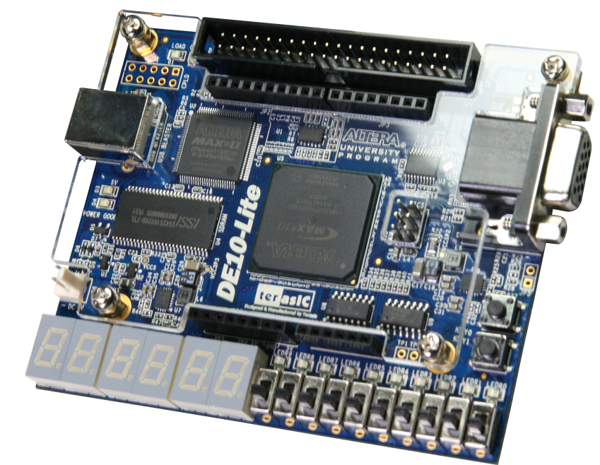
Intel/Altera academic program
https://www.intel.com/content/www/us/en/developer/topic-technology/fpga-academic/overview.html
https://www.intel.com/content/www/us/en/developer/topic-technology/fpga-academic/materials.html
https://fpgacademy.org/tools.html
DE10-Lite academic price $77
Notes:
Only two push buttons. Least expensive Altera board with “full” user IO.

Slide 28
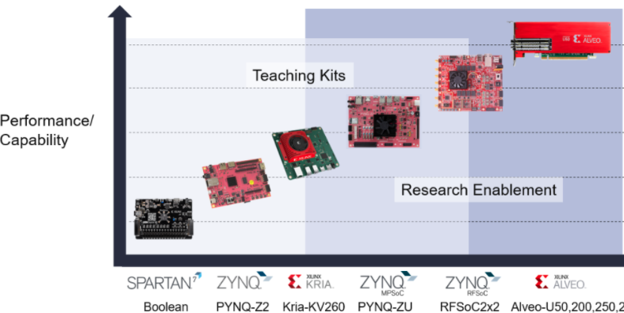
Xilinx university program
https://www.xilinx.com/support/university.html
https://www.xilinx.com/support/university/boards-portfolio/xup-boards/RealDigitalBoolenBoard.html
$69 $123 $200
Notes:
Boolean Board “endorsement” by Xilinx. Kria-KV260 has state-of-the-art FPGA, heavily backordered.

Slide 29
The chip manufacturers
Xilinx (now AMD): www.xilinx.com
Originated FPGAs with help from AMD
Altera (now Intel): www.altera.com
Originally CPLDs, #2 in FPGAs.
Microsemi (was originally Actel): www.microsemi.com/product-directory/1636-fpga-soc
SRAM & flash based
Lattice Semiconductor: www.latticesemi.com
Offer tiny FPGA chips
Quicklogic: www.quicklogic.com
ARM + ~2K LUTs
Gowinsemi: https://www.gowinsemi.com/en/

Slide 30
Built-in IO Done Just Right
10+ slide switches or DIP switches
6+ push buttons
10+ LEDs, two tri-color (RGB)
7-segment LEDs (four to eight digits)
VGA or HDMI connector
Expansion IOs
Arduino, Pi, PMOD, Grove, DIP pattern…

Slide 31
Nice to have built-in IO
Potentiometer or incremental encoder
Servo connector(s)
Navigation switch or rhombic push button pattern
Pmod connector(s)
Grove connector(s)
Built-in microprocessor (usually ARM)
SRAM or DRAM (for microprocessor support)
SD socket (for microprocessor OS)
Notes:
The servo connectors make for a robotics capable board. Usage model for potentiometer is showing the voltage on the 7-segment display. Those ready to do soft core or built in processor probably don’t need switches, LEDs and 7-segment displays; use serial terminal instead.

Slide 32
FPGA Application Areas
Communications
DSP
Software-defined radio
Aerospace and defense systems
ASIC prototyping
Medical imaging
Computer vision
Speech recognition
Cryptography
Bioinformatics
Computer hardware emulation
Data Center: AI, NN, big data
Advantages:
Outstanding Job market
Disadvantages:
Tough learning curve

