Slide 1
Fake Profile Detection using different Classification Algorithms
Nitin Yadav
2015067

Slide 2
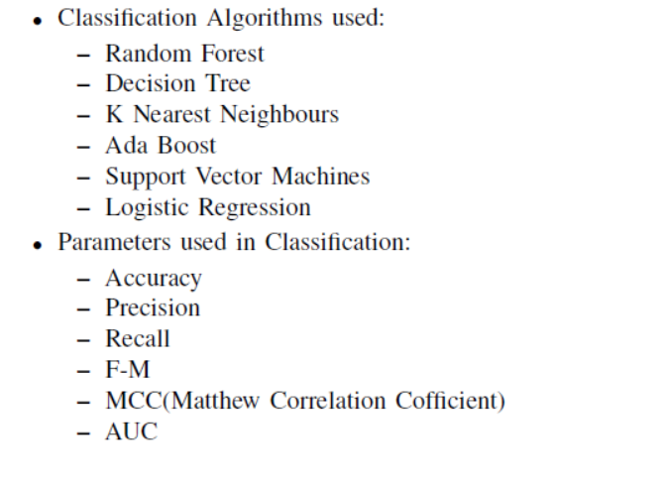

Slide 3
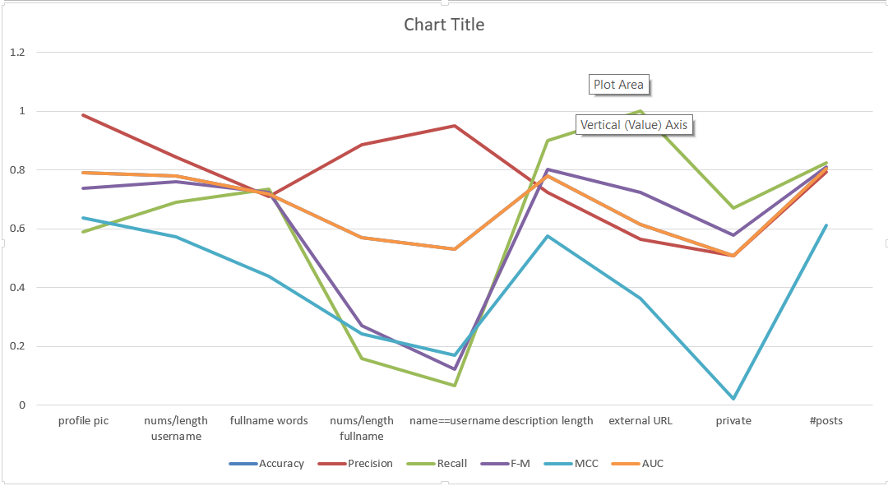
Line Graph for all attribute Classification using Random Forest

Slide 4
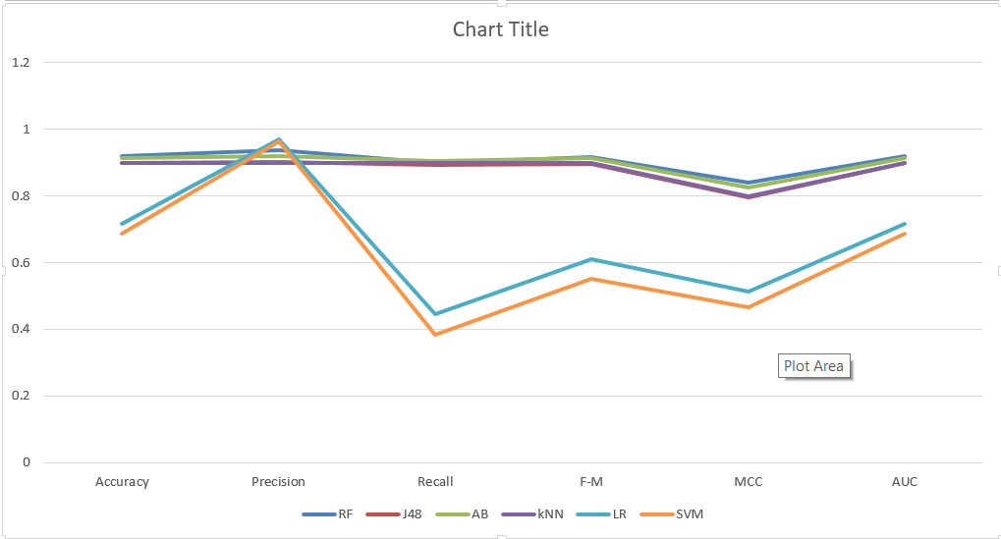
Line Graph for 6 Parameters values of different algorithms combined on Training Dataset

Slide 5
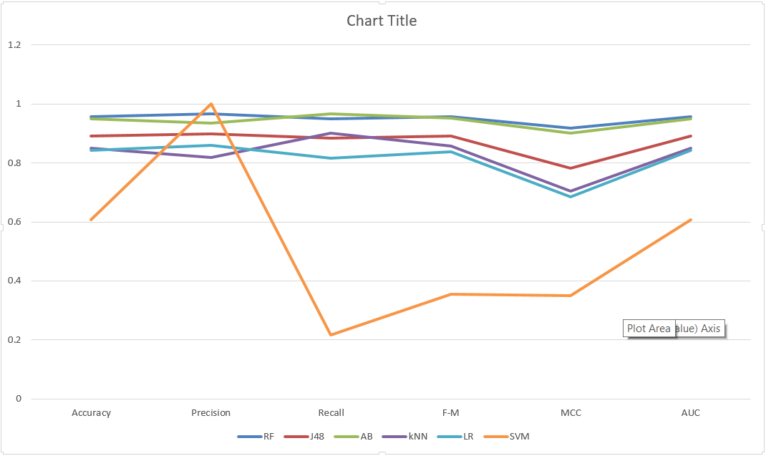
Line Graph for 6 Parameters values of different algorithms combined on Testing Dataset

