Slide 1
School Name
School of Computer Science Engineering
Final Year Project Presentation On
Automatic Attendance System With Face Recognition

Slide 2
Project Guide
Dr. Meesala Sudhir Kumar
Group Members
Mr. Gaurav Kailas Khalase Mr. Rupesh Dharmendra Jha
(200105231020) (200105231011)
Mr. Nitin Mr. Shivendra Yadav
(200105231004) (200105231016)
Kupakwashe Tinotenda Mapuranga
(200105181018)

Slide 3
Index
Understanding OpenCV
Viola-Jones Algorithm
LBPH
Methodology
System Architecture
Benefits
Accuracy and Challenges
Outcomes and Conclusion

Slide 4
The Role of Face Recognition
Face recognition is like a digital lock that recognizes your unique features.
Face recognition, powered by Python and deep learning, makes it possible by transforming your face into your ID.
Face recognition represents a cutting-edge approach to biometric identification.
Let's break it down: face recognition is like your computer's own magic trick, and Python with deep learning is the secret behind it.

Slide 5
Understanding OpenCV
OpenCV (Open Source Computer Vision Library) is an open-source software library focused on real-time computer vision and image processing.
It was originally developed by Intel and later supported by Willow Garage and other organizations.
OpenCV is widely used for tasks such as face detection, object detection, video analysis, image manipulation, and many other computer vision applications.

Slide 6
Viola-Jones algorithm
The mastermind behind this is Viola-Jones algorithm.
Viola and Jones algorithm is used to detect images from the frames.
Initially an integral image is generated from the frame which simply assigns numbers to the pixels generated by summing up the values.
Further to detect the objects from the frames the haar-like feature is generated and as millions of features being generated adaboost (boosting algorithm) is used to enhance the performance.

Slide 7
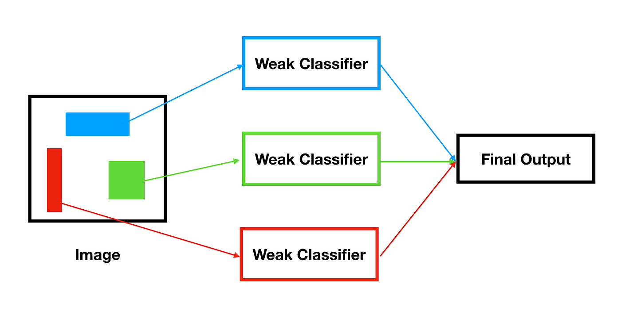
The extracted features are passed through a trained classifier which detects the faces from the objects.
These detected faces are cropped and passed through the recognition module which by applying correlation to the cropped images and the images in the databases recognizes the faces.

Slide 8
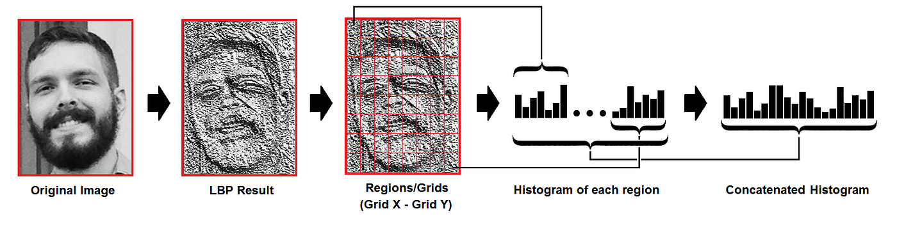
Local Binary Pattern Histogram (LBPH)
Local Binary Pattern Histogram (LBPH) is a face recognition algorithm that uses a texture operator called Local Binary Pattern (LBP) to label image pixels.
LBP labels pixels by thresholding the neighborhood of each pixel and considering the result as a binary number.
LBPH is known for its performance and is one of the easier face recognition algorithms.

Slide 9
Building Blocks of Face Recognition
Imagine neural networks as virtual artists who study faces and learn how to tell them apart.
Python and deep learning help these artists become face experts.
Neural networks are like puzzle solvers that study faces piece by piece.
Python and deep learning guide them to recognize familiar faces.

Slide 10
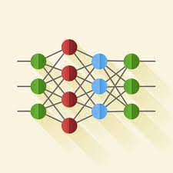
Creating digital face fingerprints – that's what neural networks do.
With Python and deep learning, they learn to identify unique facial patterns.
Neural networks are the secret behind face recognition.
With the help of Python and deep learning, they become experts in identifying faces accurately.

Slide 11
Face Detection with OpenCV
Imagine if your computer could instantly spot faces in pictures. OpenCV makes this possible by using a special technique called Haar Cascade classifier.
The algorithm works by sliding a sub-window over an image and extracting a set of features for each sub-window using Haar wavelets.
It tries to calculate features for every window and classify positive and negative.
The classifier then uses the vector of features to predict whether the sub-window contains a face.

Slide 12
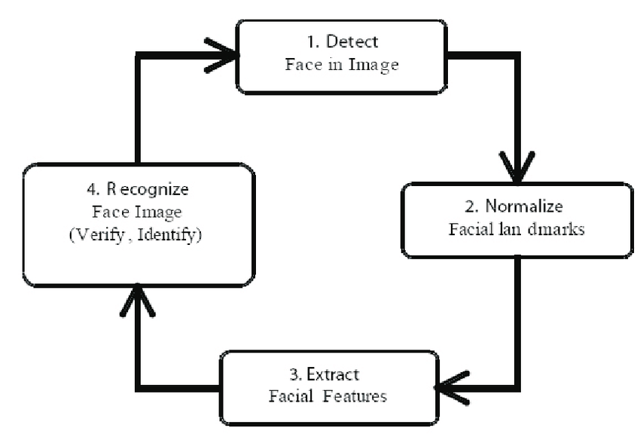
Face Recognition Process
Face recognition is like putting together a puzzle. First, we create a special face template. Then, we compare this template with real faces to see if they match.

Slide 13
Let's break down how face recognition works: first, we make a kind of map of your face, which we call a template. Then, we compare this map with real faces to see if they're the same.
Think of face recognition as solving a mystery.
We start by making a unique face ID, and then we compare it with real faces to see if they match.
Face recognition is like a digital detective that first creates a unique face profile.
Then, it looks at real faces and decides if they're a match.

Slide 14
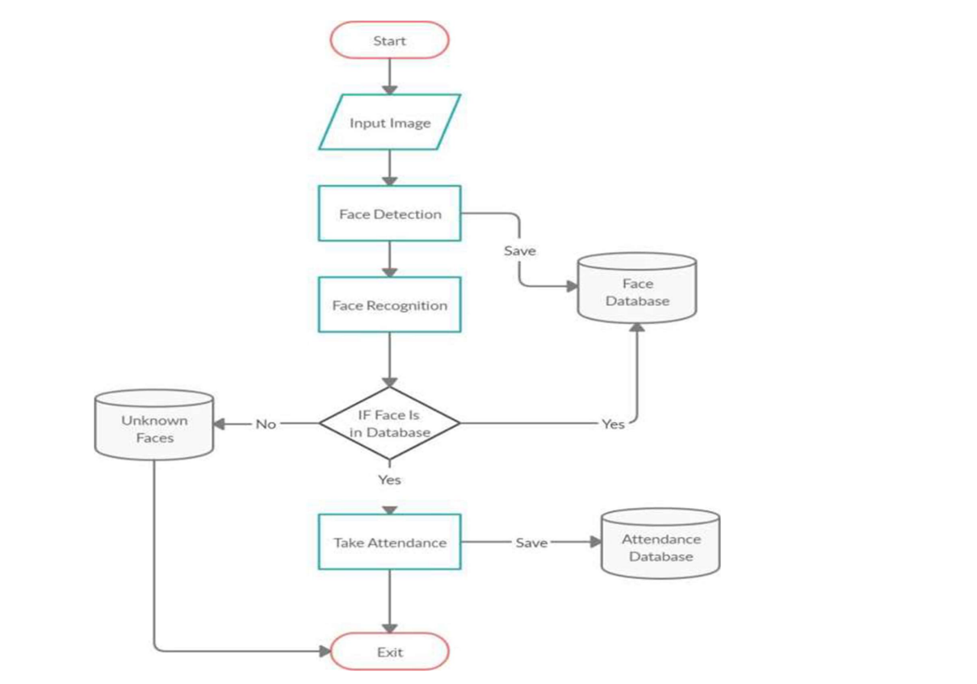
Methodology

Slide 15
Data Collection and Training
Imagine gathering data for face recognition like collecting ingredients for a recipe. We need a variety of high-quality images to train our system.
Building accurate face recognition is like making a delicious dish. We start with quality ingredients – which in this case are high-quality images of faces.
Getting accurate face recognition is a bit like baking a perfect cake. The key ingredient? High-quality images that we use to teach our system.
Achieving accurate face recognition is like crafting a masterpiece. The main ingredient? High-quality images that help us train our system.

Slide 16
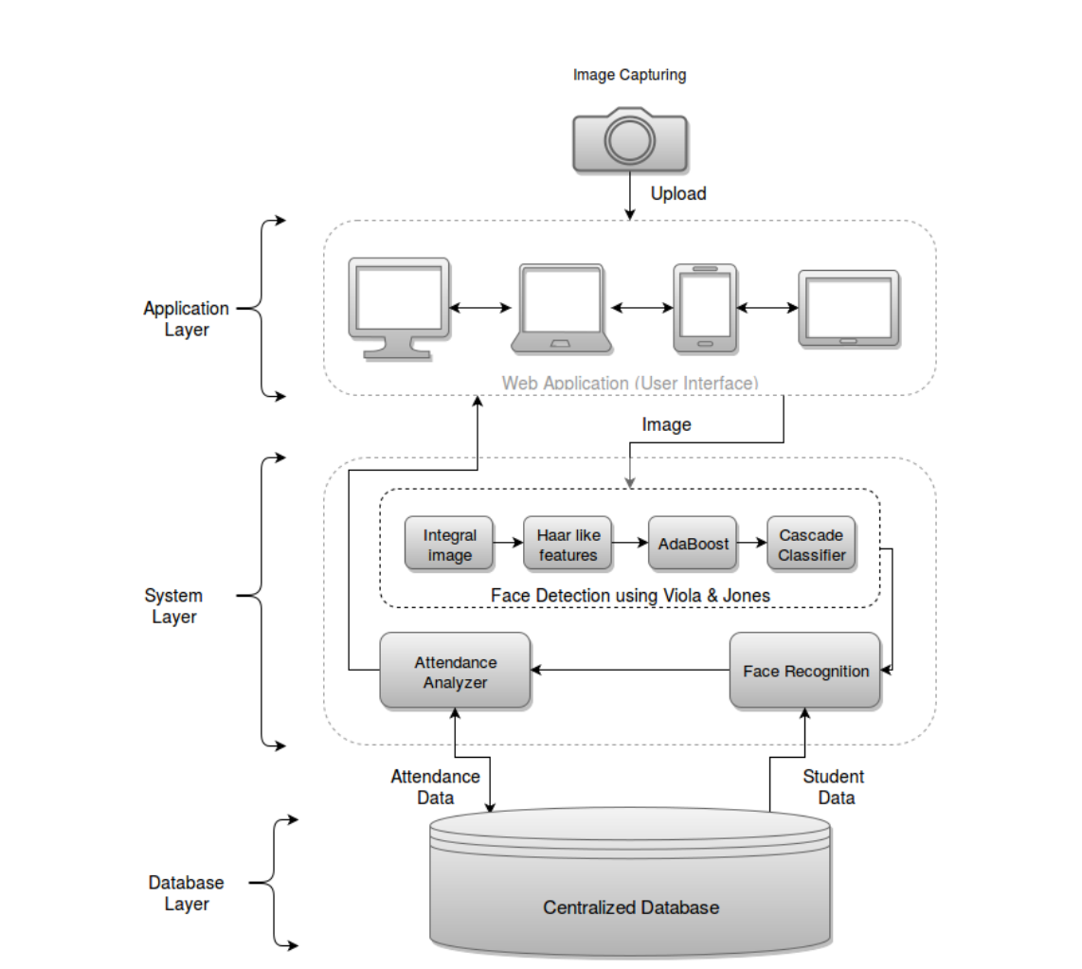
System Architecture

Slide 17
Real-world Implementation
Lets take a look at what we have worked on applying all the technologies we have explained

Slide 18
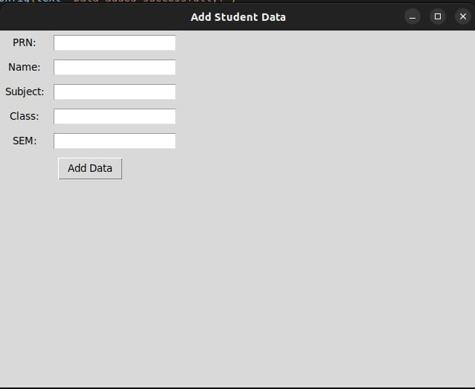
Here we Add the data of the student.

Slide 19
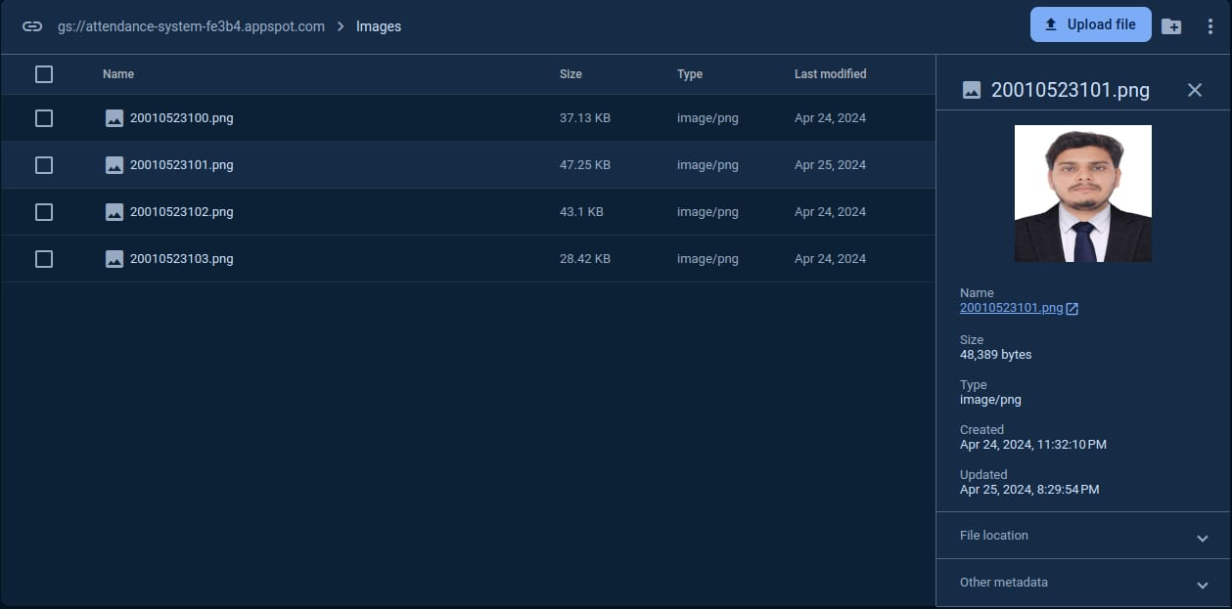
We Upload the picture of the student

Slide 20
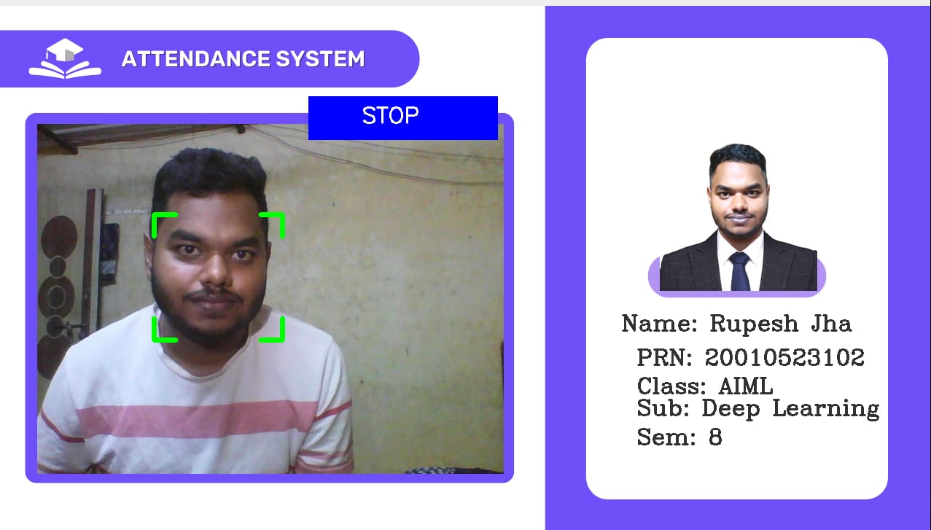
The system then recognizes the student and retrieve their details.

Slide 21
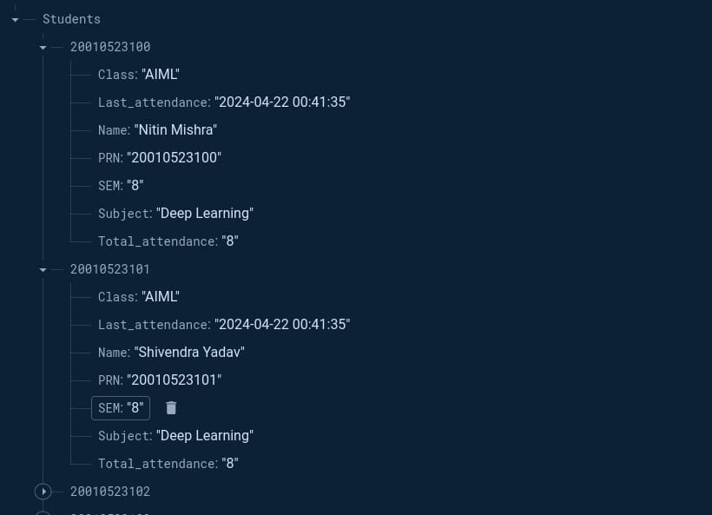
Then a real-time record is kept in the database of the attendance of the student.

Slide 22
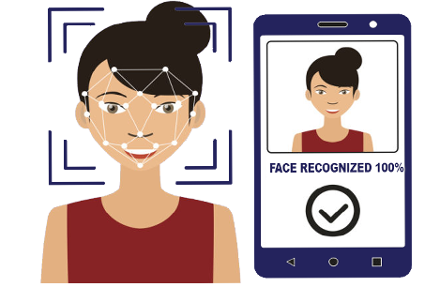
Say goodbye to manual attendance. OpenCV, Python, and deep learning are here to transform the process into a seamless, automated experience.

Slide 23
Outcomes
Accurate Attendance Tracking: The automatic attendance system with face recognition significantly improves the accuracy of attendance tracking by identifying individuals based on their facial features.
Time Efficiency: The system reduces the time spent on manual attendance tracking, allowing more time for teaching or other activities.
Convenience: By automating attendance, the system provides convenience for both students and instructors. Students do not have to remember to sign an attendance sheet, and instructors can quickly access attendance records.
Real-Time Monitoring: The system allows for real-time monitoring of attendance, making it easier to keep track of who is present at any given time..

Slide 24
Conclusion
The final year project on the automatic attendance system with face recognition demonstrates the practical application of modern technology to solve a common administrative challenge.
The project's successful outcomes show that using face recognition for attendance tracking is efficient, accurate, and convenient.
While the system offers numerous benefits, it is important to address potential privacy concerns and ensure compliance with data protection regulations.
Overall, this project highlights the potential of leveraging facial recognition technology in various domains and serves as a strong foundation for further exploration and improvement in similar applications.

Slide 25


