Slide 1
JA DTD 5.2.0 / CEP 1.2.0 / SI DTD 5.2.0
Jos Migchielsen, Rob Schrauwen
Last updated 21 March 2012

Slide 2
5.0.1: 1 July 2004
5.0.2: 1 November 2007
5.1.0: 1 August 2009
5.2.0: 1 January 2013
Rough timelines
  29 February: 5.2.0r1
  21 March: 5.2.0 final
  21 March: first handcrafted sample files
  20 April: first draft updated Tag by Tag
Go-live dates of the Journal Article (JA) DTD
<number><number>

Slide 3
Use the new Common Element Pool 1.2.0
Add PIT for case reports: crp
Added optional copyright-line
Journal Article DTD changes
<number><number>

Slide 4
JA DTD 5.1.0 uses Common Element Pool CEP 1.1.5
CEP 1.2.0 will also pick up all changes made in CEP 1.1.6 for use in the Book DTD 5.3.0:
  Added @role to 20 elements, @view to 12 elements and @id to 8 elements
  Changed ce:glossary-entry and ce:index-entry
  Changed ce:glossary-def
  Made ce:section-title in ce:further-reading, ce:glossary and ce:index optional
From CEP 1.1.5 to 1.2.0 via 1.1.6
<number><number>

Slide 5
We added ce:author-group/ce:text to allow free text in between author names and collaborations
<ce:author-group>
<ce:author>...</ce:author>
<ce:text>on behalf of the</ce:text>
<ce:collaboration>
<ce:text>Colorectal Cancer Annual
Consensus Meeting Group</ce:text>
</ce:collaboration>
<ce:affiliation>...</ce:affiliation>
</ce:author-group>
From CEP 1.1.5 to 1.2.0 via 1.1.6 (cont’d)
Text between author names
<number><number>

Slide 6
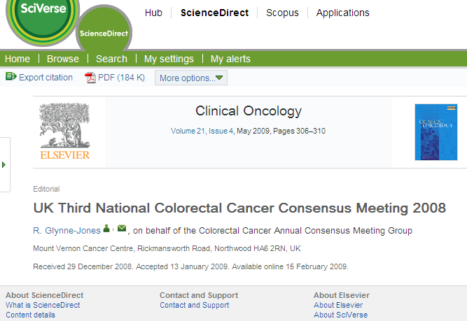
Text between author names
In this article (live on SD), “on behalf of” is made part of the collaboration name
<number><number>

Slide 7
Support for ORCID author IDs
Support for names in alternative scripts
Ability to capture members of a collaboration
Abstract classes for research highlights and SDAs
Structured affiliations
Modifications in structured bibliographic references
Other miscellaneous changes
Overview of what’s new in CEP 1.2.0
<number><number>

Slide 8
Author identifier, see Wikipedia
New attribute orcid to ce:author, sb:author and sb:editor
<!ATTLIST ce:author
%common-link.att;
%common-role.att;
orcid CDATA #IMPLIED
author-id CDATA #IMPLIED
biographyid IDREF #IMPLIED>
New in CEP 1.2.0
ORCID
<number><number>

Slide 9
In journals with many Chinese authors, names in Chinese are added between parentheses
To support this, we added ce:alt-name as subelement to ce:author, sb:author and sb:editor
<!ENTITY % name "( ( ce:given-name, ce:surname ) | ( ce:surname, ce:given-name? ) ), ce:suffix?, ce:alt-name*" >
<!ELEMENT ce:alt-name ( %richstring.data; )* >
New in CEP 1.2.0
Alternative name (1/2)
<number><number>

Slide 10
<ce:author-group>
<ce:author>
<ce:surname>Jin</ce:surname>
<ce:given-name>Chao</ce:given-name>
<ce:alt-name>&#x9773; &#x8D85;</ce:alt-name>
</ce:author>
<ce:author>
<ce:surname>Zheng</ce:surname>
<ce:given-name>Weimin</ce:given-name>
<ce:alt-name>&#x90D1;&#x7EAC;&#x6C11;</ce:alt-name>
</ce:author>
...
</ce:author-group>
New in CEP 1.2.0
Alternative name (2/2)
<number><number>

Slide 11
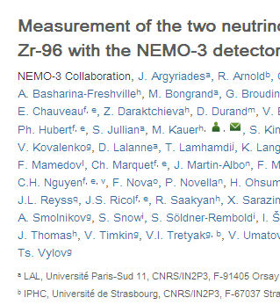
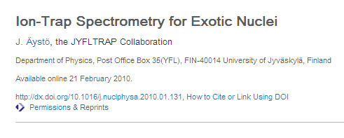
New in CEP 1.2.0
Collaboration members (1/4)
In this article, the members of the NEMO-3 collaboration are also listed as authors
And here the members are not listed as authors at all (perhaps unstructured as a footnote or in an appendix).
<number><number>

Slide 12
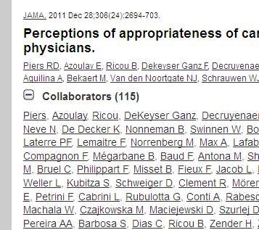
New in CEP 1.2.0
Collaboration members (2/4)
However, Pubmed/Medline insists that members of a collaboration are tagged as group members.
This is what it looks like if group members are tagged (from another Publisher): the collaborators can be expanded and collapsed
<number><number>

Slide 13
To support group members (and more), and motivated by Outlook distribution lists, we added optional/multiple ce:author-group to ce:collaboration .
At the same time we added optional/multiple ce:e-address
<!ELEMENT ce:collaboration
( ce:indexed-name?, ce:text,
(%cross-ref;)*, ce:collab-aff?,
ce:e-address*, ce:author-group* )>
New in CEP 1.2.0
Collaboration members (3/4)
<number><number>

Slide 14
<ce:collaboration>
<ce:text>NEMO-3 Collaboration</ce:text>
<ce:author-group>
<ce:author><ce:given-name>J.</ce:given-name>
<ce:surname>Argyiades</ce:surname>
<ce:cross-ref refid="aff1">...</ce:cross-ref>
</ce:author>
<ce:author><ce:given-name>R.</ce:given-name>
<ce:surname>Arnold</ce:surname>...</ce:author>
...
<ce:affiliation id="aff1"><ce:label>a</ce:label>
<ce:textfn>LAL, ...</textfn></ce:affiliation>
...
</ce:author-group>
</ce:collaboration>
New in CEP 1.2.0
Collaboration members (4/4)
<number><number>

Slide 15
New abstract classes sda, author-highlights and editor-highlights
<ce:abstract class="author-highlights">
<ce:section-title>Highlights</ce:section-title>
<ce:abstract-sec>
<ce:simple-para>
<ce:list>
<ce:list-item><ce:para>MODIS hotspot is corrected
by POLDER-3 hotspot.</ce:para></ce:list-item>
<ce:list-item><ce:para>The global clumping index
map is derived at 500 m resolution.</ce:para>
</ce:list-item><ce:list-item><ce:para>The clumping index
map is validated by 38 TRAC ground
measurements.</ce:para></ce:list-item>
</ce:list>
</ce:simple-para>
</ce:abstract-sec
</ce:abstract>
New in CEP 1.2.0
Research highlights, structured digital abstracts
<number><number>

Slide 16
In order to ease transformation to Opsbank / Scopus records adhering to the A&I DTD we added sa:affiliation
The element is optional only for backward compatibility
<!ELEMENT ce:affiliation
( ce:label?, ce:textfn, sa:affiliation? )>
<ce:affiliation>
<ce:textfn>University of Exeter Business School,
Streatham Court, Streatham Campus, University of
Exeter, Exeter EX4 4ST, Devon, UK</ce:textfn>
<sa:affiliation>
<sa:organization>University of Exeter Business
School</sa:organization>
New in CEP 1.2.0
Structured affiliations (1/2)
<number><number>

Slide 17
<sa:address-line>Streatham Court</sa:address-line>
<sa:address-line>Streatham
Campus</sa:address-line>
<sa:address-line>University of
Exeter</sa:address-line>
<sa:city>Exeter</sa:city>
<sa:state>Devon</sa:state>
<sa:postal-code>EX4 4ST</sa:postal-code>
<sa:country>UK</sa:country>
</sa:affiliation>
</ce:affiliation>
New in CEP 1.2.0
Structured affiliations (1/2)
<number><number>

Slide 18
To decrease the number of ce:other-refs, a few changes will be made to structured references:
sb:book will receive an attribute indicating the type of book, e.g. class="report"
Titles of serials will be made optional
Pagination will be added to book chapters
New in CEP 1.2.0
Changes to structured bibliographic references
<number><number>

Slide 19
Add attribute @id to 20 elements, including ce:title, ce:author-group and ce:keyword
Add attribute @role to ce:abstract-sec
Copyright type free-of-copyright
Add full copyright line (to be used verbatim) as in BK DTD
<!ENTITY % copyright
"ce:copyright, ce:copyright-line?" >
Add optional ce:displayed-quote/ce:source
Add ce:keywords to ce:figure, ce:e-component, ce:table and ce:textbox
New in CEP 1.2.0
Miscellaneous changes
<number><number>

Slide 20
Catch up with latest common element pool: use CEP 1.2.0
Used %iso639; for serial-issue/@xml:lang
Add ID attribute to title-editors-group and attribute group-id to issue-sec enabling matching items to special issues
New in SI DTD 5.2
Serial issue DTD changes
<number><number>

Slide 21
%common-lang;
Add ce:author-group/ce:bracket; instead we will use ce:author-group/@role
Figure maps
Add ce:received/@time (XSD dateTime format)
Add ce:date-online
Sentence tagging
Support for computer code
  We will add a new role for ce:list instead (needs implementation nevertheless!)
MathML 3
Changes that didn’t make it (1/2)
<number><number>

Slide 22
E-only subfigures
Add support for Facebook, LinkedIn, etc., URIs; instead we use ce:e-address with type="url" and adapt TbT
Merge simple-article and book-review
ce:uri
cme: document topics are not a workaround but the real solution
Changes that didn’t make it (2/2)
<number><number>

Slide 23
Project manager: Marc Price (m.price@elsevier.com)
DTD team contact: Jos Migchielsen (j.migchielsen@elsevier.com)
Implementation
<number><number>

