Slide 1
JA DTD 5.2.0 / CEP 1.2.0 / SI DTD 5.2.0
Jos Migchielsen, Rob Schrauwen
Last updated 21 March 2012

Slide 2
Go-live dates of the Journal Article (JA) DTD
5.0.1: 1 July 2004
5.0.2: 1 November 2007
5.1.0: 1 August 2009
5.2.0: 1 January 2013
Rough timelines
29 February: 5.2.0r1
21 March: 5.2.0 final
21 March: first handcrafted sample files
20 April: first draft updated Tag by Tag

Slide 3
Journal Article DTD changes
Use the new Common Element Pool 1.2.0
Add PIT for case reports: crp
Added optional copyright-line

Slide 4
From CEP 1.1.5 to 1.2.0 via 1.1.6
JA DTD 5.1.0 uses Common Element Pool CEP 1.1.5
CEP 1.2.0 will also pick up all changes made in CEP 1.1.6 for use in the Book DTD 5.3.0:
Added @role to 20 elements, @view to 12 elements and @id to 8 elements
Changed ce:glossary-entry and ce:index-entry
Changed ce:glossary-def
Made ce:section-title in ce:further-reading, ce:glossary and ce:index optional

Slide 5
Text between author names
From CEP 1.1.5 to 1.2.0 via 1.1.6 (cont’d)
We added ce:author-group/ce:text to allow free text in between author names and collaborations
<ce:author-group>
<ce:author>...</ce:author>
<ce:text>on behalf of the</ce:text>
<ce:collaboration>
<ce:text>Colorectal Cancer Annual
Consensus Meeting Group</ce:text>
</ce:collaboration>
<ce:affiliation>...</ce:affiliation>
</ce:author-group>

Slide 6
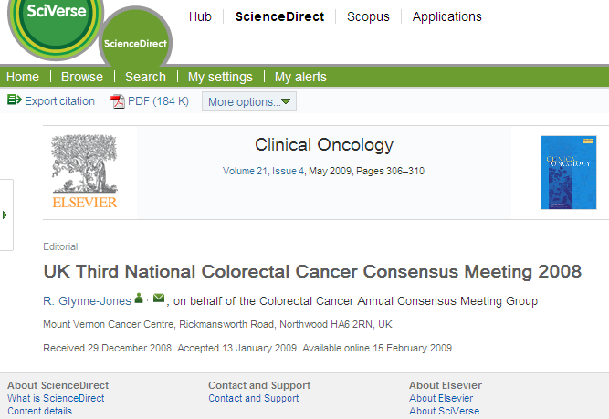
Text between author names
In this article (live on SD), “on behalf of” is made part of the collaboration name

Slide 7
Overview of what’s new in CEP 1.2.0
Support for ORCID author IDs
Support for names in alternative scripts
Ability to capture members of a collaboration
Abstract classes for research highlights and SDAs
Structured affiliations
Modifications in structured bibliographic references
Other miscellaneous changes

Slide 8
ORCID
New in CEP 1.2.0
Author identifier, see Wikipedia
New attribute orcid to ce:author, sb:author and sb:editor
<!ATTLIST ce:author %common-link.att; %common-role.att; orcid CDATA #IMPLIED author-id CDATA #IMPLIED biographyid IDREF #IMPLIED>

Slide 9
Alternative name (1/2)
New in CEP 1.2.0
In journals with many Chinese authors, names in Chinese are added between parentheses
To support this, we added ce:alt-name as subelement to ce:author, sb:author and sb:editor
<!ENTITY % name "( ( ce:given-name, ce:surname ) | ( ce:surname, ce:given-name? ) ), ce:suffix?, ce:alt-name*" >
<!ELEMENT ce:alt-name ( %richstring.data; )* >

Slide 10
Alternative name (2/2)
New in CEP 1.2.0
<ce:author-group>
<ce:author>
<ce:surname>Jin</ce:surname>
<ce:given-name>Chao</ce:given-name>
<ce:alt-name>&#x9773; &#x8D85;</ce:alt-name>
</ce:author>
<ce:author>
<ce:surname>Zheng</ce:surname>
<ce:given-name>Weimin</ce:given-name>
<ce:alt-name>&#x90D1;&#x7EAC;&#x6C11;</ce:alt-name>
</ce:author>
...
</ce:author-group>

Slide 11
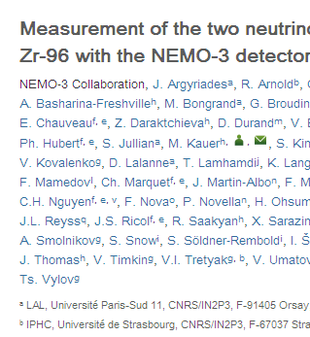
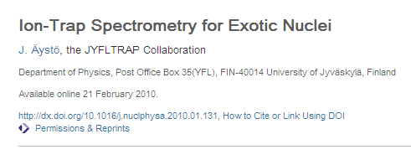
Collaboration members (1/4)
New in CEP 1.2.0
In this article, the members of the NEMO-3 collaboration are also listed as authors
And here the members are not listed as authors at all (perhaps unstructured as a footnote or in an appendix).

Slide 12
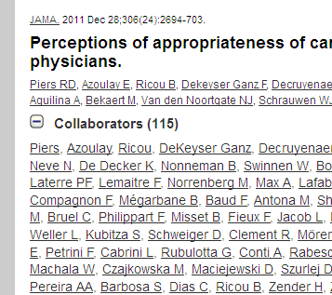
Collaboration members (2/4)
New in CEP 1.2.0
However, Pubmed/Medline insists that members of a collaboration are tagged as group members.
This is what it looks like if group members are tagged (from another Publisher): the collaborators can be expanded and collapsed

Slide 13
Collaboration members (3/4)
New in CEP 1.2.0
To support group members (and more), and motivated by Outlook distribution lists, we added optional/multiple ce:author-group to ce:collaboration .
At the same time we added optional/multiple ce:e-address
<!ELEMENT ce:collaboration
( ce:indexed-name?, ce:text,
(%cross-ref;)*, ce:collab-aff?,
ce:e-address*, ce:author-group* )>

Slide 14
Collaboration members (4/4)
New in CEP 1.2.0
<ce:collaboration>
<ce:text>NEMO-3 Collaboration</ce:text>
<ce:author-group>
<ce:author><ce:given-name>J.</ce:given-name>
<ce:surname>Argyiades</ce:surname>
<ce:cross-ref refid="aff1">...</ce:cross-ref>
</ce:author>
<ce:author><ce:given-name>R.</ce:given-name>
<ce:surname>Arnold</ce:surname>...</ce:author>
...
<ce:affiliation id="aff1"><ce:label>a</ce:label>
<ce:textfn>LAL, ...</textfn></ce:affiliation>
...
</ce:author-group>
</ce:collaboration>

Slide 15
Research highlights, structured digital abstracts
New in CEP 1.2.0
New abstract classes sda, author-highlights and editor-highlights
<ce:abstract class="author-highlights">
<ce:section-title>Highlights</ce:section-title>
<ce:abstract-sec>
<ce:simple-para>
<ce:list>
<ce:list-item><ce:para>MODIS hotspot is corrected
by POLDER-3 hotspot.</ce:para></ce:list-item>
<ce:list-item><ce:para>The global clumping index
map is derived at 500 m resolution.</ce:para>
</ce:list-item><ce:list-item><ce:para>The clumping index
map is validated by 38 TRAC ground
measurements.</ce:para></ce:list-item>
</ce:list>
</ce:simple-para>
</ce:abstract-sec
</ce:abstract>

Slide 16
Structured affiliations (1/2)
New in CEP 1.2.0
In order to ease transformation to Opsbank / Scopus records adhering to the A&I DTD we added sa:affiliation
The element is optional only for backward compatibility
<!ELEMENT ce:affiliation
( ce:label?, ce:textfn, sa:affiliation? )>
<ce:affiliation>
<ce:textfn>University of Exeter Business School,
Streatham Court, Streatham Campus, University of
Exeter, Exeter EX4 4ST, Devon, UK</ce:textfn>
<sa:affiliation>
<sa:organization>University of Exeter Business
School</sa:organization>

Slide 17
Structured affiliations (1/2)
New in CEP 1.2.0
<sa:address-line>Streatham Court</sa:address-line>
<sa:address-line>Streatham
Campus</sa:address-line>
<sa:address-line>University of
Exeter</sa:address-line>
<sa:city>Exeter</sa:city>
<sa:state>Devon</sa:state>
<sa:postal-code>EX4 4ST</sa:postal-code>
<sa:country>UK</sa:country>
</sa:affiliation>
</ce:affiliation>

Slide 18
Changes to structured bibliographic references
New in CEP 1.2.0
To decrease the number of ce:other-refs, a few changes will be made to structured references:
sb:book will receive an attribute indicating the type of book, e.g. class="report"
Titles of serials will be made optional
Pagination will be added to book chapters

Slide 19
Miscellaneous changes
New in CEP 1.2.0
Add attribute @id to 20 elements, including ce:title, ce:author-group and ce:keyword
Add attribute @role to ce:abstract-sec
Copyright type free-of-copyright
Add full copyright line (to be used verbatim) as in BK DTD
<!ENTITY % copyright
"ce:copyright, ce:copyright-line?" >
Add optional ce:displayed-quote/ce:source
Add ce:keywords to ce:figure, ce:e-component, ce:table and ce:textbox

Slide 20
Serial issue DTD changes
New in SI DTD 5.2
Catch up with latest common element pool: use CEP 1.2.0
Used %iso639; for serial-issue/@xml:lang
Add ID attribute to title-editors-group and attribute group-id to issue-sec enabling matching items to special issues

Slide 21
Changes that didn’t make it (1/2)
%common-lang;
Add ce:author-group/ce:bracket; instead we will use ce:author-group/@role
Figure maps
Add ce:received/@time (XSD dateTime format)
Add ce:date-online
Sentence tagging
Support for computer code
We will add a new role for ce:list instead (needs implementation nevertheless!)
MathML 3

Slide 22
Changes that didn’t make it (2/2)
E-only subfigures
Add support for Facebook, LinkedIn, etc., URIs; instead we use ce:e-address with type="url" and adapt TbT
Merge simple-article and book-review
ce:uri
cme: document topics are not a workaround but the real solution

Slide 23
Implementation
Project manager: Marc Price (m.price@elsevier.com)
DTD team contact: Jos Migchielsen (j.migchielsen@elsevier.com)

