Slide 1


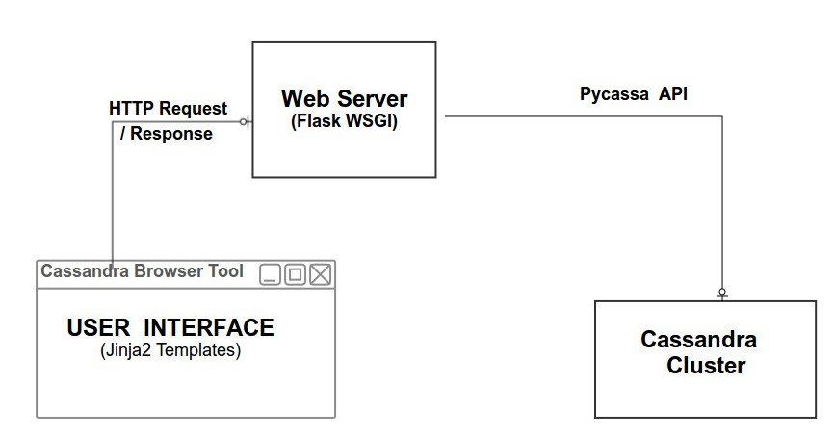
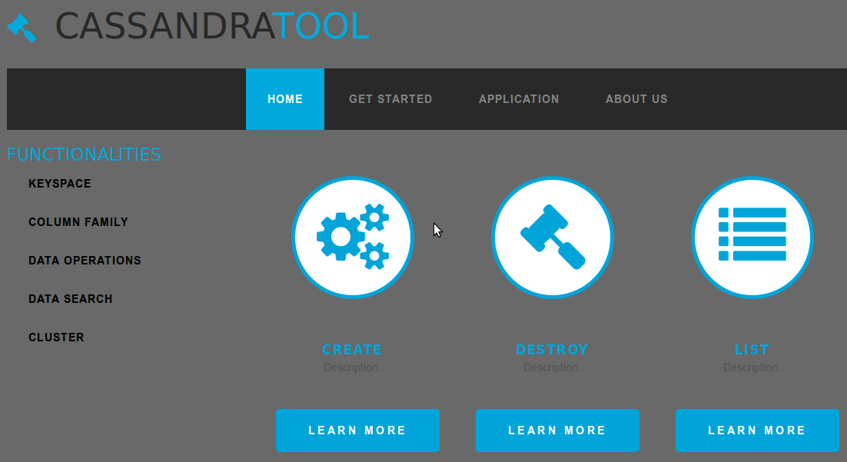

  Cassandra Browser Tool
Nitin Agarwal, Prajit Patil, Pushyami, Srikanth
Overview
Building a Cassandra Browser Tool using Python which provides User Interface to access data from the Cassandra Server.
Approach
*Understanding of Cassandra Architecture and its working.
*Operating on Cassandra Database using Pycassa (Python API).
*Implementing each functionality using Python modules.
*Generating Jinja2 templates using the results of above modules.
Functionalities
*Keyspace Operations
  Create, Drop and Retrieve information about Keyspaces.
*Column Family Operations
  Create, Index, Drop and Get Description about a Column Family.
*Rows and Columns Operations
  Insert, Delete, Alter and Retrieve information about Rows and Columns.
*Managing Cluster
  View details such as Clusters, Machine added to cluster and Load on each machine.
Application
*Web based Application so that user can easily access using Browser remotely.
*Allowing the user to work with Cassandra database efficiently and without any prior knowledge of CQL.
Architecture
Frontend Module
  Layout of our Application includes
        Dashboard : Display of all the Functionalities.
        Data Model : Attributes related to Keyspace, Column Family and Cluster.
        Data View : Information about Keyspace, Indexes, Column Family and Cluster.
*Intermediate Module
- Generating Jinja2 templates based on the results from our backend module.
- Use of Flask (based on WSGI) to communicate Frontend with the Backend module and vice-versa.
*Backend Module
- Configuring Cassandra Cluster.
- Use of Pycassa (Python API) to operate on Cassandra Database.
User Interface
Challenges
*Managing of Cassandra Server on different Clusters.
*Displaying huge database due to over-allocation of
memory in Cassandra server.
*Dynamically adding a machine without any downtime of Cluster.
Conclusion
*Web based Application so that user can easily operate on Cassandra Database.
*User can work with Cassandra without any prior knowledge of Cassandra Query Language.
Future Work
Implementing User Level Security over Cassandra Database using Authentication.
Allowing the user to export a database of other kind into Cassandra.
Link to Source Code : https://github.com/CloudProjectWork/CassandraBrowserTool

