Slide 1
Presentation on :
HIRE HELPER
Group no : 15
RAKSHANDA MESHRAM - 210543181075
SAKSHI TEKADE - 210543181087 NITIN DANGE - 210543181020 PRANAV CHAVAN - 210543181016
PROJECT MEMBER :

Slide 2

Presentation outline
Introduction
Objective
Modules
Flow of project
Advantage

Slide 3
INTRODUCTION
In this busy lifestyle its very difficult to find out service provider professionals
We have come up with the solution to this problem in our project HIRE HELPER.
Online service have become a increasingly powerful in recent year.
Our project motivation is to provide online services like driver booking , househelp booking, worker booking.Number of extra features included in this application have opened the doors to a wide
Range of doorstep service

Slide 4
Objective of the project
The prime objective of “ Helper Hire” is to provide genuine and verified doorstep service to customer.
Hire Helper is to go a step further and enable users to find and hire the right professional for all their needs
cutomers can go ahead and book a service on the site, and the professional will show up on time.
Our challenge is to stay as true to our vision and make sure quality is not compromised with growth.

Slide 5
Modules
Admin Account : Admin login.
Admin can check , update and
delete the data.
Customer: customer can book the service after the login.
Employee: Employee can register themselves on the site. And further verification will done by admin.

Slide 6
Used Technologies
For front-end : We have use ReactJS framework model for Front-end
For back-end : We have use Spring-boot for backend.
Database : For database we have used of MYSQL.

Slide 7
Flow of project
Admin Login :
Admin login page enable the admin to view, update and delete the details of employees and users such as name, age, profession, charge etc.
User Login:
User can book the professionals after the completion of registration.
Employee : Employee can register themself in the module. They have to
Fill data to register on service page. After the registration the user can see
Employee data on service page.

Slide 8
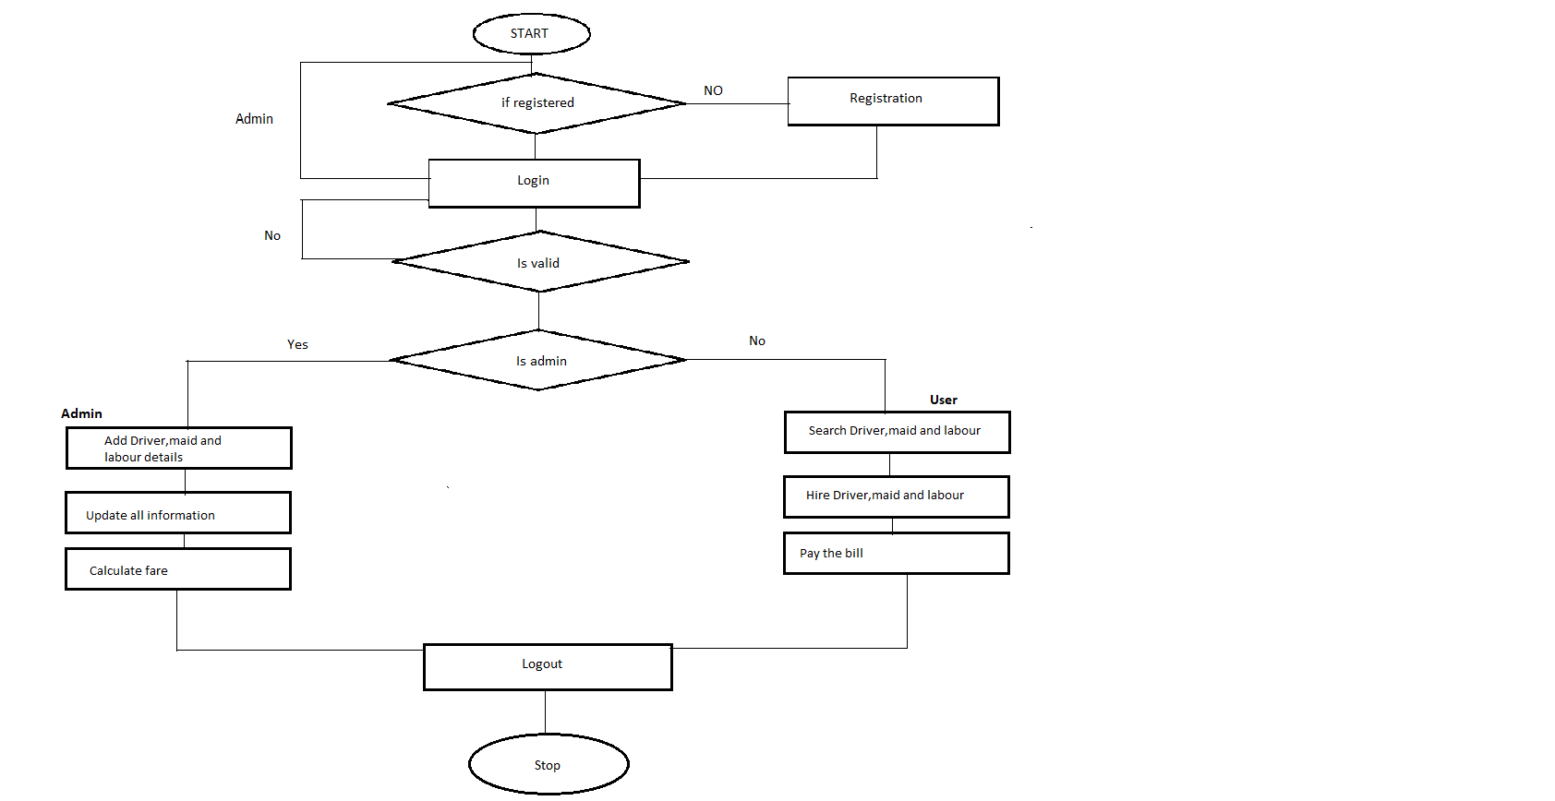
Flowchart

Slide 9
Advantage
A tech platform with a lot of data in their bag to leverage. By looking at the historical data of Driver, Househelp and worker.
Its extremely easy navigation helps users the right service they're looking for, besides prompting them to explore further.
It good internal business communications along with the
Helper Hire , there is every professional are trained and verify.
It create a employment in society as well provide good service to needed customer.

Slide 10
Database Tables
Table : Employee
Columns:
Id int AI PK
address varchar(255)
econtact varchar(255)
eemail varchar(255)
egender varchar(255)
elname varchar(255)
emname varchar(255)
ename varchar(255)
password varchar(255)
rate varchar(255)
role varchar(10)
username varchar(20)
yr_exp varchar(255)

Slide 11
Table : User
Table : booking
Columns:
Id int AI PK
address varchar(20)
contact varchar(20)
email varchar(20)
gender varchar(20)
lname varchar(20)
mname varchar(20)
fname varchar(20)
password varchar(20)
role varchar(10)
username varchar(20)

Slide 12
Table : booking
Columns:
Id int AI PK
address varchar(255)
city varchar(255)
email varchar(255)
cont_num varchar(255)
end_date varchar(255)
lname varchar(255)
fname varchar(255)
start_date varchar(255)
employee_id int
user_id int

Slide 13
Table : admin
Columns:
Id int AI PK
password varchar(20)
role varchar(10)
username varchar(20)

Slide 14
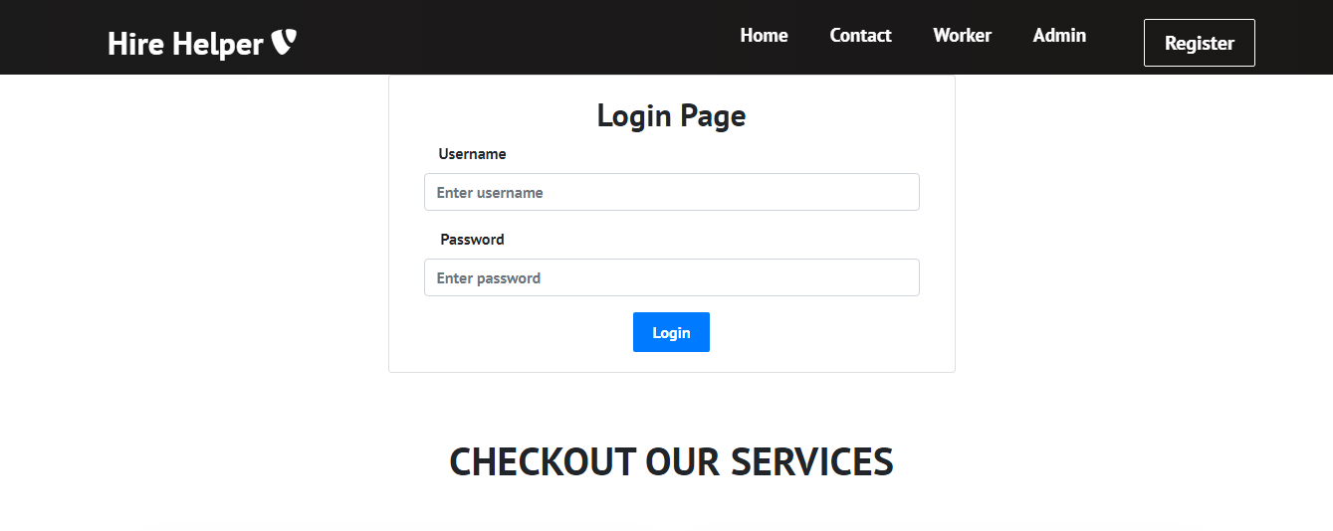
This is how look site
Login page

Slide 15
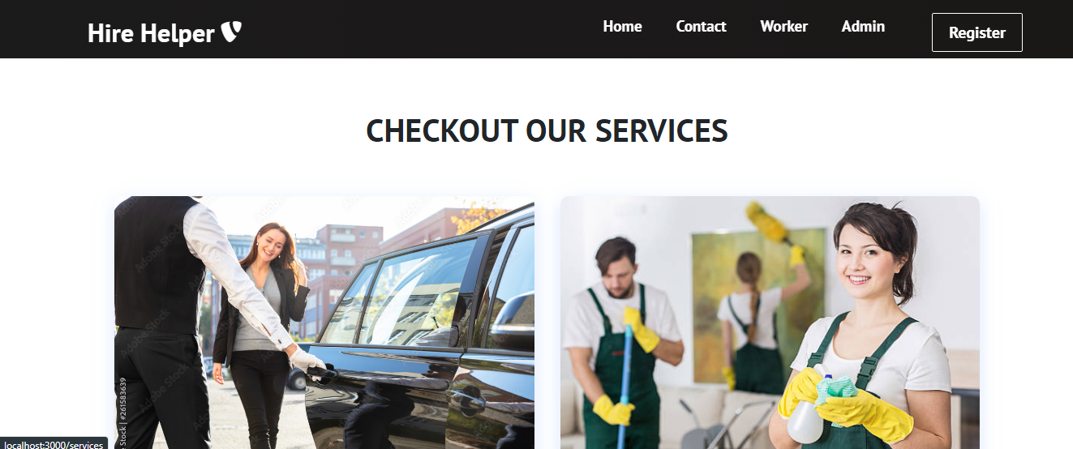
Services Page

Slide 16
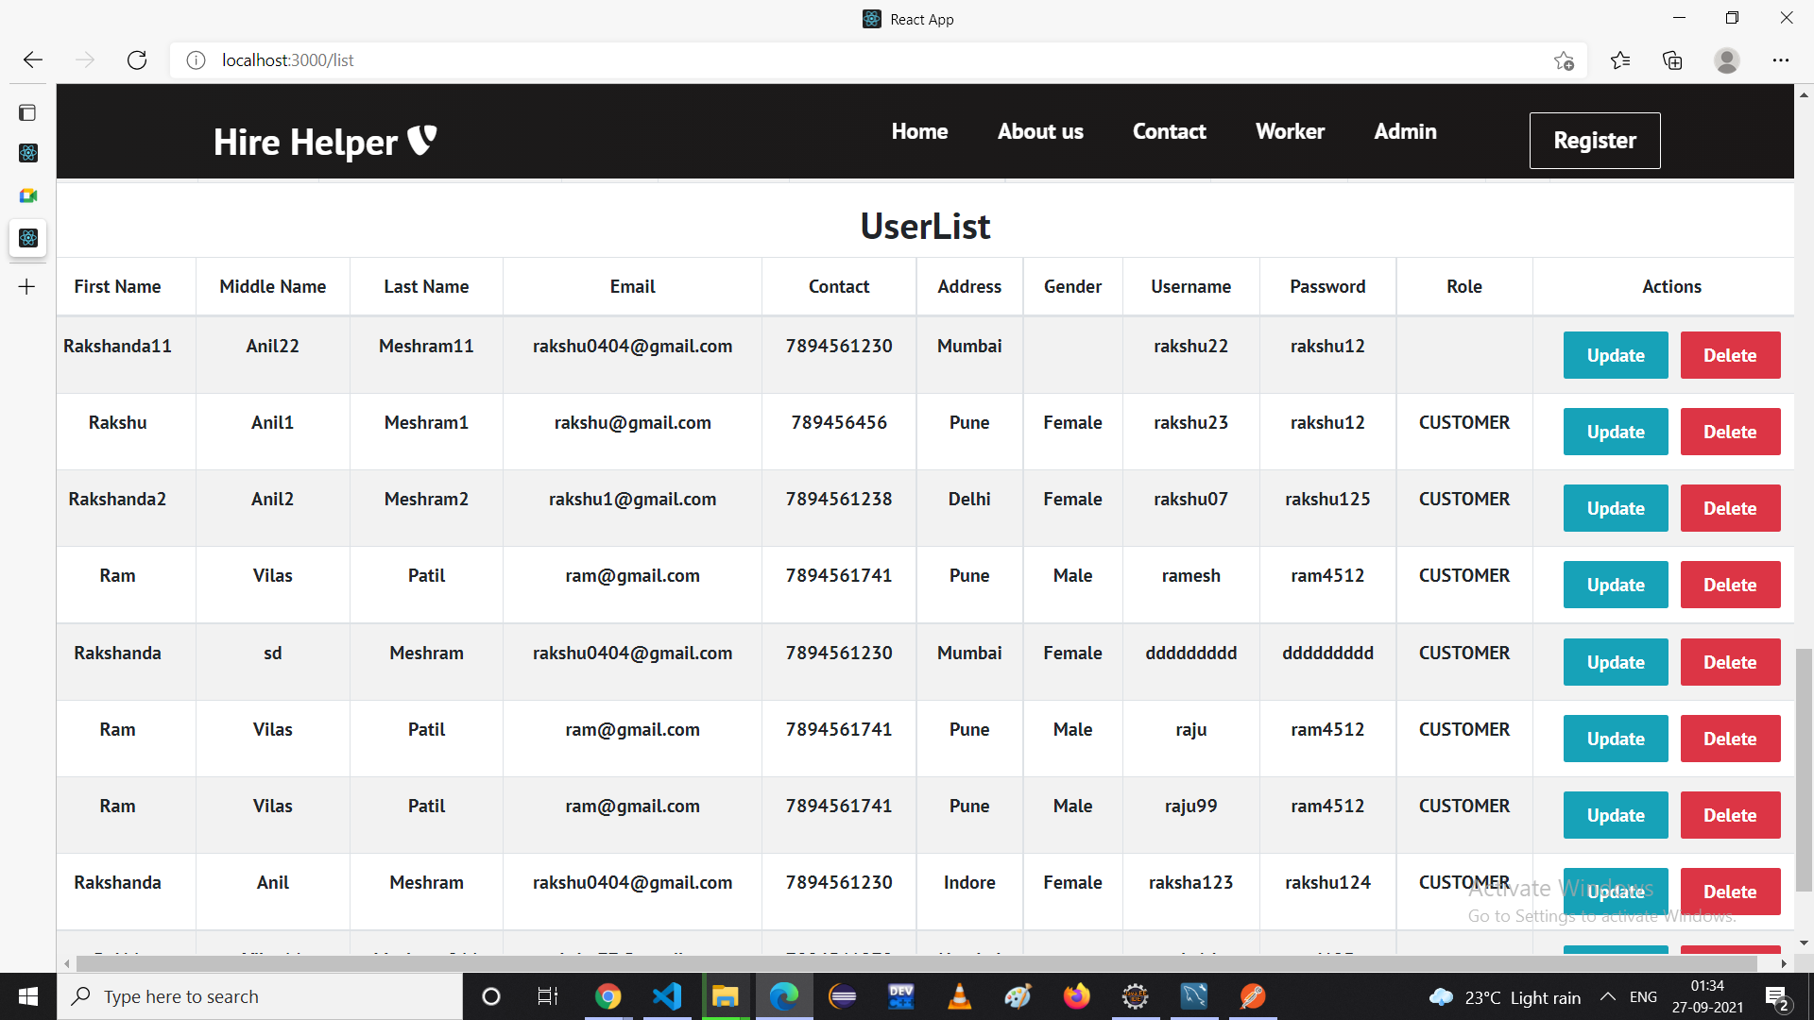
User list data

Slide 17
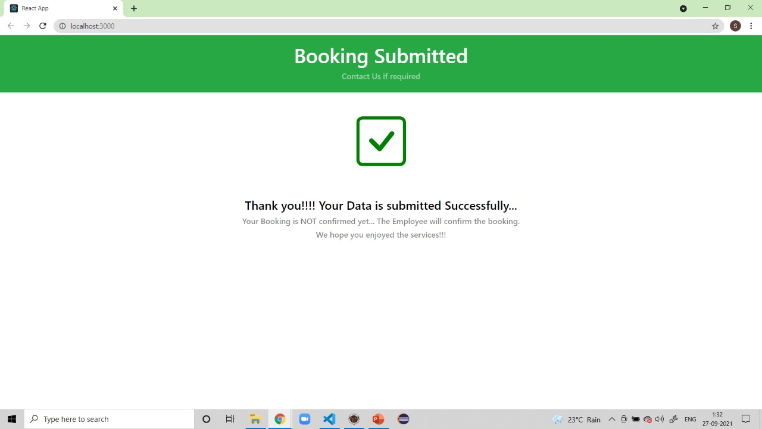

Slide 18
Future Scope
Adaption of different online payment using gateway.
Develop centralized system to back up user translation. If people lost their ID or Password then user can claim there wallet balance to retrieve.
In future we thinking to expand our idea in ruler areas.
We can develop a android based application for the customers.
Right now all rights are in hands of admin , in future we trying to make site userfriendly.

Slide 19
THANK YOU

