Slide 1

Project Title :
“Continuous User Verification for Online Exam Proctoring
based on Machine Learning and Deep learning”
Project By Group No: 10
Mr. Nitin Dange
Mr. Yash Hure
Mr. Hemant Mhapadi
Project Guide
Mrs. Priyanka Kale

Slide 2
Introduction
increase in all over the world for education purpose.
Exams are a critical component of any educational program. In any exam, there is a possibility of cheating, and therefore, its detection and prevention are important.
Today internet become reality and usage of this become very much popular and there is tremendous increase in all over the world for education purpose.
The e-Examination System comprises of Question Sets effectively blended with a whole set of Features. Using different features of the e-Examination System an administrator and coordinator can set an exam name, select an exam, and assign questions for exam.
The e-Examination System is easy to use, full-featured and flexible Testing, Examination web portal.

Slide 3
Problem Statement
The title of this project is “Continuous user verification for online exam proctoring using Machine Learning and Deep Learning”. It is an online proctoring system which helps organisations, test- takers and various others professional to assess individuals for any specific reason without actual presence of a physical proctor. It can also be used for distance learning and assessment as it is not required for the candidate to be physically present at the assessment centre.

Slide 4
Sr.no | Literature | Methodology
1. | A Deep Learning approach for face detection using YOLO. | YOLO framework for detecting objects.
2. | Automated online exam proctoring. | User verification, speech detection, active window detection, phone detection.
3. | Gaze tracking system using structure sensor and zoom camera. | Gaze tracking, face and eye detection.
4. | Online examination system with cheating prevention using question bank randomization and tab locking. | Royce model for preparation, development, validation, modification and evaluation.
5. | An intelligent system for online proctor monitoring. | Time duration for face disappearance action.

Slide 5
Proposed systems
Proposed System is web-based application use to organize online examinations using automated proctor system.
Proposed system works on Deep learning and Computer Vision which enables us to monitor test virtual. Online examination, Face detection, eye detection, speech recognition , user friendly screen are the features of the system.
This system is useful in conducting online exam, monitoring it virtually, and generating the report cards.
It has application in company drives in various colleges campus as well as off-campus, college exams, mini tutorials and many more for educational purpose.

Slide 6
System Architecture
The architecture of the system contains the following:
1.Class Diagram
2.Object Diagram
3.Use Case Diagram
4.Activity Diagrams
5.Data Flow Diagrams
6.Sequence Diagram
7.State Diagram

Slide 7
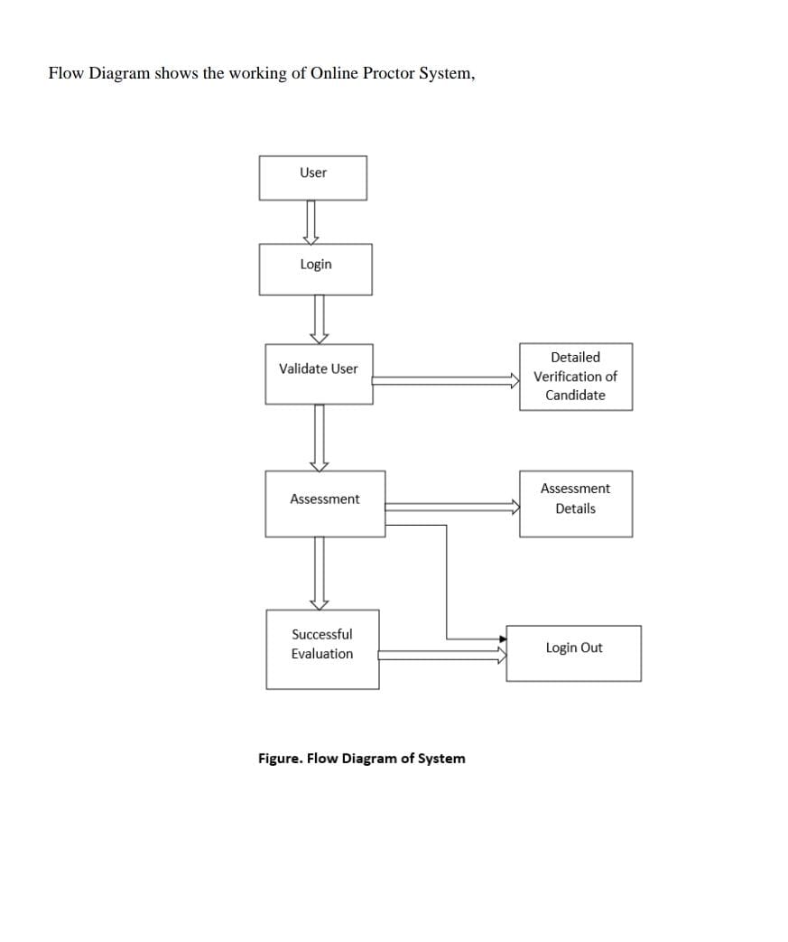
System Architecture

Slide 8
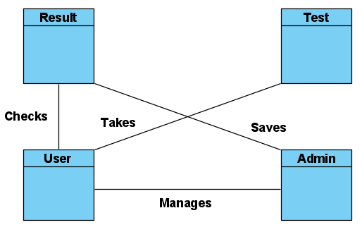
1. Class Diagram :

Slide 9
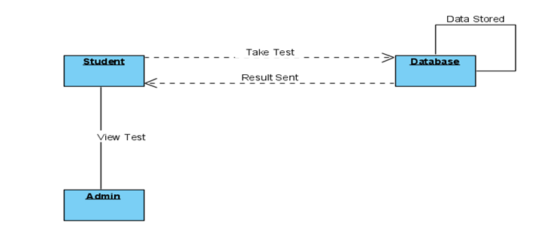
2. Object Diagram :

Slide 10
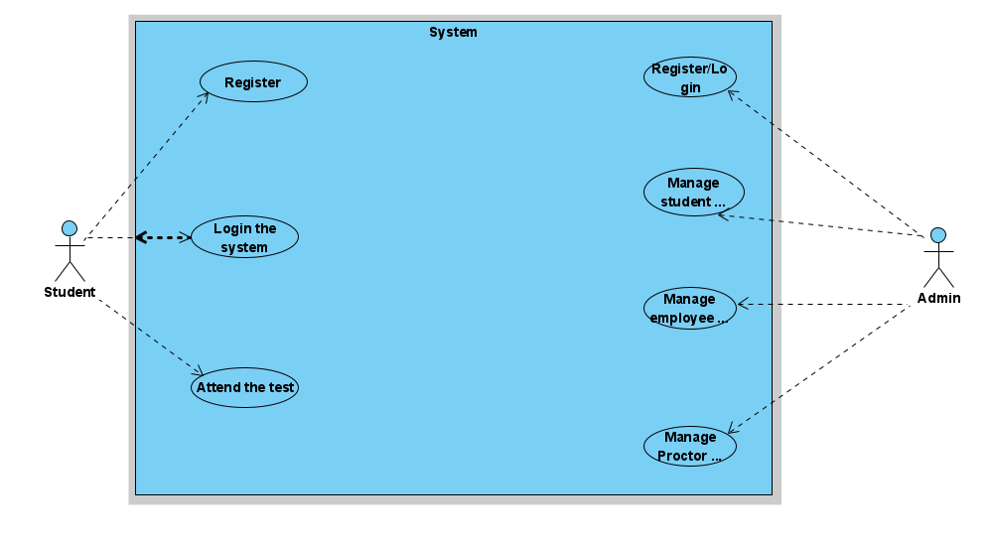
3. Use Case Diagram :

Slide 11
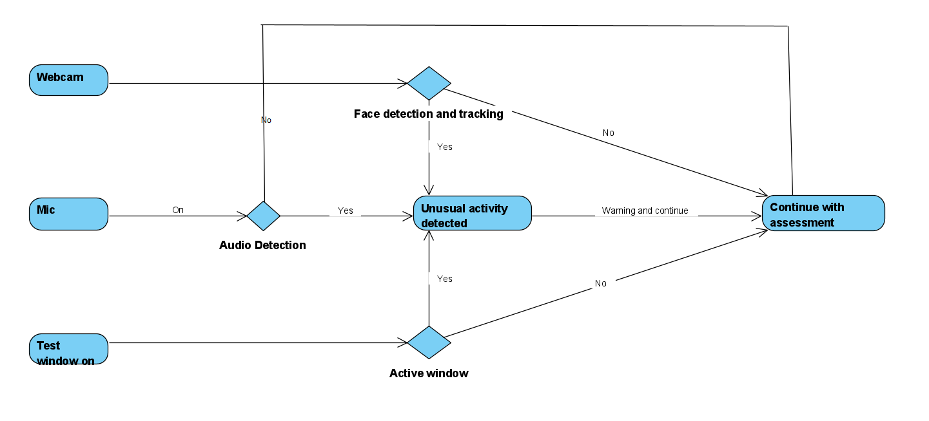
4. Activity Diagrams :
4.1 System Architecture:

Slide 12
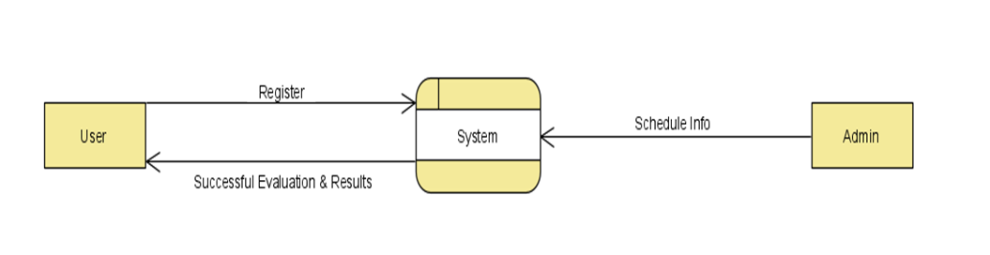
5. Data Flow Diagrams :
5.1 Level 0:

Slide 13
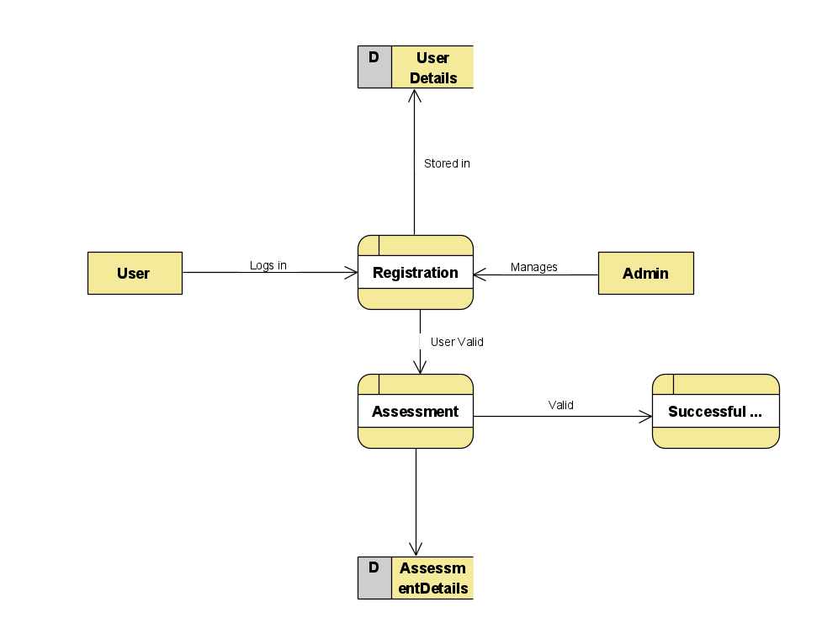
5. Data Flow Diagrams :
5.2 Level 1:

Slide 14
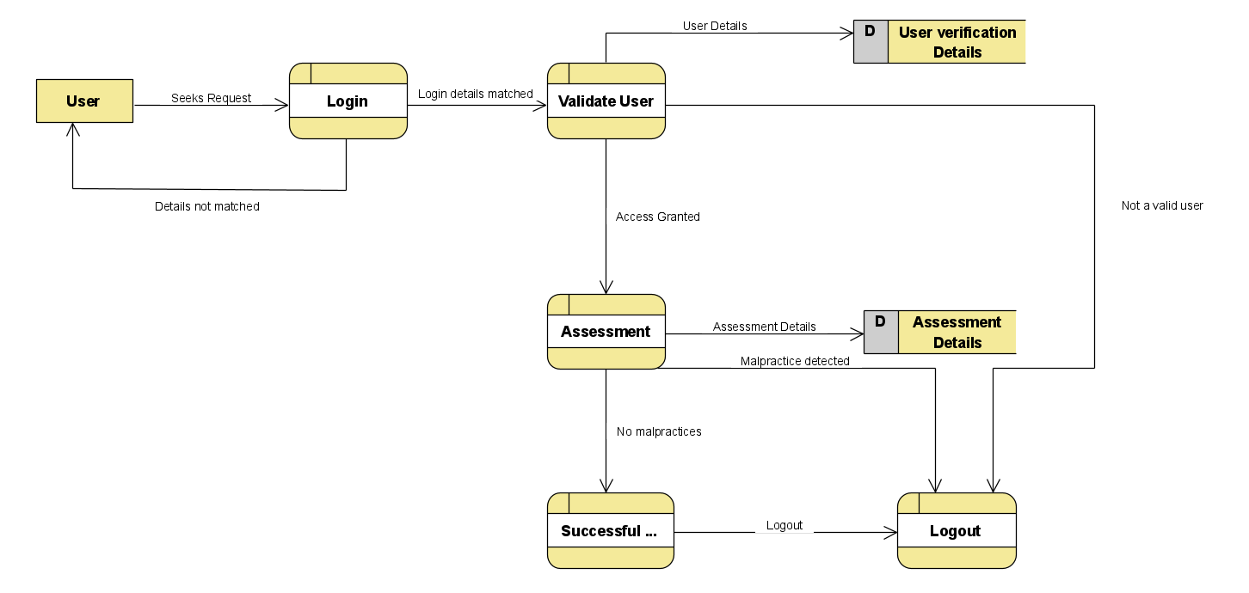
5. Data Flow Diagrams :
5.3 Level 2:

Slide 15
6. Sequence Diagram :
It has two dimensions
1. Vertical Dimension
2. Horizontal Dimension

Slide 16
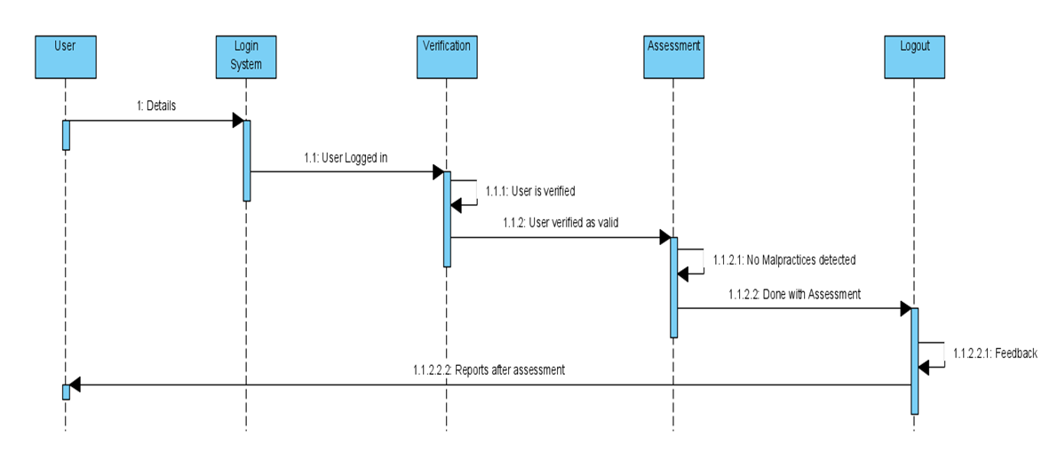

Slide 17
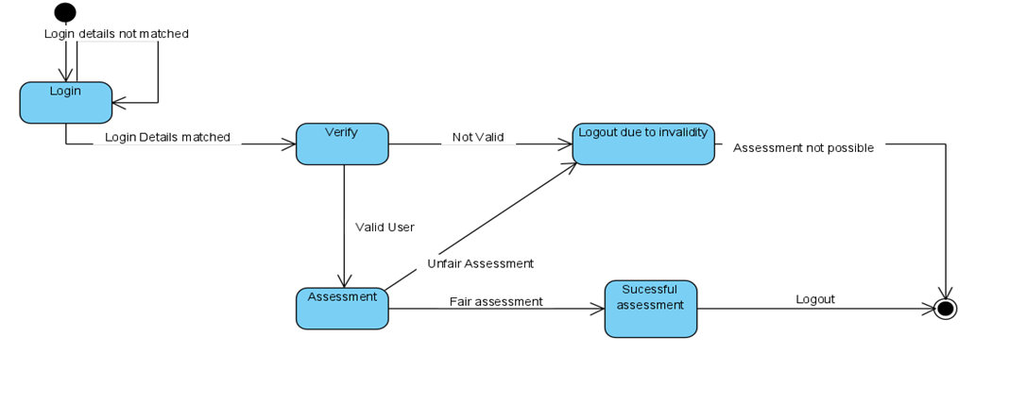
7. State Diagram :

Slide 18
Modules
Based on this methodology, we created iterations of every working module as follows:
1. Login Module (Student and Organization Login):
Here, user enters their login details, which are checked for their occurrence in the database, and upon successful verification, allows the user to access their account.
2. Registration Module:
Based on the user type (student/organization), user enters required info, which is then stored in the database.
3. Examination Module:
This is the most important and complicated module, which required multiple iterations for a properly working module. In this module, students appear for examination, making it the extremely important to find and fix any possible exploits.

Slide 19
Algorithms
The system will have four vision-based capabilities which are combined using multithreading so that they can work together:
1.Eye Tracking
2.Facial Landmark Detection
3.Mouth Detection
4.Person Counting and Mobile Phone Detection

Slide 20
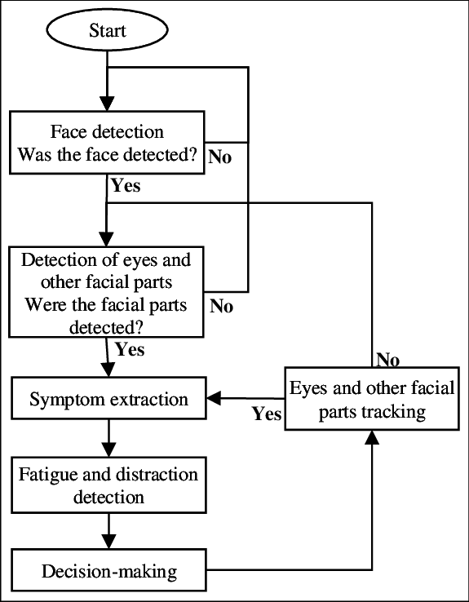
Algorithms

Slide 21
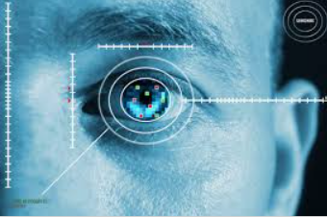
Algorithms
1. Eye Tracker
Data collection by either a remote, head-mounted or VR based ‘eye tracker’ connected to a computer.
Eye trackers generally include two common components: a light source and a camera. The light source (usually infrared) is directed toward the eye.
We shall aim to track the eyeballs of the test-taker and report if he is looking to the left, right, or up which he might do to have a glance at a notebook or signal to someone.
This can be done using D-lib’s facial key-point detector and OpenCV for further image processing.

Slide 22
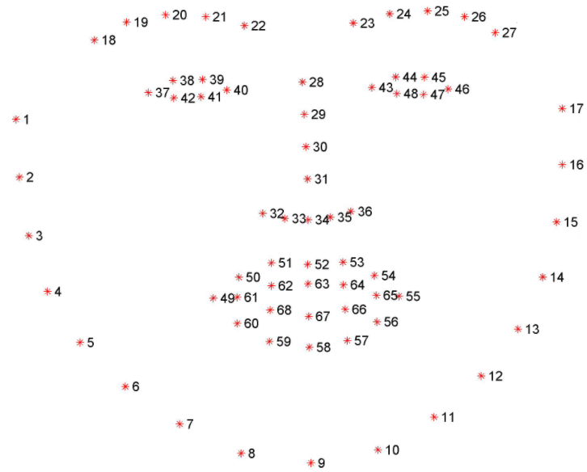
Algorithms
2. Facial Landmark Detection
The facial landmark detector which is pre-trained inside the d-lib library of python for detecting landmarks, is used to estimate the location of 68 points or (x, y) coordinates which map to the facial structures. These indexes of 68 coordinates or points can be easily visualized on the image.
The Locations of the Facial Parts are as follows:
The left eye is accessed with points [42, 48].
The mouth is accessed through points [49, 67].
The left eyebrow is accessed through points [22, 26].
The nose is accessed using points [27, 34].
The right eyebrow is accessed through points [17, 21].
The right eye is accessed using points [36, 41].
And the jaw is accessed via points [0, 16].

Slide 23
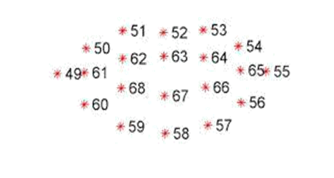
Algorithms
3. Mouth Detection
This is very similar to eye detection. D lib’s facial key-points are again used for this task and the test-taker is required to sit straight (as he would in the test) and the distance between the lips key-points (5 outer pairs and 3 inner pairs) is noted for 100 frames and averaged.
If the user opens his/her mouth the distances between the points increases and if the increase in distance is more than a certain value for at least three outer pairs and two inner pairs then infringement is reported.
The mouth can be accessed through points [49, 68].

Slide 24
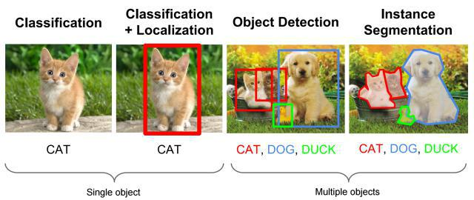
Algorithms
4. Person Counting & Mobile Phone Detection
For this purpose, we are going to use YOLOv3 in tensor-flow using instance segmentation.
Face detection is one of the important tasks of object detection. Typically, detection is the first stage of pattern recognition and identity authentication. In recent years, deep learning-based algorithms in object detection have grown rapidly. These algorithms can be generally divided into two categories, i.e., two-stage detector like Faster R-CNN and one-stage detector like YOLO.
Various face related applications like face verification, facial recognition, clustering of face etc. are a part of face detection. Effective training needs to be carried out for detection and recognition. The accuracy in face detection using the traditional approach did not yield a good result.

Slide 25
Advantages
Physical presence at a given location is absolutely not necessary
No time is spent on evaluation
Results are available instantly
Can be easily accessed 24/7 over the open test period
Can be timed to allow Y minutes to answer X number of questions
Easy Accessibility
Available at a reduced cost.
Accuracy in checking the answer, calculating result.
User friendly.
Secure because of authentication.

Slide 26
Requirements
Hardware :
Desktop with Webcam, Mic, Stable Internet Connectivity
Software:
PyCharm
Database (MongoDB)
Python, Deep Learning Libraries, ML libraries
OpenCV

Slide 27
Conclusion :
This Web Application provides facility to take online e-examination worldwide. It save the time as it allows number of students to give the exam at a time and displays the results of the exam when exam is completed, so no need to wait for the result. It is automatically generated by the server. Administrator &Coordinator has a privilege to create, modify and delete the test papers and its particular questions. User can register to exam system, login and give the exam with his specific id, and can see the results as well.

Slide 28
References
1. Asep Hadian S.G, Yoanes Bandung “A deep learning approach for face detection using YOLO”, published in IEEE conference.
2. Yousof Atoum, Lingping Chen, Alex H, Stephen D.H. Hsu, Xiaoming Liu,” Automated online exam proctoring”, published in IEEE conference.
3.HeeKyung Lee, Hoon Jo,”Gaze tracking system using structure sensor and zoom camera”, published in IEEE conference.
4.Gurlove Singh , Amit Kumar Goel ,”Face Detection and Recognition System using Digital Image Processing”, published in IEEE conference.
5.Samuel S. Chua , Joshuel B. Bondad, Zechariah R. Lumapas, Joven DL. Garcia, ”Online Examination system using question bank randomization and tab locking”, published in IEEE conference.

Slide 29
Thank You

