Slide 1



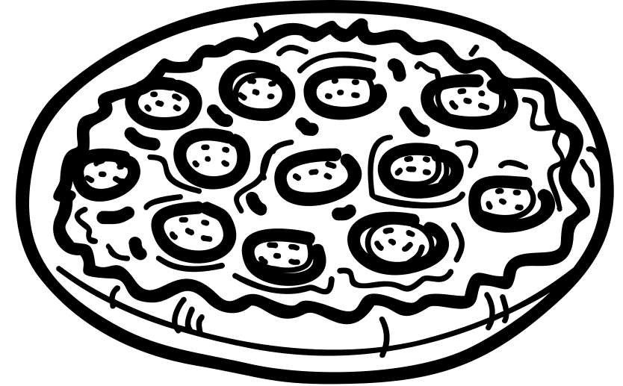


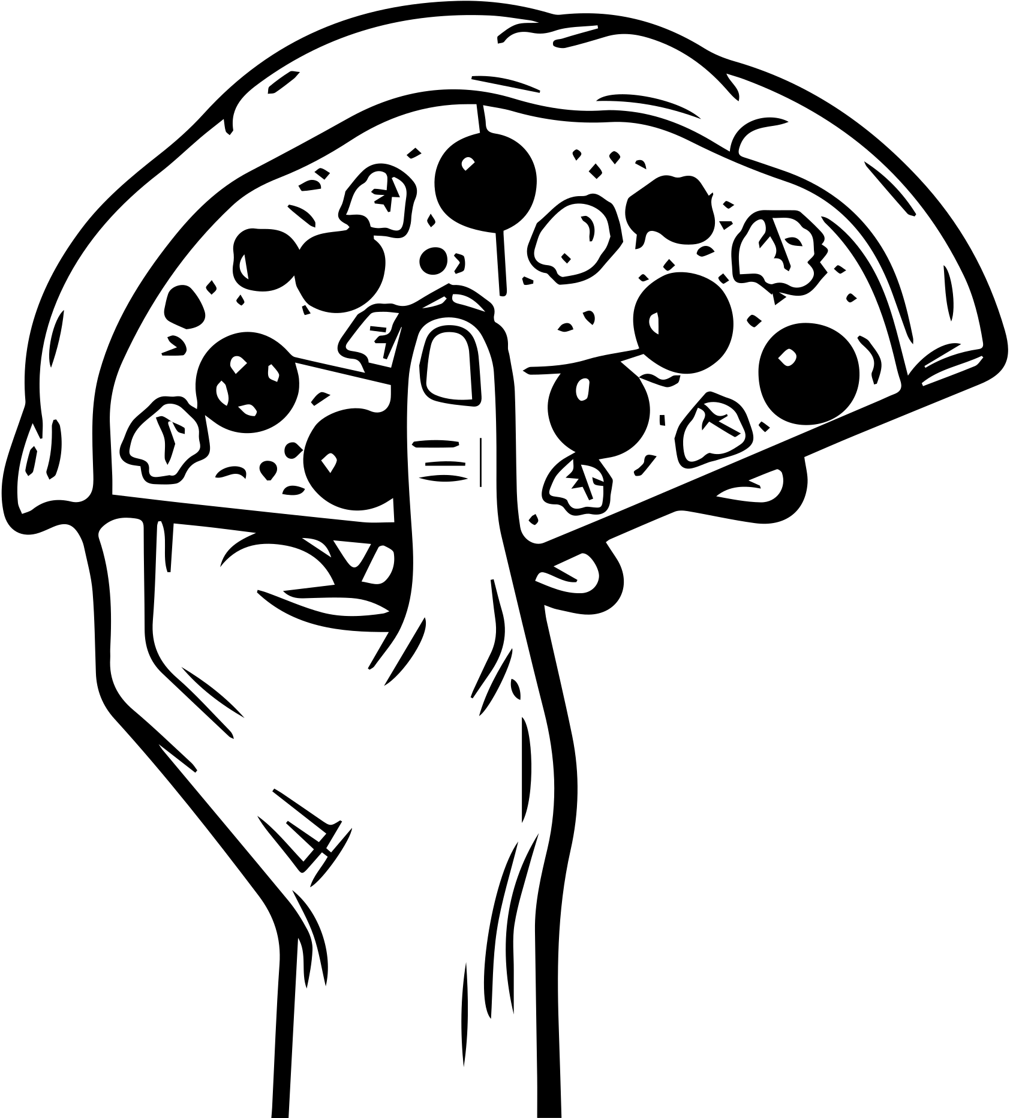
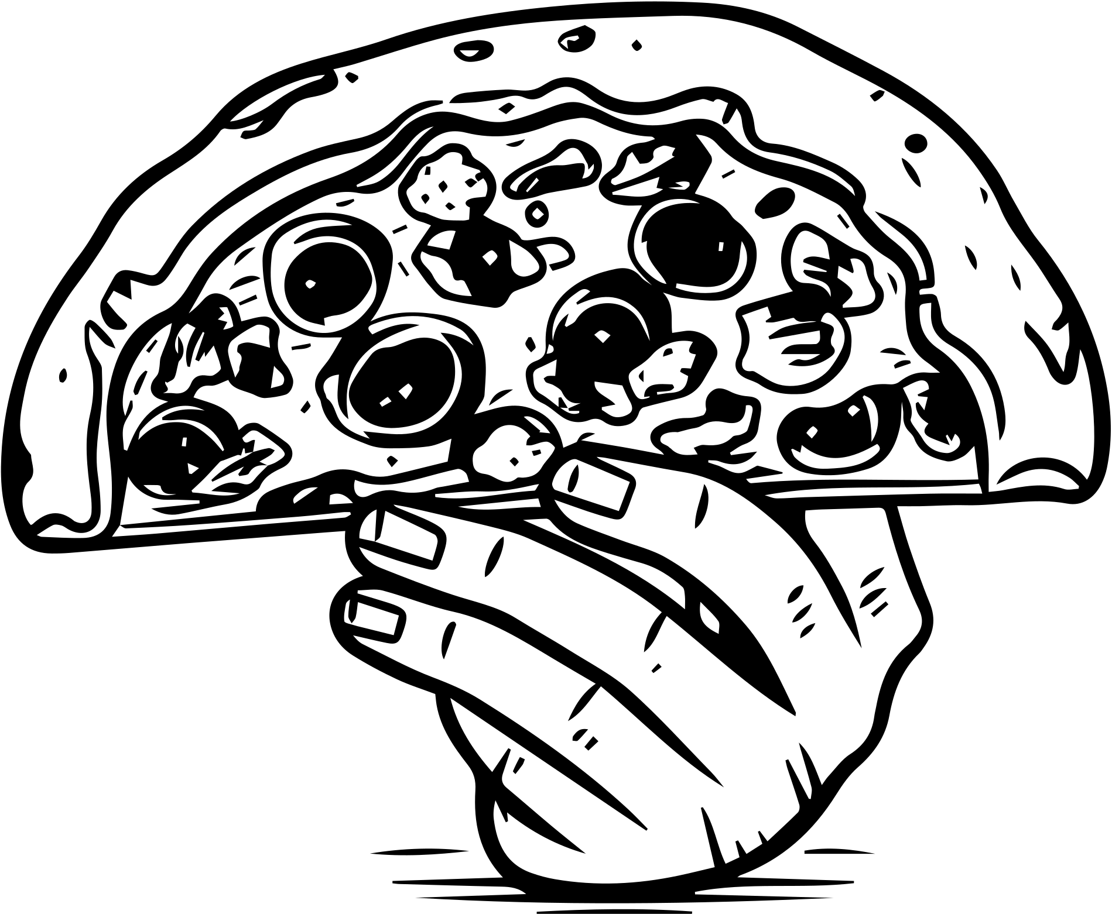
PIZZA MANIA
Hello !
Welcome to my project on SQL-based analysis of pizza sales data.
My name is Nitin Dubey, In this project, I have used SQL queries to answer questions related to pizza sales.
This analysis provides insights into sales trends, customer preferences, and business performance.

Slide 2
PIZZA MANIA
Pizza Sales Database: "pizzamania"
The "pizzamania" database in MySQL is specifically structured to manage pizza sales data. It includes four essential tables: pizzas, orders, order_details, and pizza_types. Each table is designed to capture different aspects of the sales process, providing a complete and detailed view of the data.
Database Structure
pizzas Table
Columns:
pizza_id: A unique identifier for each pizza.
pizza_type_id: Links to the type of pizza.
size: Describes the size of the pizza (small, medium, large).
price: The price of the pizza.

Slide 3
PIZZA MANIA
2. orders Table
Columns:
order_id: A unique identifier for each order.
order_time: The time the order was placed.
order_date: The date the order was placed.
3.order_details Table
Columns:
order_id: Links to the corresponding order.
pizza_id: Links to the specific pizza ordered.
quantity: The number of pizzas ordered.
order_details_id: A unique identifier for each entry in the order details.

Slide 4
PIZZA MANIA
4.pizza_types Table
Columns:
pizza_type_id: A unique identifier for each type of pizza.
name: The name of the pizza type.
category: The category of the pizza (e.g., vegetarian, non-vegetarian).
ingredients: The ingredients used in the pizza.
This well-organized database structure ensures that all aspects of pizza sales are captured efficiently, facilitating easy data access and analysis.

Slide 5
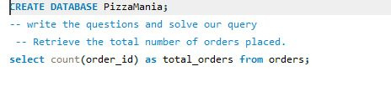

PIZZA MANIA
Retrieve the total number of orders placed.

Slide 6


PIZZA MANIA
Calculate the total revenue generated from pizza sales.

Slide 7
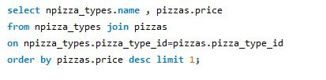
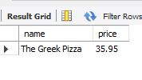
PIZZA MANIA
Identify the highest-priced pizza.

Slide 8
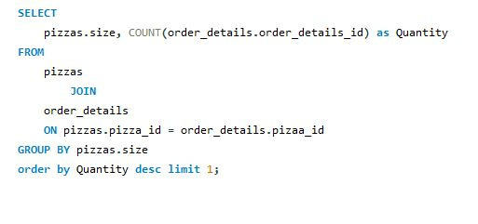

PIZZA MANIA
Identify the most common pizza size ordered.

Slide 9
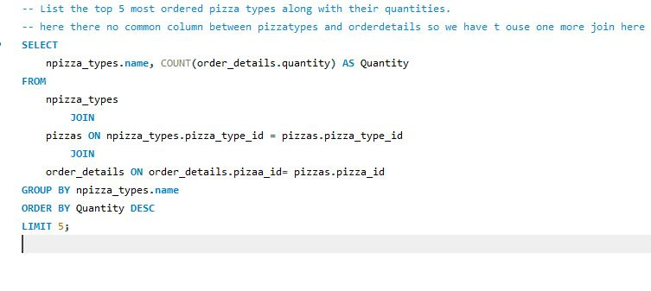
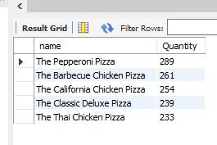
PIZZA MANIA
List the top 5 most ordered pizza types along with their quantities.

Slide 10
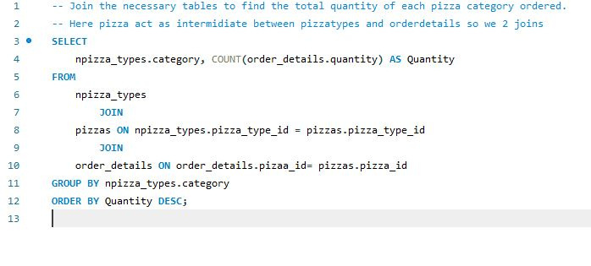
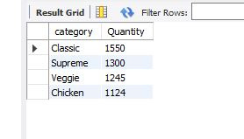
PIZZA MANIA
Join the necessary tables to find the total quantity
of each pizza category ordered.

Slide 11
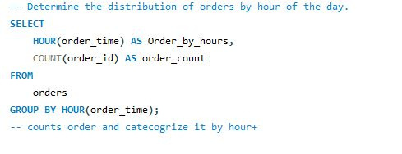
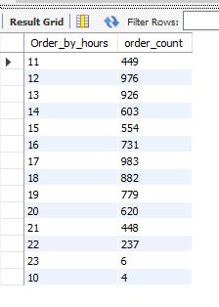
PIZZA MANIA
Determine the distribution of orders by hour of the day.

Slide 12

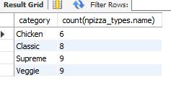
PIZZA MANIA
Join relevant tables to find the category-wise distribution of pizzas.

Slide 13
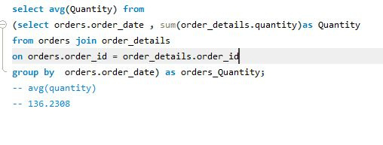

PIZZA MANIA
Group the orders by date and calculate the average number of pizzas ordered per day.

Slide 14
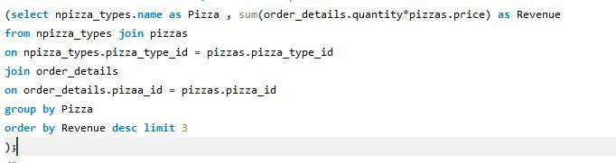
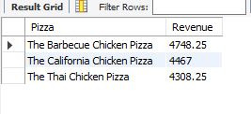
PIZZA MANIA
Determine the top 3 most ordered pizza types based on revenue.

Slide 15
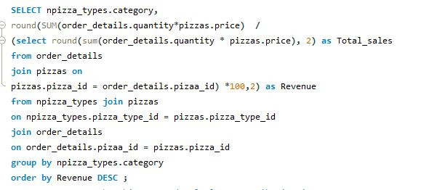
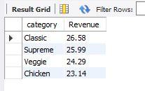
PIZZA MANIA
Calculate the percentage contribution of each pizza type to total revenue.

Slide 16
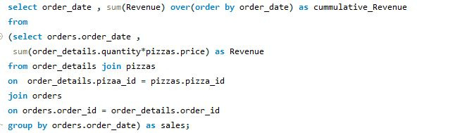
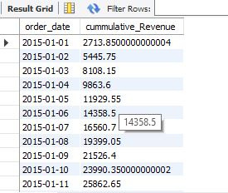
PIZZA MANIA
Analyze the cumulative revenue generated over time.

Slide 17
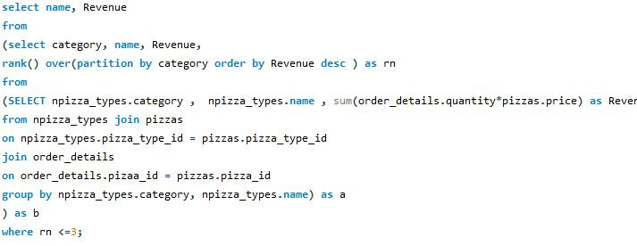
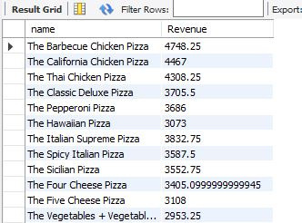
PIZZA MANIA
Determine the top 3 most ordered pizza types based on revenue for each pizza category.

Slide 18
PIZZA MANIA
Thank you
for your time

