Slide 1
Feedback Tool - Identifying Argumentative Essay Elements
Nitin Godi
Supervised by Amir jafari

Slide 2
Introduction
Writing is one of the most important skills that contributes towards a successful career.
According to National Assessment of Educational Progress, more than two-thirds of high school seniors are not proficient writers.
Automated feedback tools help students improve their writing skills.

Slide 3
Problem statement
Most of these tools are proprietary and/or often fail to recognize the writing structures such as thesis statements, support for claims, and so on.
This project aims to train a model that distinguishes essay statements and develop an application that uses this trained model to provide visual feedback.
This resulting application will allow students from all walks of life to enhance their writing skills.

Slide 4
What is an Argumentative essay?
It is a piece of writing that takes a stance on an issue.
The writer attempts to persuade readers to understand and support their point of view about a topic by stating their reasoning and providing evidence to back it up.
An argumentative essay contains four parts: Introductory paragraph, Thesis statement, Body paragraphs, and Conclusion.
There are seven different types of statements that are used in constructing an argumentative essay.

Slide 5
Types of statements in argumentative essay
Lead Statement: - It is the opening statement of an essay or other piece of writing. It begins with a statistic, a quotation, a description, or some other device that captures the reader's attention.
Example: “To majority of teenagers and working adults, the Internet has been regarded as one the most innovative achievements of humankind. Since the invention of the internet, its pervasive and life-altering influences can be felt in many aspects of people’s daily lives.”

Slide 6
Types of statements in argumentative essay
Position Statement: Describes one side of an arguable viewpoint. It is like a thesis statement.
Example: “Despite the negativity associated with the internet, I strongly believe that the Internet does better than harm.”

Slide 7
Types of statements in argumentative essay
Claim Statement: A debatable argument that generally states a fact that is not just an opinion. They usually are specific, assertive, engaging, logical, and provable.
Example: “Communication worldwide has been considerably improved thanks to the Internet.”

Slide 8
Types of statements in argumentative essay
Counter Claim Statement: It is the argument opposing the thesis or position statement.
Example: “On the other hand, objectors of the Internet argue that it spoils the young generation by spreading obscene videos and violence, which is considered rampant nowadays.”

Slide 9
Types of statements in argumentative essay
Evidence Statement: Relevant and verifiable facts, proofs, or examples that support claims, counterclaims, or rebuttals.
Example: “With the widespread availability of messengers and social networks like Yahoo and Facebook, people can easily communicate irrespective of their geographic locations.”

Slide 10
Types of statements in argumentative essay
Rebuttal Statement: It is a contradiction to someone else’s argument. It is an attempt to present reasons and evidence for why the argument is not true.
Example: “There is no doubt that adult websites and violence videos are ubiquitous online, but whether the young are spoilt by it depends on the young themselves.”

Slide 11
Types of statements in argumentative essay
Concluding Statement: Last sentence in a paragraph. It restates the topic sentence non-verbatim and summarizes the main points of the paragraph.
Example: “Similar to any other technological invention, the Internet has both pros and cons; nonetheless, its benefits far outweigh its harms. With recent upgrading of Internet security software and substantial improvements on its use, I am firmly convinced the Internet is more a blessing than a curse.”

Slide 12
Data description
The data is taken from a Kaggle competition named “Feedback Prize – Evaluating Student Writing”.
The data consists of essays written by U.S. students in grades 6 – 12.
These essays were annotated by expert raters for elements commonly found in argumentative writing.
Consists of approximately 15.6 thousand essays having approximately 144 thousand discourse elements.

Slide 13
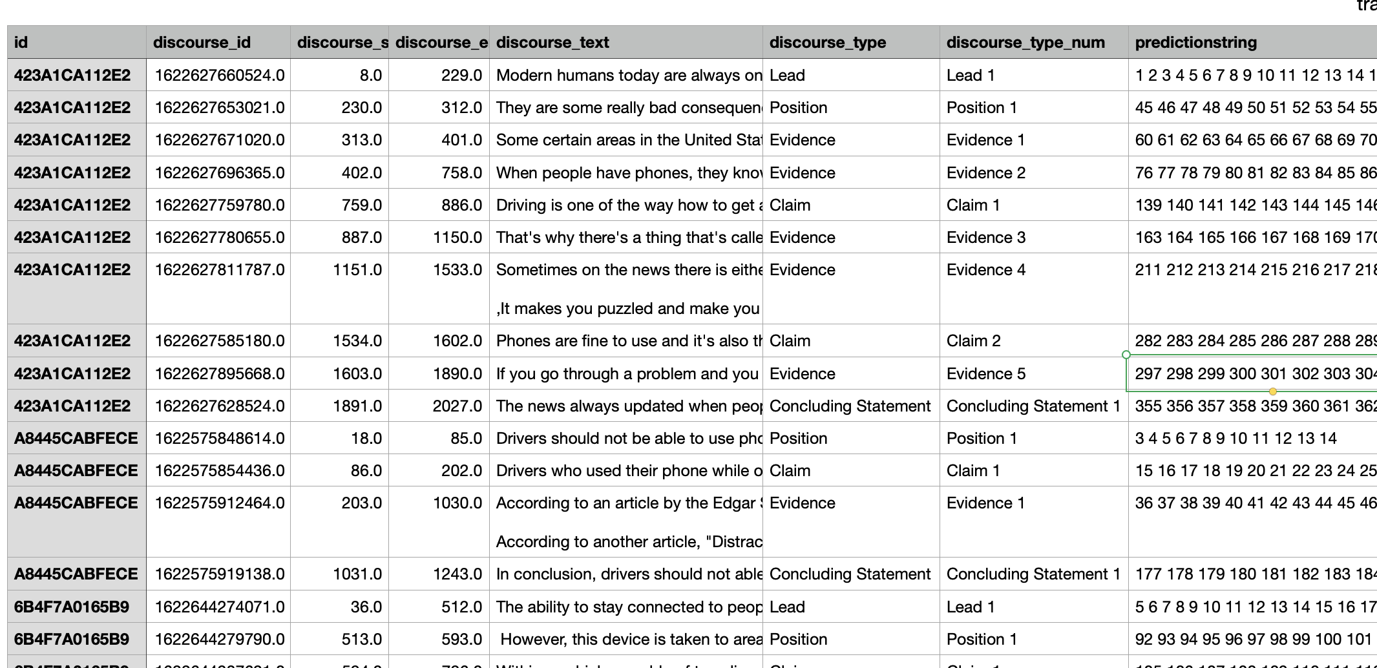
Data description
The details of all the annotated discourse elements are complied in a csv.
The csv file consists of the following details:
id: ID code for essay
discourse_id : ID code for discourse element
discourse_start: character position where discourse element begins in the essay
discourse_end: character position where discourse element ends in the essay
discourse_text: text of discourse element
discourse_type: classification of discourse element
discourse_type_num: enumerated class label of discourse element
predictionstring: the word indices of the training sample, as required for predictions

Slide 14
Methodology
Used three different methodologies. They are:
Method 1: Sequence Classification using Naïve Bayes model.
Method 2: NER using BiLSTM model.
Method 3: NER using Roberta model.

Slide 15
Method 1: naïve bayes model
Concept: Sequence classification
Preprocessing: Essays were broken down to sentences.
Input: Features extracted from these sentences using CountVectorizer and TFIDFTransformer.
Model: Multinomial Naive Bayes model
Metrics: F1 macro
Input Data
Preprocessing
Feature Extraction
Model Training
Model Evaluation

Slide 16
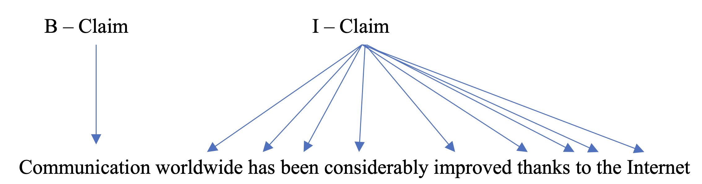
Method 2: Bilstm model
Concept: Chunking through Named-Entity Recognition
Preprocessing: Essays were broken down into words. They were tokenized and assigned labels of discourse elements they belong to in the IOB Format.
Input: Batches of entire essays and labels.
Model: BiLSTM model
Metrics: F1 macro
Input Data
Preprocessing
Model Training
Model Evaluation

Slide 17
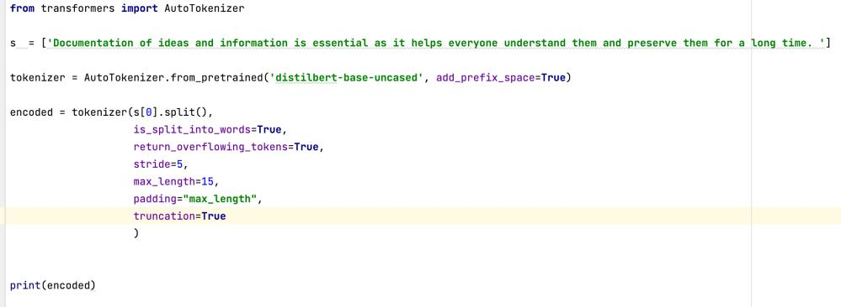
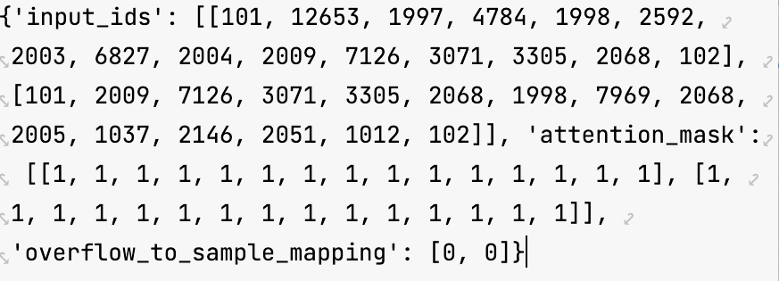
Method 3: Roberta model
Concept: Chunking through Named-Entity Recognition
Preprocessing: Essays were broken down into words and subwords. They were tokenized and assigned labels of discourse elements they belong to.
Input: Batches of tokenized discourse chunks and labels.
Model: Roberta base model
Metrics: F1 macro

Slide 18
Results
Methodology | Validation F1 score | Validation Accuracy | Validation Cohen Kappa score | Number of Parameters
Method 1 (Naïve Bayes model) | 0.1487 | 0.517 | 0.1487 | 390,280
Method 2 (LSTM model) | 0.4505 | 0.6921 | 0.5297 | 5,191,115
Method 3 (Roberta model) | 0.6198 | 0.2038 | 5.7464 | 124,066,575

Slide 19
DEMO

