Slide 1



Jaypee University of Information Technology, Waknaghat - 173234 (India)
Minor Project (18B19CI691) | AY 2024-25
End-Term Evaluation | May 14, 2025.
JUIT Companion
Group No.: 84
Team Members
Supervisor
Name: Ms. Seema Verma Department: CSE & IT
Kavya Sharma (221030106)
Khushi Mehta (221030437)
Raghav Mittal (221030208)
Siddharth Sharma (221030316)

Slide 2
Outline
Introduction
Problem Statement
Project Objectives
Literature review
Project Design
Implementation (if any)
Experimental Results and Evaluation (if any)
Future work (till End-Term Evaluation)
Work Contribution
References

Slide 3
Introduction
JUIT Companion is a mobile-friendly platform designed to simplify academic tracking and enhance student engagement.
Seamless Accessibility – Provides a user-friendly interface optimized for mobile devices.
Efficient Academic Tracking – Enables quick access to attendance, grades, and schedules.
Reduced Login Hassle – Eliminates the need for repeated logins, saving time and effort.
Real-Time Updates – Ensures students receive important academic information instantly.

Slide 4
Problem Statement
Portal isn’t mobile friendly, hindering access. Repeated logins required for different sections. Complicated layout slows access to attendance, grades and schedules. Lack of mobile-optimization cause students to miss critical info. Frustrating experience reduces student interaction, Requires a streamlined, mobile-accessible solution.

Slide 5
Project Objectives
Give up-to-date attendance and schedule data
Make Academic Management Easier
User-Friendly Design and Usability
Encourage Students and Boost Academic Performance

Slide 6
Literature Review
Authors' Name | Title and publication | Work done | Advantages | Limitations
Bernard Ugalde, Allan Salburo, Yashir Ambula,Josie del Valle | Marks Management System an Interactive Web-BasedApproach for Academic Advising : A Bluetooth-Based Approach for Automated Attendance Tracking. Developed and tested at Coventry University with Computer Science students. | Designed MAMS to automate attendance tracking using Java, PostgreSQL, and Bluetooth libraries. Tested across multiple mobile devices to ensure efficiency and accuracy. Addressed challenges like device discoverability and privacy concerns. | Automates GPA calculations, reducing errors and improving efficiency. Enhances student advising with an interactive system. | Limited to SCT’s grading system and requires manual Excel inputs. Lacks mobile compatibility for wider accessibility.
Samruddha Deshmukh, Hrushikesh Dighe, Vaishnavi Vikhe, Vedanti Tambe, Prof. G. B. Kote | Student Record Management System Speech Emotion Recognition, Datasets, Features and Models: A Review," in Proc. ICCC Conference, 2023 [2] | Developed MAMS using Java, PostgreSQL, and Bluetooth libraries. Integrated it with university databases for seamless attendance tracking. Tested with various mobile devices to assess accuracy and efficiency. | Automates attendance tracking, reducing manual effort and human error. Provides real-time attendance data, ensuring immediate updates for lecturers. Works seamlessly with university databases for better record management | Some mobile devices become non-discoverable due to security settings. Low-cost phones with poor Bluetooth stacks may fail to respond correctly. Students may share devices, leading to potential attendance fraud. Privacy concerns arise as students may feel monitored without consent.
Mr. Akash Samanekar, Mr. Ningappa T. Pujar | Student Management System. International Journal of Engineering Research & Technology (IJERT) | Developed a web-based school management system using Spring Boot and micro-services. Implemented features like attendance tracking and notifications. | Automates administrative tasks. Provides real-time updates on student activities and performance.Enhances communication between students, teachers. | Complex initial setup due to multiple micro-services. Requires stable internet connectivity for seamless access. Poses security concerns regarding student data privacy.

Slide 7
Literature review (cont..)
Authors' Name | Title and publication | Work done | Advantages | Limitations
Dr Vijaya Chandra Jadala , Dr. Narasimham Challa, Dr. Sai Kiran Pasupuleti, [1] | "Authentication and Authorization Mechanism for Cloud Security " International Journal of Engineering and Advanced Technology (IJEAT), 2019 | Authentication and authorization mechanisms in cloud security verify user identities and control access. They ensure only authorized users can access sensitive data, enhancing security. | Secure and standardized authentication, seamless integration, supports single sign-on (SSO), and reduces server load. | Cloud security implementation is complex due to many interrelated factors. Azure AD token size limits group membership data.
Einollah Jafarnejad Ghomi, Amir Masoud Rahmani, Nooruldeen Nasih Qader, [2] | "Load-balancing algorithms in cloud computing" Journal of Network and Computer Applications, 2017 | Load-balancing algorithms in cloud computing distribute workloads across multiple servers to optimize resource use, and prevent overload. They enhance system reliability, reduce response time, and efficient resource utilization. | Load balancers enhance performance and prevent server overload, while VMs provide scalability and isolation. Efficient load-balancing algorithms and resource allocation strategies optimize resource usage. | VMs can introduce performance overhead and require careful management. Load-balancing algorithms may struggle with dynamic workloads, and improper resource allocation can lead to inefficiencies.
Atta ur Rehman Khan, Mazliza Othman, Sajjad Ahmad Madani, Samee Ullah Khan [3] | " Mobile Cloud Computing Application Models “ IEEE COMMUNICATIONS, 2014 | Mobile cloud applications offload processing , storage to remote servers, improving performance and reducing energy consumption. This enables efficient execution of complex tasks without overloading mobile devices. | Mobile cloud applications enhance performance, reduce device resource limitations. They improve scalability, storage, and processing capabilities by leveraging cloud resources. | They rely on stable internet connectivity, pose security and privacy risks, and may introduce latency issues. Additionally, continuous cloud access can lead to higher energy consumption on mobile devices.

Slide 8
Literature review (cont..)
Authors' Name | Title and publication | Work done | Advantages | Limitations
Mahfuzulhoq Chowdhury, Nura Hadi | A Convenient Mobile Application For SchoolStudents Attendance, Registration, Notice, Bus Schedule,Complaint, and Parent Alert Services | Designed a mobile application that aims to streamline various school-related tasks. The proposed application includes features such as: Attendance Tracking, Course Registration, School Fee Payment, Daily Alerts, Bus Schedules, Exam Notifications, Complaint Management. | Centralizes multiple school related tasks, saves time and reduces hassle of managing these tasks separately, provides timely updates through daily parent alerts and exam notifications, allows parents to monitor their children's attendance and performance.. | The effectiveness of the application relies heavily on the availability of smartphones and internet access among students and parents, The feedback collected primarily reflects the opinions of those who chose to review the app.
Louragli El Mustapha, Yassine Gmih, Sohaib Soussi, Abdelmajid Farchi | Enhanced student attendance and communication in educational management systems | Discusses the challenges faced in managing student attendance and communication within educational institutions like: Need for Improvement, Technological Integration, Technological Framework, Long-term Benifits. | The system automates the process of tracking student attendance, significantly reducing the time and effort required compared to traditional methods, With a focus on (UX), the system provides a more engaging and efficient interface for students. | Research is the reliance on technology, which may pose challenges in areas with limited access to the necessary infrastructure or internet connectivity, the initial setup costs for RFID technology and therequired hardware may be a barrier for some institutions.
S.P. Balakannan, Kothuri Sravani, Jeyapriya, S. Fathima, Rosini | AI based Attendance System using ML | Paper presents a comprehensive approach to revolutionizing attendance tracking through advanced technology, addressing the limitations of traditional methods, and providing a robust solution. | It automates the attendance tracking process, significantly reducing the time and effort required compared to traditional manual methods, which are prone to errors. | One significant concern is the reliance on technology, which may pose challenges in areas with limited access to the necessary infrastructure. while the system is cost-effective in the long run, the initial setup costs for RFID technology and required hardware may be a barrier for some institutions.

Slide 9
Literature review (cont..)
Authors' Name | Title and publication | Work done | Advantages | Limitations
Alioune Diallo Jordan Samhi Tegawendé Bissyandé Jacques Klein | " "Security of Mobile Apps in Developing Countries: A Systematic Literature Review" | Research directions in mobile app security. Challenge s faced in securing mobile applicatio ns. The effectivene ss of existing security measures in developin g regions | Provides a comprehensive review of mobile security issues specific to developing countries. Identifies gaps in current research and suggests future directions. Highlights the importance of security in key sectors like education, finance, agriculture, and healthcare. | The study relies on existing literature and may not cover emerging threats in real-time. Possible biases in the selection of reviewed studies. Solutions or recommendations provided may not be immediately implementable in all developing regions due to infrastructure constraints.
Saqib Saeed | " Usable Privacy and Security in Mobile " Publication : Published in Big Data and Cognitive Computing | This study investigated mobile users' perceptions of privacy and security usability in Saudi Arabia through a quantitative survey of 886 respondents. Key findings revealed that user concerns and trustworthiness significantly influenced usability perceptions. | Practical Implication s: Offers actionable recommend ations for app designers, policymaker s, and educators to enhance usability and trust. | Demographic Bias: The sample was skewed toward females (65.24%) and young users (69.07% aged 19–25), limiting generalizability. Geographical Scope: Focused solely on Saudi Arabia; findings may not apply to other cultural or regional contexts.
Prof. Shah S.N., Namrata R. Shendage, Diya A. Sanas, Kiran M. Kharade, and Shraddha S. Gadekar. | "Survey Paper on Automated Timetable Generator Android Application.“Published in the International Journal of Innovative Research in Technology (IJIRT), Volume 10, Issue 6, November | The study proposed an Android application to automate university timetable generation, addressing manual inefficiencies. It reviewed existing and designed a system using user inputs (courses, faculty, slots) to produce conflict-free | The application reduces manual effort, minimizes errors, and optimizes resource allocation, offering scalability across institutions. It leverages algorithms like GA for efficient solutions and provides a userfriendly interface for easy adoption. | The paper lacks implementation details or empirical validation, and the proposed system’s adaptability to highly dynamic schedules or largescale institutions remains untested. Computational complexity of algorithms like GA may also pose challenges.

Slide 10
Work Done (after Mid-Term Evaluation)
Implementation & Backend Integration – Developed the core functionality of the app by integrating the backend with the university portal to fetch real-time attendance and timetable data seamlessly.
Feature Enhancements & Optimization – Added key features like real-time notifications, improved data synchronization, and optimized performance for smoother access to academic information.
Testing & User Feedback – Conducted extensive testing with students to identify usability improvements, gather feedback, and refine the user experience based on actual needs
Deployment & Future Scalability Planning – Prepared the application for deployment while mapping out future enhancements such as push notifications, offline mode, and faculty integration.

Slide 11
Project Design
User Interface (UI) Design
Dashboard: Displays an overview of attendance, marks, and timetables in a clean, minimalistic layout.
Navigation Bar: Provides quick access to key sections like Attendance, Marks, Timetable, and Profile Settings.
Sync Button: Allows students to manually refresh their data to ensure they always have the latest updates.
2. User Experience (UX) Design
Single Sign-On : Eliminates repeated logins, offering a seamless user experience.
Mobile Optimization: Ensures smooth navigation on different screen sizes.
Minimal Steps to Access Information: Reduces the effort needed to check marks, attendance, or timetables.
Push Notifications: Alerts students about attendance shortages, exam results, or timetable changes.

Slide 12
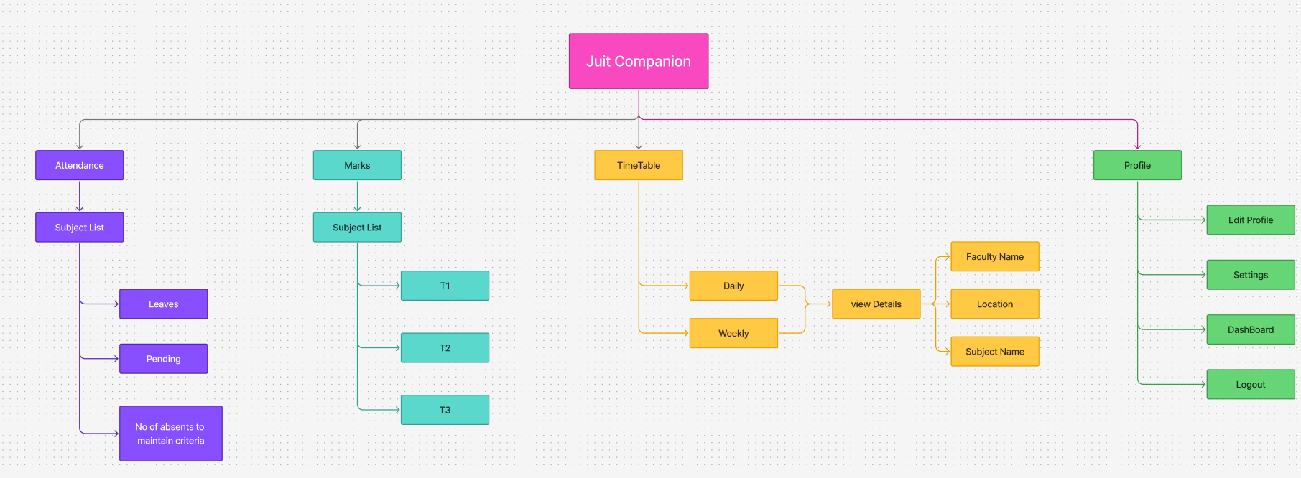
Project Design
Information Architecture:

Slide 13
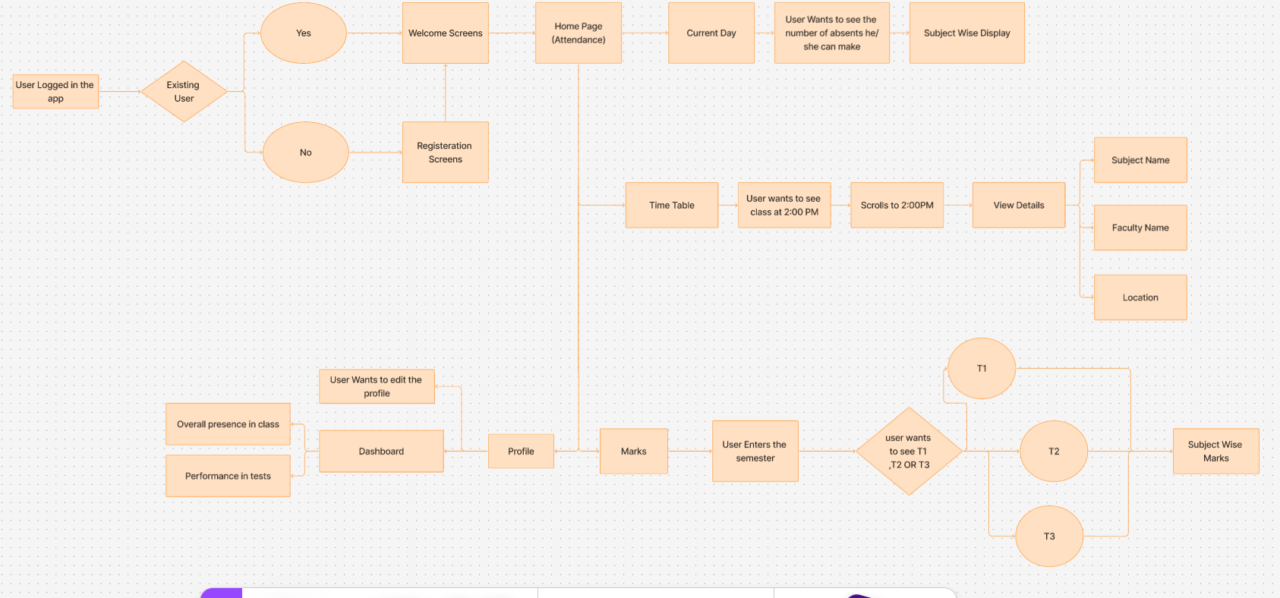
Project Design (cont…)
User Flow:

Slide 14
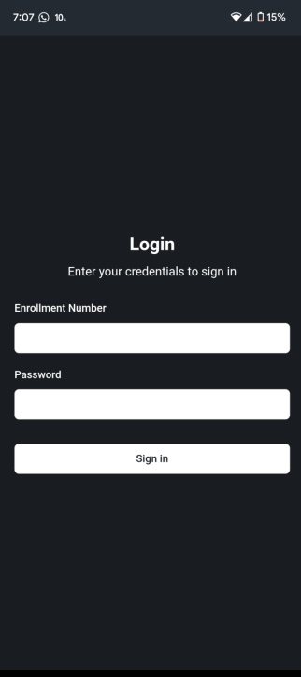
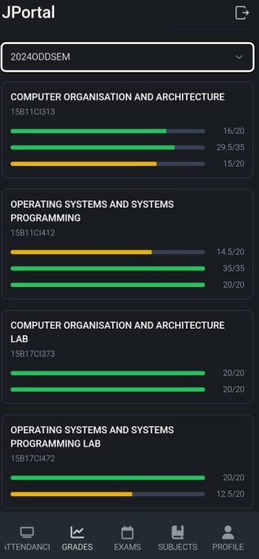
Project Design (cont…)
To ensure a smooth onboarding experience, JUIT Companion features an intuitive and user-friendly registration process.
Figure 1: login screen requiring credentials
Figure 2: screen showing marks in university format

Slide 15
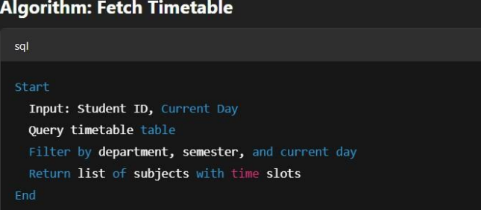
Implementation
The project's dataset is made up of structured academic records that were either used as mock data or extracted from a simulated academic database. It contains important information such as class schedules, exam results, student profiles, and attendance by subject. The application's connection to the official JUIT student portal ensures authenticity and relevance while facilitating real-time academic data extraction. This integration enables the app to provide personalized academic insights based on each student's profile as well as real-time tracking capabilities.
Figure 3 :Algorithm to fetch the time table

Slide 16
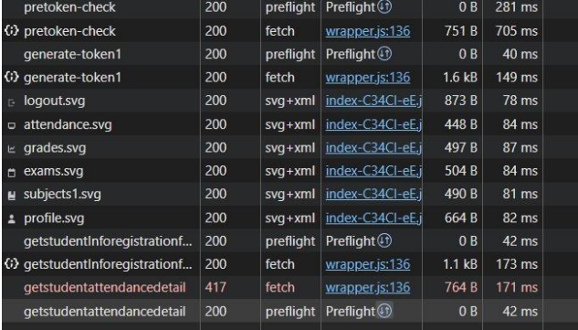
Implementation (cont…)
Figure 4 :Api request are received and called from the portal

Slide 17
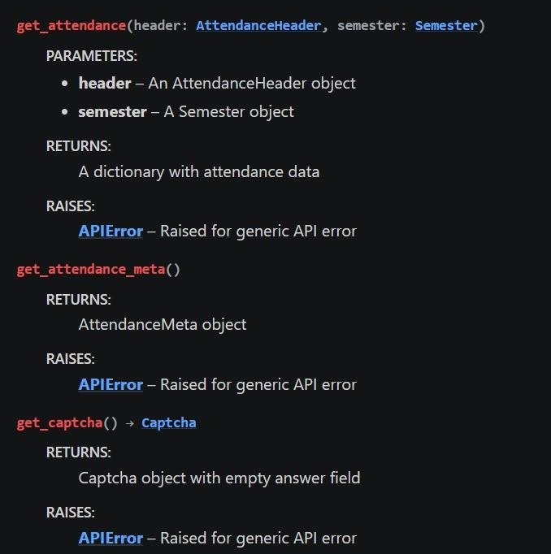
Implementation (cont…)
Figure 5 : Functions from python liberary that fetch attendence from portal

Slide 18
Experimental Results and Evaluation
The JUIT Companion App significantly improved student access to academic data by providing real-time updates on attendance, schedules, and grades through a personalized dashboard. Its secure login, instant absence alerts, and subject-wise progress tracking reduced reliance on the university portal and increased user engagement. The live synchronization feature ensured that students always had the most current information without manual refreshes. Compared to traditional methods, the app offered a more streamlined, mobile-friendly experience that fostered greater awareness and academic responsibility among students. This demonstrates the app’s effectiveness in enhancing the overall learning management process.

Slide 19
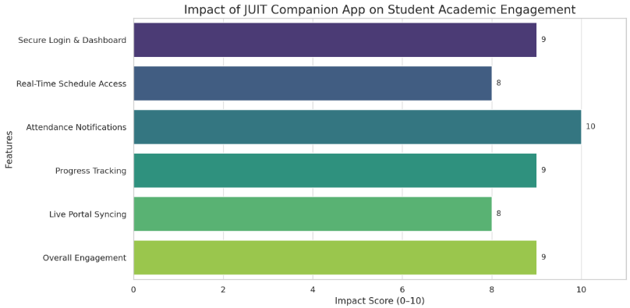
Experimental Results and Evaluation (cont…)
Figure 6 : A horizontal bar chart illustrating the effectiveness of JUIT Companion App features in enhancing student academic engagement.

Slide 20
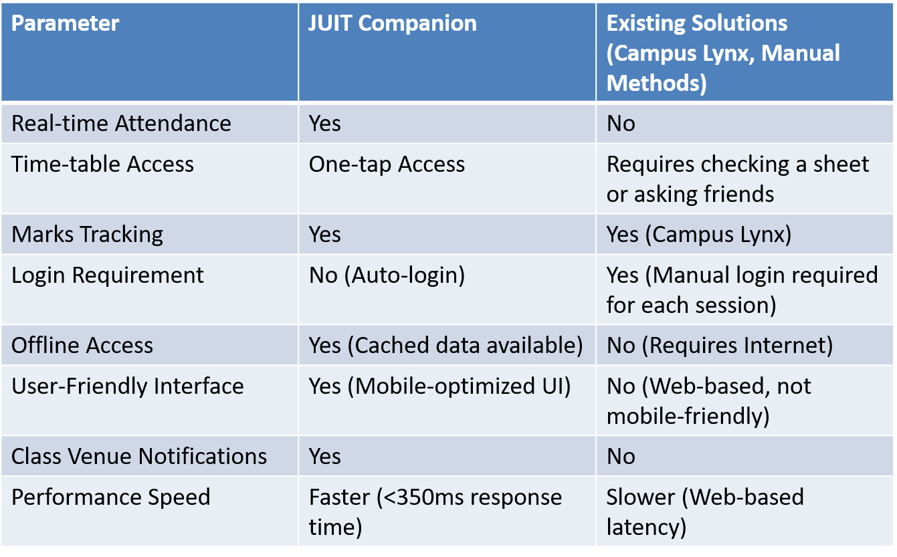
Experimental Results and Evaluation (cont…)
Figure 7 : A comparision B/W our Jportal and Web Portal

Slide 21
Key Learnings
Through the development of the JUIT Companion app, we learned the importance of user-centric design in solving real-world academic challenges. The project emphasized how even simple features—like real-time attendance tracking and daily schedules—can significantly reduce student stress and improve engagement when integrated into a centralized, accessible platform. We discovered that empathy-driven development leads to higher usability and adoption, particularly when the product addresses daily pain points experienced by users. Technically, the project strengthened our understanding of full-stack development, API integration with institutional portals, secure login systems, and responsive UI/UX using React.js and Python. Additionally, the project highlighted the value of iterative prototyping, user feedback, and real-time syncing in delivering a scalable, practical solution. Comparing this to existing fragmented systems, we realized the substantial impact of creating seamless academic tools that are not only functional but also intuitive and inclusive.

Slide 22
Future Work (till End-Term Evaluation)
Real time notification.
Offline mode.
Sync feature.
More user friendly design.

Slide 23
Work Contribution
Team Member | Roll No. | Work Done (provide complete details) | Work Contribution (%) | No. of literatures read | Implementation
1. | 221030106 |  | 25 | 3
2. | 221030437 |  | 25 | 3
3. | 221030208 |  | 25 | 3
4. | 221030316 |  | 25 | 3

Slide 24
References
S. Sharma, "Usable Privacy and Security in Mobile," Big Data and Cognitive Computing, vol. –, no. –, pp. –, [Online].
S. Sharma, "Survey Paper on Automated Timetable Generator Android Application,"
International Journal of Innovative Research in Technology (IJIRT), vol. 10, no. 6, Nov. 2023.
S. Sharma, "A Convenient Mobile Application for School Students: Attendance, Registration, Notice, Bus Schedule, Complaint, and Parent Alert Services,"
S. Sharma, "Enhanced Student Attendance and Communication in Educational Management Systems,"
S. Sharma, "AI-Based Attendance System Using ML,"
S. Sharma, "Authentication and Authorization Mechanism for Cloud Security," International Journal of Engineering and Advanced Technology (IJEAT), vol. –, 2019.

Slide 25
References
. Singh and M. Sharma, "Load-balancing algorithms in cloud computing," Journal of Network and Computer Applications, vol. –, 2017.
J. Kumar and P. Patel, "Mobile Cloud Computing Application Models," IEEE Communications, 2014.
T. Watson, "Marks Management System: A Bluetooth-Based Approach for Automated Attendance Tracking," developed at Coventry University, 2016
R. Mehta, "Student Record Management System: Speech Emotion Recognition, Datasets, Features and Models,"

Slide 26
Thanks.

