Slide 1

BMS College of Engineering
(Autonomous College under VTU)
Department of Artificial Intelligence and Data Science
Project Work Bio-Inspired Algorithms (23DS7BSBIO) Final Presentation on
SwarmFolio: Multi-Objective Stock Portfolio Optimization Using Particle Swarm Optimization and Genetic Algorithms
Submitted by
Under the guidance of
Vivek Boora
1BM23AD073
Prof. Suman M
Assistant Professor
Dept of AI & DS
Ayush Pandey
1BM23AD074
Nitin
1BM24AD404
Notes:
Introduce the project and the team. SwarmFolio compares a particle swarm optimiser and a genetic algorithm on a three-objective stock portfolio problem.

Slide 2
Table of Contents
3
Abstract
10
Implementation
4
Introduction
12
Testing and Validation
6
Literature Survey
13
Results and Discussion
7
Requirement Analysis and Specification
17
Conclusion
8
Design
18
POs mapping matrix
Circle shows the slide number
Notes:
Roadmap of the talk. The circles show the slide number where each section starts.

Slide 3
Abstract
Three goals
Two optimisers
What we found
Maximise return
Particle swarm
MOPSO
0.70 vs 0.25
Minimise volatility
front quality, optimisers vs random search
Genetic algorithm
NSGA-II
1.34 to 0.53
Minimise CVaR (tail loss)
One shared repair operator
Sharpe ratio, training to held-out data
under cap, floor and holding limits
A good front is not a promise of future return.
Notes:
Portfolio choice trades return against volatility and tail loss. We built two optimisers on one shared constraint-repair step. Both beat random search clearly, but portfolios picked for the best Sharpe ratio lost most of their advantage on unseen data.

Slide 4
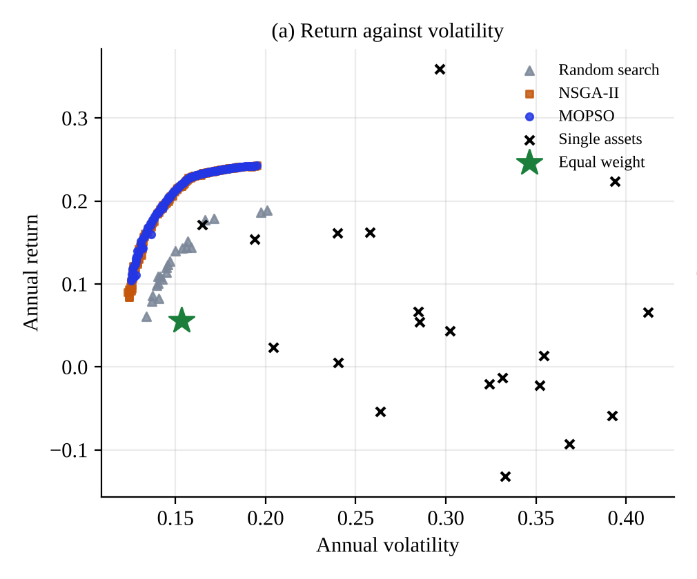
Introduction: the problem
Maximise annual return
Minimise volatility
Minimise CVaR: average loss on the worst 5% of days
Constraints applied to every portfolio
Long-only
Fully invested
Cap 30% per stock
Each dot is a feasible portfolio; the front is the best trade-off
Min holding 1%
At most K holdings
Notes:
A portfolio has to balance return against volatility and tail loss, and real mandates add constraints. The result is not one answer but a front of trade-offs.

Slide 5
Introduction: what we built
P
T
F
W
Python library
Two optimisers
Fair evaluation
Web workbench
Portfolio model, repair operator, automated tests
MOPSO and NSGA-II on one feasible space
Hypervolume, random search, 30 held-out markets
Watch the search and inspect any portfolio
Sustainable Development Goals
SDG 4 Quality Education
SDG 8 Decent Work and Economic Growth
SDG 9 Industry, Innovation, Infrastructure
Scope: simulated markets, long-only portfolios, no trading costs in the optimisation
Notes:
Four deliverables: the library, two optimisers, a fair evaluation protocol and a browser workbench. Scope is limited to simulated markets, which is stated as a limitation.

Slide 6
Literature Survey
Paper Title | Name of Journal / Conference | Published Year | Novelty / Techniques | Limitations | Gap Identified
Portfolio selection (Markowitz) | The Journal of Finance | 1952 | Mean-variance model, efficient frontier | Variance only; no holding limits | Needs tail risk and constraints
Optimization of conditional value-at-risk (Rockafellar, Uryasev) | The Journal of Risk | 2000 | CVaR as a tail-risk measure | One risk measure at a time | Combine with return and volatility
Heuristics for cardinality constrained portfolio optimisation (Chang et al.) | Computers & Operations Research | 2000 | GA, tabu search, annealing with holding limits | Limits make the frontier hard to compute exactly | Fair comparison of heuristics
A fast and elitist multiobjective GA: NSGA-II (Deb et al.) | IEEE Trans. Evolutionary Computation | 2002 | Non-dominated sorting, crowding distance | General method, not portfolio-specific | Needs portfolio constraint handling
Handling multiple objectives with PSO (Coello et al.) | IEEE Trans. Evolutionary Computation | 2004 | External archive guides the swarm | General method, not portfolio-specific | Needs a swarm vs GA comparison
PSO for constrained portfolios (Cura; Zhu et al.; Deng et al.) | Nonlinear Anal. RWA; Expert Syst. Appl. | 2009 to 2012 | PSO with cardinality and other constraints | One scalarised objective | No three-objective front with CVaR
A portfolio model with three objectives and discrete variables (Anagnostopoulos, Mamanis) | Computers & Operations Research | 2010 | Tri-objective MOEAs: risk, return, number of securities | Third objective is holding count, not tail risk | Swarm, CVaR and held-out tests added here
Notes:
Detailed survey in the required format: paper, venue, year, technique, limitation and the gap each leaves. The portfolio PSO papers use one scalarised objective, which is the gap our three-objective front addresses. Full references are in the report.

Slide 7
Requirement Analysis and Specification
12
7
0
functional requirements
non-functional requirements
INR software cost, all open source
Software stack
Python 3.13
NumPy
pandas
Matplotlib
SciPy
pytest
Browser canvas
Default run: 100 individuals, 150 iterations, 20 assets finishes in about 1.5 seconds
Notes:
Requirements cover data input, constraints, both optimisers, live progress, inspection and error messages. Everything runs on free software; a default run takes about a second and a half.

Slide 8
Design: architecture
Browser
Control panel
Live swarm canvas
Portfolio inspector
Wealth and convergence charts
JSON over HTTP
Server
POST /api/run
GET /api/jobs/id
POST .../cancel
Job manager and worker threads
function calls
Optimisation core
Portfolio model and repair
MOPSO
NSGA-II
Pareto utilities
Baselines and back-test
Notes:
Three layers. The browser draws and sends JSON. The server runs jobs on worker threads and stores the latest snapshot of each population. The core is plain Python and is shared by the tests, the command line and the web app.

Slide 9
Design: methodology
One repair operator, shared by both algorithms
Clip negatives to zero
Keep the K largest
Drop tiny weights
Add assets if the cap needs more
Cap at 30% and redistribute
Normalise to sum 1
Six experiments
Front quality
Holding limits
Number of assets
E1
E2
E3
10 seeds against random search
K = none, 10, 8 and 5
10 to 60 assets
Search budget
Held-out test
Operator ablation
E4
E5
E6
5 to 200 iterations
30 simulated markets
with and without
Seeded factor-model markets with fat tails and a crisis period; 70% training, 30% held-out
Notes:
The repair operator guarantees every portfolio is long-only, fully invested, capped and within the holding limit. Six experiments vary one factor at a time, with the last using 30 independent markets.

Slide 10
Implementation: the two optimisers
MOPSO (particle swarm)
NSGA-II (genetic algorithm)
Particles start as feasible portfolios
Population of feasible portfolios
Leader chosen from the archive by crowding
Tournament by rank and crowding
Velocity update, then repair
SBX crossover, mutation and swap
Archive keeps the non-dominated set
Parents and children: keep the best
100 particles
inertia 0.9 to 0.4
c1 = c2 = 1.5
100 individuals
SBX index 15
swap mutation 0.2
Same budget for both: 15,100 objective evaluations per run
Notes:
Both algorithms see exactly the same problem and the same evaluation budget. The swarm uses an external archive and crowding-based leaders; the genetic algorithm is standard NSGA-II with a swap mutation added.

Slide 11
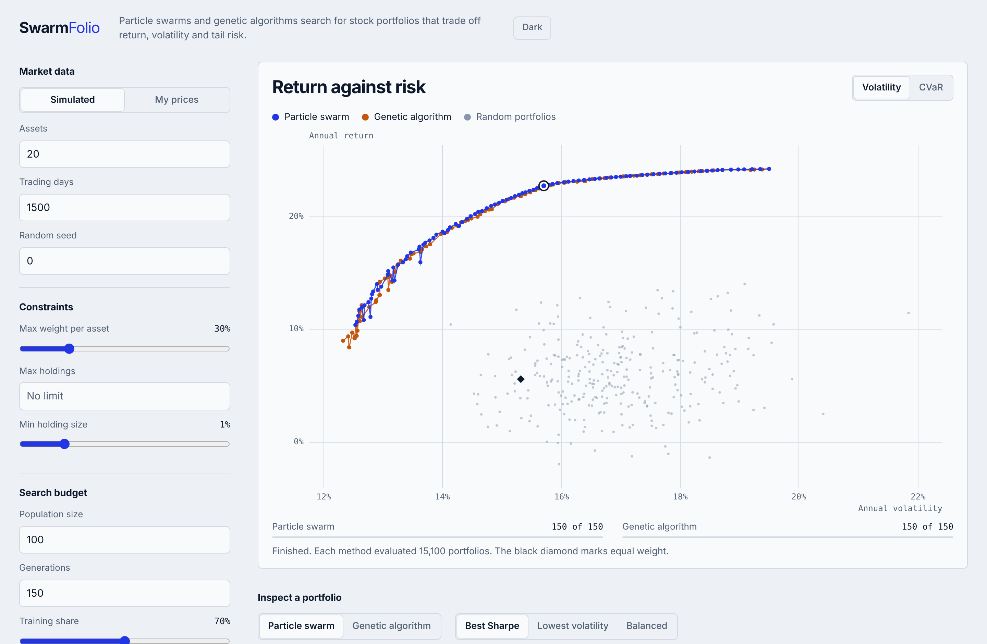
Implementation: the workbench
Watch the search
Both populations converge on their fronts, live
Inspect any portfolio
Click a point: weights, training and held-out results
Bring your own prices
Upload a CSV, set constraints, press Run
Notes:
The browser workbench runs both optimisers side by side and animates them. After the run you can click any point on a front to see its weights and how it behaved on held-out data.

Slide 12
Testing and Validation
14
19
0
automated tests pass
system test cases: server and browser
constraint violations in every experiment run
Component
Algorithm
System
Repair, objectives, Pareto maths
Feasible, non-dominated, reproducible, beats random
Server jobs, error paths, browser, phone, dark mode
Notes:
Tests run at three levels. Fourteen automated tests, nineteen system test cases including browser checks, and zero constraint violations across all experiment runs. Same seed gives the same front.

Slide 13
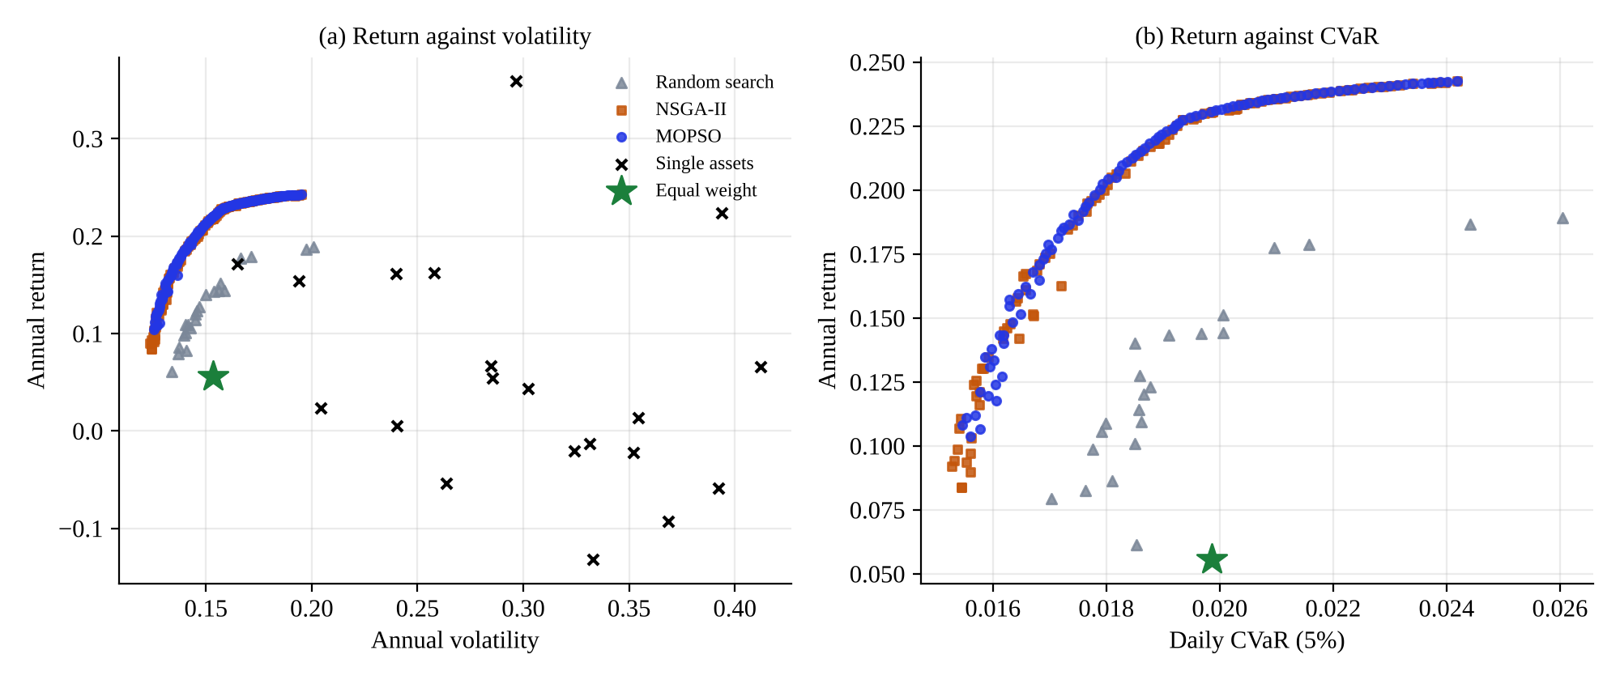
Results: front quality
100 vs 20
p = 0.002
0.70 vs 0.71
non-dominated portfolios per run: optimisers vs random
both optimisers vs random, paired test over 10 seeds
swarm vs genetic: a statistical tie in practice
Notes:
Both optimisers find roughly one hundred non-dominated portfolios against about twenty for random search, with hypervolume about 0.70 versus 0.25. The genetic algorithm is marginally ahead on average but the difference is tiny next to the seed-to-seed spread.

Slide 14
Results: search budget
Up to 50 iterations
Swarm ahead in 5 of 5 seeds
From 100 iterations
Genetic algorithm ahead in 5 of 5 seeds
Random search
Stays far behind at every budget
Notes:
With few evaluations the swarm is clearly better; it reaches in 10 iterations what the genetic algorithm needs 25 to 50 iterations to match. From 100 iterations the genetic algorithm finishes slightly ahead.

Slide 15
Results: held-out performance
Return does not transfer to new data. Risk does: lower held-out volatility in 30 of 30 markets
Notes:
Average over 30 independent simulated markets. Portfolios chosen for the best Sharpe ratio looked excellent in training but fell below equal weight on unseen data. Minimum-volatility portfolios were calmer than equal weight in every one of the 30 markets.

Slide 16
Results: robustness checks
Scale
Constraints
Operator ablation
0
No gain
No turbulence: p = 0.64
No swap mutation: p = 0.55
Neither changes front quality at these settings
violations of the cap or the holding limit, for limits of none, 10, 8 and 5 holdings
Seconds per run, 10 to 60 assets
about 1.5 s whatever the size
Notes:
Run time stays near one and a half seconds from 10 to 60 assets. The repair operator kept every portfolio feasible. The two extra operators we added did not measurably help, which we report honestly.

Slide 17
Conclusion
1
2
3
Both optimisers work
Return does not transfer
Risk does
Far better fronts than random search; every constraint respected
Best-Sharpe picks: 1.34 in training, 0.53 held out; equal weight 0.59
Minimum-volatility picks were calmer than equal weight in 30 of 30 markets
Future scope
Real market data
Shrinkage estimators
Trading costs as an objective
Hosted classroom version
Notes:
Three take-aways: the optimisers work, historical returns do not predict future returns well, but risk estimates do transfer. Future work: real market data, shrinkage estimators, costs as an objective and a hosted version for classes.

Slide 18
Program Outcomes Attained
3 High
2 Medium
1 Low
PO1
Engineering knowledge
Level 3
PO2
Problem analysis
Level 3
PO3
Design of solutions
Level 2
PO4
Investigation of problems
Level 3
PO5
Modern tool usage
Level 3
PO6
Engineer and the world
Level 1
PO7
Ethics
Level 2
PO8
Teamwork
Level 3
PO9
Communication
Level 2
PO10
Project management
Level 2
PO11
Life-long learning
Level 2
PSO1
Design AI systems
Level 3
PSO2
Decisions with AI and data
Level 2
PSO3
End-to-end systems
Level 3
Each level is justified in the project report (attainment sheet).
Notes:
Levels as assessed in the report. Strongest: engineering knowledge, problem analysis, investigations, tool usage and teamwork. Weakest: the engineer and the world, since societal impact is only addressed through the SDGs.

