Slide 1
Agentic AI Hackathon: Building Intelligent Agents with IBM Granite and LangFlow
AI-Assisted Medication Adherence Monitoring System

Slide 2



Name of the team: Undecided
Details of Team members
TEAM MEMBER NAME | Recent Passport Photo | Email ID | Phone number [WhatsApp]
Nitin Harsur |  | nitin.ad24@bmsce.ac.in | 9972029193
Varshitha B |  | varshithab.cs23@bmsce.ac.in | 6364436314
Vidyashree V |  | vidyashreev.cs24@bmsce.ac.in | 8147433511

Slide 3
Problem statement
The Challenge
Managing daily medication is difficult for many patients, especially those with chronic illnesses, as they often face:
Missed or delayed doses – due to forgetfulness, busy schedules, or lack of reminders.
Complex prescriptions – multiple medicines taken at different times increase confusion and errors.
Lack of monitoring – doctors and caregivers cannot track whether medicines are taken correctly.
Poor patient engagement – patients may not understand the importance of strict adherence.
Without an intelligent system to track and support medication use, patients experience poor treatment outcomes, increased health risks, and frequent hospital visits.

Slide 4
Proposed solution
We propose an Agentic AI-based Medication Adherence Monitoring System that:
Accepts adherence information as text or uploaded documents
Uses Agentic AI reasoning to analyze adherence behavior
Identifies risk levels (Low / Medium / High)
Tracks adherence trends over time
Provides empathetic, assistive reminders
Stores long-term adherence memory using vector databases
Ensures non-clinical, bias-free responses using IBM Granite

Slide 5
Need of project
We propose an Agentic AI-based Medication Adherence Monitoring System that:
Medication non-adherence is a common healthcare issue.
Missed doses lead to poor treatment outcomes.
Early identification of adherence risk is required.
Adherence trends need continuous monitoring.
Patients need empathetic, non-judgmental support.
Agentic AI enables intelligent behavior analysis.
Long-term memory improves personalized assistance.

Slide 6
End user of project
Patients managing long-term medication routines
Caregivers and family members
Healthcare support teams
Public health monitoring programs
Digital health platforms

Slide 7
Technology Used
LangFlow Platform
IBM watsonx.ai
IBM Granite Model
Astra DB (Vector Database)
RAG (Retrieval-Augmented Generation)
Agentic AI Architecture

Slide 8
Novelty and Uniqueness
Uses Agentic AI, not just a chatbot
Separates reasoning and action using multi-agent design
Maintains long-term adherence memory using vector databases
Supports multi-modal inputs (text + documents)
Granite-guarded outputs ensure:
Ethical AI
Non-diagnostic behavior
Bias-free responses
Designed for assistive healthcare, not clinical decision-making

Slide 9
Technical flow diagram - Architecture blueprint
AI-Assisted Medication Adherence Monitoring – End-to-End Workflow
Reminder Scheduling
AI Analysis
History Memory
Reminder scheduling service triggers notifications based on user request
User Input
AI agent analyzes user input and summarizes adherence behavior
Response Generation
Vector-enabled NoSQL database stores adherence history summaries
User provides medication adherence information via chat or text
AI agent generates user-facing response and decides reminder action
Trend Analysis
Agent 2 retrieves past history to determine adherence trends
1
2
3
4
5
6
User Interaction Layer
Adherence Analysis Agent
Action & Response Agent
Adherence History Storage
Optional Retrieval Flow
Reminder & Notification Layer

Slide 10
Langflow component Used
Chat Input
Agent (Analysis Agent)
Agent (Memory & Action Agent)
Astra DB (Vector Store – Documents)
Astra DB (Vector Store – Adherence History)
Date Utility Tool
Medication Reminder Tool
Chat Output

Slide 11
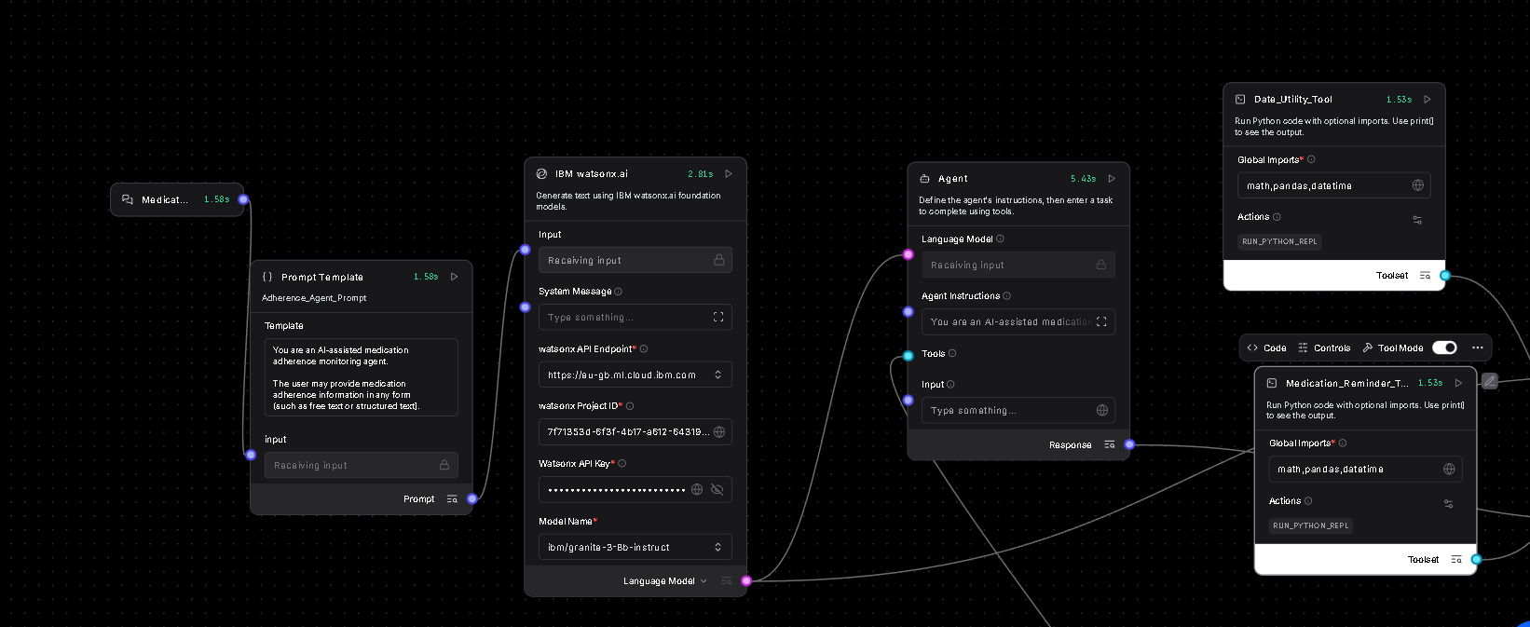
Input Screenshot 1

Slide 12
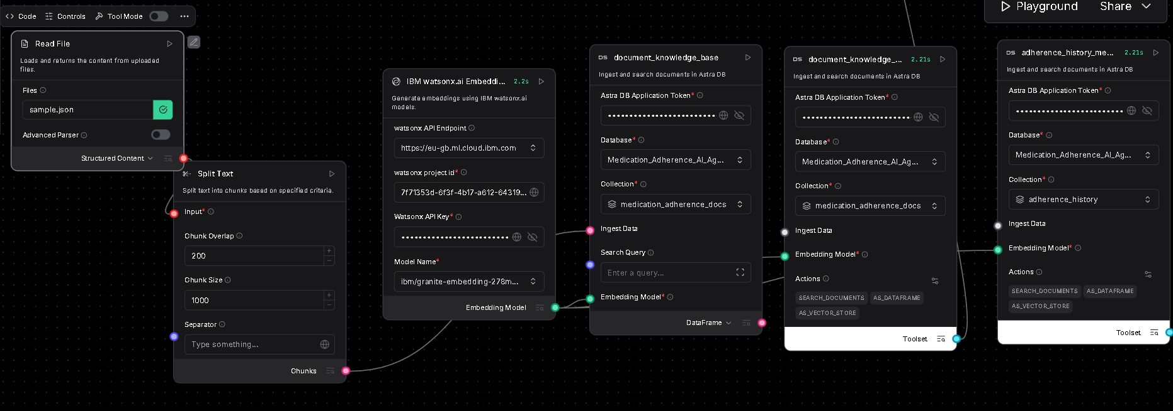
Input Screenshot 2

Slide 13
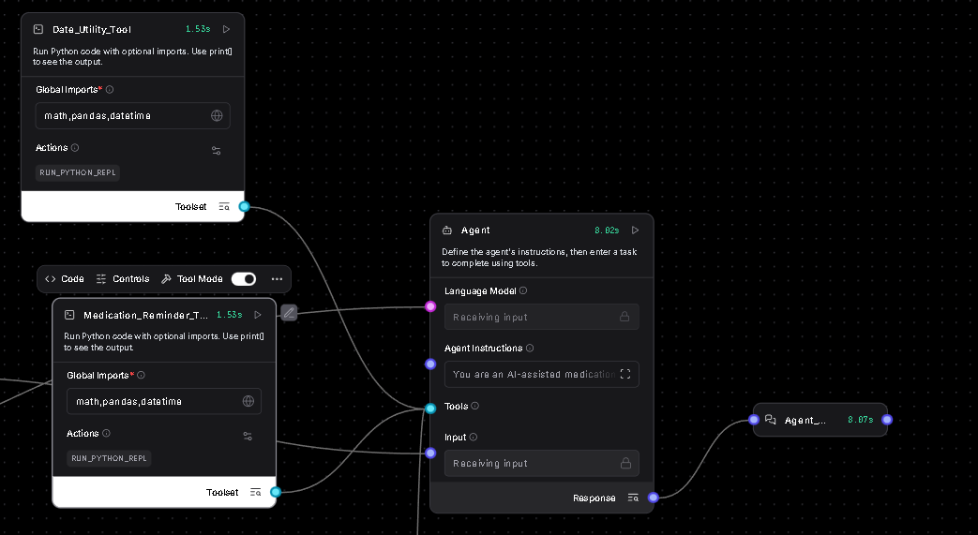
Input Screenshot 3

Slide 14
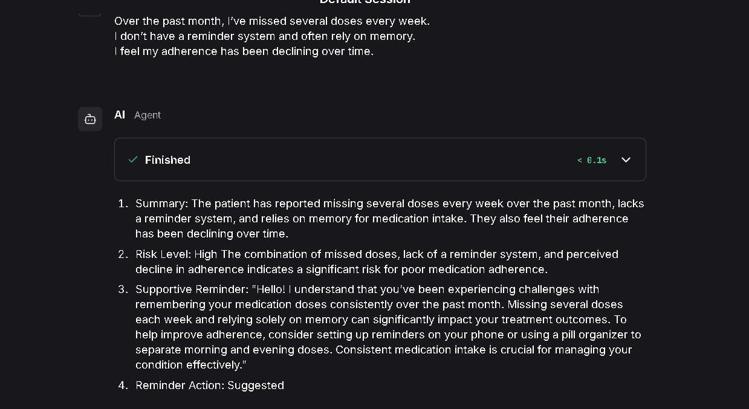
Output Screenshot 1

Slide 15
Future Scope
Integration with wearable and mobile health apps
Personalized adherence insights
Multi-language support
Analytics dashboard for healthcare teams
Integration with calendar systems (Google / Outlook)
Secure patient identity management
·
·
·

Slide 16
Git Hub Link
https://github.com/NitinHarsur/Medication_Adherence.git
·

Slide 17
References
IBM watsonx.ai Documentation
LangFlow Official Documentation
Astra DB Vector Store Documentation
·
·
·

Slide 18


