Slide 1
Nitin Mahabaleshwar Hegde 1js20is063@jssateb.ac.in J.S.S Academy of Technical Education CYBERSECURITY- 13thOct-17thNov
STU64c3803d56e691690533949

Slide 2
Project Title: Image-Based Text Encryption and Decryption System
Problem Statement:
With the increasing need for secure communication, there is a demand for novel and creative methods to protect sensitive information. Traditional text-based encryption methods may not always be sufficient or engaging. This project aims to develop an image-based text encryption and decryption system that leverages the visual appeal of images while ensuring the security of the transmitted message.

Slide 3
Project Overview:
The primary objective of this project is to create a user-friendly tool that enables the encryption and decryption of messages within images using a passcode. The tool employs basic steganography techniques to hide messages in the RGB values of image pixels, providing a visually discreet means of communication.
Technologies Used:
Programming Language: Python
Libraries: OpenCV for image processing, Tkinter for GUI development
User Interface: Tkinter GUI for a seamless user experience

Slide 4
End Users:
1. Enthusiasts of Steganography:
Individuals interested in the art and science of concealing information within other data, such as hiding messages within images.
2. Students Learning Cryptography Concepts:
Students studying cryptography or related fields looking for a practical application to understand encryption and decryption processes.
3. Privacy-Conscious Users:
Users who prioritize data security and want a simple method to secure messages within visual content.
4. Individuals Communicating Privately:
Users seeking a basic means of private communication by hiding messages within seemingly innocuous images.
5. Education and Awareness Programs:
Educational institutions or organizations conducting workshops or awareness programs on cybersecurity and steganography.

Slide 5
Solution and Value Proposition:
This application provides a straightforward GUI for encrypting a user-provided message within an image using a passcode. It also offers the ability to decrypt the message from the image using the same passcode. The encryption process involves mapping characters to pixel values, and decryption reverses this process.
User-Friendly Encryption/Decryption:
The GUI simplifies the process of encrypting and decrypting messages within images, making it accessible for users without a programming background.
Basic Steganography:
The application provides a basic form of steganography by hiding messages within the RGB values of image pixels.
Passcode Protection:
The use of a passcode adds a layer of security to the encryption and decryption processes, ensuring that unauthorized users cannot access the hidden message.
Visual Representation:
The application allows users to visualize the encrypted image, enhancing the understanding of how the message is embedded within the image.

Slide 6
Customization and Modeling:
Code Customization:
GUI Integration:
Transformed the original command-line-based script into a GUI-based application using Tkinter, enhancing user interaction.
Separation of Encryption and Decryption:
Separated the encryption and decryption processes into distinct frames in the GUI, allowing users to choose an image for decryption separately.
Improved User Prompts:
Enhanced user prompts and labels in the GUI for a more user-friendly experience.
Error Handling:
Implemented error handling by ensuring that the passcode provided during decryption matches the one used during encryption.

Slide 7
Modeling:
Object-Oriented Approach:
Utilized a simple object-oriented approach by encapsulating global variables and functions within the script, enhancing code structure and readability.
Modular Functions:
Designed modular functions for encryption and decryption, promoting code reusability and maintainability.
Global Variables:
Used global variables to manage the image, message, password, and decrypted message across different functions.
Lambda Functions:
Employed lambda functions in GUI button commands for concise and efficient event handling.
By customizing the code, the application now serves as an entry-level tool for users interested in exploring basic image-based steganography with a user-friendly interface. The separation of encryption and decryption processes provides flexibility for users to work with different images during decryption.

Slide 8
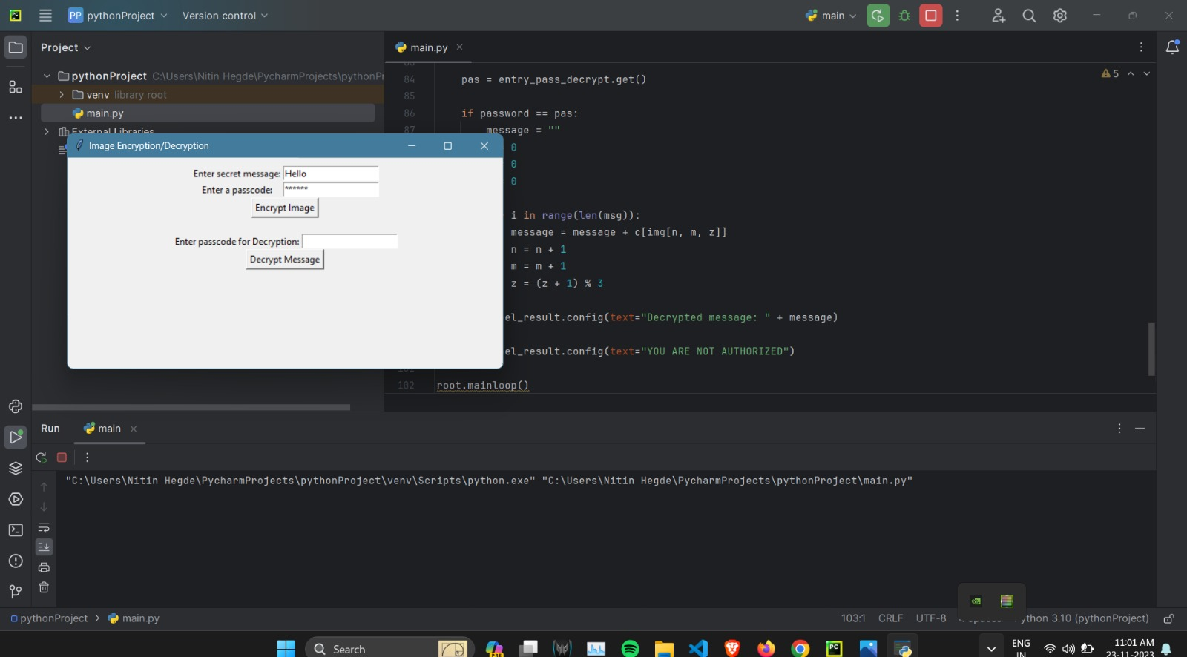
Screenshots of Results
Initial GUI to enter message and password

Slide 9
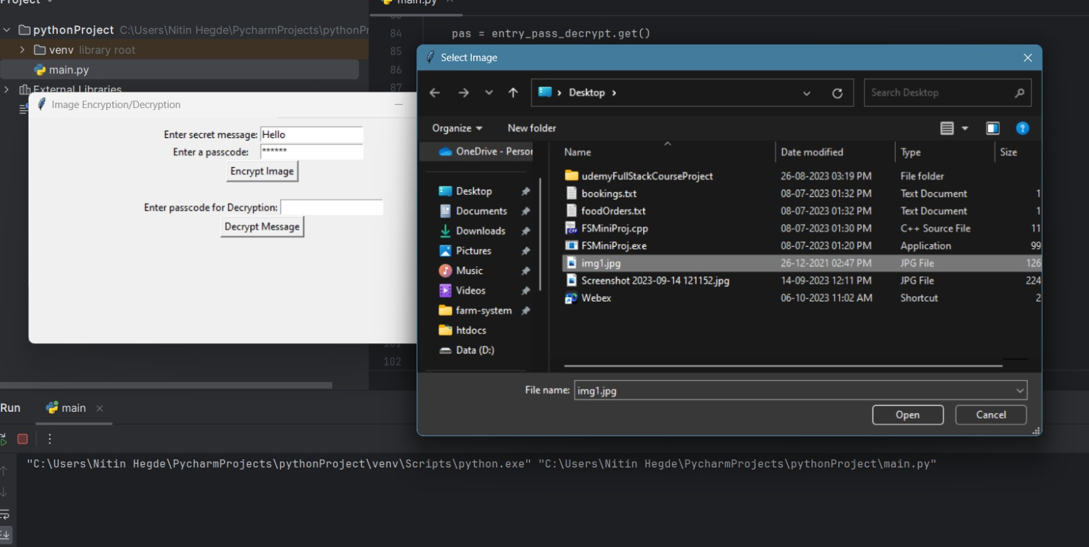
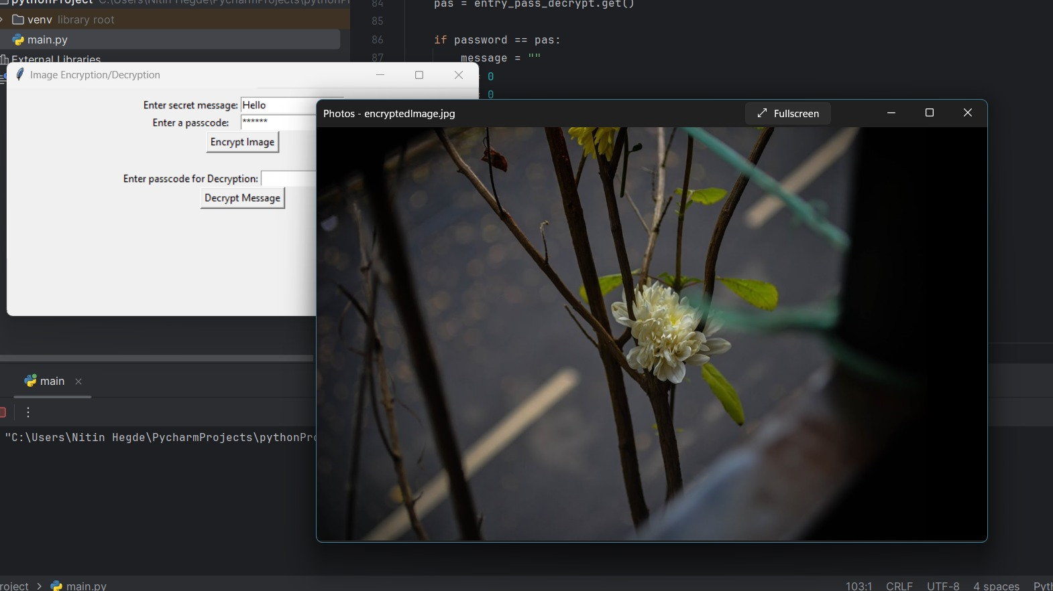
Selecting the image
Encrypted image displayed

Slide 10
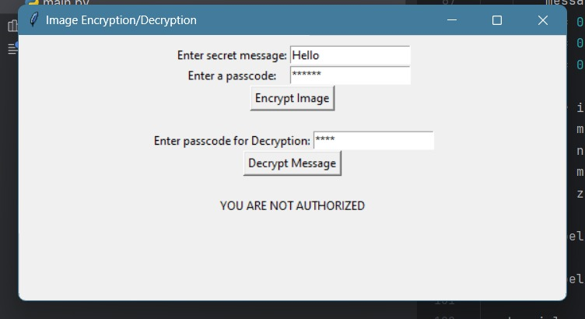
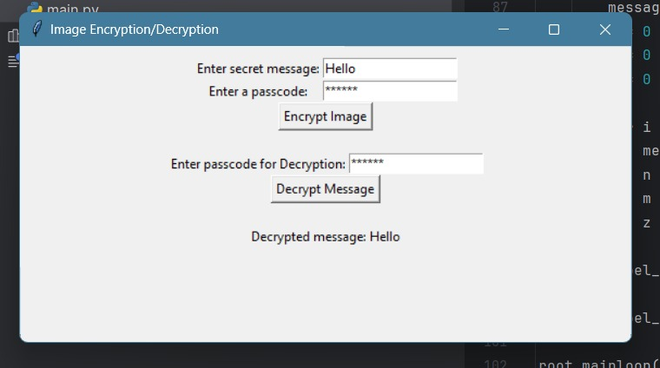
Upon entering a wrong password for decryption
Upon entering the right password for decryption

Slide 11

Links & References:
https://www.geeksforgeeks.org/python-gui-tkinter/
https://wiki.python.org/moin/GuiProgramming
https://www.geeksforgeeks.org/image-steganography-in-cryptography/
https://docs.opencv.org/4.x/
My Project- https://github.com/NitinHegde2002/IBMSkillsBuildInternship_Steganography

Slide 12
Thank You

