Slide 1
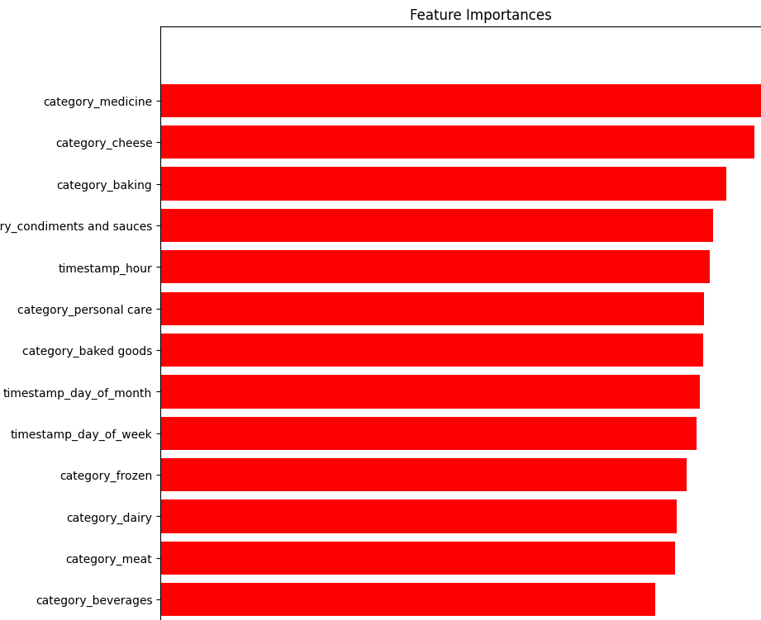
Modeling Findings
This feature importance visualisation tells us:
Most of the product categories are important
The category_medicine and category_cheese were most important in predicting stock
. The timestamp_hour is more important than timestamp_day_of_moth etc., for predicting stock

