Slide 1


E-COMMERCE WEBSITE
An One-Stop Destination for all your Techy Need.
By NITIN JOSHI | NIKHIL SAINI | KUNAL ROY | GARIMA CHAUHAN | DEEPAK KUMAR

Slide 2

Introduction
The E-Commerce Website is mainly designed to provide fast and effective user environment for Online Shopping activities. This application software is based on Model view controller architecture.
The Client side forms used for display forms the view, database connections, business logics are developed and are represented as models, while controllers are pages used to link model with the view.

Slide 3

Objectives
To develop an online system to help the Customer in interacting with the product and its properties.​
To manage the product details effectively​
Easy to perform CRUD related operations.
We can create an account as both admin and user.​
Our application is easy to use, secure and safe as the user details are encrypted in the data base​.

Slide 4

Software Requirements
Windows version 7+.
Front-end Software: Bootstrap, HTML & CSS.
Back-end software: Oracle Database, Spring boot, Spring Data JPA.
A browser which supports HTML & JavaScript.​

Slide 5

Used Tools And Technologies
Back-end Used
Java
Database(Oracle)
Spring Boot
Spring Data JPA
Front-end Used
1.Html
2.CSS
3.JavaScript

Slide 6

Significance
• Easy to update product information.​
• Work becomes speedy.​
• Access to product information individually.​
• Decrease the load of the person involve in existing manual system. ​
• Well-designed reports. ​
• Easy & fast retrieval of information.​
• Accuracy in work.​
• It contains better storage capacity. ​
• Robust database back-end. ​
• Creating and changing data at ease.​
​

Slide 7

Modules
Admin.
Customers(Users).
Registration.
Feedback.

Slide 8
Conclusion
The project has been appreciated by all the users in the organization.
It is easy to use, since it uses the GUI provided in the user dialog.
User friendly screens are provided.
The usage of software increases the efficiency, decreases the effort.
It has been efficiently employed as a site management mechanism. It has been thoroughly tested and implemented.

Slide 9
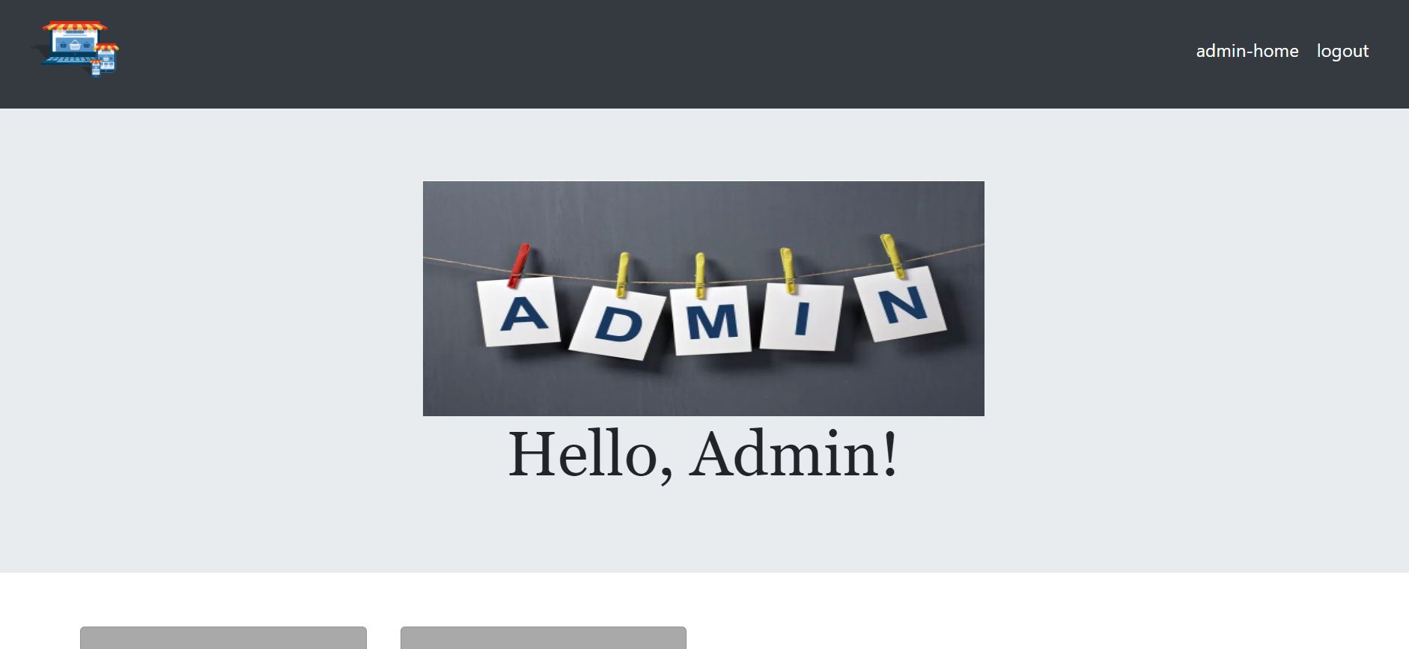
ADMIN PAGE:

Slide 10
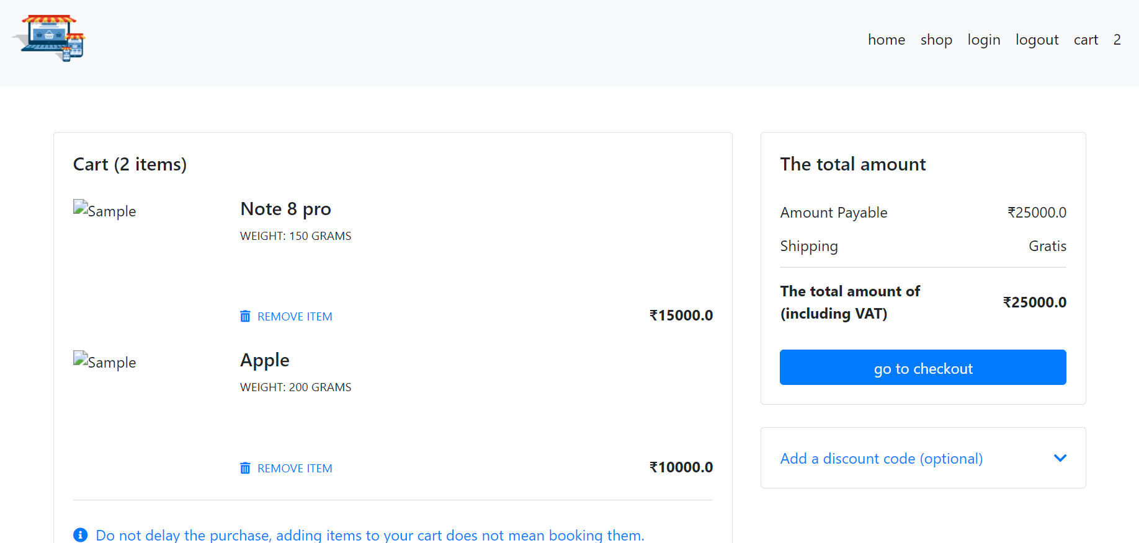
CART PAGE:

Slide 11
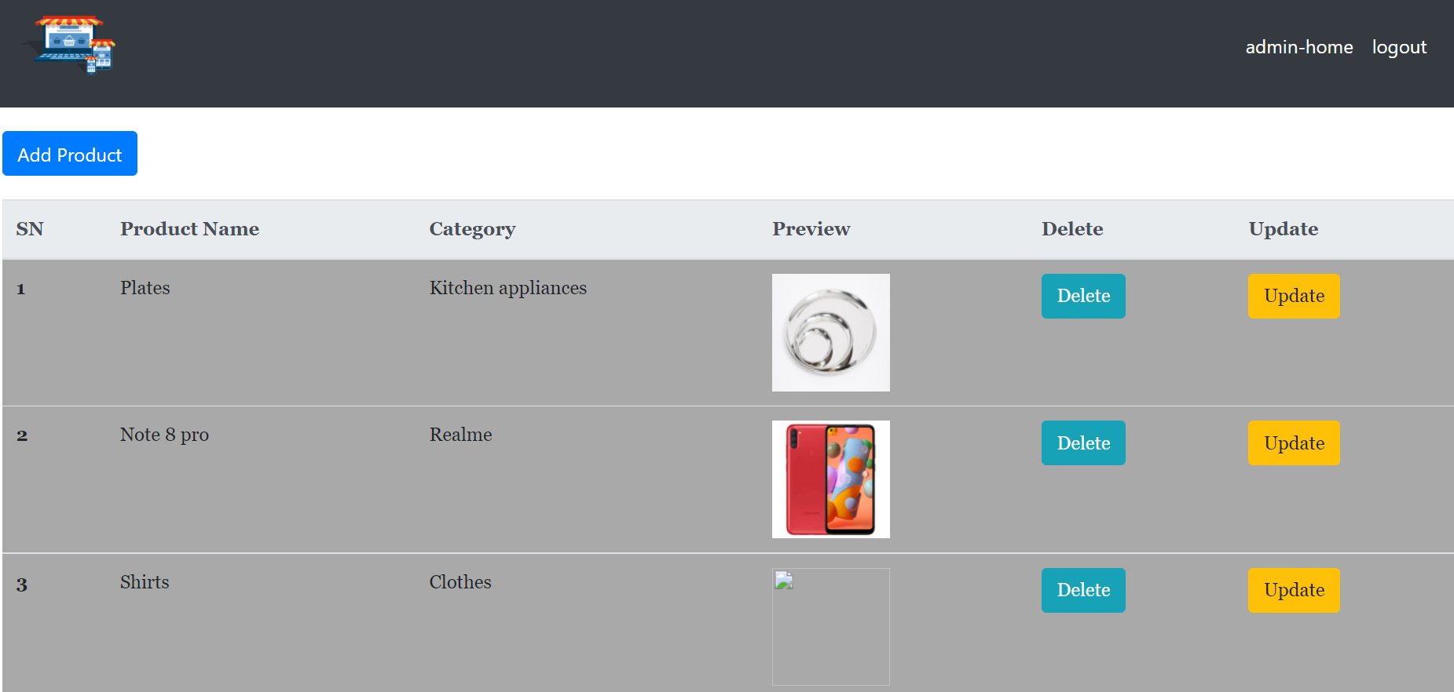
ADD PRODUCTS:

Slide 12
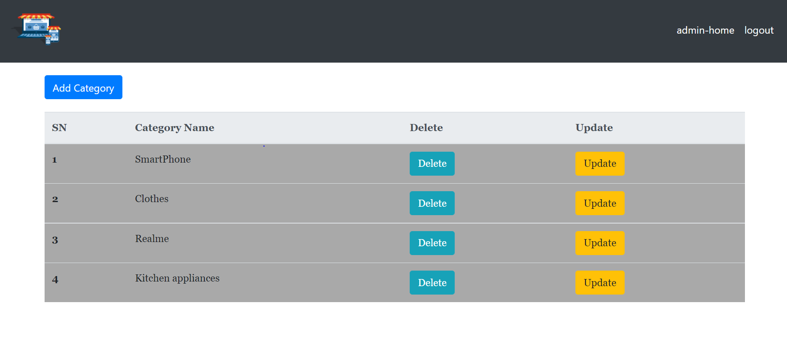
ADD CATEGORY:

Slide 13
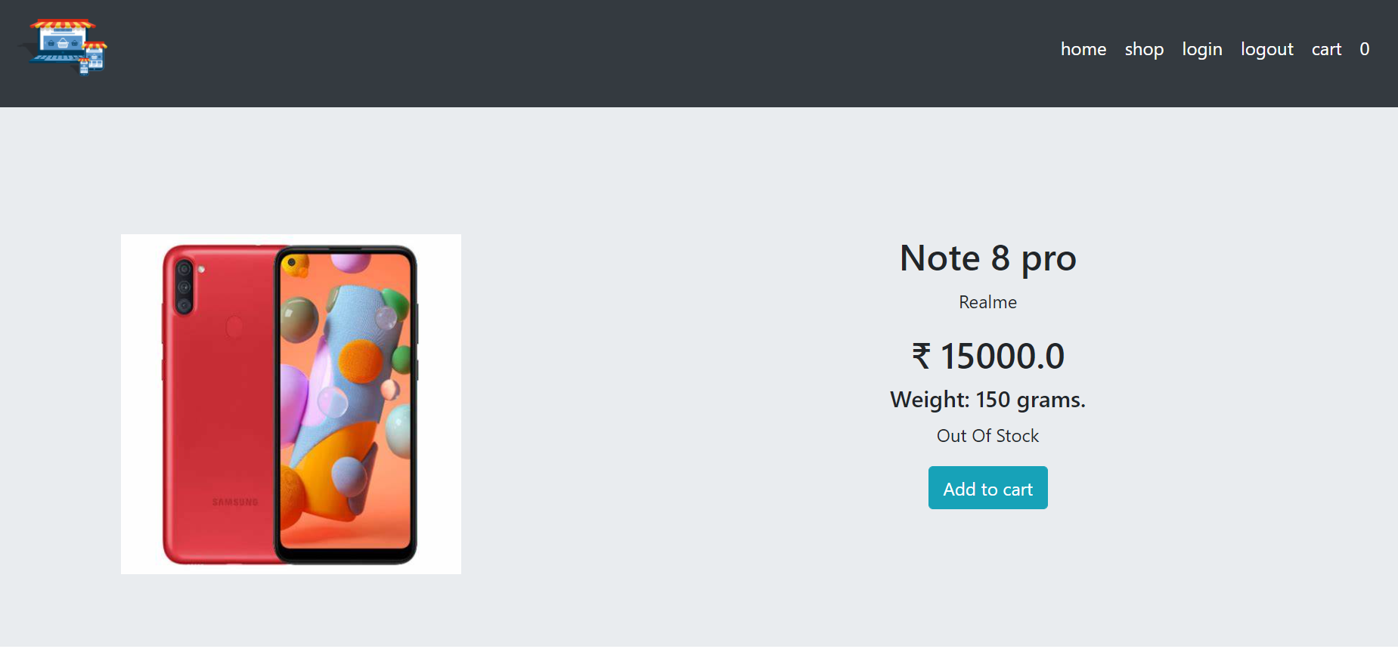
PRODUCT DESCRIPTION:

Slide 14
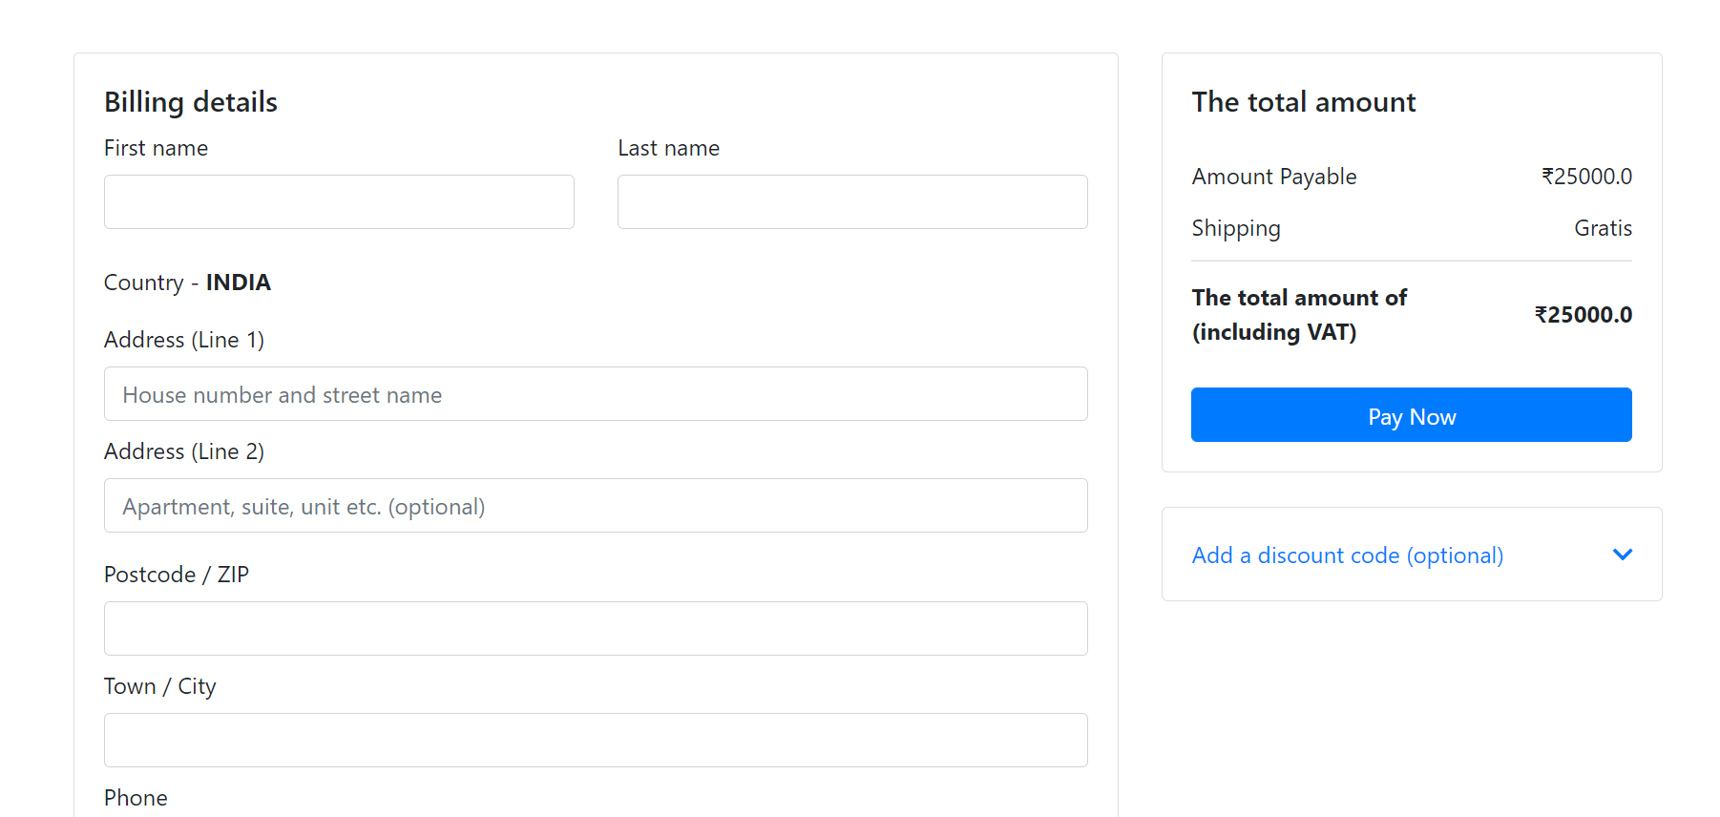
CHECKOUT PAGE:

Slide 15
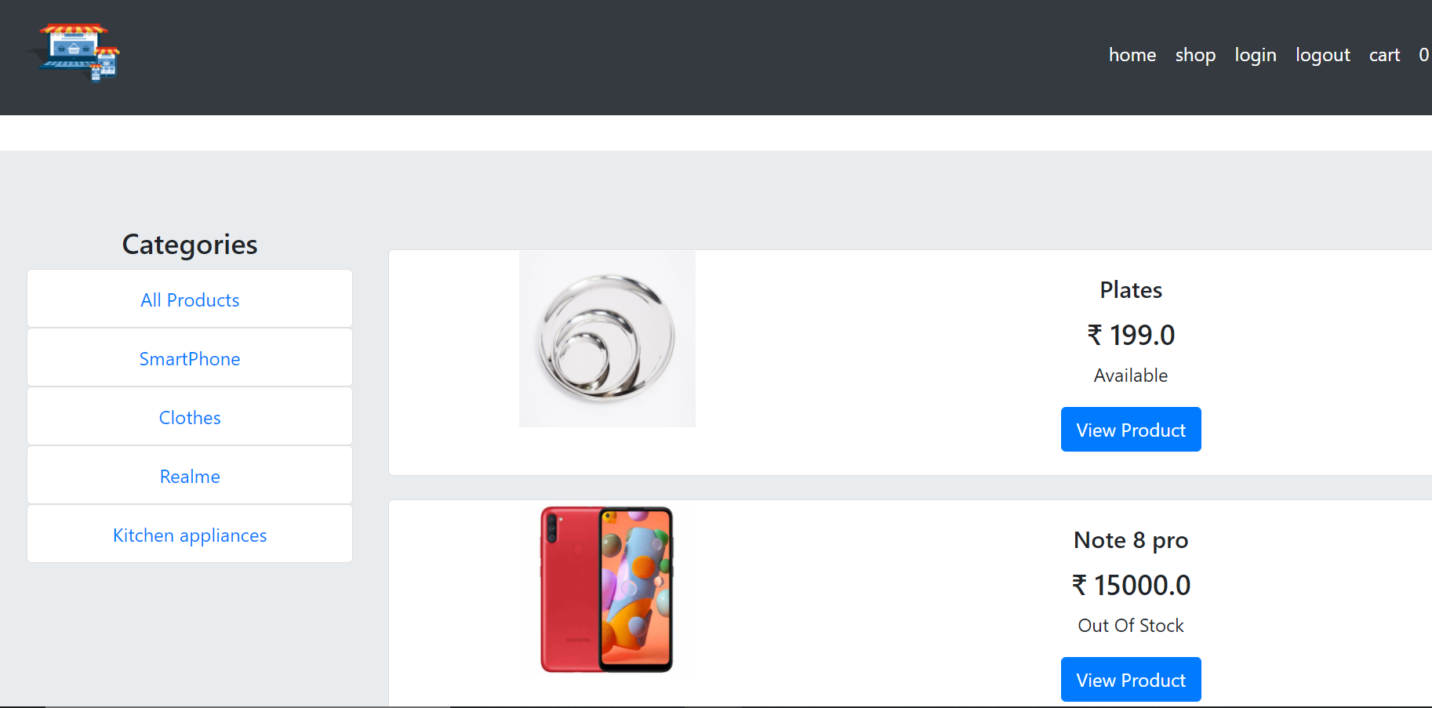
SHOP PAGE:

Slide 16


