Slide 1

Design And Fabrication Of Arduino Based Robotic Arm
Prepaerd by: Nitin Khule & Nikhila Patil
Guided by: Prof. Sachin Shinde & Prof. Ganesh Dhurde
Department Of Mechanical Engineering Datta Meghe College Of Engineering

Slide 2
Outline Of Project
Introduction
Objective.
Literature Review.
Research Methodologies.
Work Analysis.
Bill of materials.
Action plan.
Expected outcome.
Reference.

Slide 3
Introduction -
This project focuses on the improvement of standard robotic system, its performance and comfort.
Programming is introduced in the standard robotic arm using Arduino as microcontroller.
Gesture of operator's hand is interfaced with all the 3 DOF of the arm and actuation of end effector. The end effector can be pick and place etc.
Single handed operation of all the three Degree of Freedom is introduced without depending on any switches.

Slide 4
Objective
Achieving all the three Degree of Freedom of the Robotic Arm by single hand gesture of the operator
Developing programme with standard Robotic Arm using Microcontrolller device.
Actual interfacing and trouble shooting the operator's hand and arm movement.
Application oriented programming which can be changed as per the requirement of the Robotic operation.

Slide 5
Literature Review
Sr. No. | Author and Year of Publication | Summary
1. | Mohamed et.al., 1991 | Pick and place robotic arm controlled by Computer vision. Here the robot picks the object at a specific orientation only. Rubber griper can be used so that it can handle the materials safely.
2. | Anush et.al., 2011 | Design and Fabrication of pick and place Robot to Be used in Library. Here the robot pick up the books from library and deliver this to the destination. This system can be made capable of doing specific task by making it a line following robot.
3. | Begum et.al., 2012 | Autonomous android controlled robot design using wireless energy. Here the system can be made to work according to voice commands by the user so that the robotic arm is capable of picking up the objects in any orientation.
4. | Yoshimi et.al., 2005 | A system for picking up operation of thin objects by robotic arm with two fingered parallel gripper. Thin objects like paper and plastic cards are picked up by this robotic arm.

Slide 6
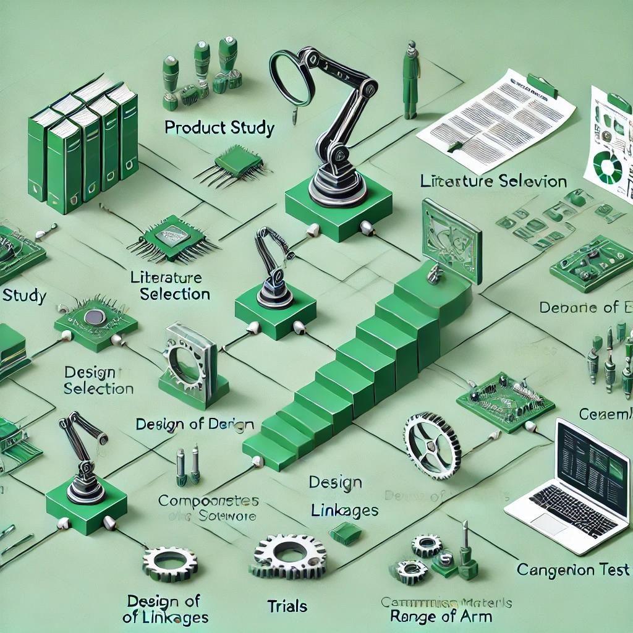
Methodology

Slide 7
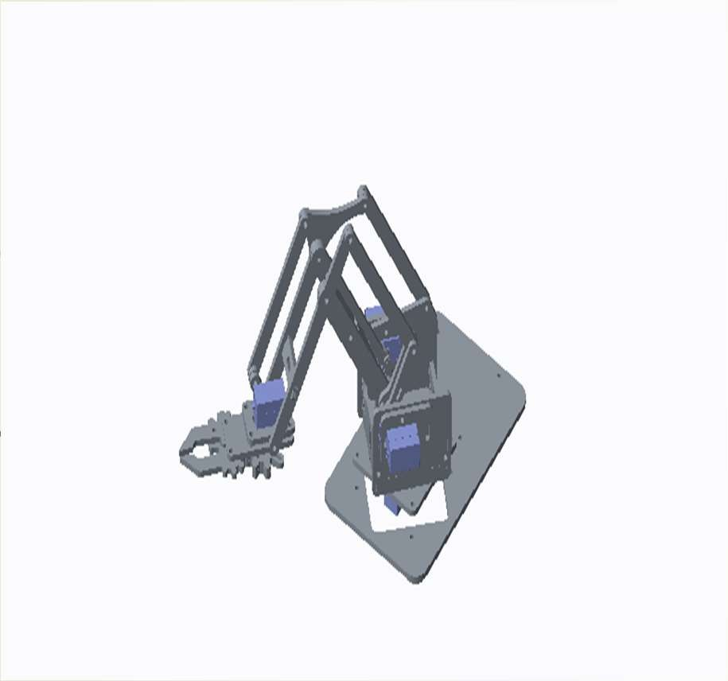
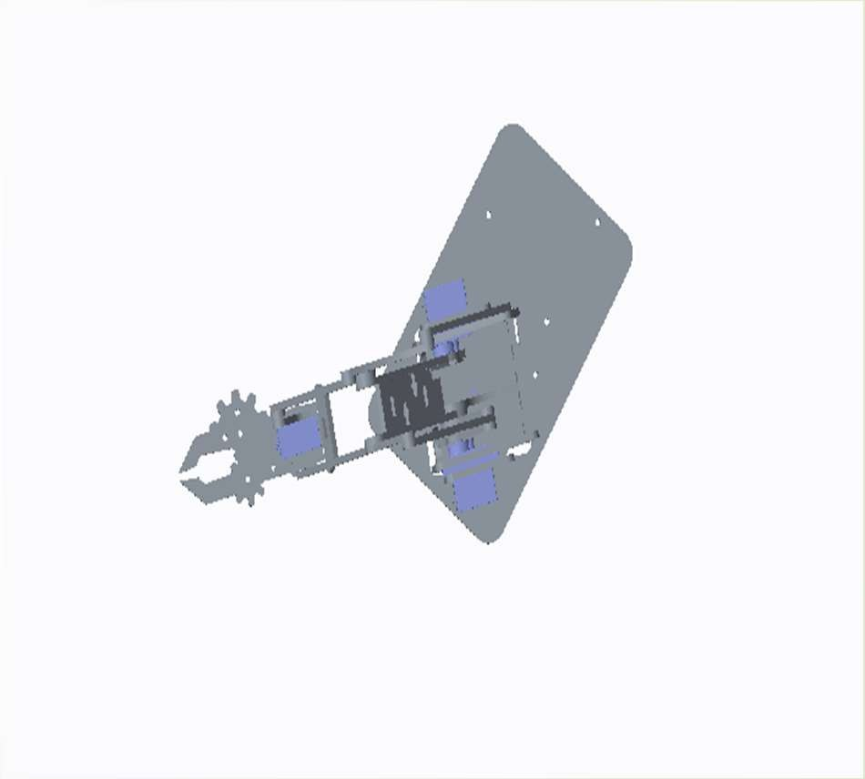

Design And Fabrication
Parallel linkage connector
Right arm servo plate (60*40*3)
(630mm.sq)
Parallel linkage
Base plate.
(135*80*3)
wrist joint
(90*8*3)
Servo motor for gripper
(120*12*3)
Main cross web (55*30*3)
Gripper
Pivot plate
(60*60*3)
Left arm servo plate (60*40*3)
Servo gear
Servo motor for up and down movement.
Servo motor for right & left movement
Fig.1 – Robotic arm 3D CAD model.
Fig.2 – Robotic arm 3D model (top view).

Slide 8
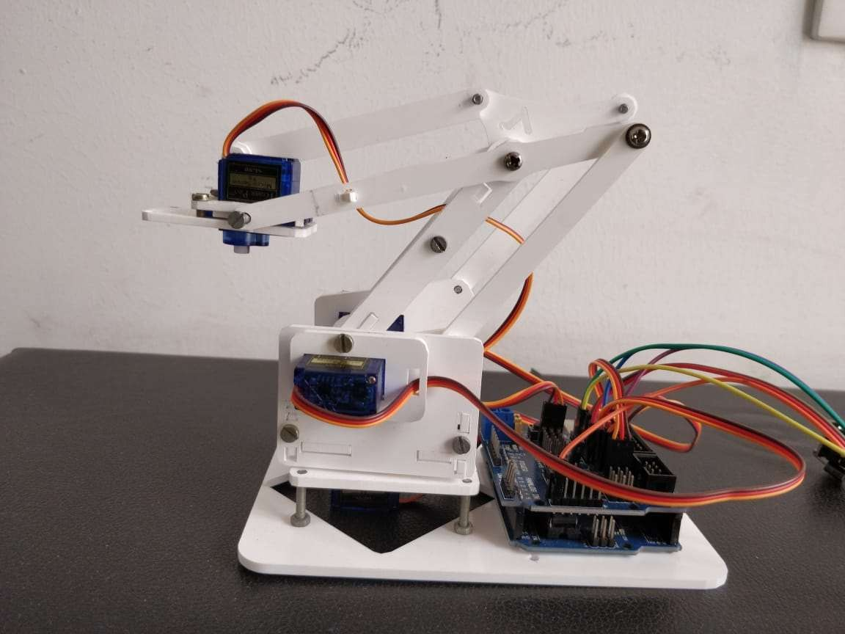
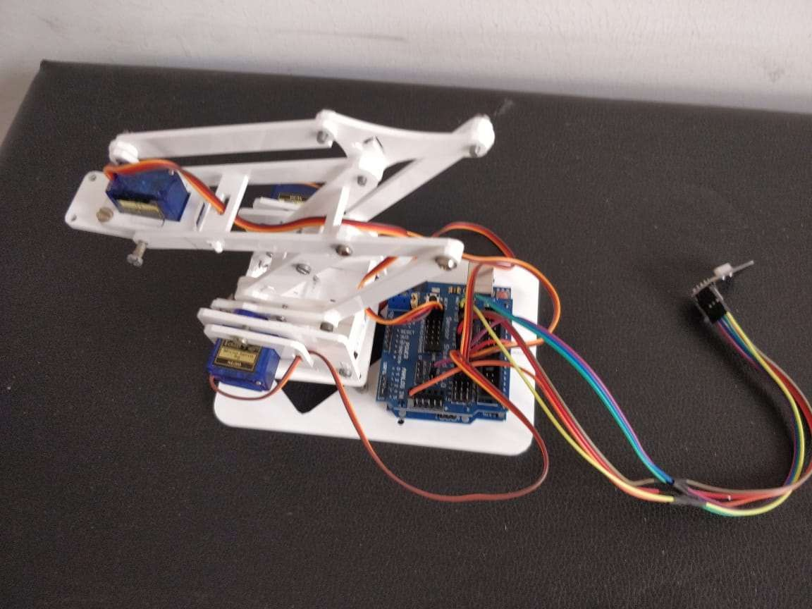
Fig.3 - Robotic arm (front view)
Fig.4 - Robotic arm (top view)

Slide 9
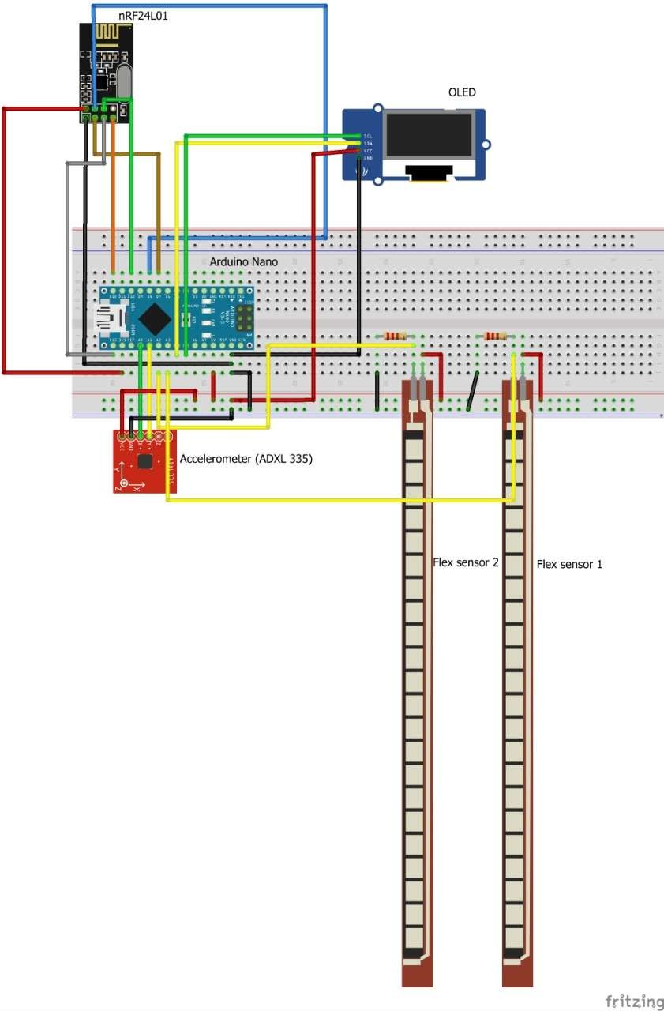
Fig.6 - Hand circuit Diagram

Slide 10
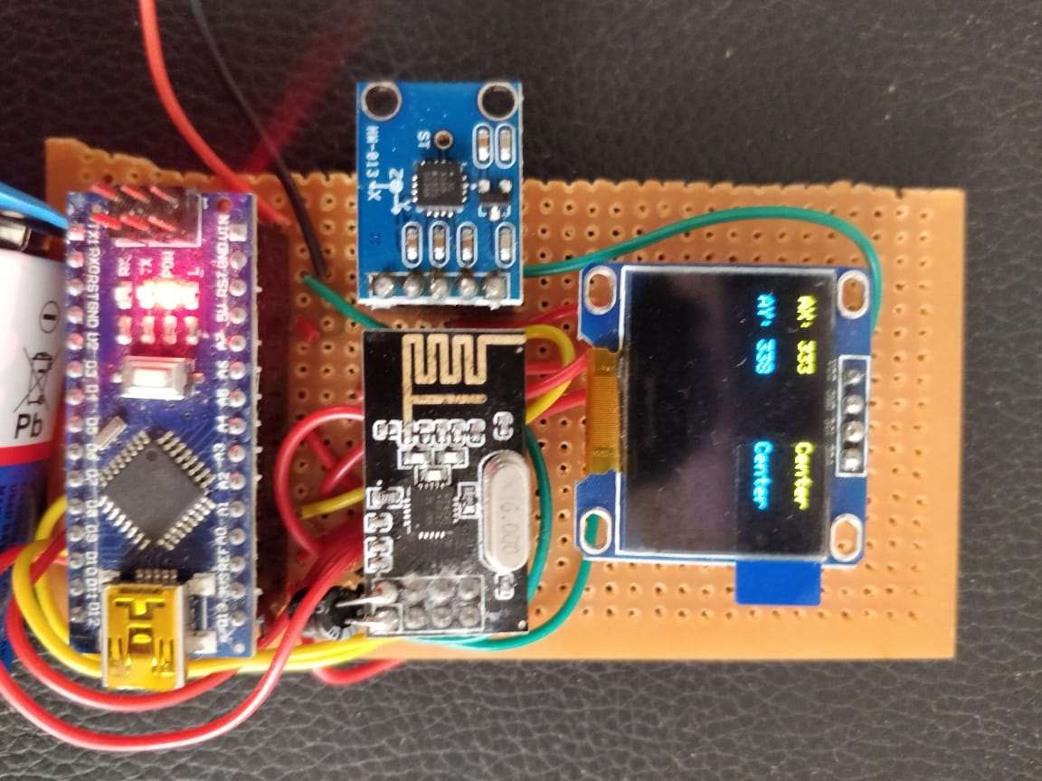
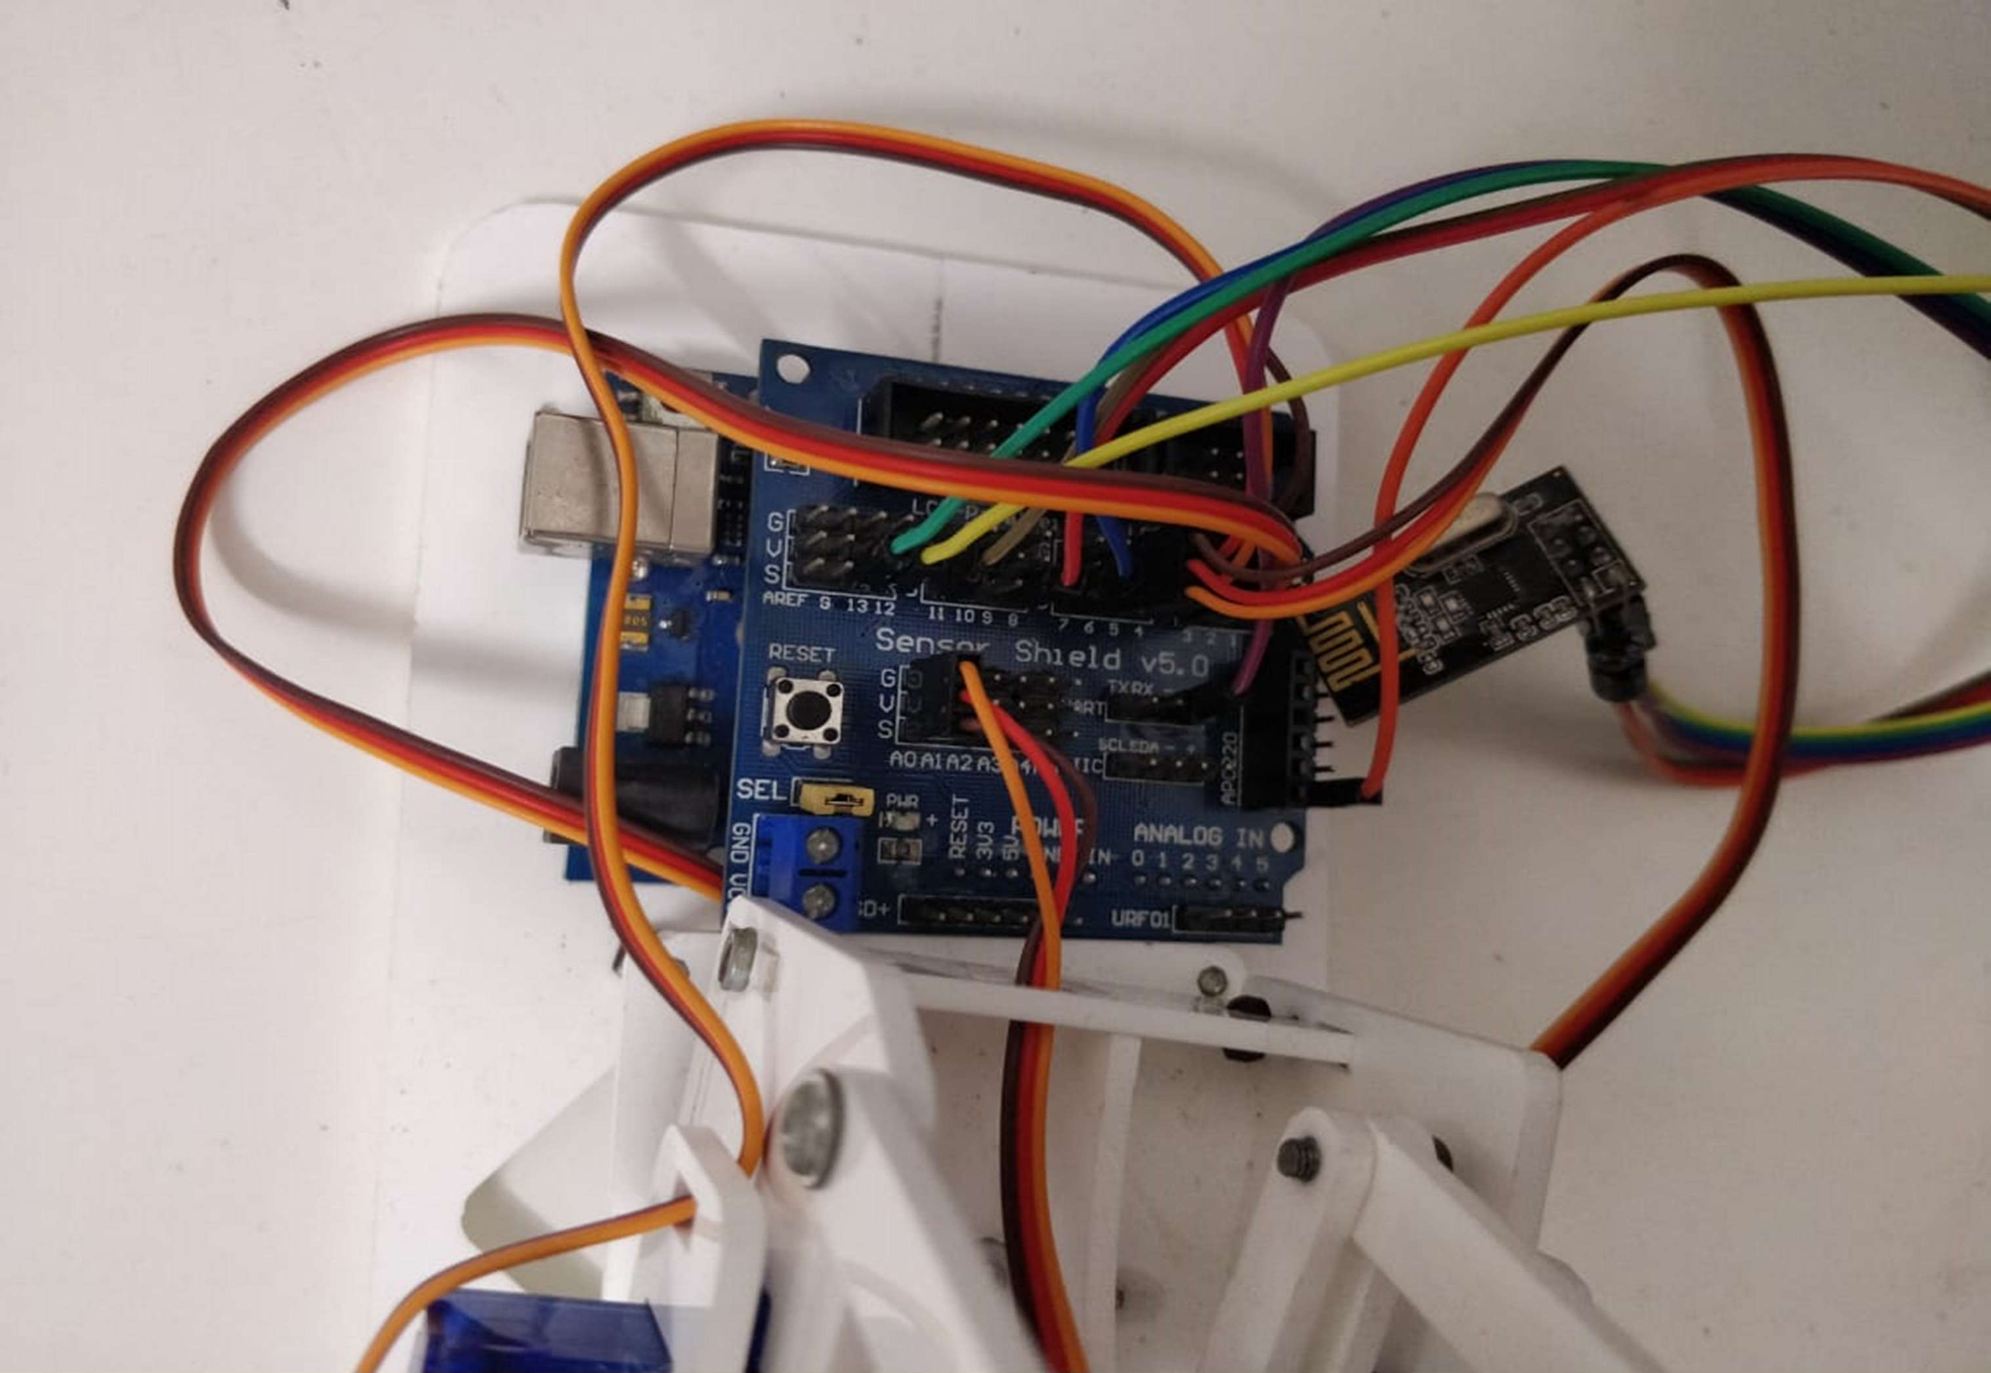
Fig.7 - Actual Hand circuit
Fig.8 - Arm circuit

Slide 11
Observation And Results
It can pick and place a weight upto 0.8 kg with servomotor having accuracy of drive of 0.5 degree.
Linear velocity of arm is calculated to be 36 millimeter per second for the servos programmed to rotate 1 degree in 32 milliSeconds.
It's circular range is 200 mm i.e the reach of the arm from origin.
Semicircular working Envelope is 100 mm since the arm cannot access inner reach upto 100 mm.
Validation of Result
Validation is done since the arm is getting successfully actuated as per the Gesture of operator's hand.

Slide 12
Future Scope
The robot so programmed for picks and place operation can be made versatile and more efficient by providing the feedback.
Making it to work on own than any human interventions.
It can be made possible by image processing tool interfaced with this Arduino.
It operate on its own thought without any human intervention are line follower, obstacle avoider, metal detector, bomb diffuser etc.
Conclusion
The system has a very good response time and requires less time for set-up.
Achieving all the three Degree of Freedom of the Robotic Arm by single hand gesture of the operator.

Slide 13
References
S Mohamed, “New Approaches to Robotics”, Science, vol. 253, pp. 1227- 1232, 13 September, 1991.
J. Anush, J. Adams and H. Molle “Arduino Robotics”, Springer Science and Business Media, 2011.
N F Begum, M. Couceiro, C. Figueiredo and R. Rocha, "TraxBot: Assembling and Programming of a Mobile Robotic Platform". In Proc. of the 4th International Conference on Agents and Artificial Intelligence (ICAART 2012), Vilamoura, Portugal, Feb 6-8, 2012.
T Yoshimi, B. Gerkey, R. Wheeler, and A. Y. Ng, "ROS: an open-source Robot Operating System," in Proc. Open-Source Software workshop of the International Conference on Robotics and Automation, Kobe, Japan, May, 2009.
S Wang and A. Howard, "The Player/Stage Project: Tools for Multi - Robot and Distributed Sensor Systems", In Proc. of the Intl. Conf. on Advanced Robotics, pp. 317-323, Coimbra, Portugal, 2003.

