Slide 1

B.E. Project Outline
DESIGN AND FABRICATION OF FRICTIONLESS BREAKING SYSTEM
BACHELOR OF ENGINEERING IN MECHANICAL ENGINEERING
By
Nikhila Vijay Patil Roll no. A-71
Nitin Parshuram Khule Roll no. A-70
Preeti Ramkrushna Jadhav Roll no. A-21
Sushant Dattu Choraghe Roll no. A-11
Guided by
Prof. Amol J. Ghude (Guide)
Prof. Rajesh R. Shekapure (Co-Guide)
Department of Mechanical Engineering
Datta Meghe College of Engineering
Plot no. 98, Sector 3, Airoli, Navi Mumbai, 400708
2019-20

Slide 2
1. INTRODUCTION
Frictionless brakes rely completely on certain magnetic properties and resistance.
Frictionless brakes are silent and are much smoother than friction brakes.
Frictionless brakes are more efficient than normal brakes.
It reduces the risk of accidents.
.

Slide 3
2. OBJECTIVE
To design and fabricate Frictionless Braking system with greater performance replacing conventional breaking system.
To achieve better braking efficiency.
To increase the reliability and life span of brakes.
To increase power to weight ratio.
To reduce the maintenance cost.
To analyse the stresses in braking system.

Slide 4
3.LITERATURE REVIEW
Sr No. | Year | Author | Paper | Summary
01 | 2013 | Ajay Yadav | Electromagnetic brakes in two wheelers | Electromagnetic brakes can be applicable in two wheeler at high speed with low maintenance cost.
02 | 2008 | Sergey Kitanov and Anatoly Podol’skii | current and magnetic rail brakes for high speed trains | The magnetic eddy current brakes containing permanent magnet pieces offer several advantages over convention braking system
03 | 2014 | Akshay kumar S. Puttewar, Nagnath U. Kakade | Electromagnetic brakes in automobile | In electromagnetic braking system even any coil fails the brake does not completely fails and remaining three coils work properly unlike oil or air braking system. This system needs very low maintenance.

Slide 5
4.RESEARCH METHODOLOGY
Studying Frictionless Braking system working principle
Introduction of components
Selection of material
Design of Braking System
Manufacturing of Braking System and Stress analysis
Analysis of Braking System
To get experimental result

Slide 6
5. ACTION PLAN
SR NO | PROJECT ACTIVITIES | STAT DATE | COMP DATE
1 | PLANNING THE TASK | 19/8/2019 | 14/9/2019
2 | MARKET SURVEY | 4/10/2019 | 18/10/2019
3 | DESIGN & PLANNING THE FABRICATION PROCESS | 14/12/2019 | 28/12/2019
4 | PREPAIRING DRAWING AND ESTIMATION OF MATERIAL | 3/1/2020 | 17/1/2020
5 | MARKET SURVET FOR PURCHASE AND PROCURING THE MATERIAL | 30/1/2020 | 8/2/2020
6 | PLANNING AND PROCESS | 21/2/2020 | 23/2/2020
7 | MANUFACTURING THE SUBCOMONENTS | 28/2/2020 | 13/3/2020
8 | ASSEMBLY | 14/3/2020 | 15/3/2020
9 | Comparative study | 14/3/2020 | -

Slide 7
6.EXPERIMENTATION AND ANALYSIS
PRINCIPLE AND WORKING OF FRICTIONLESS BRAKING SYSTEM
When an electrical conductor, such as copper or aluminium, moves through the field of a permanent magnet or an electromagnet, electromagnetic induction creates eddy currents, which dissipate some of the kinetic energy into Joule heat and results in slowing the motion of the conductor.
This principle is utilized in the construction of magnetic brakes. This demonstration shows magnetic braking applied to a rotating metallic disc.
In contrast to conventional friction brakes, there is no direct contact between interacting surfaces, which makes magnetic braking more reliable and reduces wear and tear.
A magnetic brake is a device that leverages strong magnetic forces to slow a vehicle down.

Slide 8
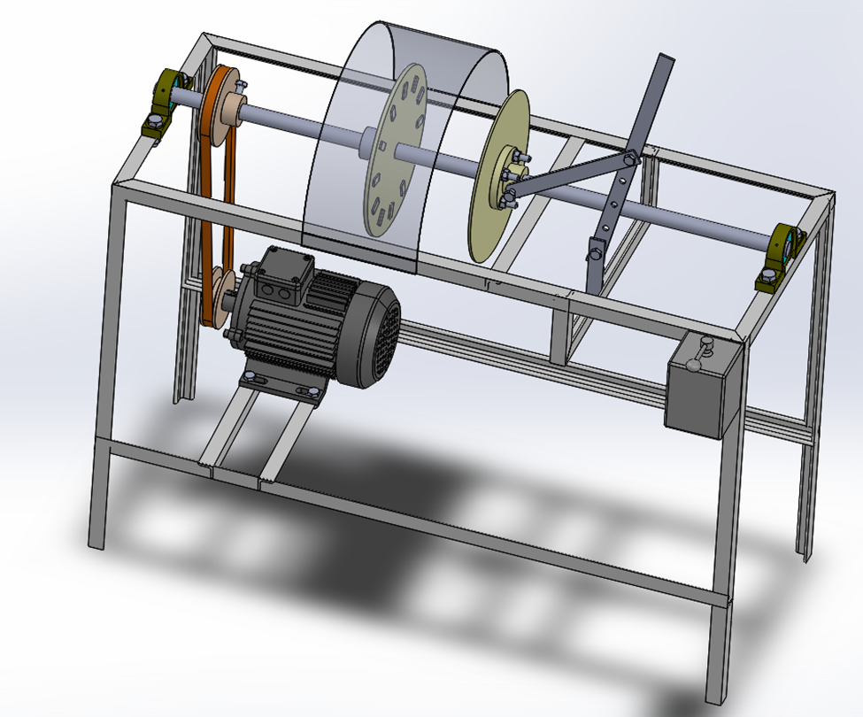
Magnetic Plate
Neodymium Magnets
Hood
Stopping Plate
Pulley
Handle
Shaft
V Belt
Bearing
Motor
Main Frame
Fig (A):Frictionless braking system

Slide 9
7. MATERIAL USED
Table of Raw Material & Standard Material
SR NO | PART NAME | MAT | QTY
1 | Frame | MS | 1 Nos
2 | Magnet | Neodymium | 12 Nos
3 | Shaft Dia 20 mm | EN 8 | 1 Nos
4 | 0.5 Hp 3 Phase Ac Motor 1380 | STD | 1 Nos
5 | Pulley | MS | 2 Nos
6 | Flywheel | STD | 1 Nos
7 | Aluminium Wheel | Al | 1 Nos
8 | Pedestal Bearing | CI | 2 Nos
9 | Free Wheel | STD | 1 Nos

Slide 10
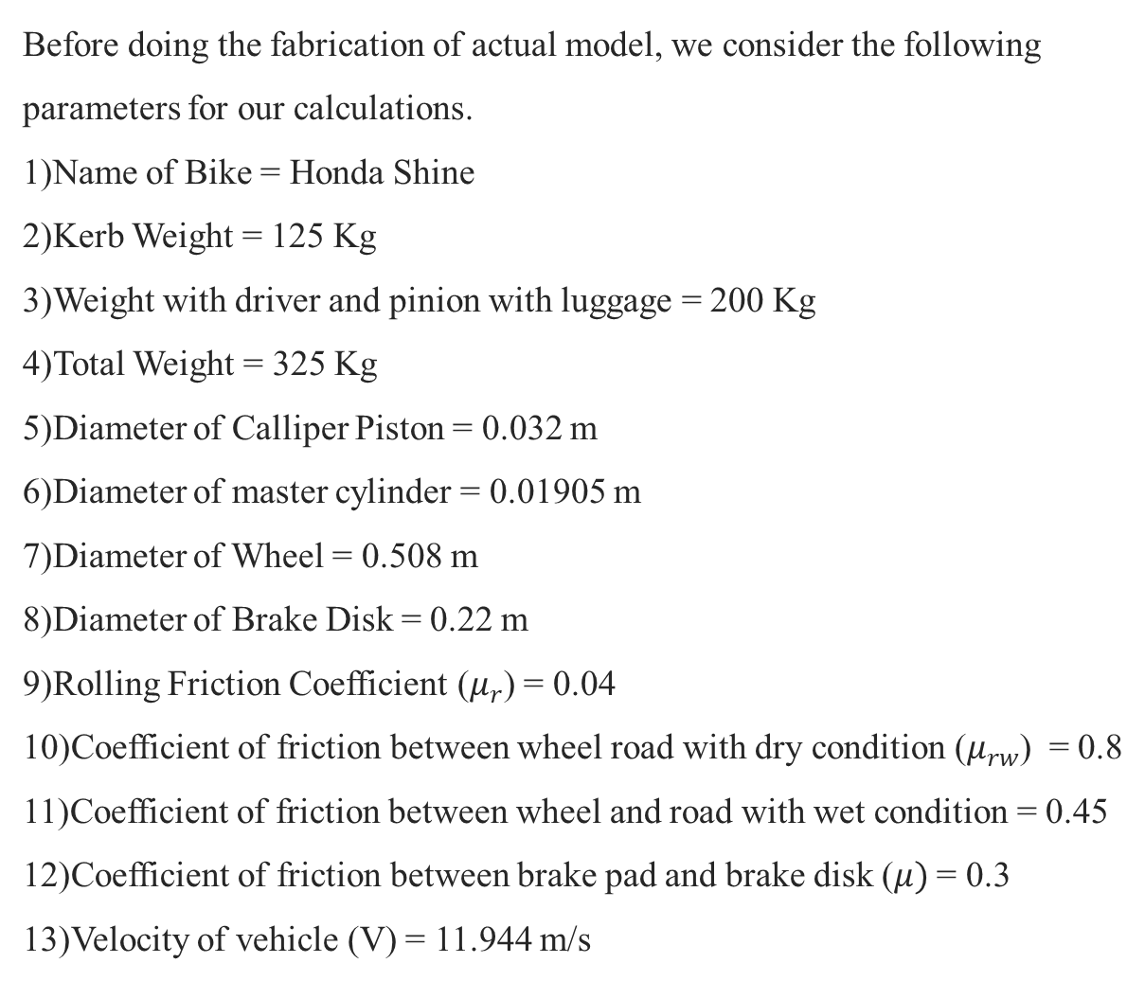
Before doing the fabrication of actual model, we consider the following parameters for our calculations. 1)Name of Bike = Honda Shine 2)Kerb Weight = 125 Kg 3)Weight with driver and pinion with luggage = 200 Kg 4)Total Weight = 325 Kg 5)Diameter of Calliper Piston = 0.032 m 6)Diameter of master cylinder = 0.01905 m 7)Diameter of Wheel = 0.508 m 8)Diameter of Brake Disk = 0.22 m 9)Rolling Friction Coefficient ($μ_{r}$) = 0.04 10)Coefficient of friction between wheel road with dry condition ($μ_{rw}$) = 0.8 11)Coefficient of friction between wheel and road with wet condition = 0.45 12)Coefficient of friction between brake pad and brake disk ($μ)$ = 0.3 13)Velocity of vehicle (V) = 11.944 m/s
7. FABRICATION

Slide 11
7.1 Design specification for Frictionless Braking System :
Sr No. | Design Part | Specification
1 | Motor | 0.5 Hp, 1380 rpm
2 | Pulley-1 | 100 mm
3 | Pulley-2 | 75 mm
4 | V Belt (L) | 37 inch
5 | Shaft (D) | 20 mm
6 | Bearing | P204
7 | Bolt (D) | 8 mm
8 | Stand Angle (L Shaped) | 20*20*4

Slide 12

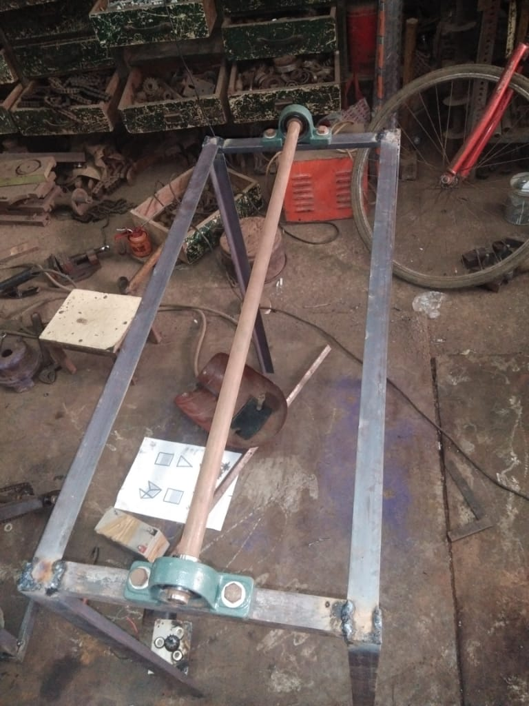
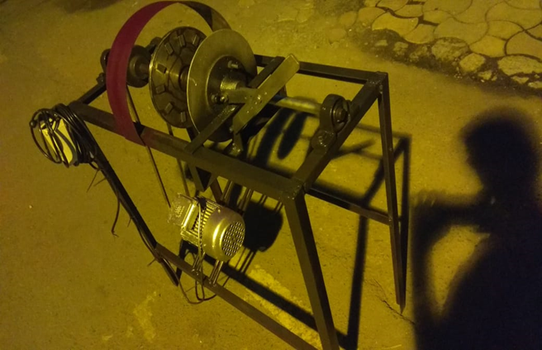
Fig(B):CAD model of Frictionless Braking System
Fig(C):Project in making
Fig(D):finished model of
frictionless brake

Slide 13
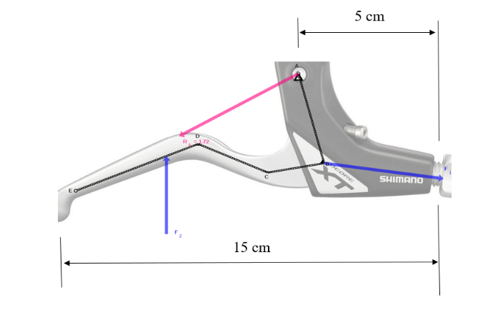
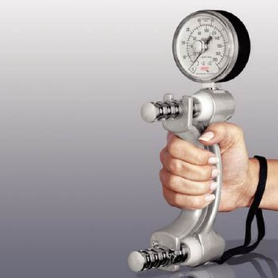
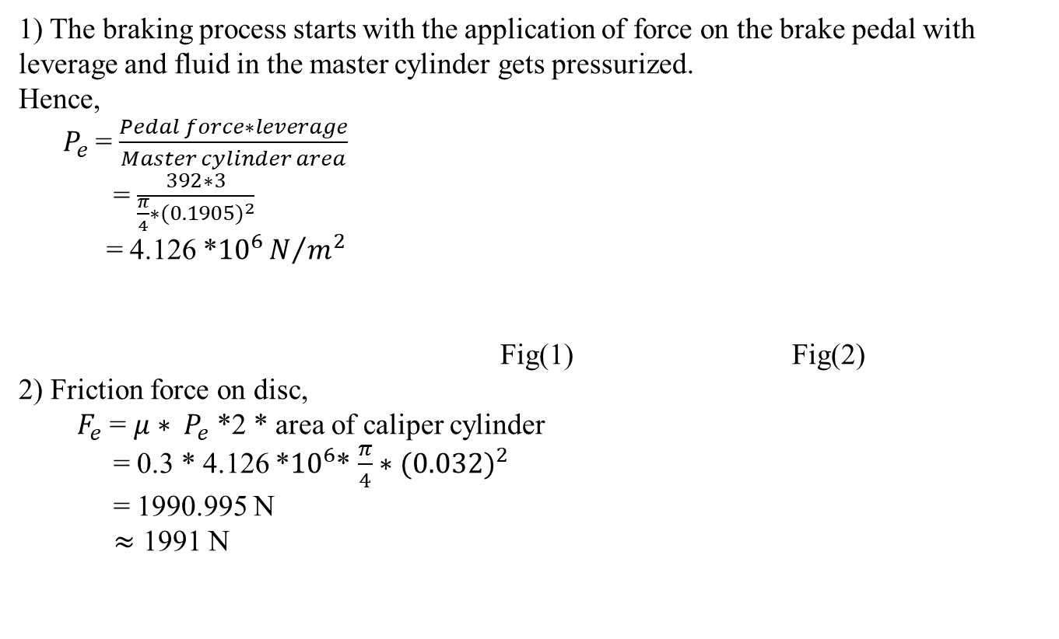
7.2 Braking Time Calculation For Disc Brake:
1) The braking process starts with the application of force on the brake pedal with leverage and fluid in the master cylinder gets pressurized.
Hence,
$P_{e}$ = $\frac{Pedal force∗leverage}{Master cylinder area}$
= $\frac{392∗3}{\frac{π}{4}∗{(0.1905)}^{2}}$
= 4.126 *${10}^{6}N/{m^{2}}$
Fig(1) Fig(2)
2) Friction force on disc,
$F_{e}$ = $μ∗ P_{e}$ *2 * area of caliper cylinder
= 0.3 * 4.126 *${10}^{6}$* $\frac{π}{4}∗{(0.032)}^{2}$
= 1990.995 N
$≈$ 1991 N

Slide 14
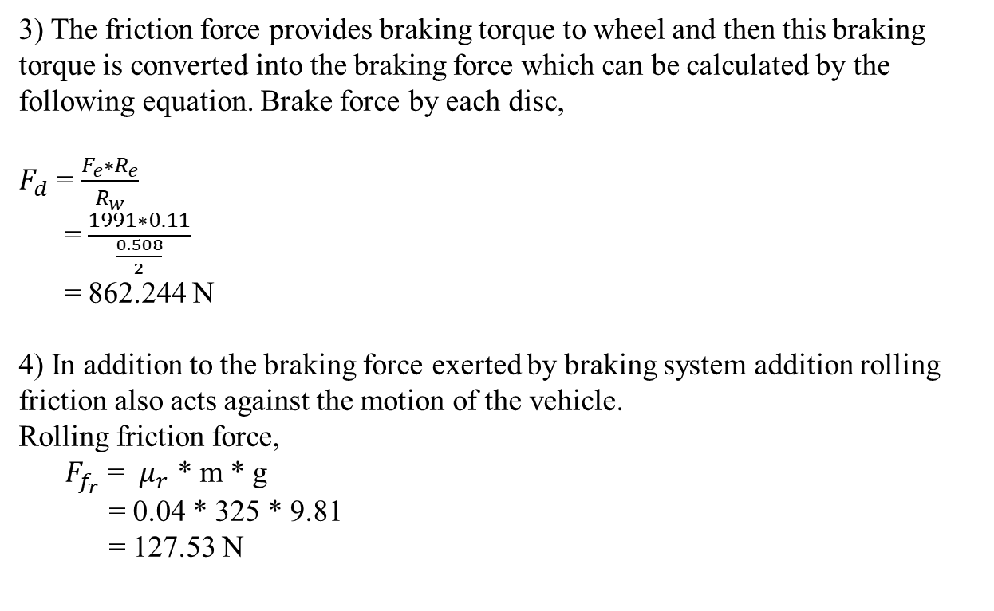
3) The friction force provides braking torque to wheel and then this braking torque is converted into the braking force which can be calculated by the following equation. Brake force by each disc,
$F_{d}$ = $\frac{F_{e}∗R_{e}}{R_{w}}$
= $\frac{1991∗0.11}{\frac{0.508}{2}}$
= 862.244 N
4) In addition to the braking force exerted by braking system addition rolling friction also acts against the motion of the vehicle.
Rolling friction force,
${ F}_{f_{r}}$ = $μ_{r}$ * m * g
= 0.04 * 325 * 9.81
= 127.53 N

Slide 15
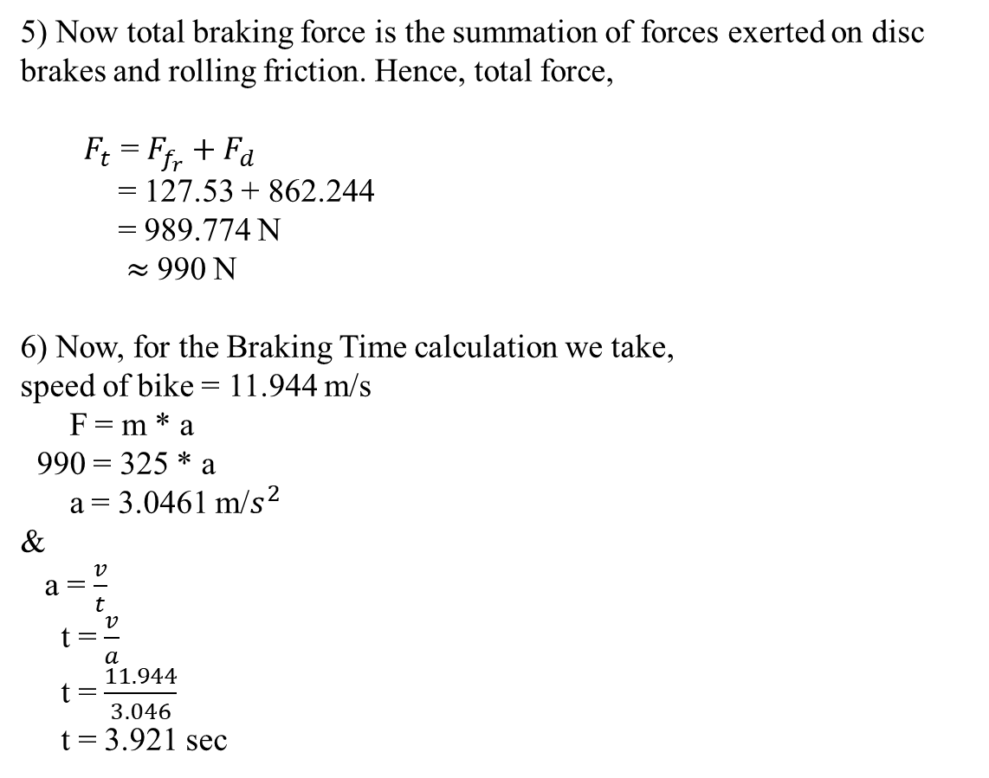
5) Now total braking force is the summation of forces exerted on disc brakes and rolling friction. Hence, total force,
$F_{t}$ = $F_{f_{r}}+F_{d}$
= 127.53 + 862.244
= 989.774 N
$≈$990 N
6) Now, for the Braking Time calculation we take,
speed of bike = 11.944 m/s
F = m * a
990 = 325 * a
a = 3.0461 m/$s^{2}$
&
a = $\frac{v}{t}$
t = $\frac{v}{a}$
t = $\frac{11.944}{3.046}$
t = 3.921 sec

Slide 16
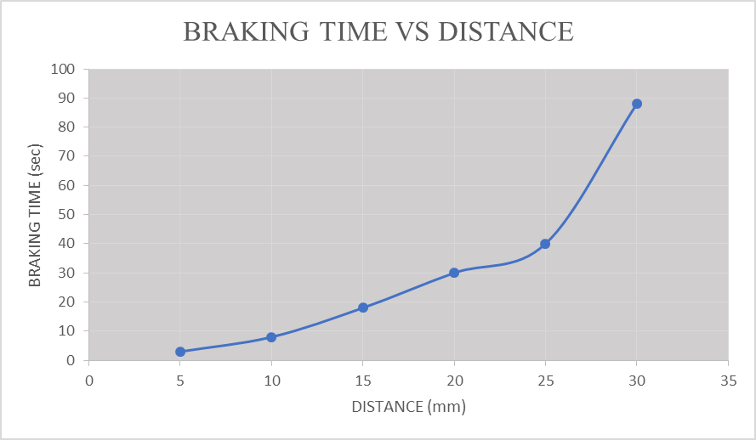
8.OBSERVATION
Sr No. | DISTANCE (mm) | BRAKING TIME (sec)
1 | 30 | 88
2 | 25 | 40
3 | 20 | 30
4 | 15 | 18
5 | 10 | 8
6 | 5 | 3

Slide 17
9. VALIDATION OF RESULTS
Sr No | Type Of Brake | Theoretical Braking Time (Sec) | Practical Braking Time (Sec)
1 | Disc Brake | 3.921 | 4.5
2 | Frictionless Brake | - | 3 (For 5mm)

Slide 18
10. RESULTS
Braking efficiency increases.
Stopping time of vehicle decreases.
Power consumption of vehicle reduces.
Wear and tear of brake is zero.
High Braking effect is obtained at minimum distance between magnet and stopping plate.

Slide 19
11.CONCLUSION
Frictionless Braking System found to be more reliable compared to other braking system.
This system required very less maintenance.
It is an abrasion free method.
Frictionless brake increases the safety and reduces the risk of accident.
Overall cost of Frictionless Braking System is lesser than others.

Slide 20
12.LIMITATIONS
The installation of an frictionless brake is difficult.
Complexity is higher than conventional brakes.
All magnets have a sudden curie point ,a temperature at which they lose their magnetism. This is very bad for braking action.
Neodymium magnets get corroded after some time.
Installation cost is high.

Slide 21
13.FUTURE SCOPE
Frictionless brakes satisfy all the energy requirements of braking without use of friction.
With the help of frictionless braking system, the braking time is reduced.
They can be also used as a supplementary retardation equipment in addition to the regular friction brakes in heavy vehicles.
The overall cost is less.
With the use of this technology noise will be reduced.
This can be used as an alternative method for the future crisis of oil.

Slide 22
14. REFERENCE
1) Ajay Yadav, “Electronic Motor Braking,” IEEE Trans. On Industry Applications, vol.IA-19,pp.824-831,Apr.1983.
2) A. Podol’skii, “On a numerical solution of a case of magnetization of ferromagnetic materials” (in Russian), Electrichestvo, No 8, pp. 80-84, Aug. 1990.
3) Akshyakumar S Puttewar “Enhancement of Braking System in Automobile Using Electromagnetic Braking” IJAREEIE, 2010
Braking” IJAREEIE, 2010
4) Lenz, E. (1834), "Ueber die Bestimmung der Richtung der durch elektodynamische Vertheilung erregten galvanischen Ströme", Annalen der Physik und Chemie, 107 (31), pp. 483–494. A partial translation of the paper is available in Magie, W. M. (1963), A Source Book in Physics, Harvard: Cambridge MA, pp. 511–513.
5) Schmitt, Ron. Electromagnetics explained. 2002. Retrieved 16 July 2010

Slide 23
THANK YOU !!!!

