Slide 1

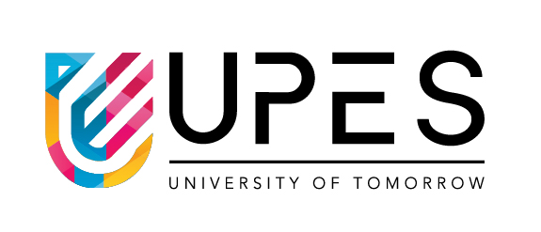
Minor Project
Title: A Language independent tool for Document Creation
Presented by:
Kshitij Chandrakar (500124827)
Nitin Kumai (500124609)
Ansh Negi (500124417)
Guided by:
Dr. Deepika Sachdeva

Slide 2
Content
Abstract
Introduction
Literature Review
Problem Statement and Objective
Methodology
SWOT Analysis
Pert Chart
Conclusion
10. References

Slide 3
Abstract
Current document creation systems all come with their own problems and restrictions. Our tool proposes a Language Independent Method to creating documents and thus overcoming the Individual Drawbacks of every Document Creation Method.

Slide 4
Introduction
Traditional document creation methods are often hindered by their inherent limitations. Our proposed solution addresses these challenges by integrating support for all languages within a unified, language-agnostic editing environment. By synchronizing changes across various file formats and maintaining a master document structure, our tool ensures consistent output while mitigating the individual drawbacks associated with any single language or file type.

Slide 5
Literature Review
Technology | Pros | Cons
LaTeX | Extremely feature-complete for math and advanced formatting | Slow to compile; Steep learning curve, Extremely large package sizes.
Typst | Incredibly quick to compile, Enables Scripting. | Math insertion is less feature-complete than LaTeX, Relatively Less Mature than LaTeX.
Markdown | Simple, lightweight, easy to learn | Does not natively support creating multiple pages or advanced layouts
Microsoft Word | User-friendly GUI, widely used, Easy to Learn | Slow to run on low end computers. Breaks Easily for Long Documents. Has Messy Formatting. No Modularization. No Version Control.

Slide 6
Problem Statement and Objective
Develop a Language-Agnostic Platform: To create a unified document creation system where the editing process is independent of any single markup or typesetting language.
Combine Strengths, Reduce Weaknesses: To combine the best features of all existing methods (e.g., LaTeX's precision, Markdown's simplicity, Typst’s Quick Compilation), and eliminating the individual drawbacks of each.
Enable Synchronization: To implement a robust synchronization engine that maintains consistency across different filetype representations of the same document, ensuring changes in one format are accurately reflected in all others.

Slide 7
Methodology
Core Synchronization Engine: Develop an offline tool with a bidirectional parser and converter for primary formats (e.g., .tex, .md, .docx). It will create and maintain a master abstract document model that stores content, structure, and styling in a neutral, intermediate representation.
Refinement & Robustness: Polish the tool through iterative testing with complex documents. This phase focuses on edge-case handling (e.g., custom LaTeX commands, complex Word layouts), conflict resolution algorithms for simultaneous edits, and improving the accuracy and performance of the synchronization cycle.
User-Facing Interface & Integration: Create a wrapper application to provide a unified user experience. This includes either a graphical user interface (GUI) that abstracts the underlying complexity or a CLI wrapper that allows users to initiate syncs and manage documents seamlessly across formats from a single point of control

Slide 8
SWOT Analysis
Strengths Solves a clear pain point for users juggling multiple document formats. "Best of all worlds" value proposition. | Weaknesses High development complexity for robust synchronization. The Current Document Converter is Unpolished (Pandoc)
Opportunities Targets academia, technical writing, and publishing where multi-format work is common. Can integrate with or become a backbone for collaborative editing platforms. | Threats Established tools (Overleaf, Obsidian, Office 365) adding limited cross-compatibility. User inertia and reluctance to adopt a new, unproven workflow.

Slide 9
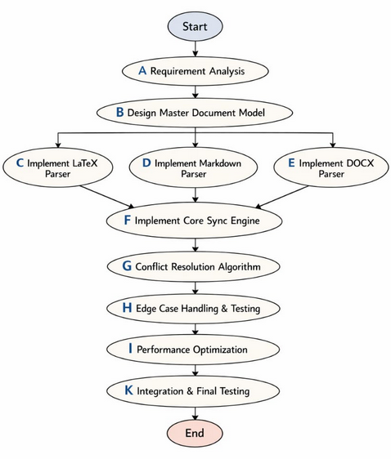
Pert Chart

Slide 10
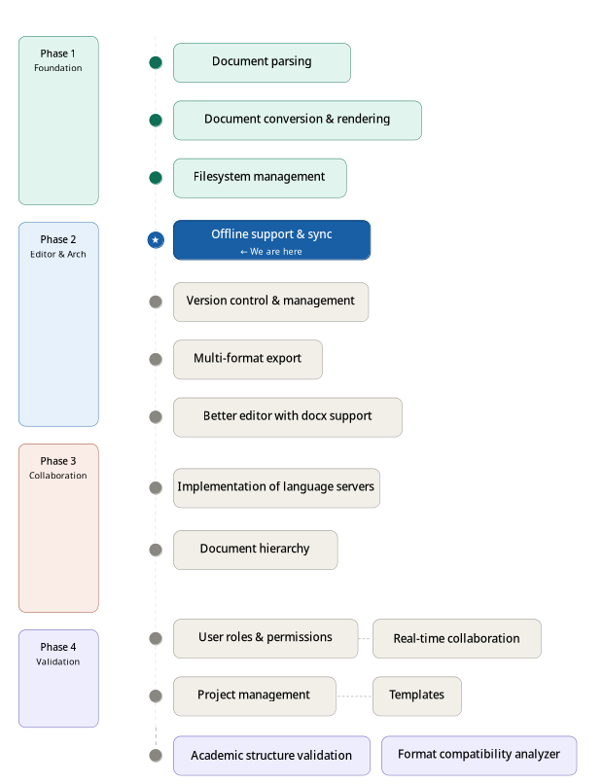
Roadmap

Slide 11
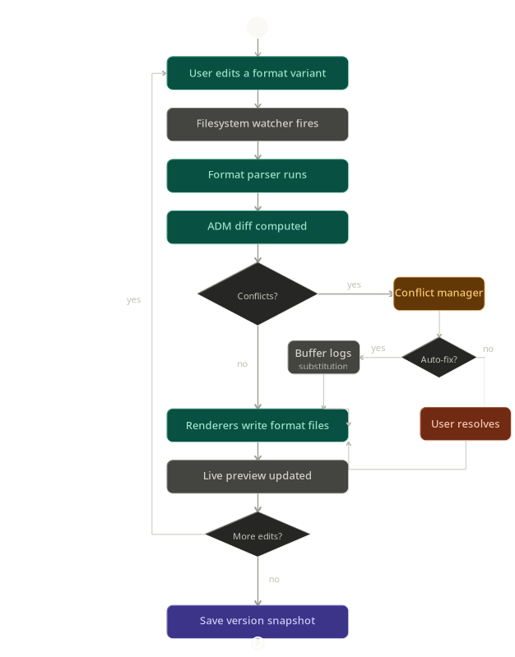
Class Diagram

Slide 12
Activity Diagram

Slide 13
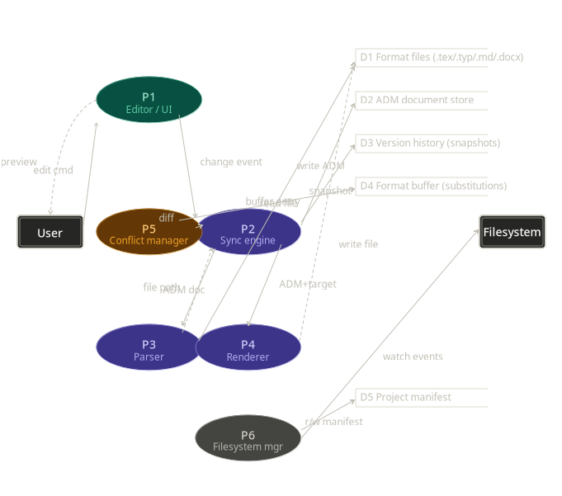
Data Flow Diagram

Slide 14
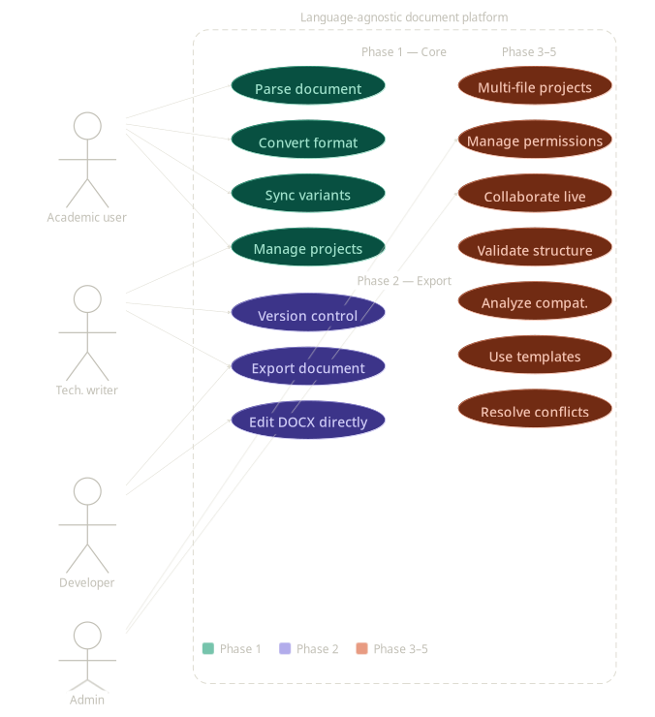
Use Case Diagram

Slide 15
Conclusion
The proposed platform directly addresses the fragmented landscape of document creation by introducing a novel, language-agnostic methodology. By developing a core synchronization engine to maintain a master document model, refining its conversion robustness, and wrapping it in an intuitive interface, the project aims to unify the distinct advantages of tools like LaTeX, Markdown, and Word while nullifying their individual shortcomings.

Slide 16
References
https://typst.app/docs/
https://www.latex-project.org/help/documentation/
https://www.markdownguide.org/
https://support.microsoft.com/en-us/word
https://pandoc.org/MANUAL.html

