Slide 1

Sales Lead
Intelligence
Predicting Lead Conversion and Segmenting Prospects Using Machine Learning
Nitin Prasad | Data Analyst
Python • Pandas • Scikit-learn • XGBoost • K-Means • Plotly • Streamlit
SALES LEAD INTELLIGENCE
01

Slide 2
The Business Problem
B2B teams face a capacity problem—not a lead volume problem.
Large Lead Pool
Different Lead Quality
Limited Sales Capacity
Intelligent Prioritization
Purchase intent varies significantly
Follow-up capacity is limited
Manual prioritization can be inconsistent
Lead types need different engagement strategies
How can we identify which leads are more likely to convert and determine the right approach for different lead types?
SALES LEAD INTELLIGENCE
02

Slide 3
How the Problem Was Solved
A four-stage framework turns behavior into focused sales action.
01
02
03
04
ANALYZE
PREDICT
SEGMENT
ACT
Understand behavior
Find conversion signals
Estimate probability
Prioritize follow-up
Discover lead profiles
Differentiate strategy
Translate insight
into sales action
Analyze
Predict + Segment
Business Insights
Sales Action
SALES LEAD INTELLIGENCE
03

Slide 4
Project Objectives & Solution Scope
OBJECTIVES
INPUTS
OUTPUTS
Analyze historical lead behavior
Identify factors associated with conversion
Predict lead conversion probability
Segment leads by behavioral and business traits
Translate ML results into sales actions
Build and deploy an interactive application
Company profile
Conversion probability
Lead acquisition
ANALYTICS
+ MACHINE LEARNING
Lead segment
Digital engagement
Model evaluation
Sales interactions
Business insights
Buying signals
Sales recommendations
SALES LEAD INTELLIGENCE
04

Slide 5
Synthetic Data Generation & Dataset Structure
Synthetic dataset generated using ChatGPT to simulate realistic B2B SaaS sales lead activity.
20,000
24
19,269
28
Raw Records
Original Columns
Final Records
Final Columns
Lead & Company
Engagement
Outcome
Lead_ID • Lead_Date • Industry • State • Employee_Count
Sales_Rep_Interactions • Previous_Interactions • Days_Since_Last_Interaction • Website_Visits • Pages_Viewed • Email_Opens • Email_Clicks • Content_Downloads • Product_Page_Visits
Converted • Conversion_Date
Acquisition
Buying Signals
Lead_Source • Campaign_Type
Demo_Attended • Estimated_Budget • Estimated_Deal_Value • Decision_Maker • Contact_Requests • Trial_Started
SALES LEAD INTELLIGENCE
05

Slide 6
Data Quality & Cleaning
A rule-based audit protected model quality before any analysis.
PROBLEMS
VALIDATION
TREATMENT
CLEAN DATA
366 exact duplicates
344 repeated Lead IDs
9 future-dated records
Missing / invalid values
Negative-value checks
Email Clicks ≤ Email Opens
Product Visits ≤ Website Visits
Logical consistency
Remove duplicates
Validate IDs and dates
Invalids → missing
Categoricals → Unknown
19,269 final records
Standardized dates
Validated relationships
Model-ready fields
IQR + DOMAIN LIMITS • Employee Count 5,000 • Website Visits 100 • Pages Viewed 200 • Email Opens 50 • Email Clicks 20 • Content Downloads 20 • Product Page Visits 50
SALES LEAD INTELLIGENCE
06

Slide 7
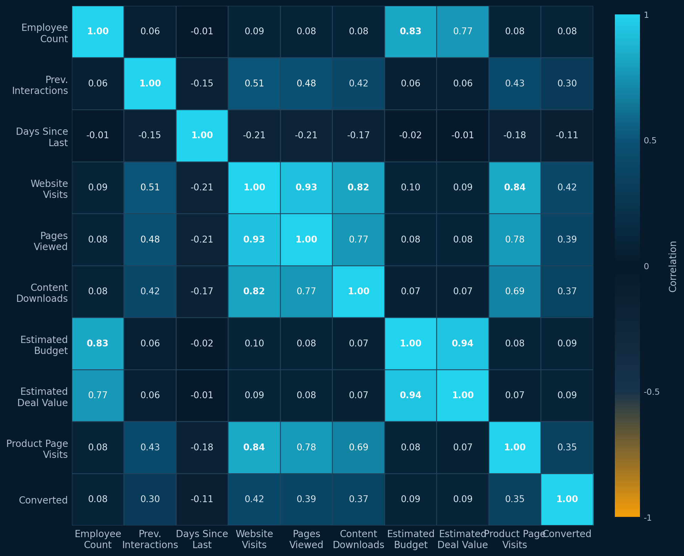
Exploratory Data Analysis
Correlation structure reveals where engagement and commercial value move together.
0.94
Estimated Budget ↔ Estimated Deal Value
0.93
Website Visits ↔ Pages Viewed
0.84
Website Visits ↔ Product Page Visits
0.83
Employee Count ↔ Estimated Budget
CONVERSION CORRELATIONS
Website Visits .42 • Pages Viewed .39 • Content Downloads .37 • Product Page Visits .35 • Previous Interactions .30 • Contact Requests .28 • Sales Rep Interactions .15
SALES LEAD INTELLIGENCE
07

Slide 8
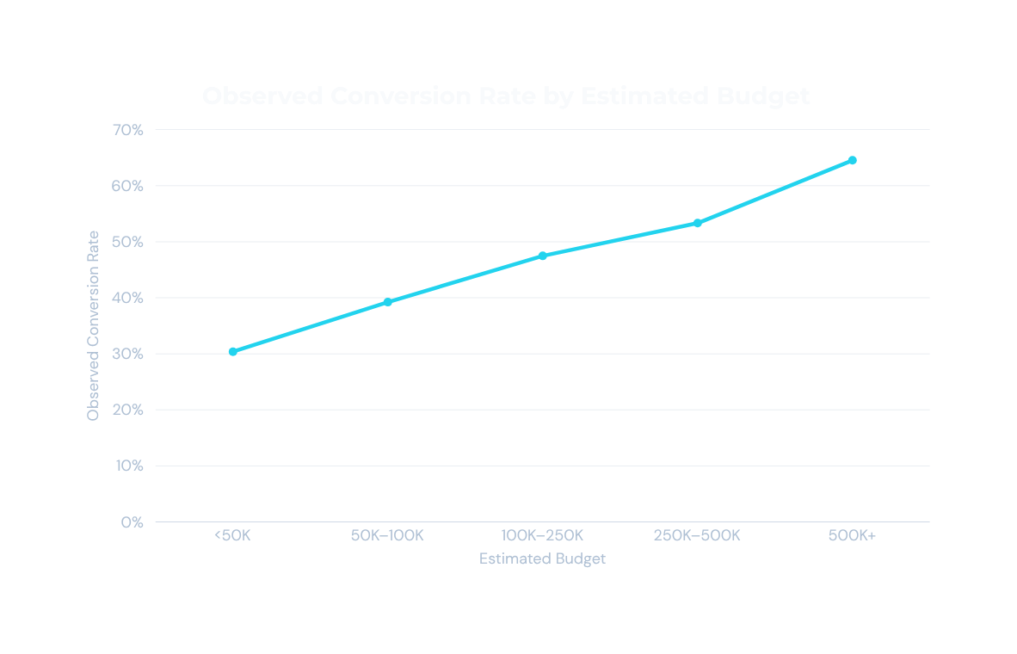
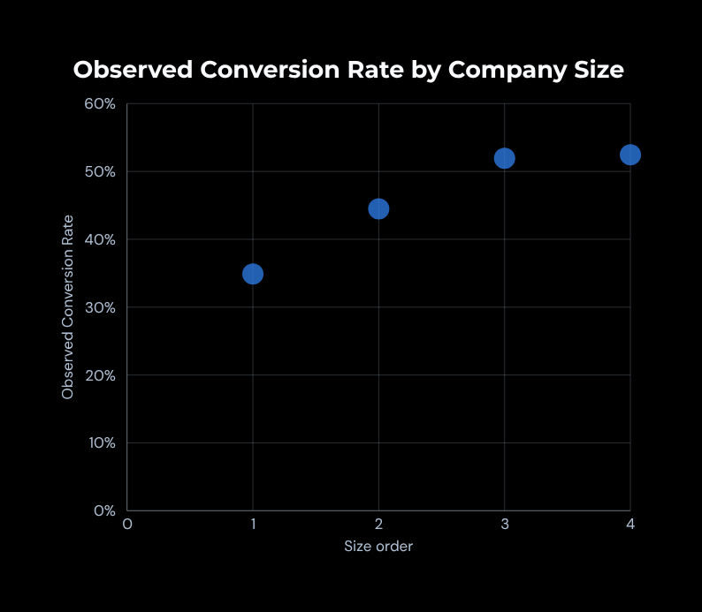
Conversion Patterns in the Data
OBSERVED CONVERSION RATES
Observed conversion increased across higher-budget and larger-company segments in this dataset.
SALES LEAD INTELLIGENCE
08

Slide 9
Feature Engineering
Business logic converts raw activity into stable, pre-outcome model signals.
RAW VARIABLES
BUSINESS LOGIC
ENGINEERED FEATURES
ML-READY DATASET
Total Interactions = Previous Interactions + Sales Rep Interactions
Digital Engagement Score = normalized composite of five digital behaviors
Budget per Employee = Estimated Budget ÷ Employee Count
Deal-to-Budget Ratio = Estimated Deal Value ÷ Estimated Budget
Company Size derived from Employee Count
Temporary EDA grouping variables excluded • Features use only pre-outcome information
SALES LEAD INTELLIGENCE
09

Slide 10
End-to-End Project Architecture
From synthetic data generation to an accessible live application.
ChatGPT
Synthetic Dataset
Python / Pandas
Cleaning + EDA
DATA PREPRATION
Feature Engineering
Classification + Clustering
Model Evaluation
Business Insights
MACHINE LEARNING
Streamlit Application
GitHub Repository
Streamlit Cloud
Live Web Application
APPLICATION & DEPLOYMENT
NumPy • Scikit-learn • XGBoost • K-Means • Plotly • Streamlit • GitHub • Streamlit Cloud
SALES LEAD INTELLIGENCE
10

Slide 11
Lead Conversion Prediction
BUSINESS OBJECTIVE
Estimate the probability a lead will convert
Lead
Information
Preprocessing
Feature
Engineering
Binary classification
MODELS EVALUATED
Logistic Regression • Decision Tree • Random Forest • Gradient Boosting • XGBoost
Classification
Model
Conversion
Probability
Sales
Prioritization
IMPORTANT FEATURES
Digital Engagement Score • Demo Attended • Sales Rep Interactions • Trial Started • Decision Maker • Contact Requests
SALES LEAD INTELLIGENCE
11

Slide 12
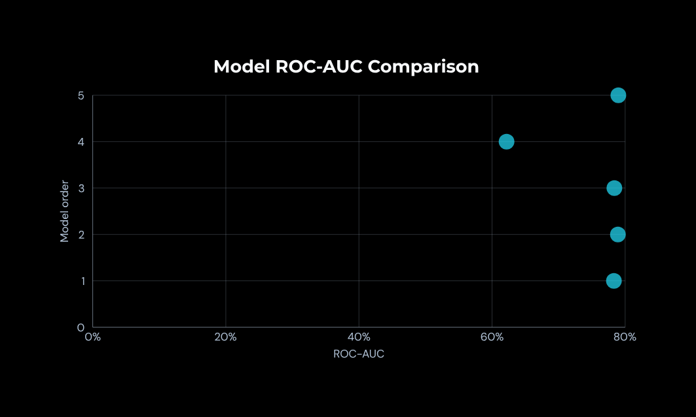
Classification Model Performance
73.88%
70.56%
57.42%
63.31%
78.91%
Accuracy
Precision
Recall
F1-Score
ROC-AUC
CONFUSION MATRIX
Predicted 0
Predicted 1
Actual 0
1,958
383
Actual 1
652
861
0 = Not Converted • 1 = Converted
CROSS-VALIDATION ROC-AUC 79.07%
Gradient Boosting selected for the application based on cross-validation and overall evaluation.
SALES LEAD INTELLIGENCE
12

Slide 13
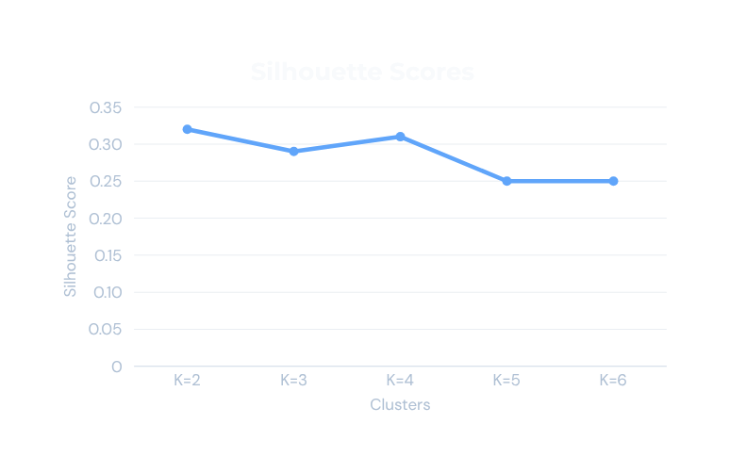
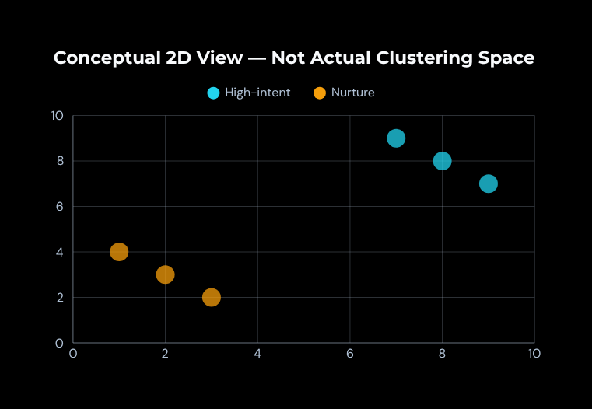
Lead Segmentation Using K-Means
K = 2 selected
Clustering Features: Digital Engagement Score, Total Interactions, Days Since Last Interactions, Estimated Budget, Employee Count and Deal-to-Budget Ratio
Clear business interpretation with comparable silhouette quality.
HIGH-INTENT / HIGHLY ENGAGED
5,119 leads • 26.57%
Observed conversion: 68.12%
LOW-ENGAGEMENT / NURTURE
14,150 leads • 73.43%
Observed conversion: 28.81%
SALES LEAD INTELLIGENCE
13

Slide 14
From Insights to Application & Deployment
HIGH-INTENT LEADS
Prioritize direct sales follow-up
Python
Models
Streamlit
Application
GitHub
Streamlit
Cloud
Live Web
Application
LOWER-ENGAGEMENT LEADS
Use targeted nurture campaigns
APPLICATION CAPABILITIES
Conversion Prediction • Lead Segmentation • Model Performance • Business Insights
GITHUB REPOSITORY
LIVE APPLICATION
SALES LEAD INTELLIGENCE
14

Slide 15

Project Outcome & Future Scope
Project Outcome
FUTURE SCOPE
Built an end-to-end sales lead intelligence solution
Combined EDA, classification, and clustering to understand lead behavior
Converted ML results into practical sales prioritization and nurturing strategies
Deployed the solution as an interactive Streamlit application
Integrate real CRM and marketing-platform data
Add model monitoring, drift detection, and automated retraining
Add explainability for individual lead predictions
Integrate lead scoring directly into CRM workflows
THANK YOU
SALES LEAD INTELLIGENCE
15

