Slide 1
Supply Chain Performance
& Inventory Strategy Analysis
End-to-End SQL & Power BI Analytics Project
MYSQL SQL POWER BI DAX ABC–XYZ ANALYSIS
Author: Nitin Prasad
SUPPLIERS
PROCUREMENT
WAREHOUSES
INVENTORY
CUSTOMERS
RAW TRANSACTIONS → DECISION SUPPORT

Slide 2
SUPPLY CHAIN ANALYTICS • CAPSTONE PROJECT
Business Problem & Objectives
01 BUSINESS PROBLEM
02 OBJECTIVES
• Supply chain data distributed across sales, procurement, suppliers, inventory and warehouses
• Operational inefficiencies are difficult to isolate from raw transactions
• Inventory decisions need both product value and demand-stability insight
• Management lacks a consolidated decision view
• Evaluate end-to-end supply chain performance
• Analyze sales, customers, suppliers and procurement
• Monitor inventory and warehouse operations
• Classify products with ABC-XYZ analysis
• Translate segments into differentiated inventory strategies
02 / 15

Slide 3
SUPPLY CHAIN ANALYTICS • CAPSTONE PROJECT
Dataset & Database Foundation
99,470
RECORDS
7
TABLES
500
PRODUCTS
120
SUPPLIERS
800
CUSTOMERS
Jan 2024 – Aug 2026 • 35,000 purchase orders • 58,000 sales orders
Customers
Sales Orders
Inventory
Products
Suppliers
Purchase Orders
Warehouses
Dataset generated using Google Gemini for project simulation and analytical practice.
03 / 15

Slide 4
SUPPLY CHAIN ANALYTICS • CAPSTONE PROJECT
From Raw Data to Business Insights
01
02
03
04
Raw CSV Data
Database & Tables
Data Ingestion
Cleaning & Validation
05
06
07
08
Relationships
SQL Analysis
ABC Analysis
XYZ Analysis
09
10
11
12
ABC-XYZ Segment
Power BI Model
Interactive Reports
Strategies
RAW DATA → ANALYSIS → DECISION SUPPORT
04 / 15

Slide 5
SUPPLY CHAIN ANALYTICS • CAPSTONE PROJECT
Data Preparation & SQL Foundation
DATA CLEANING
SQL FOUNDATION
• Text standardization
• NULL / missing-value handling
• Duplicate treatment
• Outlier analysis & treatment
• Data validation
• Referential integrity checks
• Primary & Foreign Keys
• JOINs, CTEs & subqueries
• Window Functions
• CASE Statements & aggregations
• Date Functions
• Analytical Views
RAW DATA
CLEAN DATA
RELATIONAL DATA
05 / 15

Slide 6
SUPPLY CHAIN ANALYTICS • CAPSTONE PROJECT
SQL Analysis Framework
GENERAL SUPPLY CHAIN
ADVANCED PRODUCT
DATABASE OUTPUTS
• Sales & Customer Analysis
• Supplier & Procurement Analysis
• Inventory Analysis
• Warehouse Analysis
• ABC Classification
• XYZ Demand Variability
• Combined ABC-XYZ Segmentation
• vw_product_sales_summary
• vw_monthly_product_demand
• vw_abc_xyz_classification
SQL transformed transactional data into analytical datasets and business insights.
06 / 15

Slide 7
SUPPLY CHAIN ANALYTICS • CAPSTONE PROJECT
ABC-XYZ: From Product Value to Inventory Strategy
ABC • PRODUCT VALUE
AX
AY
AZ
A High Value
B Medium Value
C Low Value
BX
BY
BZ
XYZ • DEMAND VARIABILITY
X Stable / Predictable
Y Moderately Variable
Z Highly Variable
CX
CY
CZ
VALUE + DEMAND STABILITY → INVENTORY STRATEGY
07 / 15

Slide 8
SUPPLY CHAIN ANALYTICS • CAPSTONE PROJECT
From SQL Analysis to Power BI
MySQL
Tables
SQL Analytical
Views
Power BI
Data Model
DAX
Measures
Interactive
Reports
Business
Insights
MODEL HIGHLIGHTS
• Centralized Dates table
• Transactional + master relationships
• DAX measures for KPIs
• Interactive slicers and cross-filtering
• Top-N analysis and report navigation
CONNECTED • REUSABLE • DECISION-READY
08 / 15

Slide 9
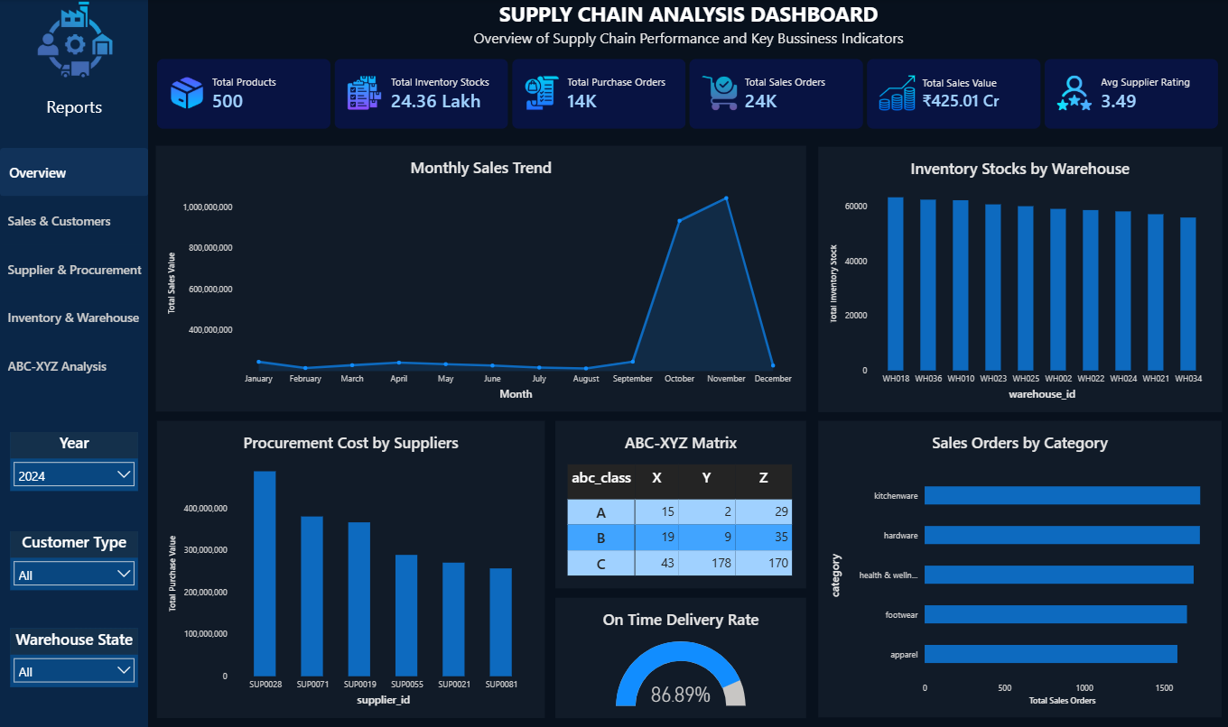
POWER BI REPORT • INTERACTIVE ANALYTICS
Report 01 — Supply Chain Overview
REPORT PURPOSE
• Executive view of supply chain performance
• Monitor sales, procurement and inventory KPIs
• Track sales trends and warehouse stock
• Monitor supplier performance
• High-level ABC-XYZ visibility
09 / 15

Slide 10
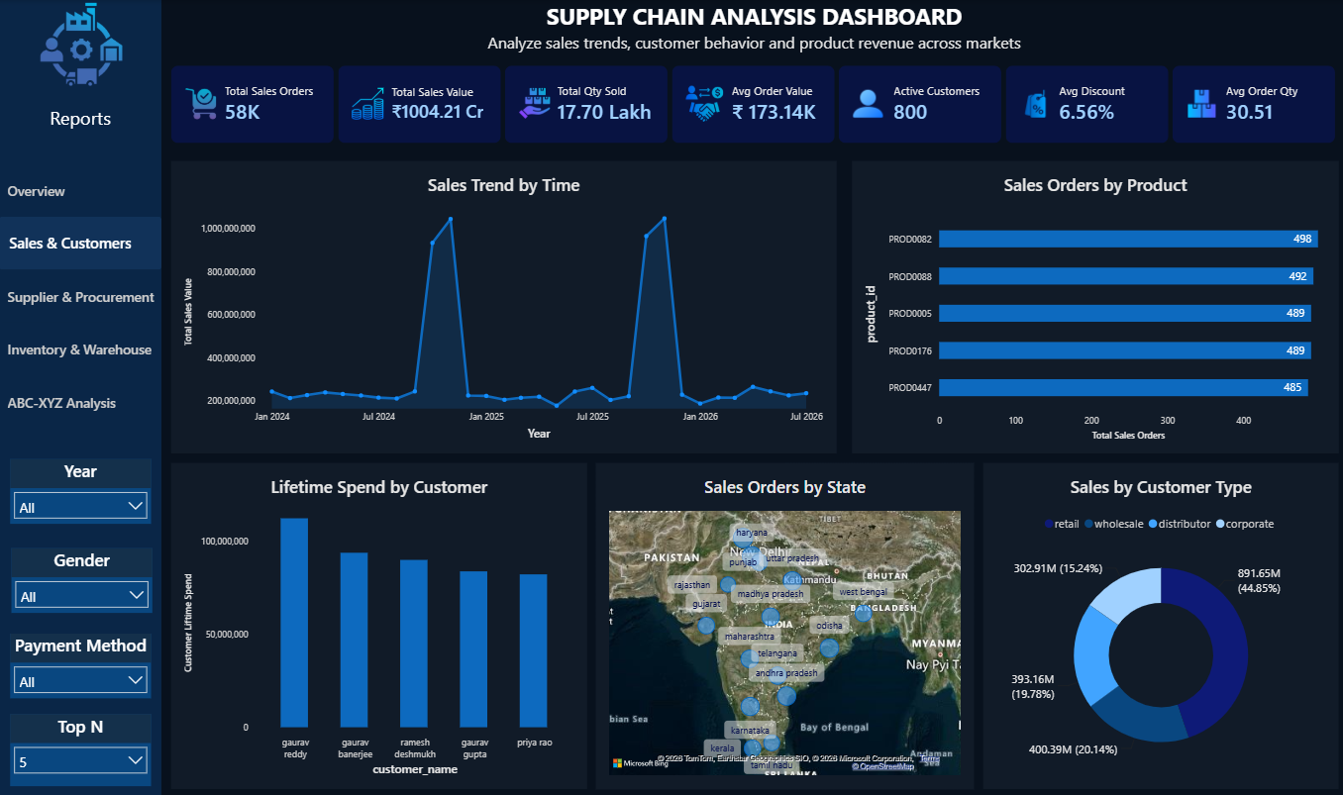
POWER BI REPORT • INTERACTIVE ANALYTICS
Report 02 — Sales & Customer Analysis
REPORT PURPOSE
• Evaluate sales performance over time
• Identify high-performing products
• Analyze customer purchasing behavior
• Compare customer types and geographies
• Identify high-value customers
10 / 15

Slide 11
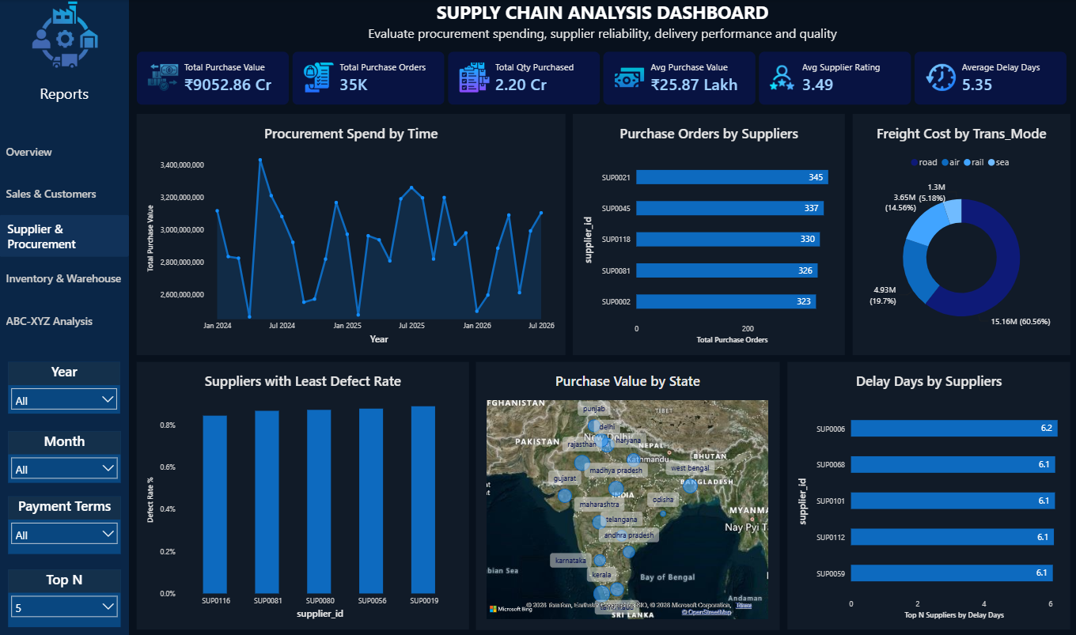
POWER BI REPORT • INTERACTIVE ANALYTICS
Report 03 — Supplier & Procurement Performance
REPORT PURPOSE
• Monitor procurement spending
• Evaluate delivery and quality performance
• Analyze delays and defects
• Compare supplier order volumes
• Review freight cost by transport mode
11 / 15

Slide 12
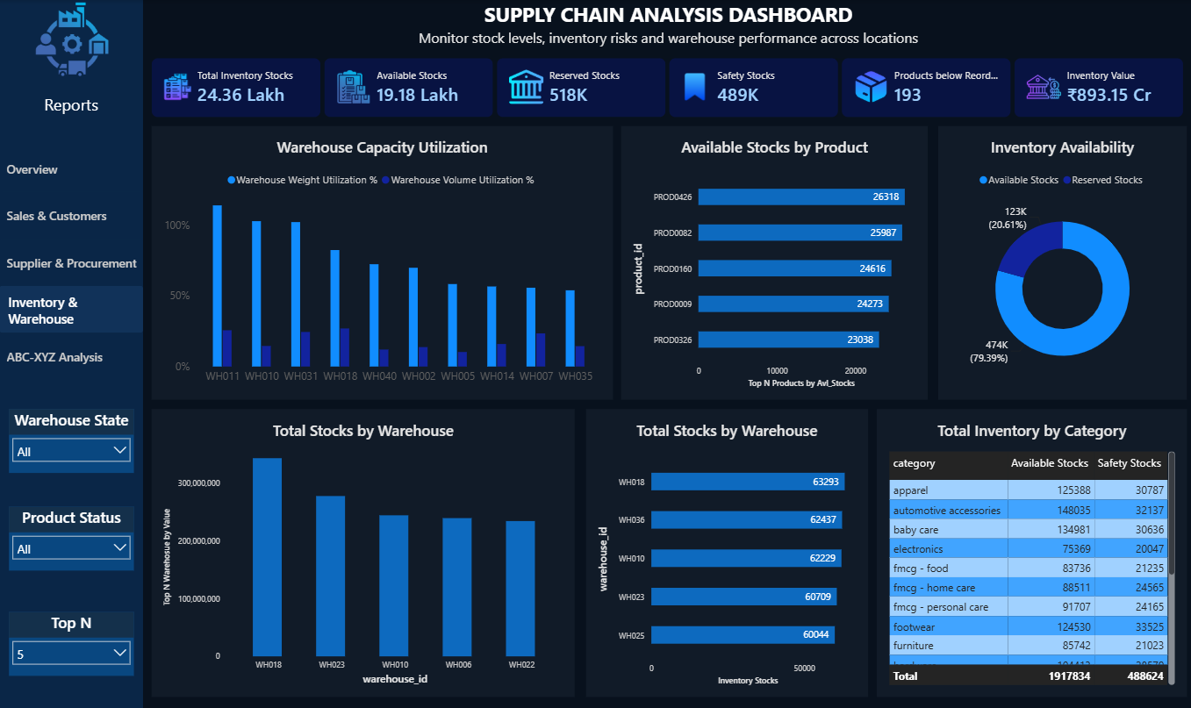
POWER BI REPORT • INTERACTIVE ANALYTICS
Report 04 — Inventory & Warehouse Analysis
REPORT PURPOSE
• Monitor stock and safety stock
• Identify products below reorder level
• Evaluate warehouse capacity utilization
• Analyze stock distribution and value
• Identify potential inventory risks
12 / 15

Slide 13
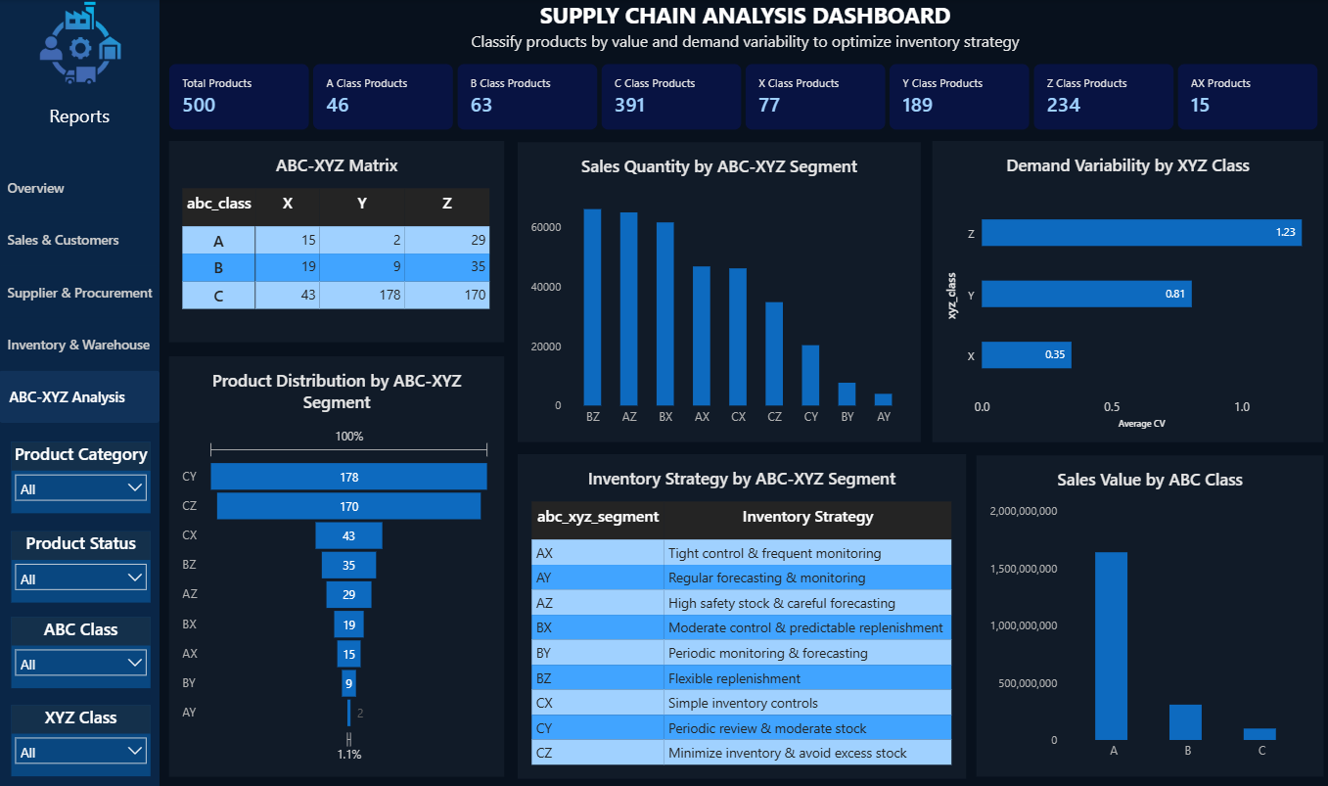
POWER BI REPORT • INTERACTIVE ANALYTICS
Report 05 — ABC-XYZ Inventory Strategy
REPORT PURPOSE
• Classify value and demand variability
• Identify critical product segments
• Compare quantities across segments
• Evaluate demand variability
• Translate segments into control strategies
13 / 15

Slide 14
SUPPLY CHAIN ANALYTICS • CAPSTONE PROJECT
Key Findings → Business Actions
Sales and procurement vary over time
Monitor high-value products closely
Supplier delivery and quality performance differs
Escalate delayed / low-performing suppliers
Warehouse stock levels differ by location
Rebalance warehouse capacity and stock
Some products need closer reorder monitoring
Maintain safety stock for critical products
ABC value and XYZ predictability vary
Differentiate replenishment; reduce excess inventory
14 / 15

Slide 15
SUPPLY CHAIN ANALYTICS • CAPSTONE PROJECT
From Data to Inventory Strategy
PROJECT DELIVERED
FUTURE SCOPE
• Relational MySQL database
• Cleaned & validated dataset
• SQL business analysis + analytical views
• ABC-XYZ product classification
• Power BI model + 5 interactive reports
• Inventory strategy recommendations
• Demand forecasting
• Stockout prediction
• Automated reorder recommendations
• Supplier risk scoring
• Delivery delay prediction
• What-if inventory analysis
Transformed raw supply-chain transactions into actionable insights for performance monitoring and inventory strategy.
THANK YOU
15 / 15

