Slide 1

Capstone project 2021-’22
Presentation

Slide 2
Proposing energy-efficient urban spaces USING IoT and data visualisation
Project guide
Team members
Dr Gladys Kiruba Gnana
Anubhav Singh Guleria, 18BCE0186
Nitin Pramod Ranjan, 18BCE0272
Srinivasa Sharma, 18BCE0931

Slide 3
Goals

Slide 4
Problem design and challenges

Slide 5
Methodology adopted
Visualize and study data of energy production, consumption and wastage.
Analyse this data to suggest benchmarking standards based on consumption and wastage
Suggest IoT-tools to minimize wastage and optimize consumption
Simulate the suggestions in a real-world scenario (inspired from Karol Furdik et al.)

Slide 6
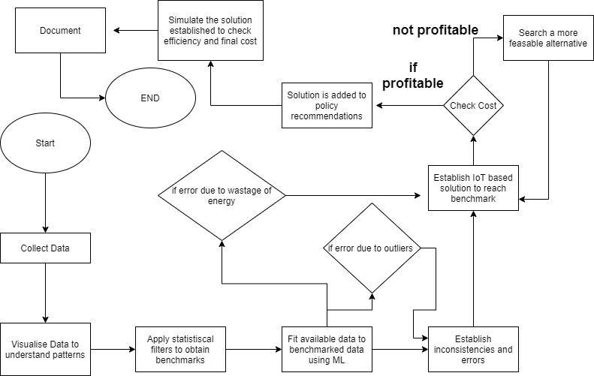

Slide 7
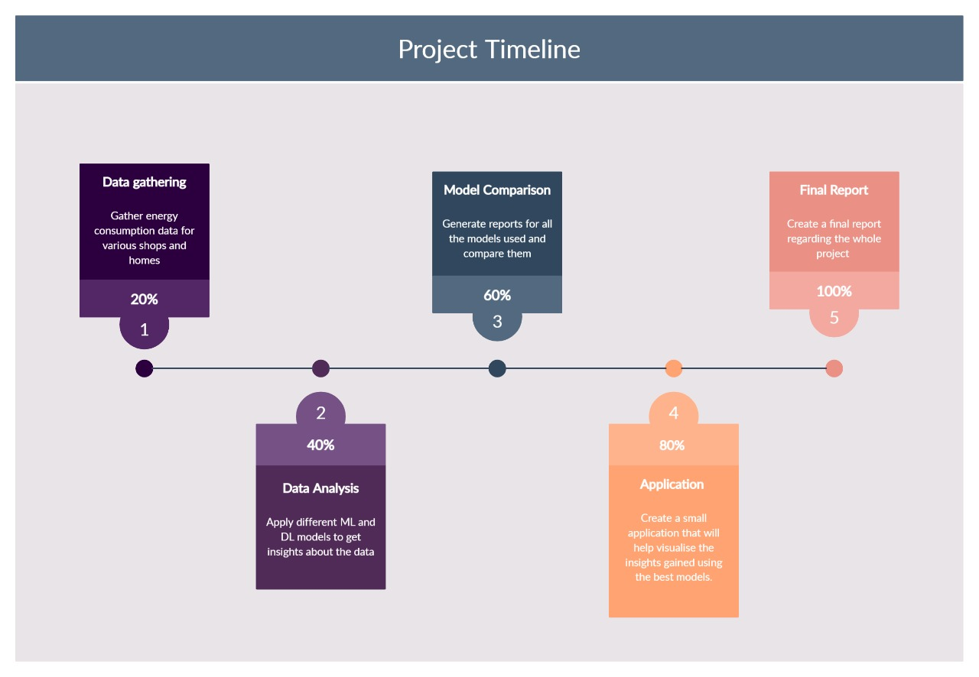

Slide 8
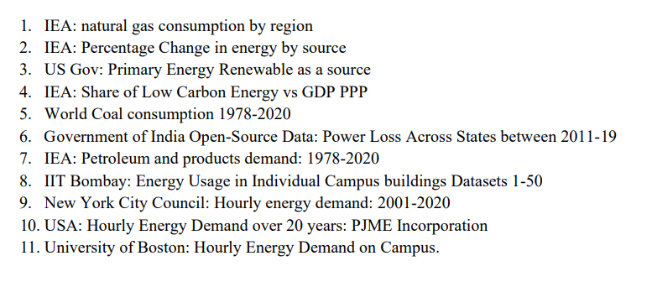
DATASETS
12. London City Daily Household Energy Consumption
13. Energy Consumption in India: GoI

Slide 9
Analyzing Indian energy consumption between oct’20-mar’21

Slide 10
STATISTICAL centralities OF DATA
Test case:
Power Consumption in India between Mar-Oct 2020

Slide 13
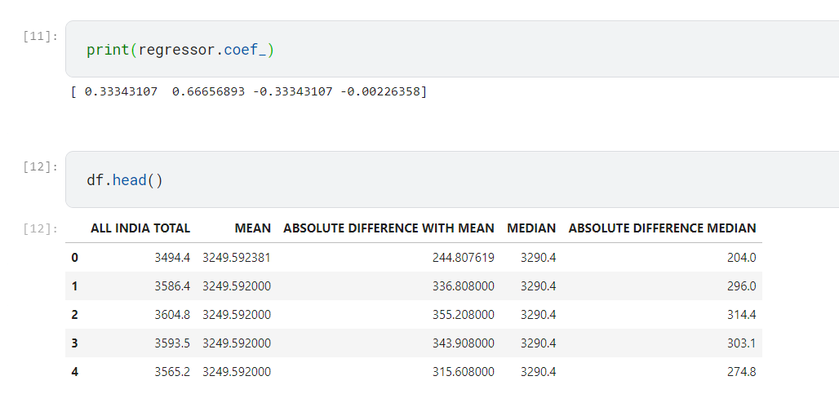
Total Energy consumed over all time = 682414.4 MW
Total of all median energy consumed = 690964MW
Total of mean energy consumed = 682414.3 MW
Accuracy with median ~ 98.76%
Accuracy with mean ~99.9%

Slide 15
STATISTICAL CENTRALITIES OF DATA – mean, median, mode
results
results
Mode is rejected for use since a lot of irregular values are generated.
Median and Mean are very consistent with each other.
The difference between median and absolute data is less than absolute difference with mean.
Median is better over mean

Slide 16
Using regression

Slide 17
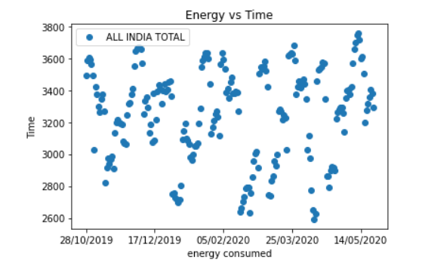
Observations:
Linear regression is almost akin to statistical centralities. However, the curve is fairly irregular.
Linear Regression will have a lot of outliers.
A multi-linear regression will give an accurate value only when order of curve is very high.

Slide 18

Primary conclusions
Median and ARIMA with LSTM are so far the strongest benchmarking tool amidst statistical centralities and regressions.
ARIMA’s accuracy >98%.
But, the computational complexity needed for computing median is way less than ARIMA.

Slide 19
Analyzing the city of London

Slide 20
For the next part
MODEL AN ORGANISATION USING IOT DEVICES for SIMULATION.
PREPARE A COST SHEET.
UNIVERSALISE THIS COST SHEET IN CONTEXT OF VARIOUS COUNTRIES.

Slide 21
Thank you

