Slide 1
Indirect Material Classification Enabler Solution
- Using primal AI based techniques to Enable Faster and Accurate Classification of Indirect Materials

Slide 2
About the solution – Indirect Material Classification Enabler (ICE)
Indirect materials procured from suppliers are often described in an ambiguous manner in various source systems. Thus, impairing a proper spend analytics. Hence, there is a need to map and match indirect material to closest UNSPSC description is essential to expedite accurate spend analytics.
A manual matching process is
Monotonous
Prone to errors
Quite time consuming
Objective:
This automated solution (ICE) simplifies matching process of identifying “most appropriate” UNSPSC description

Slide 3
Features
Auto-Match based on root words/ key words search
Creates all possible UNPSC matches
Front end for data steward thereby, enabling to select the most appropriate match in 2-3 clicks
UNSPSC description can be updated (Write Back)
Technology
Natural language processing – key word identification and word stemming rules in R
Visualization – D3.js

Slide 4
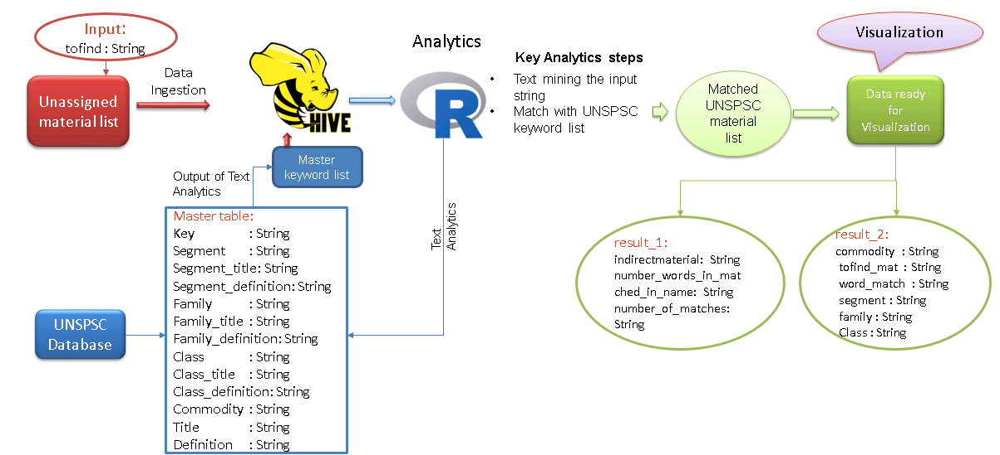
Flow for Indirect Classification Enabler

Slide 5







DiME Architecture – Technical Components
Data Preparation
OPERATIONS
Ingestion
Data Analytics
PORTAL COMPONENTS
Workflow Automation
Visualization
Administration
Source Code Management
Build and Integration
Ingestion APIs
Data Wrangling
Analytics Notebook APIs
Metadata Management
CONTAINERAZITION
SDKs & APIs
Visualization APIs
Lineage APIs
Source Code Management
Security & Access Controls
Logging & Auditing
Sqoop
Kafka
HDFS
HIVE
Code Repo
PLATFROM & SERVICES
NiFi
Spark
HBase
PIG
Oozie
Monitoring and Control

Slide 6
Thank you

