Slide 1
TEAM SIGMA
*Akhila Pam (11711224)
*Akshara Reddy Bathula (11713259)
*Jyothi Anjan Manini (11715079)
*Lakshmichatura Medidi (11682526)
*Manoj Kumar Bandari (11711378)
*Nimitha Bangalore Sathyanarayana (11649788)
*Nitin Reddy Balaiahgari (11698724)
*Satya Laxman Pranav Vadlamani (11701928)
*Sumuk Reddy Kalagiri (11702970)

Slide 2
SAFEGUARDING THE DIGITAL WORLD DATA SHARING WITH PROXY RE-ENCRYPTION USING BLOCKCHAIN
The "Safeguarding the Digital World" project aims to develop a secure and privacy-focused data sharing system that leverages proxy re-encryption techniques and blockchain technology. This system will empower individuals and organizations to share sensitive data while maintaining full control over their data's security and access permissions. It addresses the growing need for secure data sharing in an interconnected world while ensuring transparency and trust through blockchain-based auditing.
In an era of increasing digitalization and interconnectedness, secure data sharing is paramount. The project, "Safeguarding the Digital World," is dedicated to developing an innovative solution that combines proxy re-encryption and blockchain technology to ensure the utmost security and privacy in data sharing.

Slide 3
PROJECT OBJECTIVE
Enhanced Data Security: Implement advanced encryption techniques to safeguard sensitive data during sharing, ensuring that only authorized parties can access it.
Privacy Preservation: Maintain data owner privacy by employing proxy re-encryption, allowing data to be shared without exposing decryption keys.
Transparency and Trust: Utilize blockchain technology to provide a transparent and immutable record of data access and sharing activities.
User-Friendly Interface: Create an intuitive and user-friendly web and mobile application for easy management of data sharing settings and access controls.

Slide 4
PROJECT PLANING
Phase 1: Project Initiation (1ST WEEK)
Project Objectives and Scope
Assemble Project Team
Conduct Initial Research on Technologies
Develop Project Proposal
Phase 2: Requirement Analysis and Design (2ND WEEK)
Gather Detailed Requirements
Design System Architecture
Create User Interface Wireframes
Plan Blockchain Integration

Slide 5
PROJECT PLANING
Phase 3: Development (3RD WEEK)
Set Up Development Environment
Build User Authentication System
Develop Data Encryption Mechanism
Implement Proxy Re-Encryption
Phase 4: Testing and Quality Assurance (4TH WEEK)
Conduct Unit Testing
Perform Integration Testing
User Acceptance Testing
Security Testing
Bug Fixing and Optimization

Slide 6
PROJECT PLANING
Phase 5: Deployment (5TH WEEEK)
Deploy to Production Environment
User Training and Documentation
Set Up Monitoring and Error Tracking
Phase 6: Project Conclusion (6TH WEEK)
Finalize Documentation
Conduct Project Review with Team

Slide 7
ADVANTAGES
Enhanced Data Security
Privacy Preservation
Transparency and Trust
User-Friendly Interface
Access Control
Data Privacy Compliance
Security Against Data Breaches
Scalability
Future-Proofing

Slide 8
BLOCK CHAIN TECHNOLOGY
Transparent Auditing:
The blockchain serves as a decentralized ledger that records all data access and sharing activities. Every access request, permission change, or data sharing event is recorded as a transaction on the blockchain.
Immutability:
Once data is recorded on the blockchain, it becomes immutable, meaning it cannot be altered or deleted. This immutability ensures the integrity and trustworthiness of the recorded data.
Smart Contracts:
Blockchain smart contracts are used to define access control rules, data sharing agreements, and auditing mechanisms. These smart contracts are self-executing and enforce predefined rules without the need for intermediaries.

Slide 9
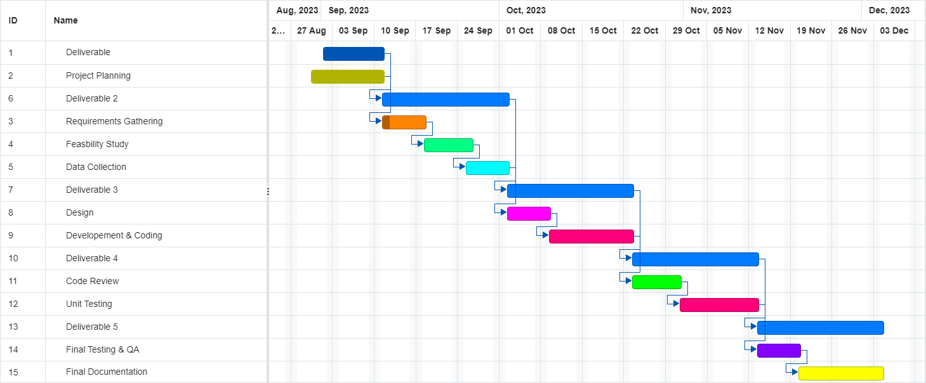
Gantt Chart

Slide 10
Development Environments
Programming Languages
JavaScript :
Reduces load on the server
HTML/CSS :
To Develop a web page with style
Solidity :
To Develop Ethereum Network
React JS :
It allows you to create interactive and dynamic web applications with ease
SQL :
SQL (Structured Query Language) will be crucial for managing your database. You can create, read, update, and delete records in your database using SQL queries

Slide 11
Development Environments
Platform
Blockchain:
Ethereum or a compatible blockchain platform to implement the smart contract logic.
Web Application:
The system will have a web-based user interface accessible through standard web browsers.
Cloud Hosting:
To deploy web services and databases securely.

Slide 12
TEAM MEMEBERS AND ROLES FOR THE PROJECT
Project Management Lead & Solidity : NITHIN REDDY
Requirements Lead & JavaScript : LAKSHMI CHATURA MEDIDI
Design Lead & JavaScript : JYOTHI ANJAN MANINI
Implementation Lead For front End & HTML/CSS : AKSHARA REDDY
Implementation Lead For back End & React JS : AKHILA PAM
Configuration Management Lead & Java Script : MANOJ KUMAR
Testing Lead & React JS : NIMITHA Bangalore Satyanarayana
Documentation Lead & Solidity : SUMUK REDDY KALAGIRI
Demo And Presentation Lead & React Js : VADLAMANI PRANAV

