Slide 1

Automated Identification of Gait Abnormalities
TEAM NO. 10 · PROBLEM NO. 28
Classifying six gait patterns from skeleton-derived bone structure and joint angle data.
NISHIT SURESH
PES2UG24CS326
NITIN SOMISETTY
PES2UG24CS327

Slide 2
Problem Statement
Gait abnormalities are early indicators of musculoskeletal and neurological conditions. Manual clinical assessment is subjective, slow, and requires expert observation. We build a model that classifies gait type directly from skeleton pose data, enabling fast, consistent, and scalable screening.
Antalgic
Lurch
Steppage
Stiff-legged
Trendelenburg
Pain-avoidance limp
Trunk compensation
Foot drop, high knee lift
Reduced knee flexion
Pelvic drop, hip weakness
Automated Identification of Gait Abnormalities · Team 10

Slide 3
Dataset
2,182
6 gait classes, near-balanced
Antalgic | 366
Lurch | 359
Normal | 364
Steppage | 370
Stiff-legged | 366
Trendelenburg | 357
labeled skeleton-frame samples
480
walking patterns noted
Features derived from skeleton joint coordinates: bone-segment lengths, knee/hip/ankle angles, and stride-cycle dynamics. Evaluated with 5-fold cross-validation.

Slide 4
From Skeleton Data to Gait Prediction
Each stage transforms raw joint coordinates into a validated classification result.
01
02
03
04
05
06
07
Skeleton
data
Load &
validate
Feature
engineering
Clean &
prepare
Train
models
Evaluate &
compare
Predict
gait
3D joint keypoints
across walking frames
Check files, labels,
columns and missing data
Calculate joint angles,
segment lengths, symmetry
Handle invalid values;
scale features if needed
Logistic Regression,
Random Forest, Boosting
5-fold validation;
accuracy and macro F1
Classify into one of
six gait categories
WHAT THE MODEL LEARNS
Movement patterns in knee/hip angles, stride cadence and left–right symmetry help distinguish the six gait categories.
HOW WE CHECK IT
Compare accuracy and macro F1 across folds. Keeping subjects separated helps test performance on unseen people.
Automated Identification of Gait Abnormalities · Team 10

Slide 5
Feature Engineering & Modeling
Features
Models Compared
Bone-segment lengths from joint keypoints
Knee, hip, and ankle flex angles
Stride cadence and symmetry ratios
Normalized per-subject to remove scale bias
Logistic Regression
Random Forest
Gradient Boosting
Dummy baseline (reference)
Validated with stratified 5-fold cross-validation.

Slide 6
Model Comparison
Model | Accuracy (mean) | Macro F1 (mean) | Accuracy Std
Logistic Regression | 75.6% | 74.7% | ±6.6%
Gradient Boosting | 74.1% | 73.3% | ±8.4%
Random Forest | 73.7% | 72.7% | ±5.4%
Dummy (baseline) | 16.8% | 4.8% | ±0.4%
Logistic Regression leads on both accuracy and macro F1, with the lowest fold-to-fold variance among the trained models — well above the 16.8% baseline.

Slide 7
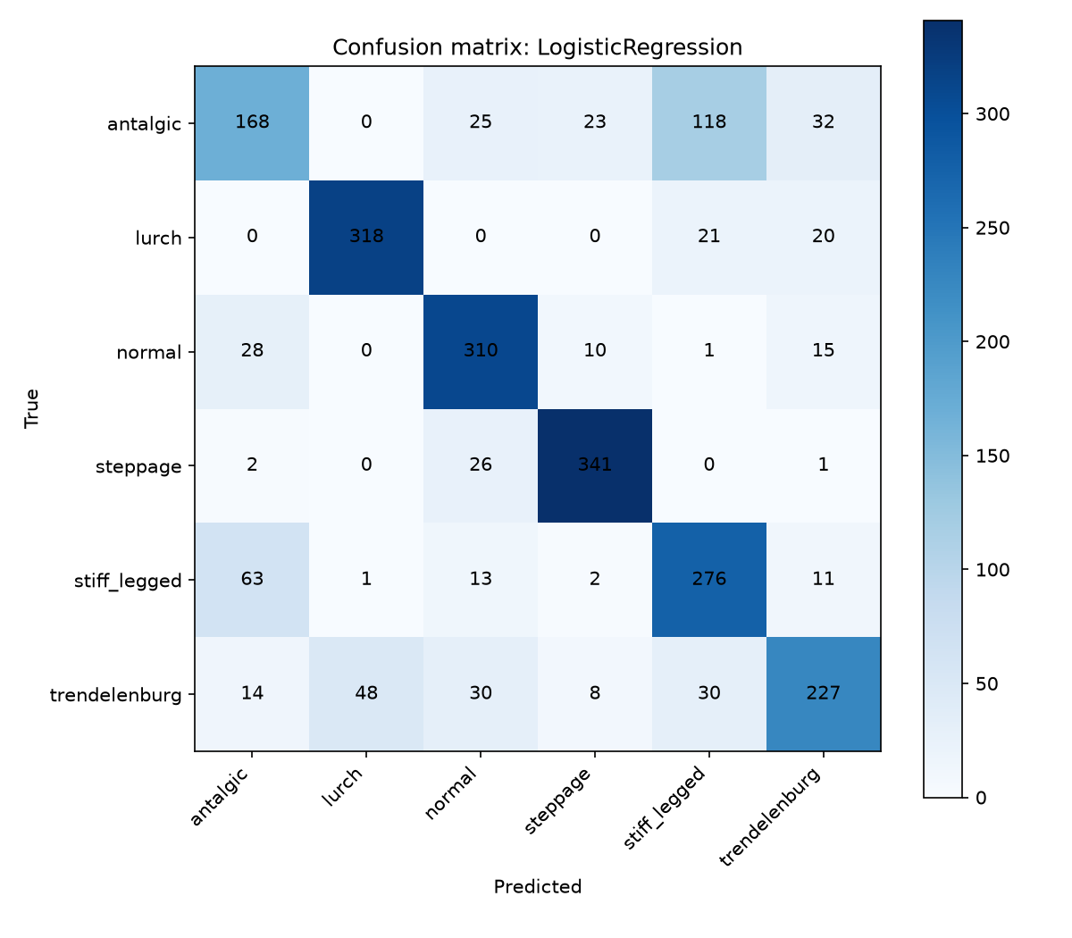
Confusion Matrix — Logistic Regression
Rows = true label, columns = predicted. Confusion is concentrated between Antalgic ↔ Stiff-legged and Trendelenburg ↔ Lurch, both pairs sharing similar compensatory joint-angle signatures.

Slide 8
Takeaways
75.6%
6
4.5x
accuracy with Logistic Regression, best of 4 models tested
gait classes separated from skeleton features alone
over baseline macro F1 (74.7% vs 4.8%)
Next steps: richer temporal features across full stride cycles, and targeted data collection to resolve the Antalgic/Stiff-legged and Trendelenburg/Lurch confusion pairs.
Team 10 · Nishit Suresh & Nitin Somisetty

Slide 9
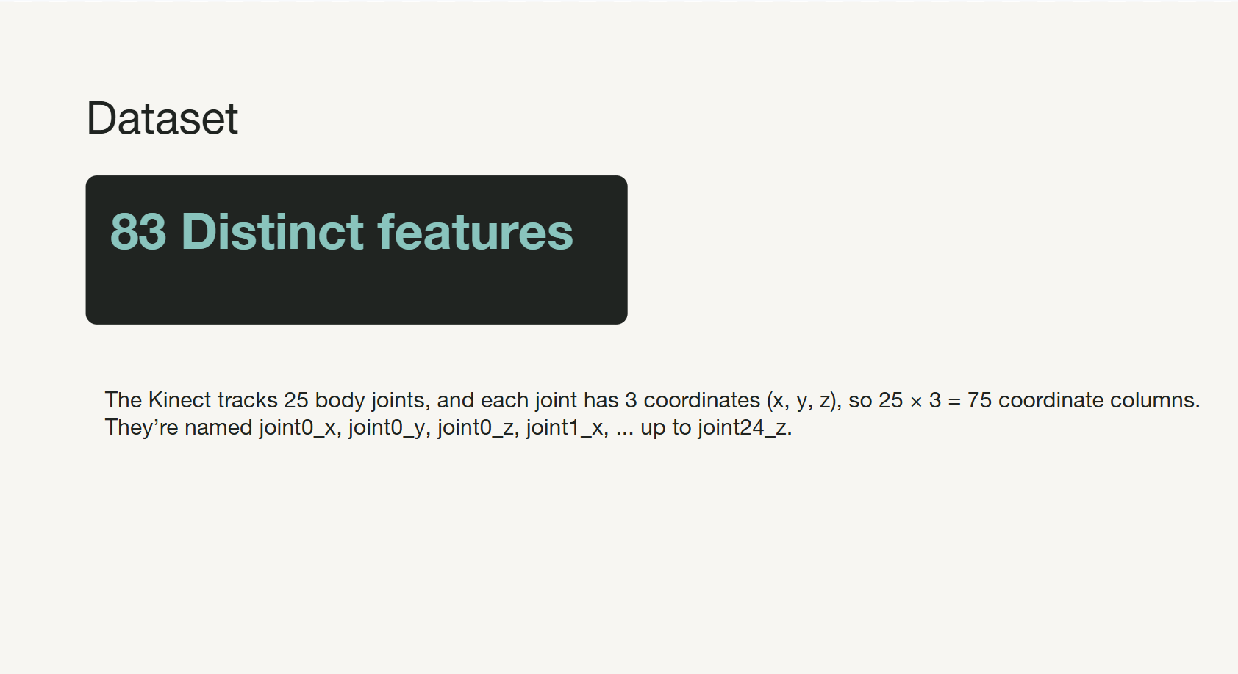
Dataset: From Joints to Features
The Kinect records a 3D skeleton; we convert its joint coordinates into inputs for gait classification.
83
25 tracked body joints
What the columns represent
Each joint has three 3D coordinates: X, Y and Z.
Examples: joint0_x, joint0_y, joint0_z … joint24_z.
Derived features add biomechanical information such as joint angles and segment relationships.
distinct features
75 coordinates + 8 derived features
25 × 3 = 75 coordinate columns
HOW RAW DATA BECOMES MODEL INPUT
Joint coordinates
Derived features
ML input
X, Y, Z for each joint
Angles and body-segment relationships
Numerical representation of walking
Why it matters: joint positions describe body posture, while derived features summarize movement relationships that can help distinguish the six gait classes.
Automated Identification of Gait Abnormalities · Team 10

