Slide 1

Room Occupancy Detection
An analysis of sensor data to predict room occupancy using machine learning models.
Team Members:
Abhilash Bandi (801329252)
Nitin Sai Talluri (801324883)
Hari Chandana Pulaparti (801329190)
Sahasraa vaka (801327852)
Naga Swetha Prathipati (801328550)
Sa

Slide 2

Introduction
The purpose of this project is to estimate the number of people in a room using a dataset from sensors deployed in the room. The outcome can be used to reduce energy use and be cost-effective. Five classifier models were used to forecast and assess the optimal model in terms of accuracy. Additional information, such as a heat map, confusion matrix, and classification report for each model, were created for further analysis.
Sa

Slide 3
Data Set Description
Sensor Data
Target Variable
Data Characteristics
The dataset contains data from 7 sensor nodes (S1-S7) and an edge node, with 16 input attributes. The sensors measure temperature, light, sound, and CO2 levels in the room.
The target variable, 'Room_Occupancy_Count', indicates the number of people in the room, either 0 (empty), 1, 2, or 3 persons.
The dataset does not have any missing data, making it relatively easy to analyze and develop ML models to estimate the number of people in the room.

Slide 4
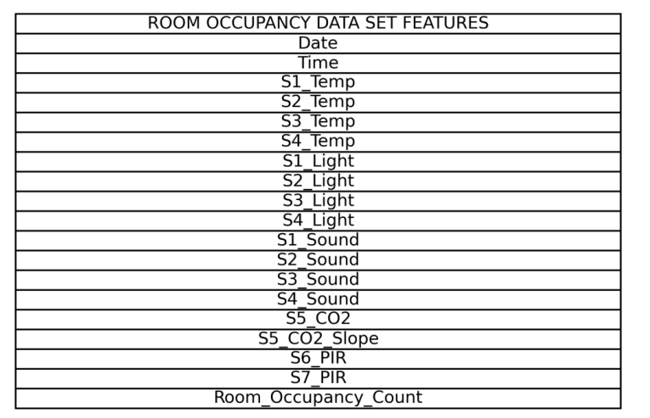
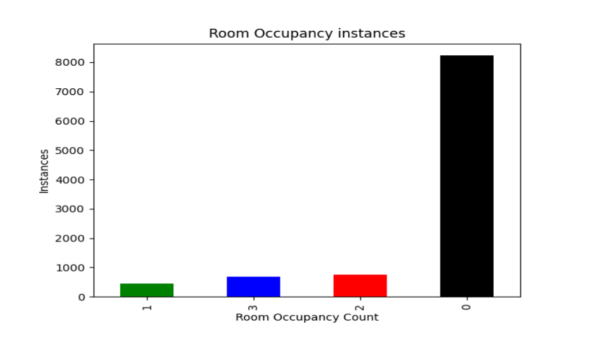
Features of Dataset

Slide 5

Data Visualization and Exploration
1
Imbalanced Dataset
2
Feature Correlation
The target variable, Room_Occupancy_Count, is significantly skewed, with 8,228 instances of no occupancy, 459 instances of one person, 748 instances of two persons, and 694 instances of three persons.
The heatmap analysis reveals the correlation between the various features in the dataset, which is essential for the feature selection step during data preparation.
3
Data Cleaning
The dataset is cleaned in such a way it doesn’t contain any null or "na" values or outliers, making it suitable for use with the machine learning models.

Slide 6
Model Development
1
Logistic Regression
Logistic regression is used for multi-class classification tasks, with the goal of fitting a logistic function to predict the class (0, 1, 2, or 3) based on the input features.
2
K-Nearest Neighbors
The KNN algorithm plots every data point and then searches for the class that each of its k nearest neighbors belongs to, in order to predict the output class.
3
Support Vector Machines
SVM creates a hyperplane in the input feature space to separate the data into distinct classes for optimal impact, performing well with non-linear boundaries and high-dimensional data.

Slide 7
Model Performance Evaluation
Logistic Regression
K-Nearest Neighbors
The logistic regression model achieved an accuracy of 98.3% on the test data, with high precision, recall, and F1-scores across all classes.
The KNN model achieved an accuracy of 99.4% on the test data, with excellent performance in terms of recall, precision, and F1-score for all classes.
Support Vector Machines
Decision Tree
The SVM model achieved an accuracy of 98.2% on the test data, with good precision, recall, and F1-score for the majority of the classes.
The decision tree model achieved an accuracy of 98.6% on the test data, with strong performance on the majority class but lower recall and F1-score for the minority classes.

Slide 8
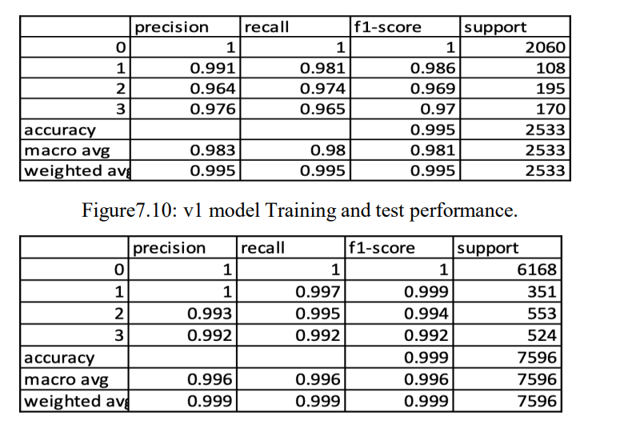
Random Forest
Accuracy
Feature Importance
The random forest classifier achieved the highest accuracy of 99.5% on the test data, demonstrating excellent generalization capabilities.
The random forest model was able to effectively identify the most relevant features for predicting room occupancy, providing valuable insights into the underlying data.
Precision
The random forest model exhibited high precision, recall, and F1-scores across all classes, indicating its ability to accurately classify the room occupancy counts.

Slide 9
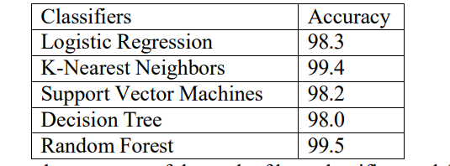
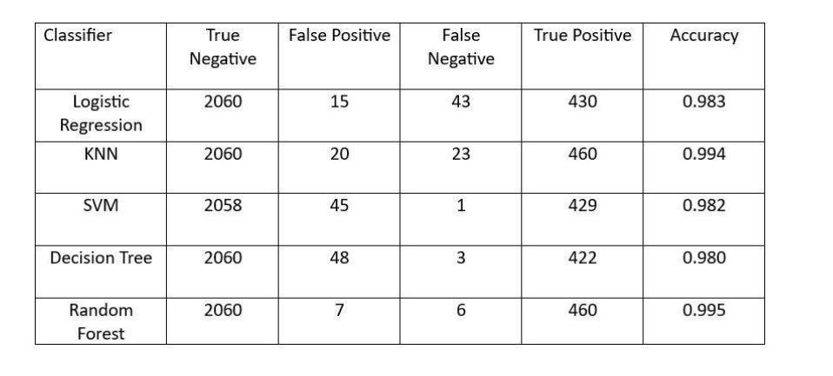
Evaluation of Top Classifier Models' Accuracy

Slide 10
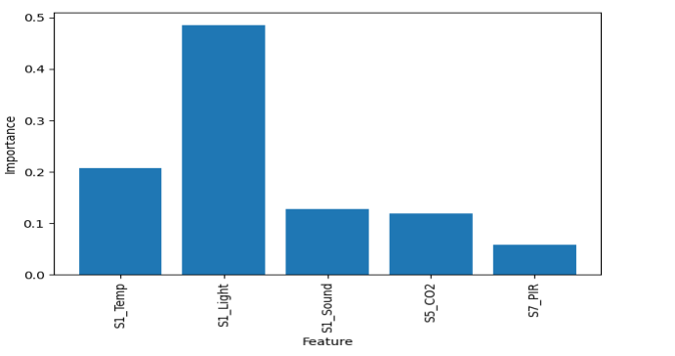
Analysis & Outcomes
The table presented demonstrates the effectiveness of the Principal Component Analysis (PCA) in highlighting feature correlations within the dataset. It specifically identifies which features show strong correlations after the application of PCA.

Slide 11




Conclusion
Best Performing Model
Generalization Capability
Practical Applications
The successful development of this room occupancy detection model can be leveraged to optimize energy usage, improve building management, and enhance overall efficiency in various real-world applications.
Based on the performance evaluation, the random forest classifier emerged as the best performing model, achieving an accuracy of 99.5% on the test data.
The random forest model demonstrated excellent generalization capabilities, with high precision, recall, and F1-scores across all classes, indicating its ability to accurately classify room occupancy counts.

Slide 12
Future Enhancements
Sensor Integration
Real-Time Deployment
Deep Learning Approaches
Incorporating data from additional sensors, such as HVAC, lighting, and security systems, could further enhance the model's accuracy and provide more comprehensive insights into room occupancy patterns.
Deploying the model in real-time and continuously monitoring its performance could enable dynamic occupancy tracking, allowing for more responsive and efficient building management.
Exploring advanced deep learning techniques, such as convolutional neural networks or recurrent neural networks, could potentially lead to even more accurate and robust room occupancy estimation models.

Slide 13
References
Kaggle Room Occupancy Estimation Dataset
Top Machine Learning Algorithms for Classification
Building a Logistic Regression in Python
Support Vector Machine Python Example
K-Nearest Neighbors in Python: A Practical Guide
UCI Room Occupancy Estimation Dataset

Slide 14
THANK YOU !

