Slide 1

RETAIL INTELLIGENCE · 2026
Customer Shopping
Behavior Analysis
3,900
records
Uncovering insights from 3,900 purchases to guide strategic business decisions.
3,900 transactions analyzed
Notes:
Introduce the scope of the customer shopping analysis covering 3,900 transactions. Highlight the core goal: translating purchase patterns into commercial growth.

Slide 2

FOUNDATION
Dataset Overview
3,900 rows
of purchase data
18 columns
covering demographics, purchase details and shopping behavior
37 missing values
all in Review Rating
Notes:
Detail the size and cleanliness of the source dataset: 3,900 records across 18 features, with only 37 missing ratings requiring imputation.

Slide 3
PIPELINE ARCHITECTURE
Data Preparation Process
01
02
03
04
05
Data Loading
Initial Exploration
Missing Handling
Feature Engineering
DB Integration
Imported raw CSV transaction files directly via Python pandas dataframes.
Loaded curated tabular models into PostgreSQL for production querying.
Validated structural schema, type integrity, and baseline summary statistics.
Imputed 37 missing Review Ratings using the median of each product category.
Derived age_group and purchase_frequency_days; formatted snake_case and removed redundant promo_code_used.
ETL pipeline built in Python 3.11 and PostgreSQL · validated against 3,900 transaction records.
Notes:
Walk through the five preparation phases: loading raw files, exploratory profiling, category-median imputation, feature engineering, and database export.

Slide 4
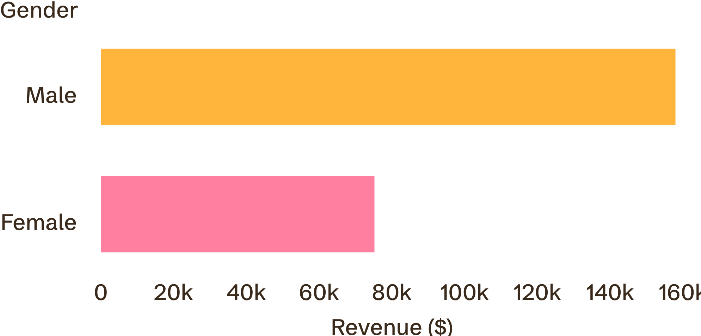
DEMOGRAPHIC REVENUE SPLIT
2.1x revenue multiple
Male customers generate more than twice the revenue of female customers
MALE SEGMENT
$157,890
67.7% of total portfolio revenue, driven by higher transaction volume.
FEMALE SEGMENT
$75,191
32.3% of portfolio revenue; clear expansion opportunity via tailored marketing.
Total gross revenue across 3,900 purchases: $233,081.
Notes:
Point out the male revenue dominance ($157,890 vs $75,191) and explain the opportunity to close the gap through female-targeted campaigns.

Slide 5

High-Value Discount Users
839
customers used a discount yet spent above the average purchase amount
Smart shoppers: high spenders who maximize value with discounts
Opportunity: target these customers with exclusive offers
Notes:
Examine the 839 smart shoppers who used promo codes yet beat the average order amount. Recommend premium thresholded discounts to preserve margins.

Slide 6
Top-Rated Products
Product | Rating (out of 5.0)
Gloves | 3.86
Sandals | 3.84
Boots | 3.82
Hat | 3.80
Skirt | 3.78

Slide 7
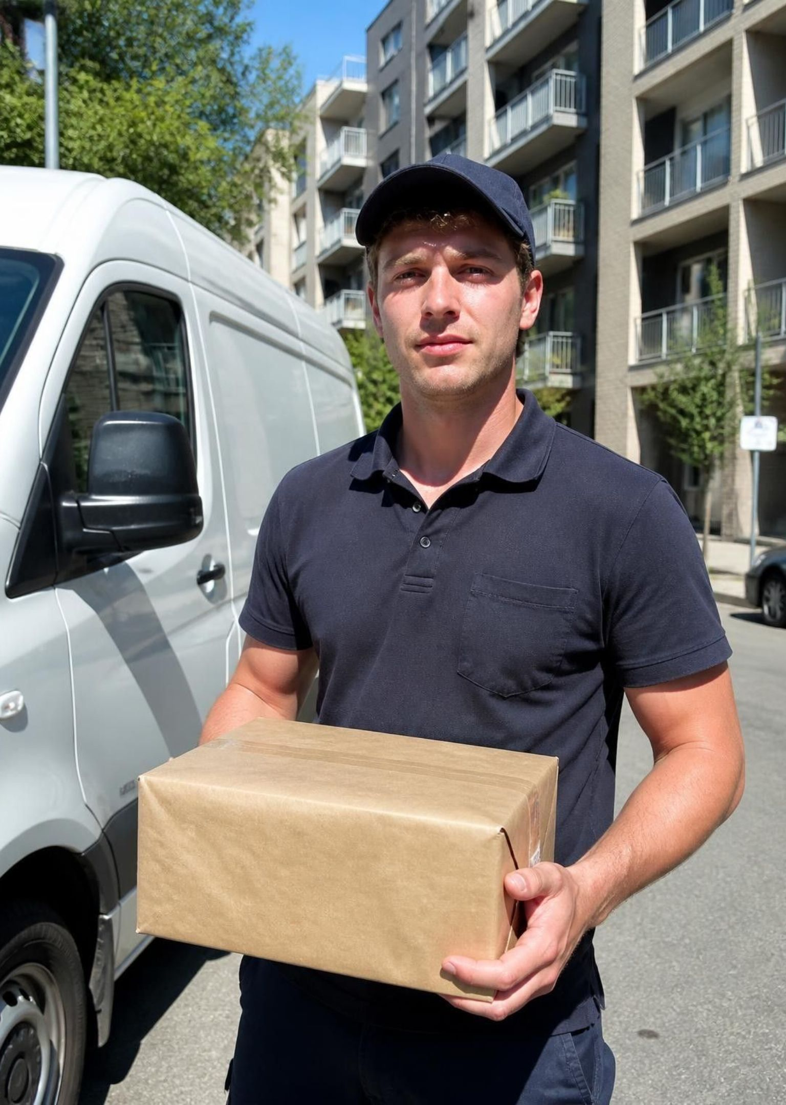
Express shipping customers spend slightly more
$60.48
$58.46
Express
Standard
average purchase
average purchase
Notes:
Express: $60.48 average purchase. Standard: $58.46 average purchase.

Slide 8
LOYALTY & MONETIZATION
Subscription Impact
SUBSCRIBERS
NON-SUBSCRIBERS
RETENTION DYNAMICS
1,053
2,847
91.0%
Customers
Customers
Subscriber Repeat Rate
Avg Spend: $59.49
Avg Spend: $59.87
958 of 1,053 subscribers made over 5 repeat purchases, proving subscription acts as a retention anchor rather than a basket-size multiplier.
Total Revenue: $62,645
Total Revenue: $170,436
Repeat (>5 buys): 958
Repeat (>5 buys): 2,518
Average spend remains nearly identical ($59.49 vs $59.87), demonstrating that membership drives purchase cadence, not ticket inflation.
91% subscriber repeat rate
Notes:
Analyze subscriber dynamics: average ticket is virtually identical ($59.49 vs $59.87), but 91% of subscribers become heavy repeat buyers (over 5 orders).

Slide 9
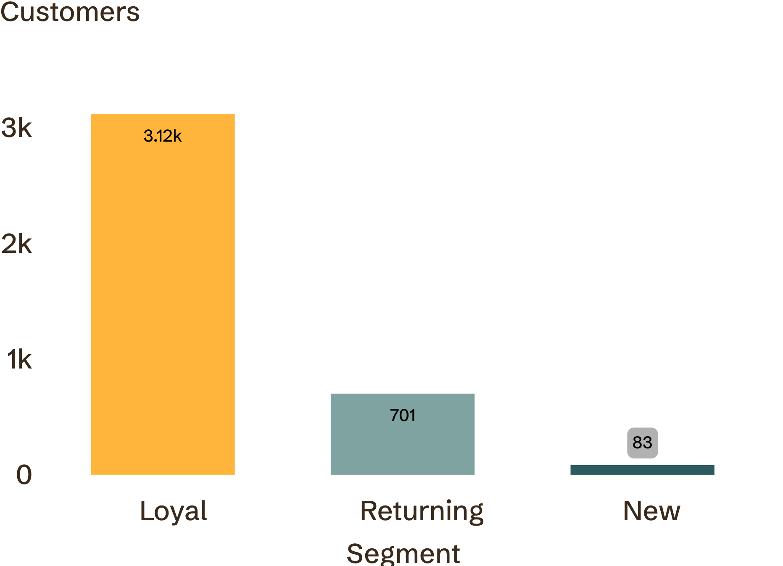
Customer Segmentation
Segment | Customers
Loyal | 3,116
Returning | 701
New | 83

Slide 10
PROMOTION DEPENDENCY
AGE COHORT MONETIZATION
Discount-Dependent Items
Revenue by Age Group
Top products purchased using price promotions.
Total gross revenue contribution across generational tiers.
Product | Discount Rate
Hat | 50.00%
Sneakers | 49.66%
Coat | 49.07%
Sweater | 48.17%
Pants | 47.37%
Age Group | Gross Revenue
Young Adult | $62,143
Middle-aged | $59,197
Adult | $55,978
Senior | $55,763
Young Adults lead at $62,143
Apparel and headwear show near-50% promo utilization, signaling habitual discount conditioning.
Notes:
Synthesize product discount reliance (Hats 50%, Sneakers 49.66%) with revenue across age tiers (Young Adults leading at $62,143), guiding promotional efficiency.

