Slide 1

Healthcare Patient Analytics
HEALTHCARE DATA ANALYTICS · 2026
55,500
One Dataset, Three Tools —
Python, MySQL, and Power BI
raw admission rows
54,966
From admission records to evidence-based insights for healthcare operations reporting.
clean records
106
Python
MySQL
Power BI
billing records flagged
Notes:
Introduce the project: one healthcare admissions dataset analysed with three tools. Source: Kaggle healthcare dataset. Findings describe patterns in this dataset only.

Slide 2





Turning admission records into reliable insight
PROJECT OBJECTIVES
Data cleaning & validation
The problem
Python · Pandas, NumPy
Admission records hold patient demographics, conditions, admission types, billing, insurance and length of stay — but duplicates, inconsistent text and unusual billing values reduce reliability.
Data transformation
Age groups, length of stay
Exploratory data analysis
Clear charts across key themes
SQL analysis
Goal: clean and validate the data, then analyse admission patterns, billing amounts and length of stay.
MySQL queries
Interactive Power BI dashboard
Validated against Python & SQL
Out of scope: the dataset has no employee data and cannot support claims about treatment effectiveness or readmission rates.
Notes:
Walk through the five deliverables from the project document. Stress the scope limits: no employee data, no treatment effectiveness or readmission claims, no causal or clinical conclusions.

Slide 3






What we started with
DATASET OVERVIEW
55,500
15
0
534
original rows
columns
missing values
duplicate records
What each record describes
Patient demographics
Medical conditions
Admission types
Billing amounts
Insurance providers
Admission & discharge dates
Source: Kaggle healthcare dataset (prasad22).— the quality issues were duplicates, inconsistent text and unusual billing.
Notes:
Exact figures: 55,500 rows, 15 columns, 0 missing values, 534 duplicate records. Even with no missing data, reliability was reduced by duplicates, inconsistent text formats and unusual billing values.

Slide 4
From 55,500 raw rows to 54,966 clean records
DATA CLEANING & VALIDATION · PYTHON
55,500
534
54,966
106
−
=
raw rows
duplicate records removed
clean records
nonpositive billing records flagged for review
1
2
3
4
5
Inspect
Standardise
De-duplicate
Flag
Preserve
Data types, missing values, duplicate rows, date fields
Fix inconsistent text formats
534 duplicate records removed
Nonpositive billing values flagged (106) for review
Raw file kept; every cleaning decision documented
54,966 = 55,500 − 534. The 106 flagged billing records are a separate review check, not part of the 534 duplicates.
Notes:
Exact: 55,500 original rows, 534 duplicate records removed, 54,966 clean records, 106 nonpositive billing records flagged for review. Raw file preserved; each cleaning decision documented.

Slide 5




Derived fields and exploratory analysis
TRANSFORMATION & PYTHON EDA
Data transformation
Exploratory analysis (clear charts)
Patient demographics
Medical-condition counts
Patient age groups
Created where the data supports it
Admission types
Billing distributions
Length of stay
Discharge date − admission date
Insurance-provider comparisons
Length-of-stay patterns
Validate before use
Derived values checked before analysis
Built with Pandas and NumPy as a reproducible analysis. Category-level values appear in the project notebook and dashboard.
Notes:
Age groups and length of stay are derived fields; length of stay comes from admission and discharge dates and is validated before use. EDA themes are as listed in the project document. Specific category counts, billing statistics and monthly figures were not in the supplied materials, so they are not shown here.

Slide 6





Six query techniques answer the project questions
SQL ANALYSIS · MYSQL
Filtering
Aggregation
Grouping
Isolate valid records and the flagged nonpositive billing rows
Admission counts plus billing totals and averages
By medical condition, admission type and insurance provider
CASE statements
Date calculations
Ranking
Bucket values such as age groups into readable categories
Length of stay from admission and discharge dates
Order categories and providers by volume or billing
Cleaned data
›
MySQL load
›
SQL query file
›
Cross-check results
Notes:
The project document lists the techniques: filtering, aggregation, grouping, CASE statements, date calculations and ranking. The 'used for' lines connect each technique to the project themes (conditions, admission types, insurance, billing, length of stay). The exact query text was not in the supplied files.

Slide 7
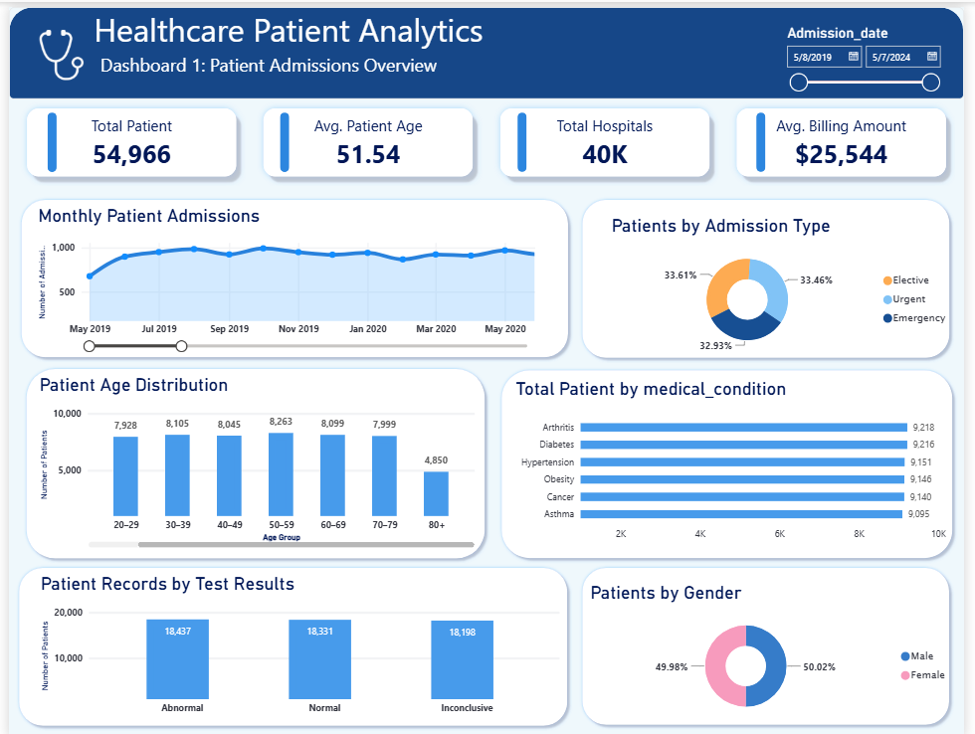
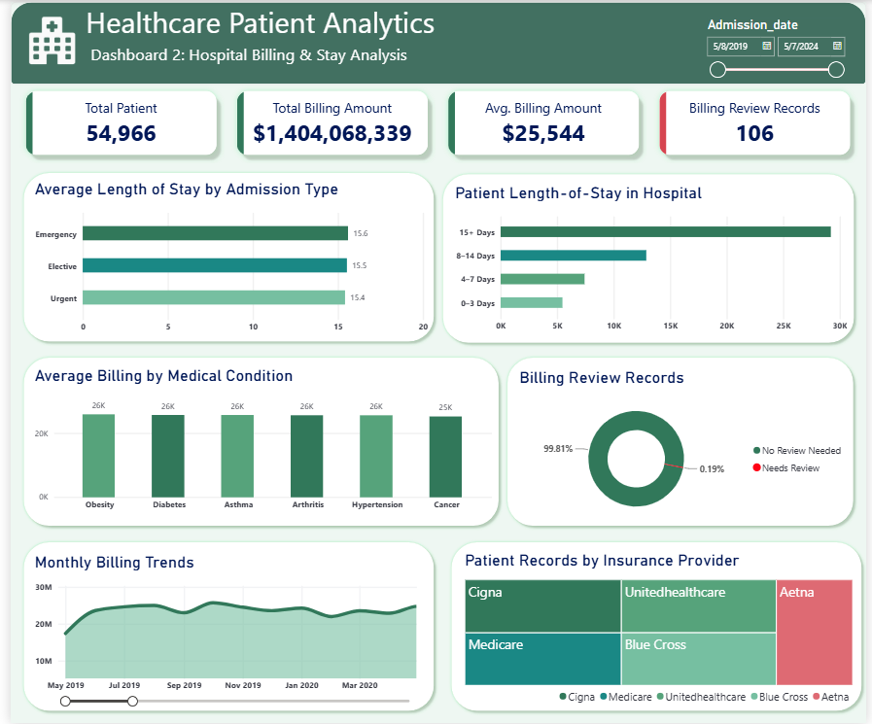
One interactive view of admissions, billing and stay
POWER BI DASHBOARD · OVERVIEW
Purpose
A concise, interactive dashboard that lets users explore the cleaned admissions data without writing code.
Headline views
Key admission counts, billing summaries and length-of-stay patterns.
Breakdowns
By medical condition, admission type and insurance provider.
Notes:
The dashboard is a core deliverable. Its scope per the project document: key admission counts, billing summaries, length-of-stay patterns, and breakdowns by medical condition, admission type and insurance provider; totals validated against Python and SQL. Insert actual screenshots from the Power BI file here — none were supplied, so none are invented.

Slide 8
Three breakdowns drive the dashboard's story
POWER BI DASHBOARD · ANALYTICAL SECTIONS
Medical condition
Admission type
Insurance provider
Which conditions appear most often among admissions, and how do billing and stay compare across them?
How are admissions split by type, and what are the billing and stay patterns for each?
How do providers compare on admission volume and recorded billing amounts?
Across all views: admission counts · billing summaries · length-of-stay patterns
Notes:
Each panel answers one business question using the breakdowns named in the project document. Replace placeholders with the real chart screenshots. Medication counts and test-result counts were mentioned in the request but are not in the supplied project document, so they are not presented as dashboard content; confirm before adding.

Slide 9

Trust the totals, respect the limits
VALIDATION & LIMITATIONS
Three tools, one set of totals
Data limitations
Findings describe this dataset only
Not causal or clinically validated conclusions
Python
No employee data included
MySQL
Power BI
Cannot support treatment-effectiveness or readmission-rate claims
Dashboard totals are validated against Python and SQL results. Reconciliation results were not in the supplied files — confirm before presenting as complete.
106 nonpositive billing records need review
Notes:
Limitations come directly from the project document. Findings are descriptive patterns in this dataset only. 106 nonpositive billing records are flagged for review.

Slide 10

Next steps and takeaway
RECOMMENDATIONS & CONCLUSION
Review the 106 flagged billing records before billing totals are used in reports.
1
Keep one validated dataset as the source for Python, SQL and Power BI; reconcile totals each refresh.
Conclusion
2
A documented, validated dataset (55,500 → 54,966 records) now feeds reproducible Python analysis, a SQL query file and an interactive Power BI dashboard.
Together they turn admission records into clear, evidence-based insight for operations reporting — within the limits of this dataset.
Standardise text entry at source to prevent duplicates and inconsistent formats.
3
Use results for operations reporting — as descriptive patterns, not causal or clinical claims.
4
To confirm: dashboard screenshots, category-level values, and medication / test-result counts (not in the supplied files).
Notes:
Close by restating the pipeline and its limits. Recommendations are process-focused and follow from the cleaning and validation work; they are not clinical recommendations.

