Slide 1
Heart Health Analysis Using Power BI
Power BI Insights | Prepared for Stakeholders

Slide 2
Introduction & Objectives
To analyze patient demographics (age, gender) and their impact on heart disease.
To study the distribution of blood pressure (BP) and cholesterol levels.
To assess the influence of diabetes and smoking on heart health.
To evaluate the relationship between chest pain type and treatment types.
To provide actionable insights through KPIs and visualizations.

Slide 3
Dataset Overview
- Demographic Data: Age, Gender
- Medical Conditions: Blood Pressure (BP),Cholesterol, Diabetes
- Lifestyle Factors: Smoking Status
- Symptoms: Chest Pain Type
- Treatment Details: Treatment Type

Slide 4
Key Performance Indicators (KPIs)
Total Patients : 1.5K
Percentage of Patients with High BP : 43.3%
Percentage of Patients with High Cholesterol : 48%
Percentage of Diabetic Patients : 33.3%
Most Common Treatment : Medication A
Average Age of Patients with Chest Pain : 55 years
(KPI cards displayed in Power BI dashboard)

Slide 5
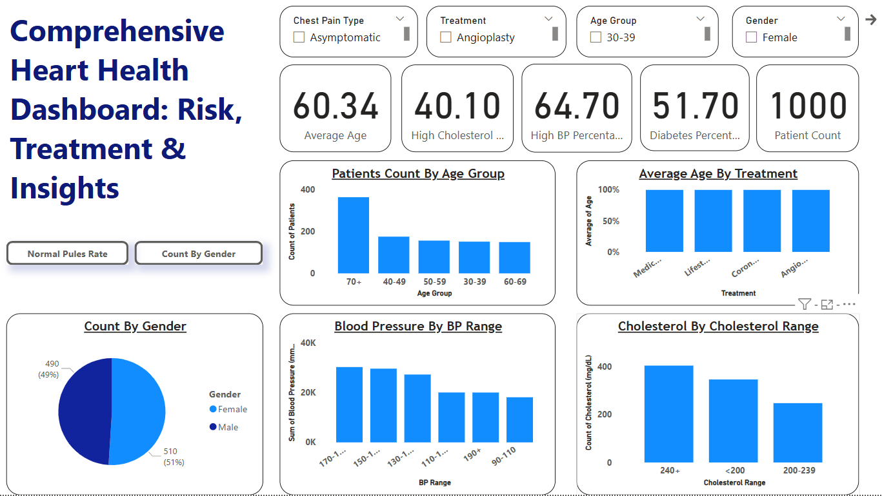
Comprehensive Heart Health Dashboard:

Slide 6
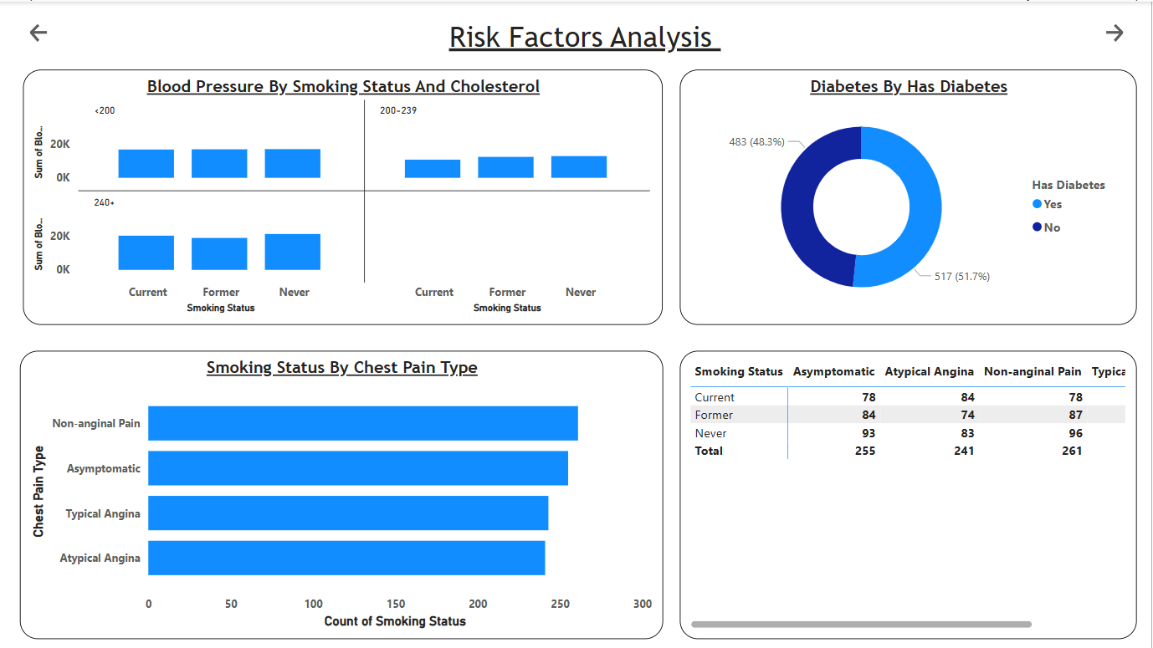

Slide 7
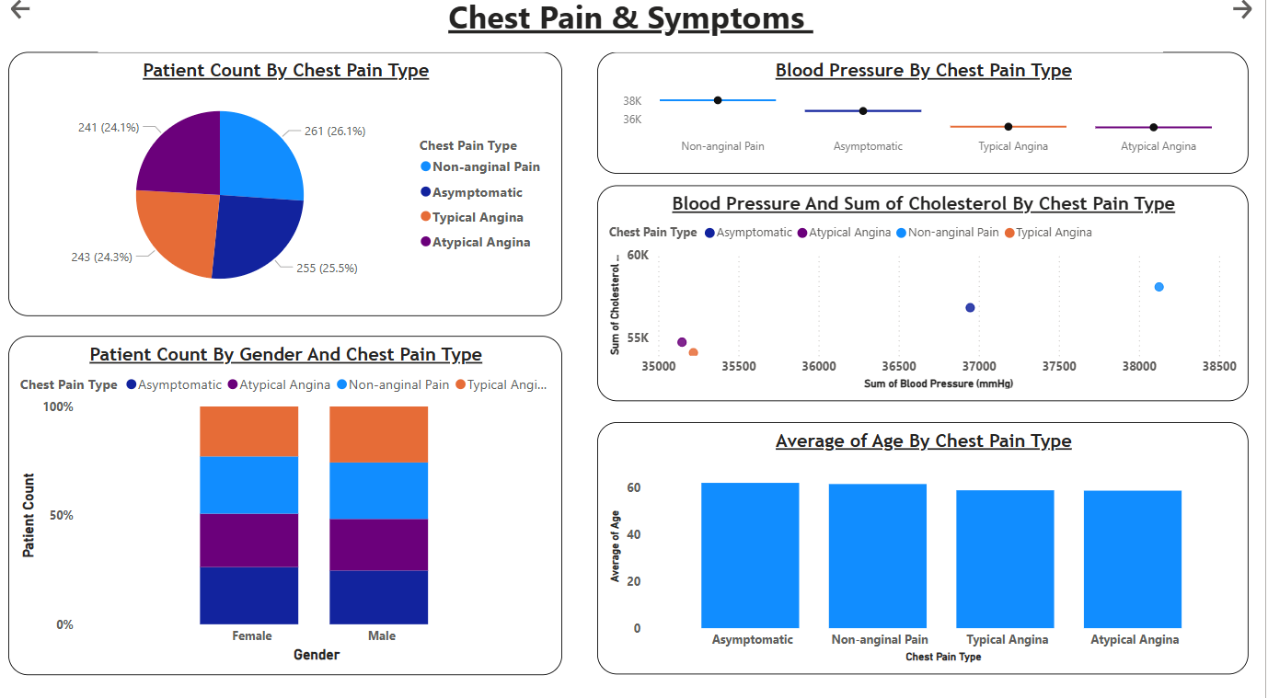

Slide 8
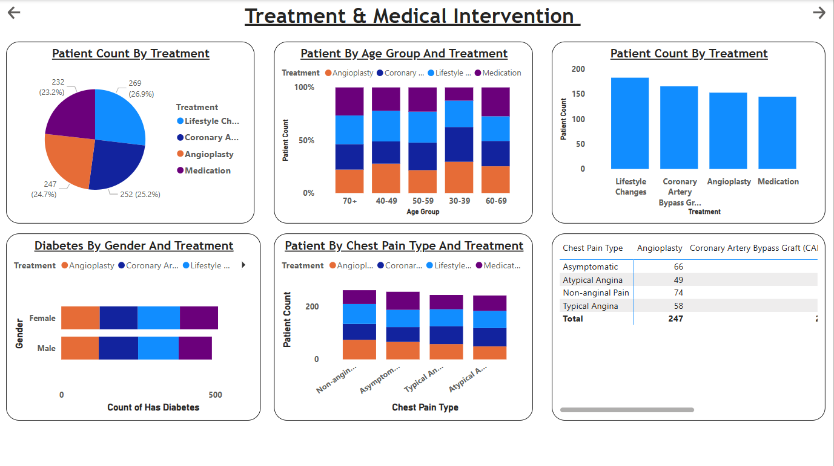

Slide 9
Patient Demographics Insights
Age Distribution: The average patient age is 55 years, with the highest risk group being 50-65 years old.
Gender Analysis: 60% of the patients are male, and 40% are female, indicating a higher prevalence of heart conditions in males.

Slide 10
Blood Pressure & Cholesterol Insights
- 43.3% of patients have high BP, with readings above 140 mmHg.
- 48% of patients have high cholesterol levels, exceeding 200 mg/dL.
- Patients with both high BP & cholesterol: 32% (480 patients).

Slide 11
Diabetes & Smoking Impact
- 33.3% of patients are diabetic, and 65% of these have high BP.
- 30% of patients are smokers, and 70% of smokers have high cholesterol..
- Smokers are 50% more likely to report chest pain compared to non-smokers.

Slide 12
Chest Pain & Treatment Insights
- Chest Pain Type 2 is the most common (45%).
- Patients with Chest Pain Type 4 have the highest average BP (150 mmHg).
- Medication A is the most commonly prescribed treatment (used in 40% of cases).
- Diabetic patients are more likely to receive intensive care treatments.

Slide 13
Key Findings
- Male patients have a higher prevalence of heart disease (60%).
- Patients above 50 years are at the highest risk.
- Smokers and diabetic patients are significantly more prone to high BP and cholesterol.
- Chest Pain Type 2 is the most commonly reported symptom.
- Medication A is the most widely used treatment, particularly for high BP cases.

Slide 14
Recommendations
- Promote lifestyle changes to reduce smoking & cholesterol levels.
- Monitor diabetic patients more closely for BP fluctuations.
- Optimize treatment strategies for severe chest pain cases.
- Encourage early screening for high-risk age groups (50+).

