Slide 1
19ECS493 INTERNSHIP
B.Tech CSE 7th SEM
AY : 2023-2024
Machine Learning and Data Science with Python
PHN Technology
Nitinsai.Avirneni
322010322007

Slide 2
Objective of the Internship Tasks:
Gained practical experience in Data visualization using matplotlib library in Python.
Learned how to create different types of plots such as bar charts, histograms, pie charts, and scatter plots.
Understood how to manipulate and analyze data using NumPy library in Python.
Familiarized with working on a real-world dataset and perform data analysis tasks.
Overview of Skills to be Learned:
Data visualization using matplotlib: Learn to create various types of visualizations to represent data effectively.
Working with NumPy: Understand how to work with arrays and perform mathematical operations on data.
Data analysis: Gain skills in analyzing and summarizing data to derive meaningful insights.
Python programming: Enhance Python programming skills while implementing the tasks.
Data manipulation: Learn to reshape, merge, and manipulate data using Python libraries.

Slide 3
WEEK 1:
Task 1: Prepare the sample CSV file for car model with the following column names
Task 2: Prepare the sample Excel file car pricing and loan amount with the following column names:
Task 3: Write the code to read the CSV file and the Excel file and convert them into DataFrames.
Task 4: Merge the two DataFrames on the basis of primary key (Company Name and Model Name).
Task 5: Fill the "NA" values in the merged DataFrame (if any).
Task 6: Iterate over the merged DataFrame and add the GST value in the "On road pricing" column.
Skills Learned:
Data processing and manipulation using Python's pandas library.
Reading data from CSV and Excel files and converting them into DataFrames.
Merging DataFrames based on primary keys to combine related data.
Handling missing data (NA values) and filling them appropriately.
Performing calculations and data transformations on the merged DataFrame.
Data visualization (can be shown through appropriate plots or charts in the presentation slides).

Slide 4
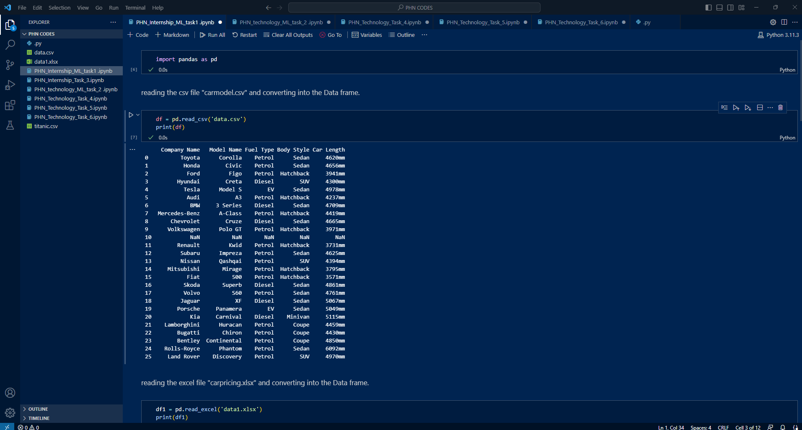

Slide 5
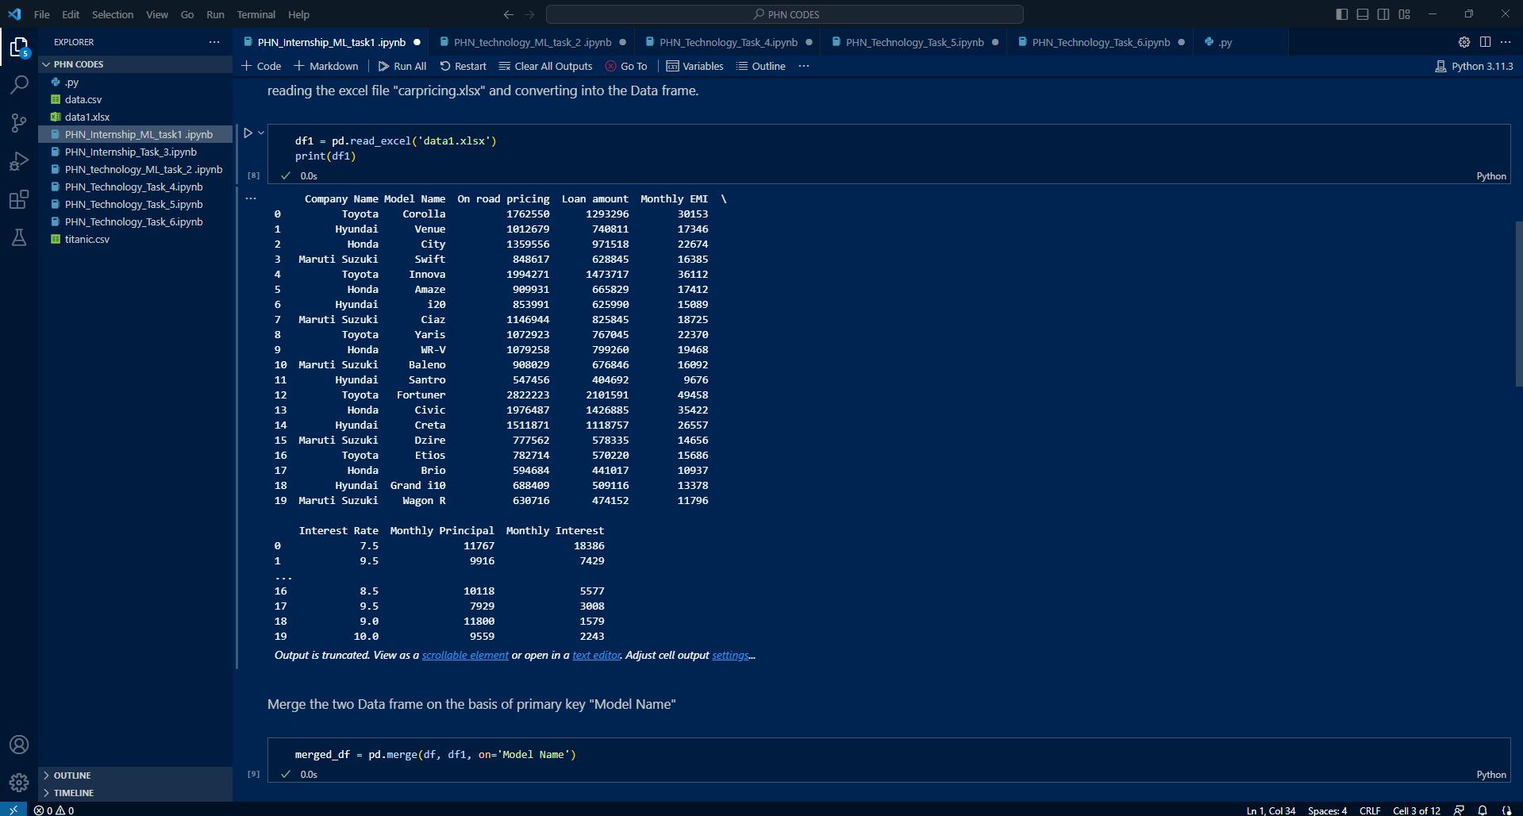

Slide 6
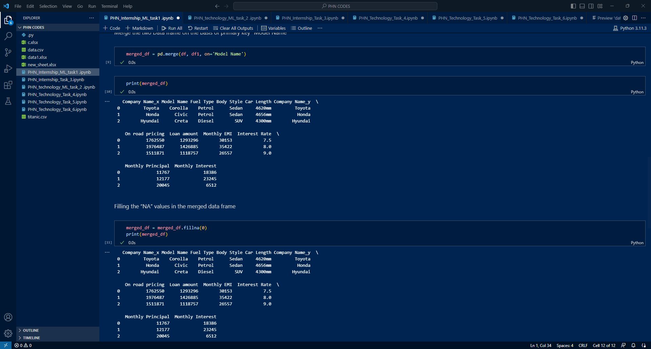

Slide 8
WEEK 2:
Task 1: Prepare the Titanic dataset file (download it from Google)
Task 2: Find out the names of passengers younger than 35 years.
Task 3: Print the rows from index 10 to 25 and columns 3 to 5
Task 4: Find out the statistics aggregate of Age & Fare using the DataFrame.agg() method.
Task 5: Find out the mean ticket fare price for each of the sex and cabin class combinations .
Skills Learned:
1.Data Loading and Manipulation:
Loading data from CSV files using pandas read_csv() method.
Dataframe manipulation using methods like agg(), and groupby().
Data Filtering and Selection: Filtering data based on specific conditions, like selecting passengers younger than 35 years using boolean indexing.
Data Statistics and Aggregation: Calculating statistical aggregates like mean, median, standard deviation, min, and max using the agg() method.
Data Grouping and Aggregation: Grouping data based on specific columns (e.g., 'Sex' and 'Pclass') and calculating aggregate functions (mean fare).

Slide 9
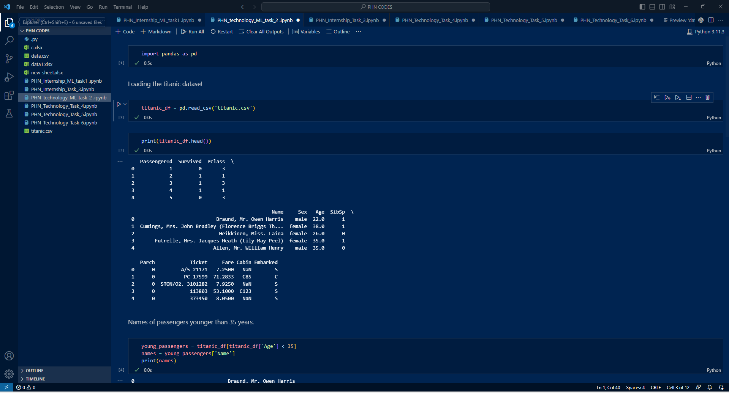

Slide 10
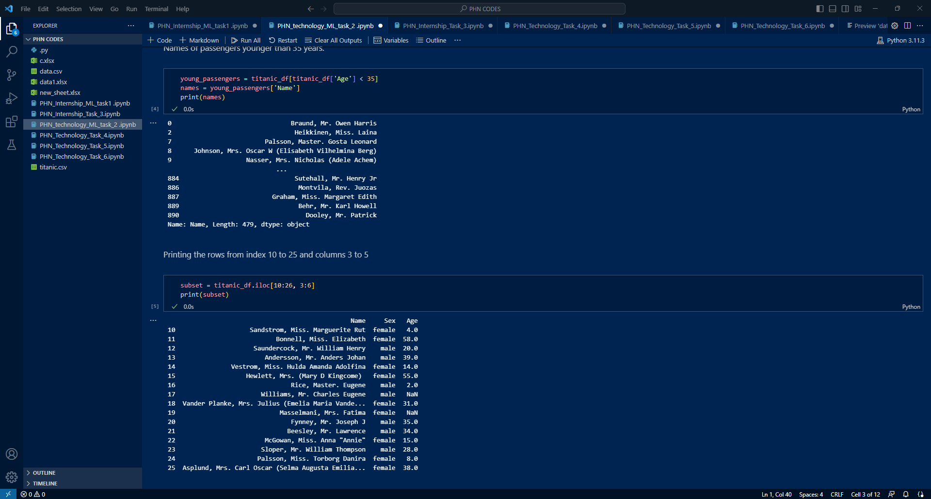

Slide 11
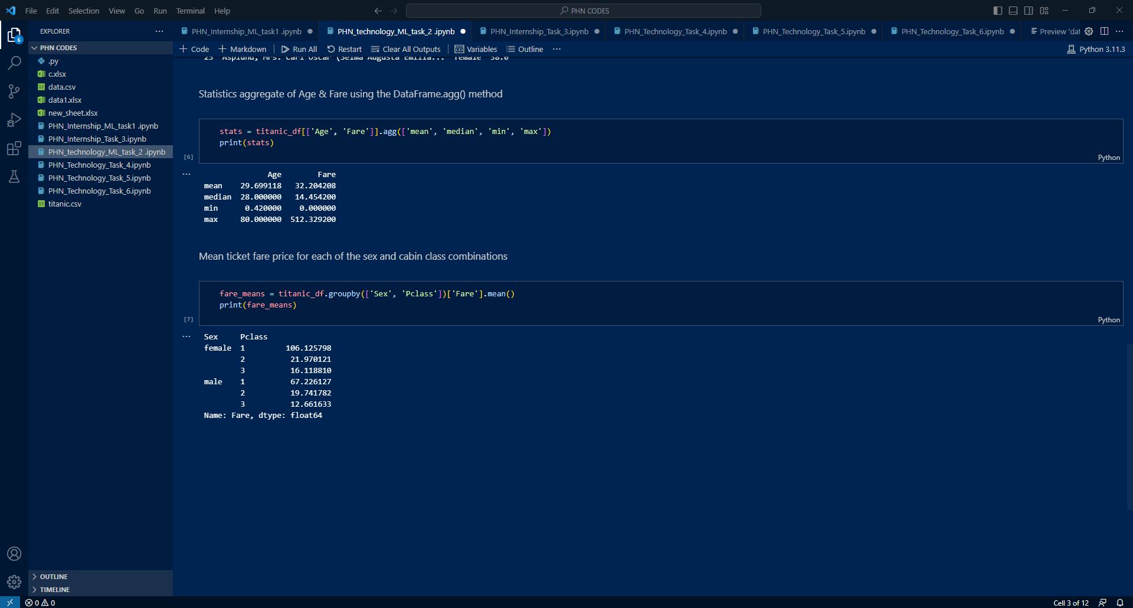

Slide 12
WEEK 3:
Task:
Write a Python script that should perform the following tasks:
1. Read the data from the Excel spreadsheet.
2. Calculate the total quantity of each fruit.
3. Write the results to a new Excel spreadsheet with the following format:
4. The first column should contain the name of each fruit.
5. The second column should contain the total quantity of that fruit.
Skills Learned:
Excel File Handling: The ability to read data from an existing Excel spreadsheet and create a new one.
Data Manipulation: Extracting, processing, and calculating data from the Excel spreadsheet. 3.Dictionary Usage: Utilizing dictionaries to store and update the total quantity of each fruit
4.Data Writing: Writing data to a new Excel spreadsheet.
5.Python Programming: Utilizing Python programming language to interact with Excel files and perform data manipulation tasks.

Slide 13
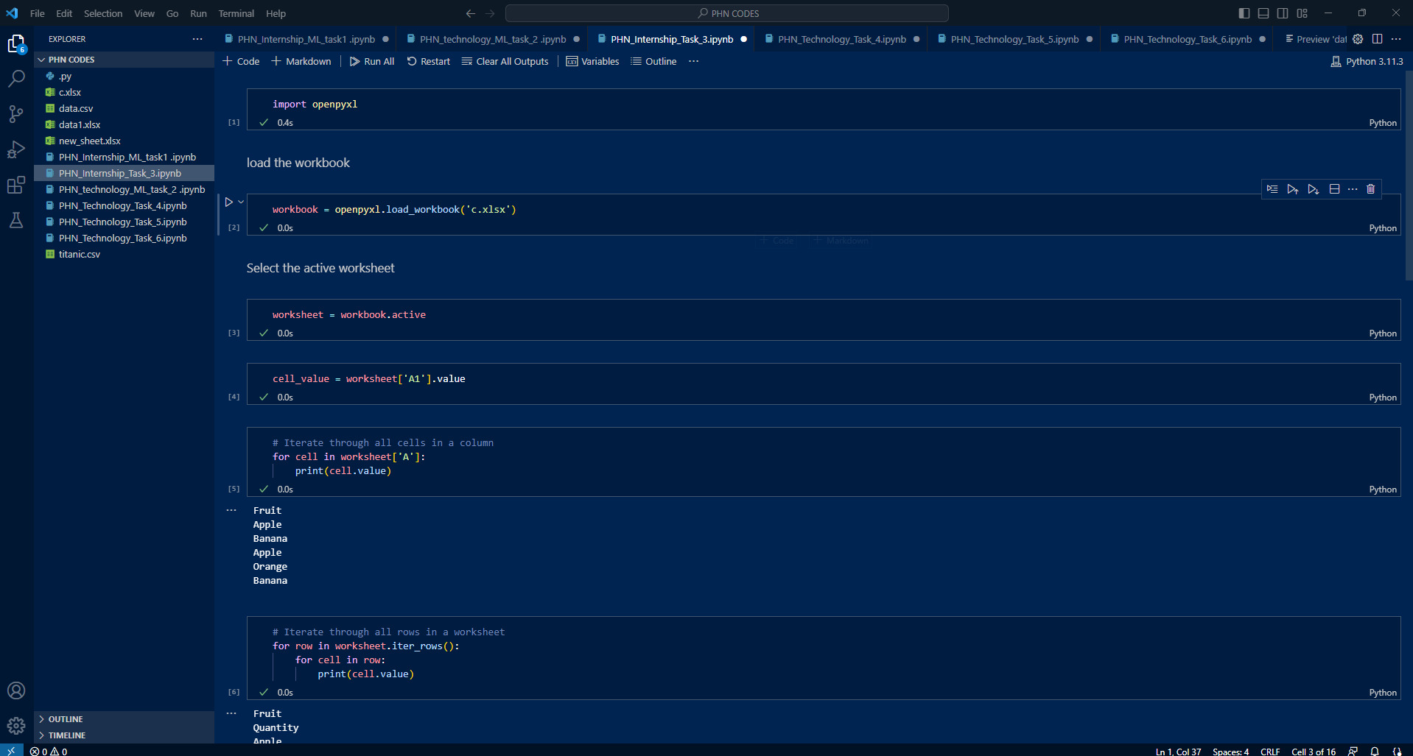

Slide 14
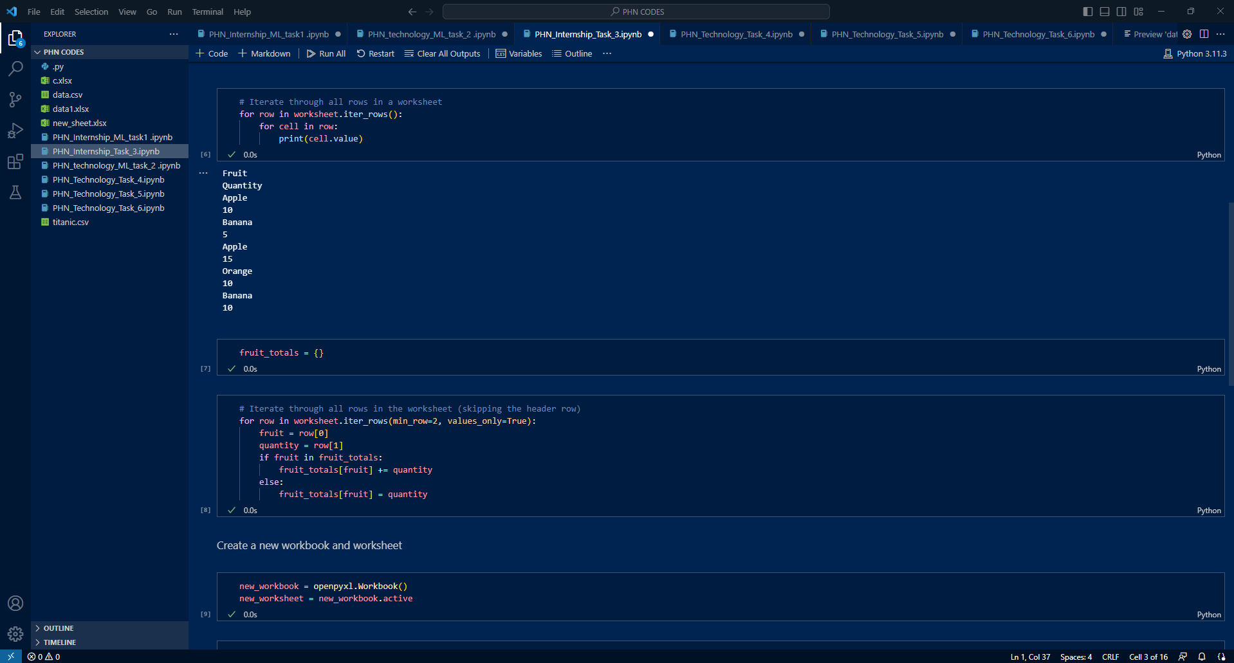

Slide 15
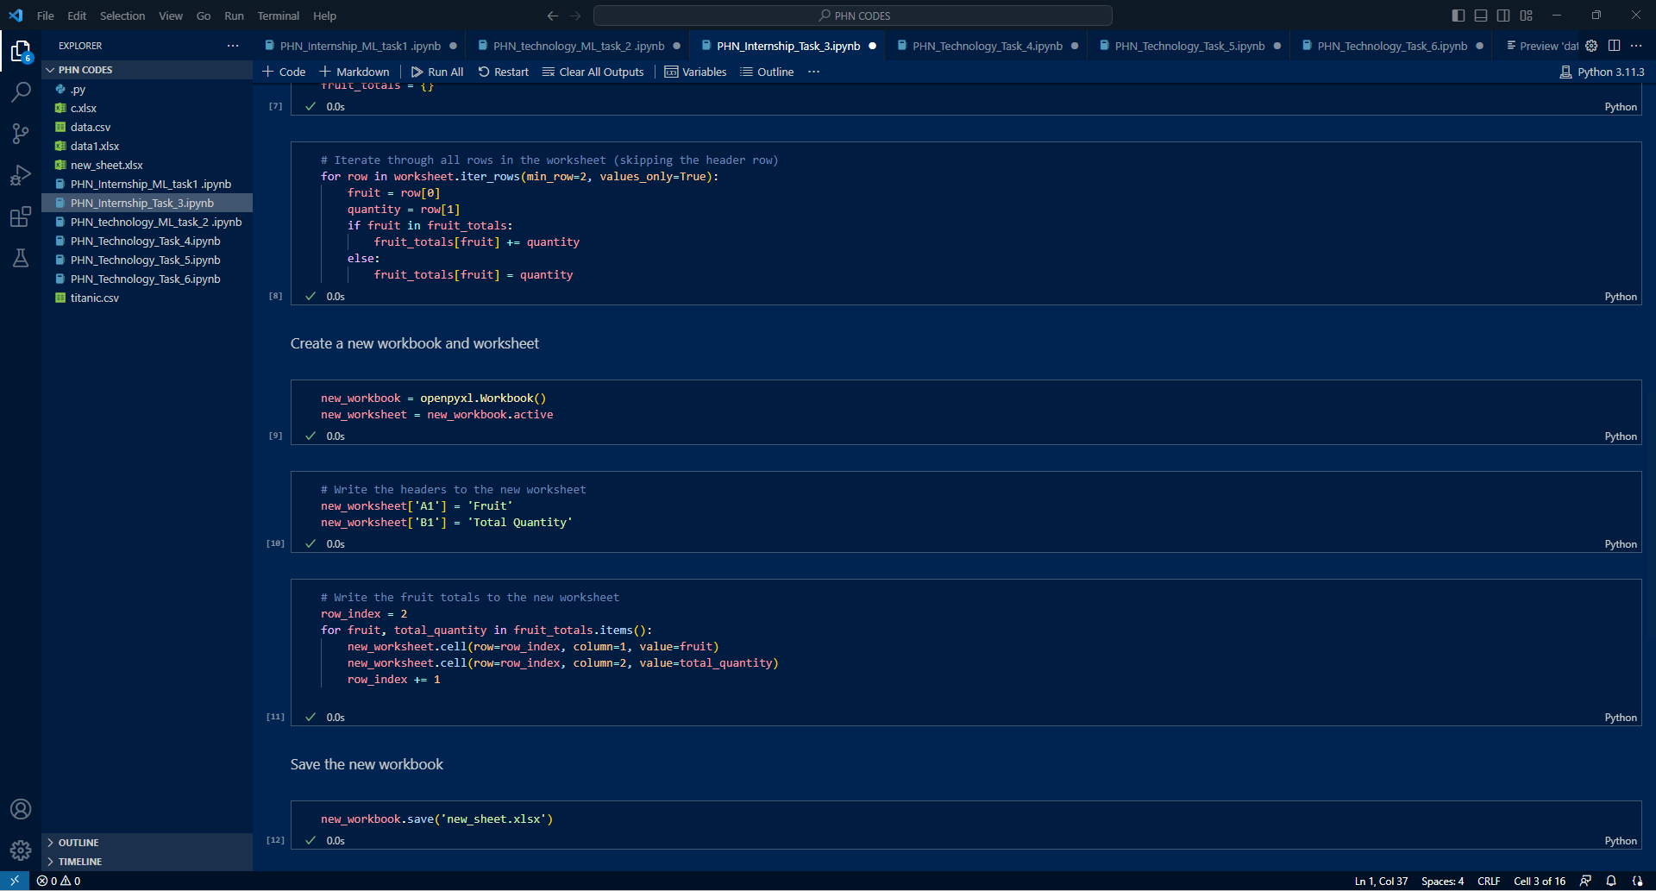

Slide 16
WEEK 4:
Task:
Write a Python program using NumPy to perform the following tasks on a given array:
1. Create a NumPy array with the following values: [1, 2, 3, 4, 5].
2. Print the shape of the array using the .shape attribute.
3. Reshape the array into a 2D array with 2 rows and 3 columns.
4. Print the shape of the new array.
5. Create a second NumPy array with the following values: [6, 7, 8, 9, 10].
6. Compute the resulting array's mean, median, and standard deviation.
Skills Learned:
Creating NumPy arrays: You learn how to create one-dimensional NumPy arrays from Python lists.
Array attributes: You learn how to access and utilize array attributes, like the .shape attribute to get the dimensions of the array.
Reshaping arrays: You learn how to reshape arrays to change their dimensions.
Array operations: You learn how to perform arithmetic operations on arrays, like element-wise addition of two arrays.

Slide 17
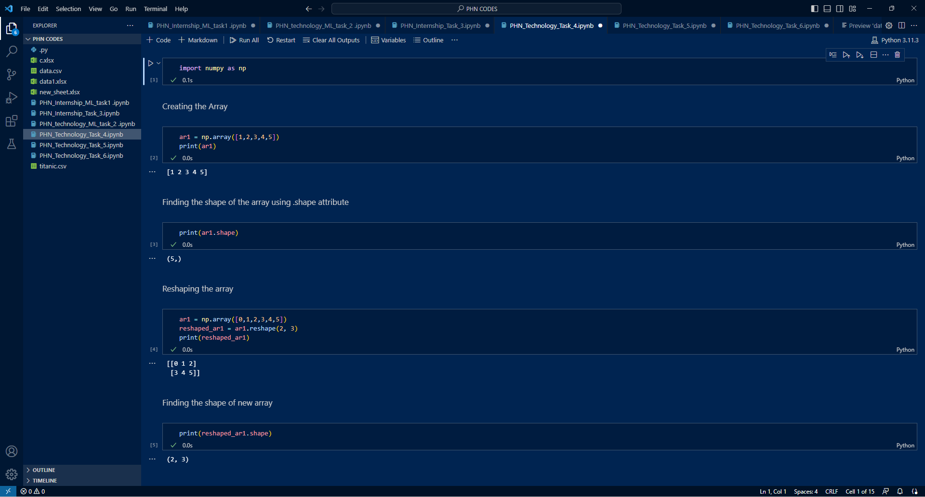

Slide 18
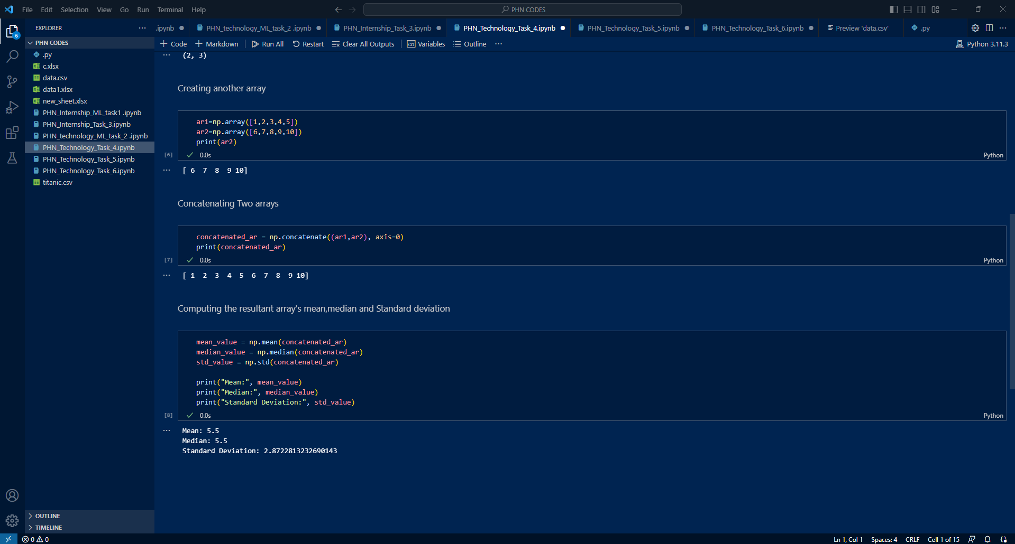

Slide 19
WEEK 5:
Task:
1.Write a Python code to Create a figure with 2x2 subplots.
2. In the first subplot (top-left), plot a bar chart.
3. In the second subplot (top-right), plot a histogram.
4. In the third subplot (bottom-left), plot a pie chart.
5. In the fourth subplot (bottom-right), plot a scatter plot.
6. Add appropriate titles and labels to each subplot.
7. Adjust the spacing between subplots to avoid overlapping.
Skills Learned:
Data Visualization: Creating various charts to visually represent data.
Subplotting: Dividing the figure into multiple subplots to plot different charts.
Bar Charts: Plotting categorical data using bar charts.
Histograms: Visualizing the distribution of numerical data with histograms.
Pie Charts: Representing proportions using pie charts.
Scatter Plots: Visualizing relationships between variables using scatter plots.
Figure Customization: Adjusting the size and spacing of the figure.
Data Manipulation: Handling and using data effectively for plotting.

Slide 20
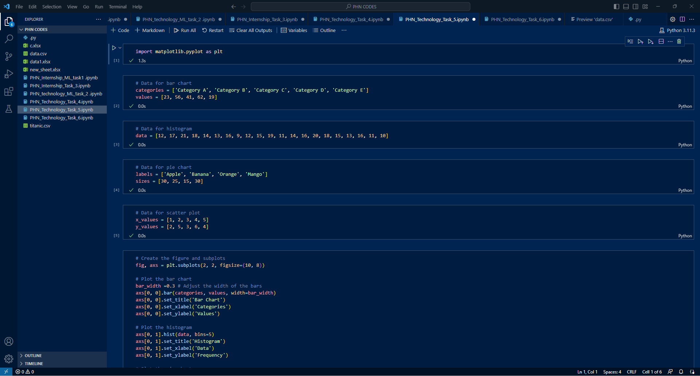

Slide 21
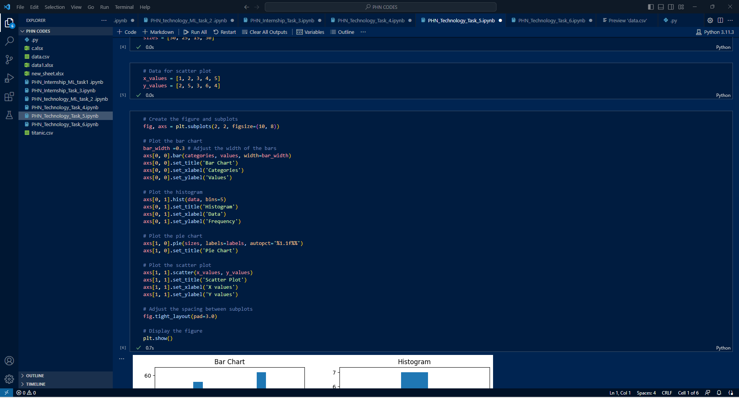

Slide 22
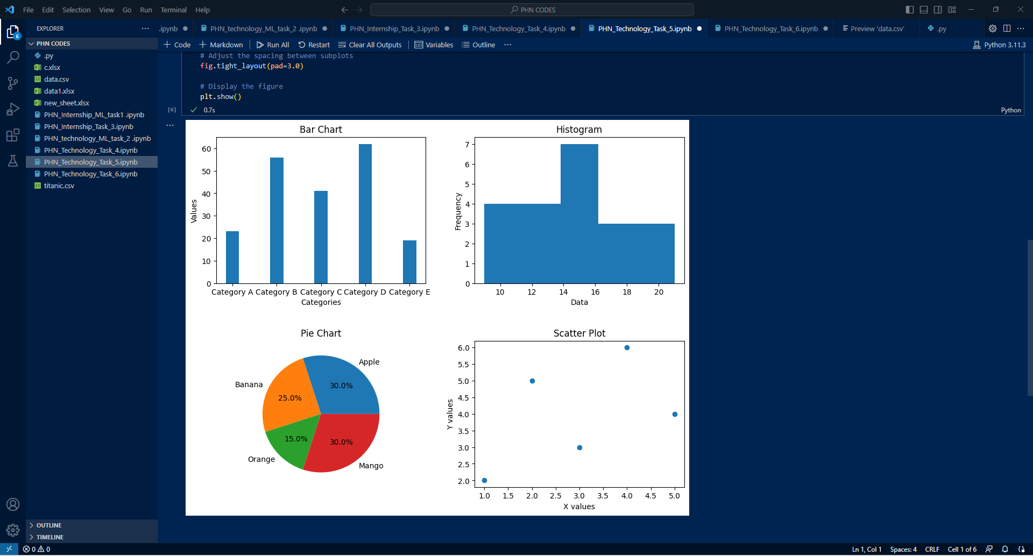

Slide 23
WEEK 6:
Task:
Machine Learning for Linear Equation Prediction.
You are tasked with developing a machine learning model that can predict linear equations based on a given dataset. The dataset consists of pairs of input variables and corresponding output values, representing different linear equations.
Your goal is to train a model that can accurately predict the coefficients of a linear equation given new input values.
Skills Learned:
Data Generation: Creating a diverse dataset of linear equations with input variables and output values.
Data Pre-processing: Normalizing or standardizing the data for better model performance.
Model Selection: Choosing an appropriate machine learning model, like linear regression.
Model Training: Training the model to accurately predict linear equation coefficients for new inputs.

Slide 24
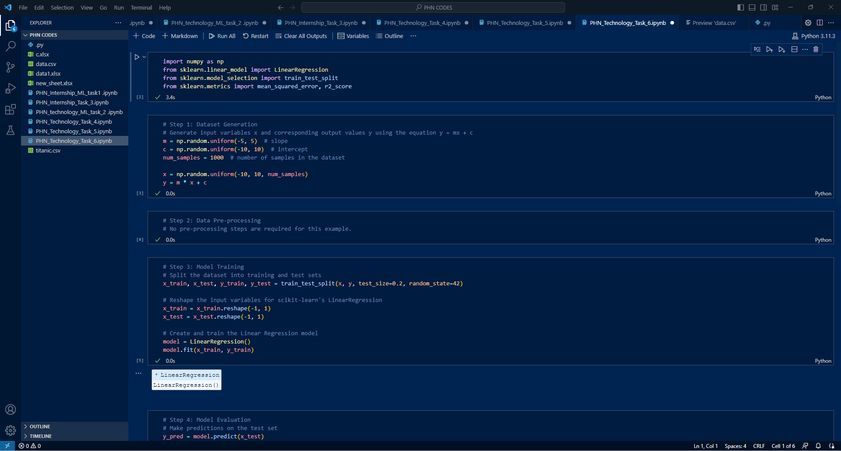

Slide 25
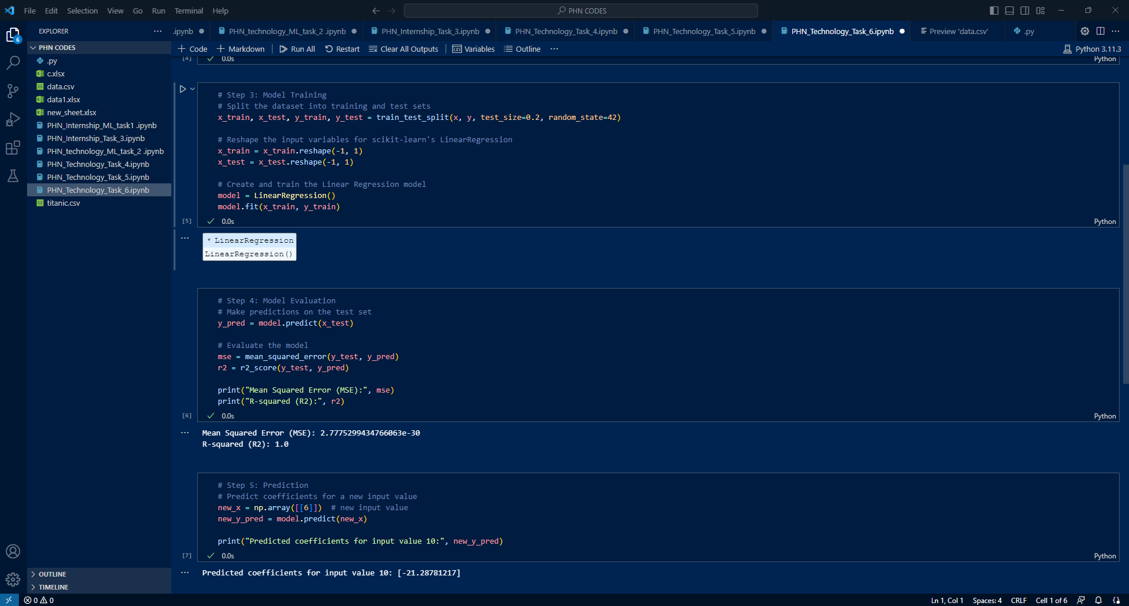

Slide 26
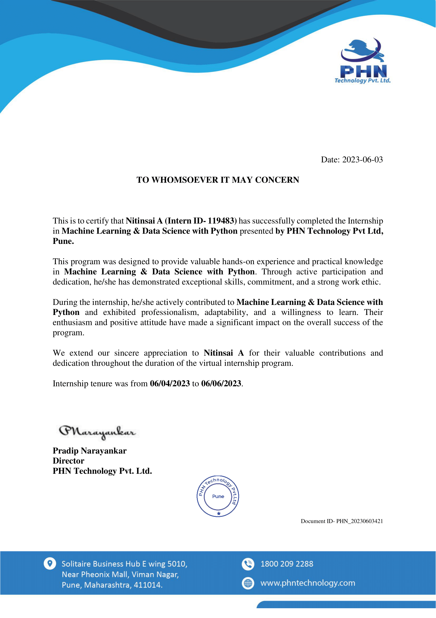

Slide 27


