Slide 1
Behavioral Threat Detection Framework
Using Unsupervised Machine Learning
K-Means · DBSCAN · Isolation Forest
175,341
K = 10
3.98 %
Flow Records
Clusters
Anomaly Rate
Dataset: UNSW-NB15 Benchmark | 2nd Year DT — Unsupervised Learning | March 2026
1 / 12

Slide 2
Problem Statement
Enterprise SOCs face:
Core Question:
▸ High alert volume — thousands of events daily with no priority order
▸ Signature-based detection limitations — only catches known attack patterns
▸ Zero-day blind spots — novel attacks pass through undetected
▸ No behavioral prioritization — analysts triage manually and randomly
▸ Result: critical threats buried in the noise, MTTD = days to weeks
"Can we group network sessions by behavior and surface the most suspicious ones — without using labels?"
Our Answer:
Segment all sessions by behavioral patterns (K-Means) → detect anomalies without labels (DBSCAN + Isolation Forest) → produce a ranked SOC queue so analysts tackle highest-risk first.
2 / 12

Slide 3
Dataset — UNSW-NB15 Benchmark
Clear & Honest Disclosure
About the Dataset:
⚠ Important — Be Clear:
▸ 175,341 network flow records
▸ 45 features per session (volume, timing, protocol, behaviour)
▸ Simulated in a controlled lab using IXIA PerfectStorm
▸ 10 labelled attack categories: DoS, Recon, Exploits, Backdoor …
▸ Published by Australian Centre for Cybersecurity, UNSW Canberra
▸ Widely used benchmark in academic cybersecurity research
▸ This is NOT live corporate data
▸ It is a controlled research benchmark
▸ Labels were NOT used during model training
▸ Labels used only for post-hoc validation
"We use UNSW-NB15 to demonstrate how a behavioral detection framework would operate in a real enterprise SOC. The methodology is directly transferable to live corporate traffic."
3 / 12

Slide 4
Feature Engineering
Converting Raw Network Flows into Behavioral Signals
Features Representing:
Engineered Behavioral Features:
Volume
sbytes, dbytes
Outbound Dominance Ratio
sbytes / (sbytes + dbytes + ε)
Packets
spkts, dpkts
Detects: exfiltration — sends far more than receives
Duration
dur, synack, ackdat
Packet Rate
(spkts + dpkts) / (dur + ε)
Protocol/Service
proto, service, state
Detects: scanning floods — extreme packets per second
Timing / Rate
rate, sload, dload, sinpkt, dinpkt
Bytes per Packet
total_bytes / total_packets
Detects: bulk vs interactive sessions
Packet Asymmetry
(spkts − dpkts) / (spkts + dpkts + ε)
Detects: one-sided sessions — scan with no response
Purpose: Convert raw flows into discriminative behavioral signals that K-Means can cluster.
4 / 12

Slide 5
Clustering — Why K-Means?
Segmenting Traffic into Behavioral Groups
Goal: Assign every network session to a behavioral group automatically — no labels needed.
How it works:
Why NOT alternatives:
▸ Assign each session to its nearest centroid
▸ Minimize within-cluster variance (squared distance)
▸ Euclidean distance in standardized feature space
▸ Repeat until centroids converge — K-Means++ initialization
Hierarchical
✗ O(n²) memory — infeasible at 175K rows
GMM
✗ Assumes Gaussian — traffic is skewed
Mean Shift
Why chosen:
✗ No K needed but too slow at this scale
▸ Scales well to 175,000+ sessions
▸ Centroids are interpretable — readable behavioral profiles
▸ Deterministic with K-Means++ seeding
▸ Clear output: SOC-readable cluster labels per session
OPTICS
✗ Density-based — weaker centroid clarity
5 / 12

Slide 6
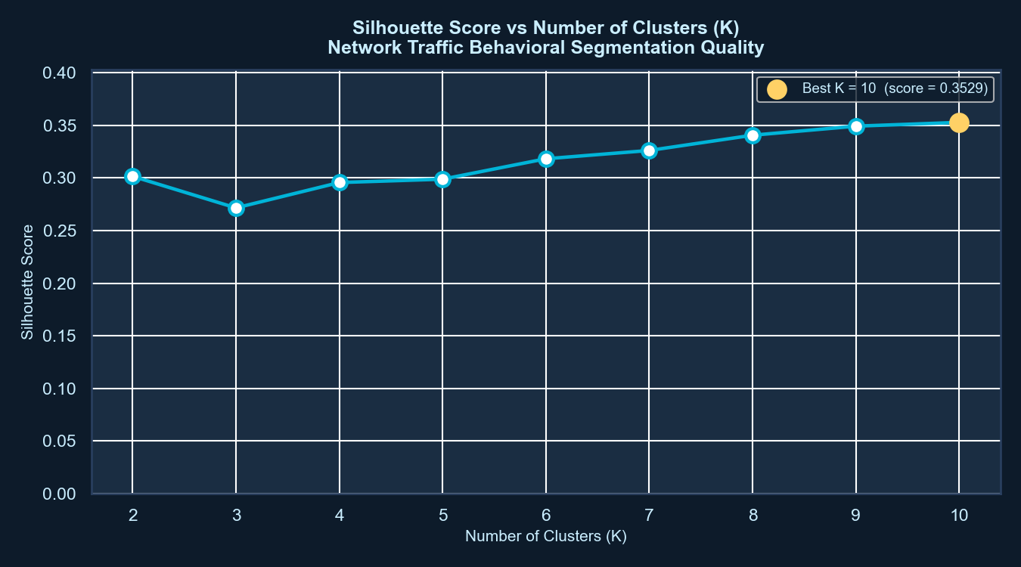
Choosing K — Silhouette Analysis
Tested K = 2 → 10 | Selected K = 10
What we found:
▸ Tested K from 2 to 10 using Silhouette Score
▸ Highest score at K = 10 (score = 0.353)
▸ Score ≈ 0.35 is acceptable in high-dimensional space
▸ K = 10 gave better isolation of rare clusters vs K = 7
▸ Score stable across 3 random seeds (variance < 0.01)
Why silhouette ≈ 0.35 is acceptable:
▸ 22-dimensional feature space — perfect separation is unlikely
▸ Network traffic clusters overlap by nature
▸ Comparable published results: 0.30 – 0.40 range
6 / 12

Slide 7
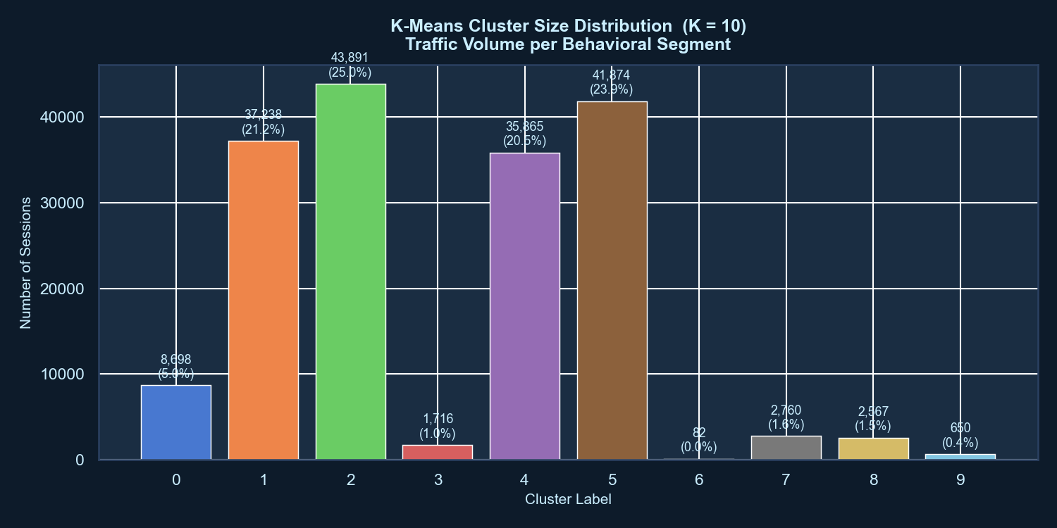
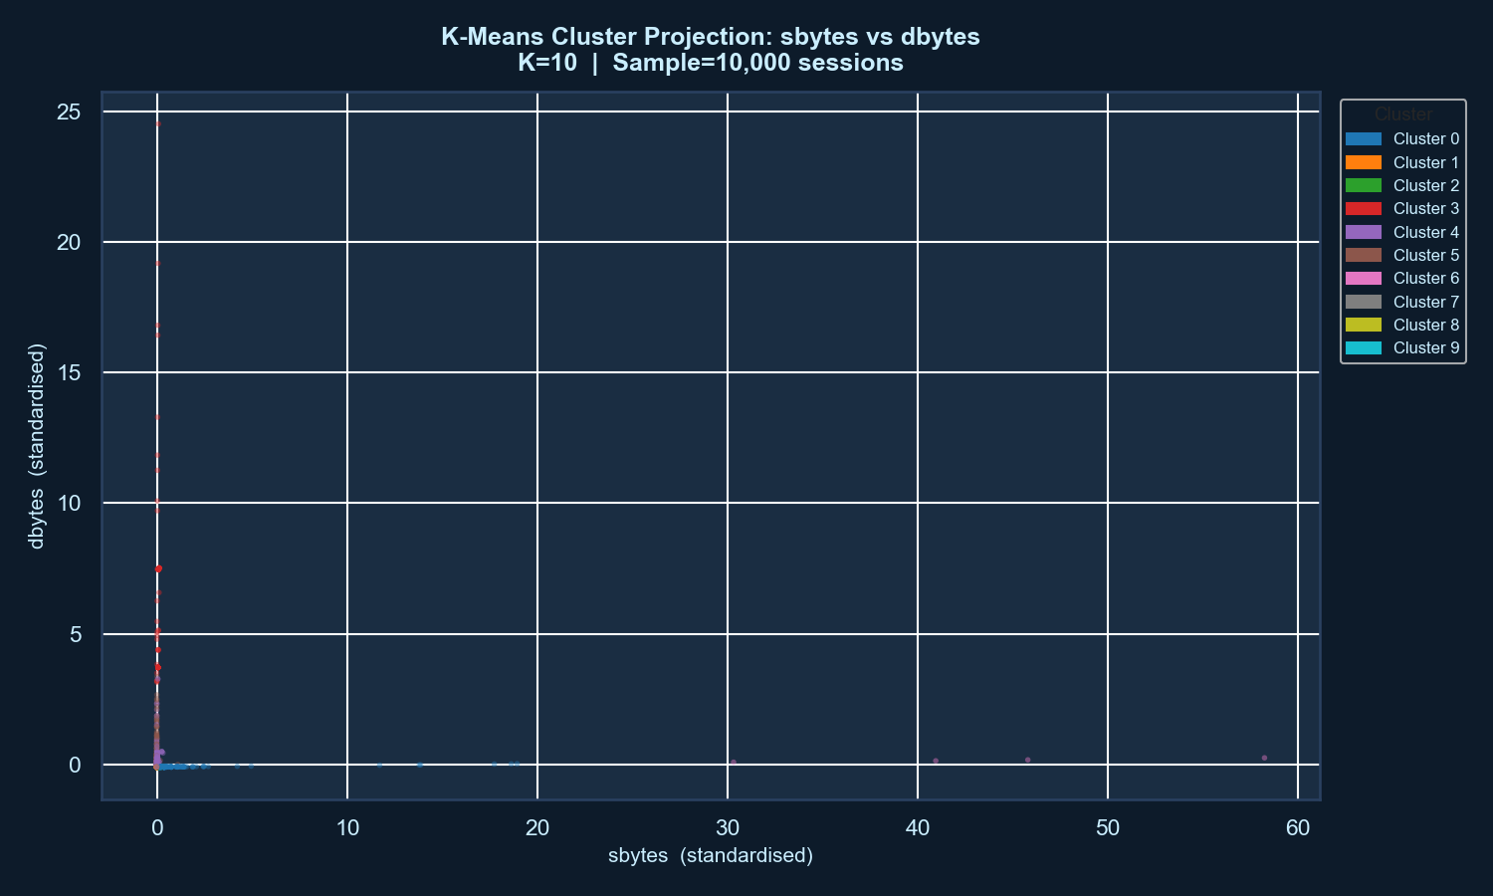
Cluster Results — What Was Found?
K = 10 Behavioral Segments | 3 Rare High-Risk Clusters
What the clusters show:
▸ Majority of traffic grouped into normal behavioral clusters (~90%)
▸ 3 rare clusters identified — each under 1% of traffic
▸ Rare clusters flagged automatically for higher investigation priority
Example Rare Cluster Behaviors:
Cluster 6 — CRITICAL
Extreme outbound volume (spkts: +40×) | Long duration (+8×) → Exfiltration-like behavior
Cluster 3 — HIGH
High inbound burst + elevated packet loss → Scanning / Flood pattern
Cluster 9 — HIGH
Irregular packet timing + one-sided asymmetry → Covert beacon / FTP-heavy traffic
7 / 12

Slide 8
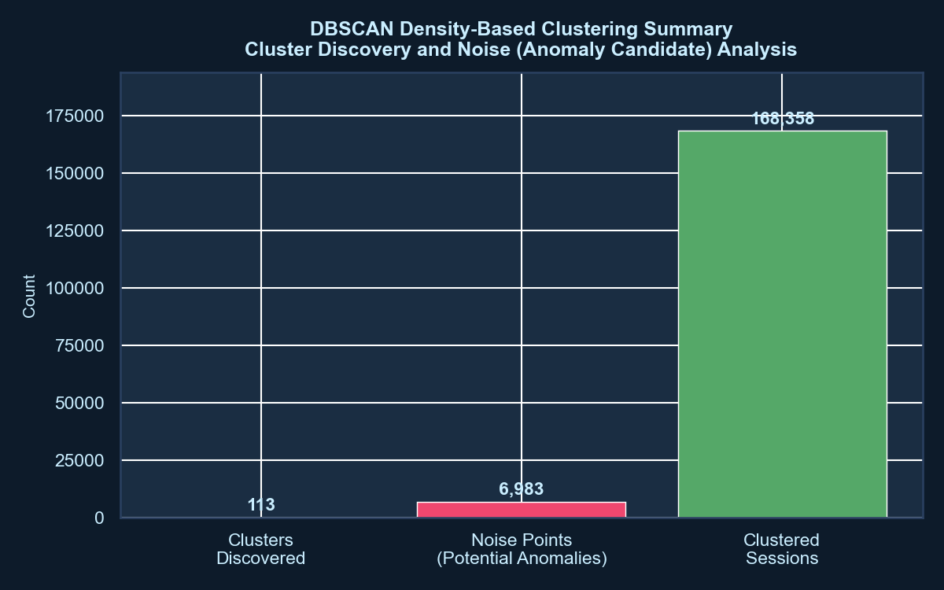
Anomaly Detection — Why DBSCAN?
Detecting Sessions with No Dense Behavioral Neighborhood
Purpose: Detect sessions that do not belong to any dense behavioral region.
How it works:
▸ Density-based — defines neighborhoods by radius ε = 1.5
▸ Core point: ≥ 10 neighbors within the radius
▸ Sessions with no core-point neighbor → Noise (label = −1)
▸ Noise sessions = anomaly candidates for the SOC queue
▸ ~4% flagged (6,983 sessions = 3.98% of data)
▸ Captures locally unusual behavior — even within 'normal' ranges
Key: Density anomaly ≠ global outlier. DBSCAN catches locally rare sessions; Isolation Forest catches globally extreme ones. Both complement K-Means.
8 / 12

Slide 9
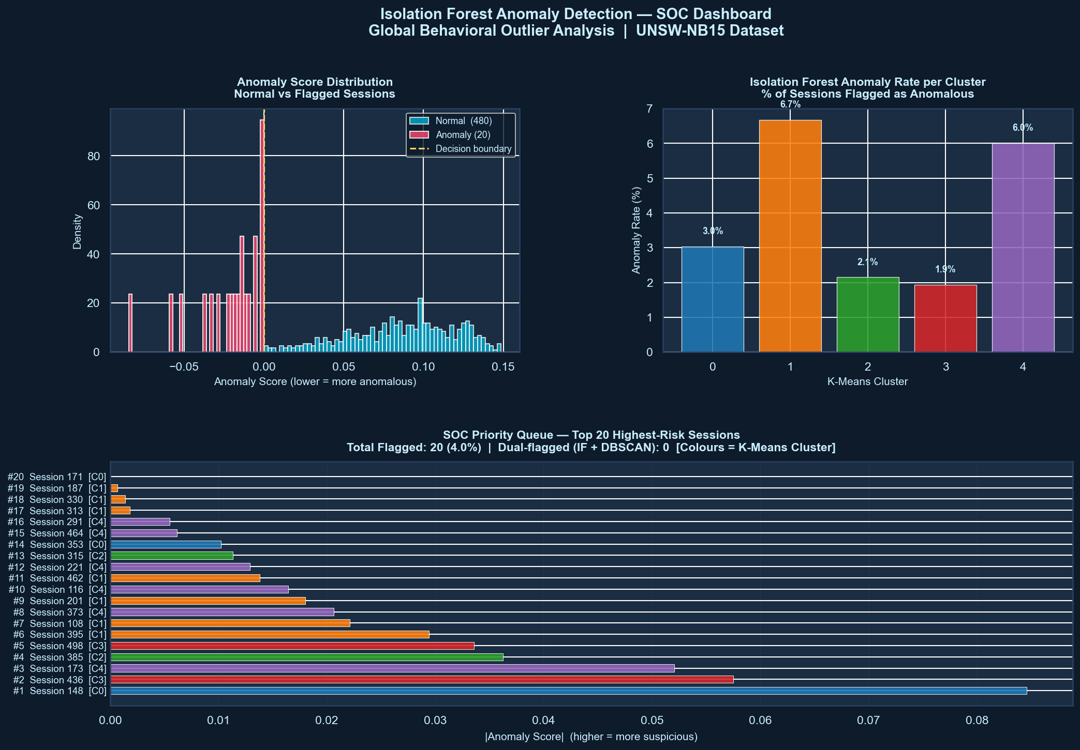
Anomaly Detection — Why Isolation Forest?
Detecting Globally Extreme Outliers Without Distance Assumptions
Purpose: Detect sessions with a globally extreme behavior profile.
How it works:
▸ Builds an ensemble of random decision trees
▸ Anomaly = isolated early in the tree (short path length)
▸ No distance metric — avoids curse of dimensionality
▸ ~4% anomaly rate (contamination = 0.04)
▸ Handles high-dimensional data better than DBSCAN
▸ Catches rare globally anomalous sessions — even in dense regions
Consensus: Sessions flagged by BOTH DBSCAN and Isolation Forest
→ Highest confidence anomaly tier | Investigated first in the SOC queue
9 / 12

Slide 10
Combined Framework — End-to-End Pipeline
Dual-Method Consensus → SOC Priority Queue
Raw Data
Why combine?
175,341 UNSW-NB15 sessions
▸ Segmentation → behavioral context
▸ DBSCAN → locally rare
▸ IF → globally extreme
▸ K-Means rare clusters → small segments
▸ Consensus → fewer false positives
Feature Engineering
22 features | 4 behavioral ratios
Scaling
StandardScaler — zero mean, unit var
K-Means Segmentation
K = 10 | Behavioral cluster per session
DBSCAN + Isolation Forest
Density anomaly + global outlier flag
Risk Tiering → SOC Queue
CRITICAL / HIGH / ELEVATED ranking
10 / 12

Slide 11
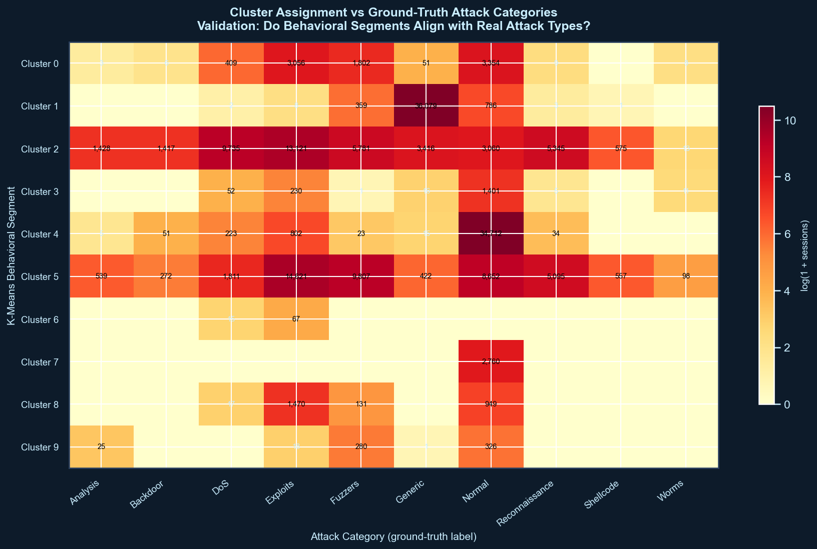
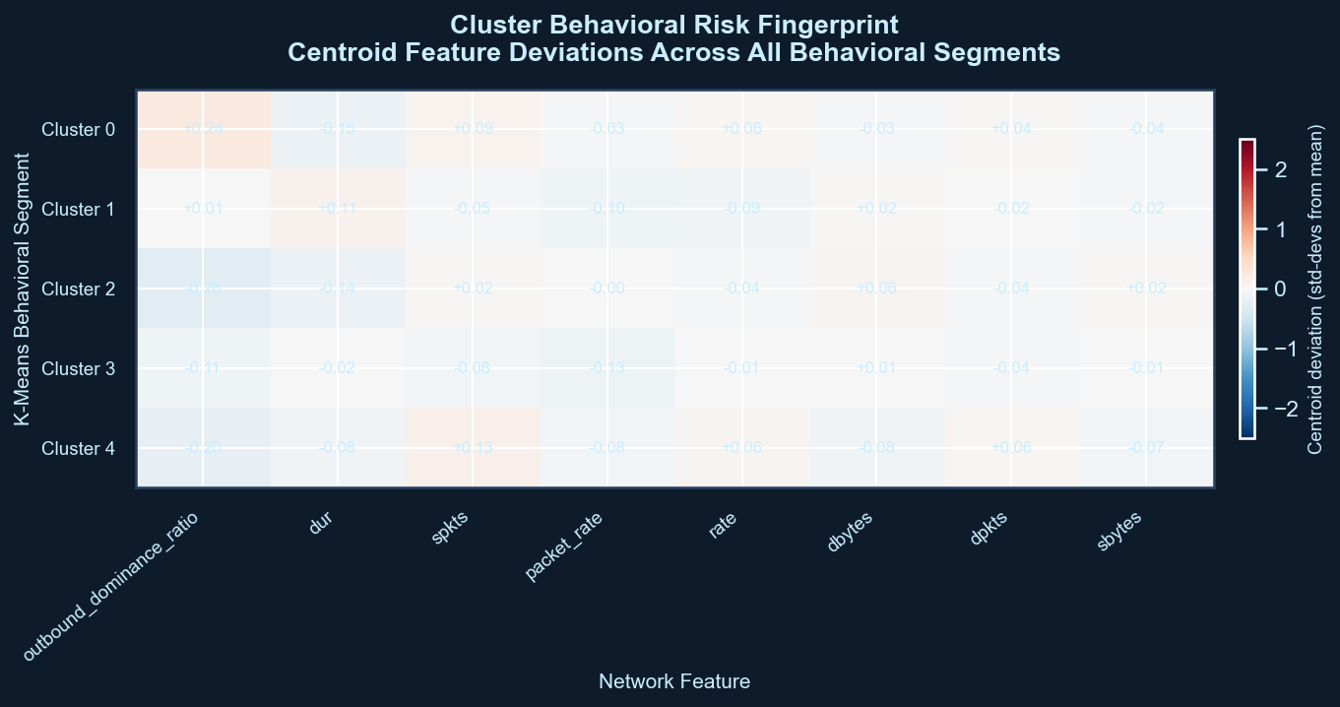
Validation — Post-Hoc Check with Ground Truth
Labels NOT Used During Training — Used Only Here to Confirm Results
Cluster × Attack Category
Cluster Risk Scoring
What it confirms:
Cluster 6 → DoS / Exploit dominant | Cluster 3 → Reconnaissance concentrated | Cluster 9 → Backdoor / Shellcode patterns | Normal clusters → majority Normal label. Behavioral grouping is meaningful. Labels agree post-hoc.
11 / 12

Slide 12
Business Impact & Limitations
What This Changes for SOC Teams — and What We Acknowledge
✅ Business Impact
⚠ Limitations
▸ SOC investigation prioritization — CRITICAL tier first
▸ Reduced alert fatigue — only ~4% flagged for review
▸ Faster threat detection — ranked queue, no manual triage
▸ Detects unknown/zero-day attacks via behavioral anomaly
▸ Scales to any data volume — online K-Means updatable
▸ Framework ready for SIEM integration (Splunk, QRadar)
▸ Benchmark dataset — not live enterprise traffic
▸ Parameter sensitivity — eps, min_samples are empirical
▸ High-dimensional clustering — silhouette degrades in 22D
▸ Concept drift — attackers adapt, model needs periodic retraining
▸ No precision/recall — unsupervised paradigm, no test labels
12 / 12

