Slide 1
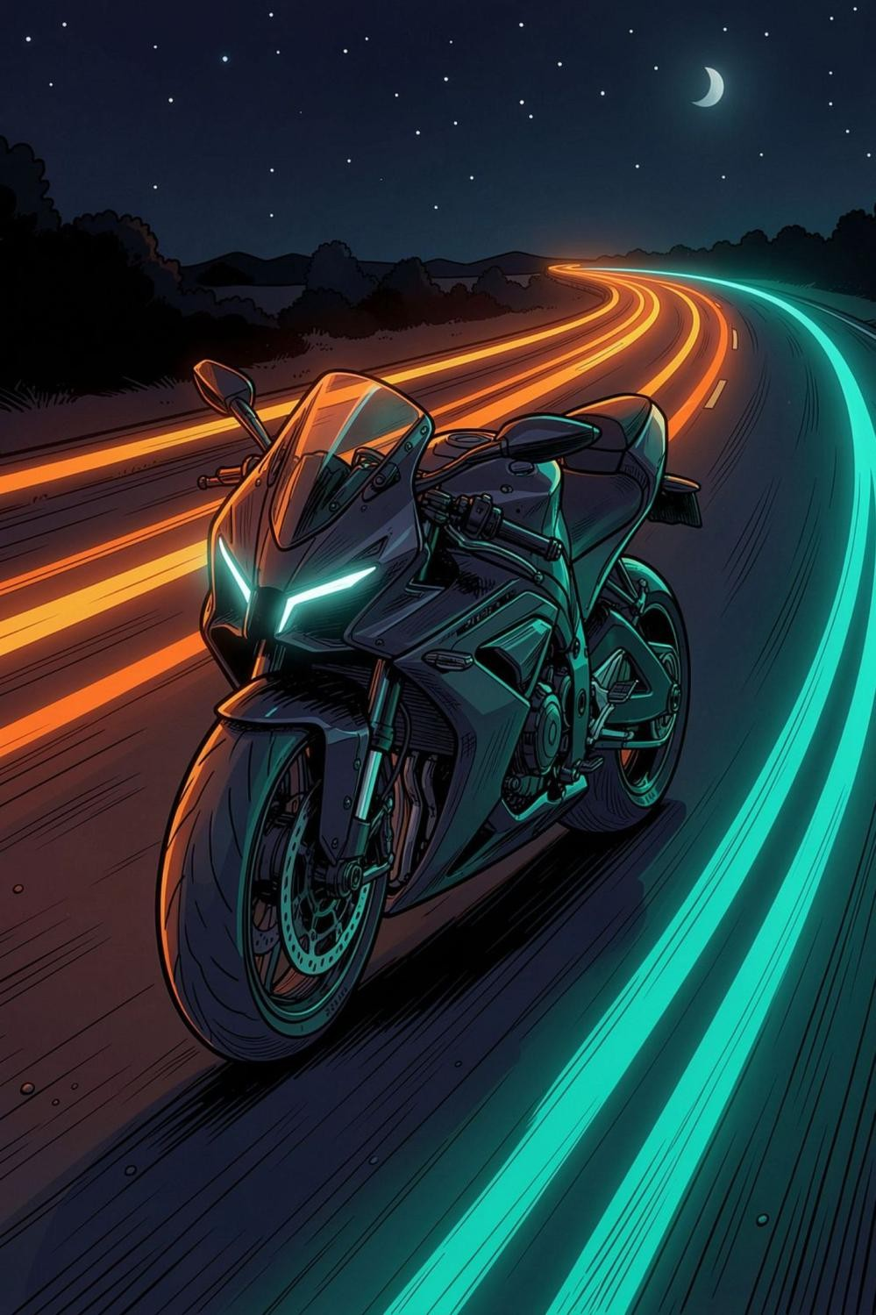




NovaShields Plus
Smart Two-Wheeler Safety Ecosystem
Team ID = ECF5 - 166
PRODUCT & ENGINEERING OVERVIEW
Accident Detection + Tiered Escalation
Insurance Telemetry
Guardian Dashboard
Rider Telemetrics
Team Code Catalyst · Panipat Institute of Engineering & Technology (PIET)

Slide 2
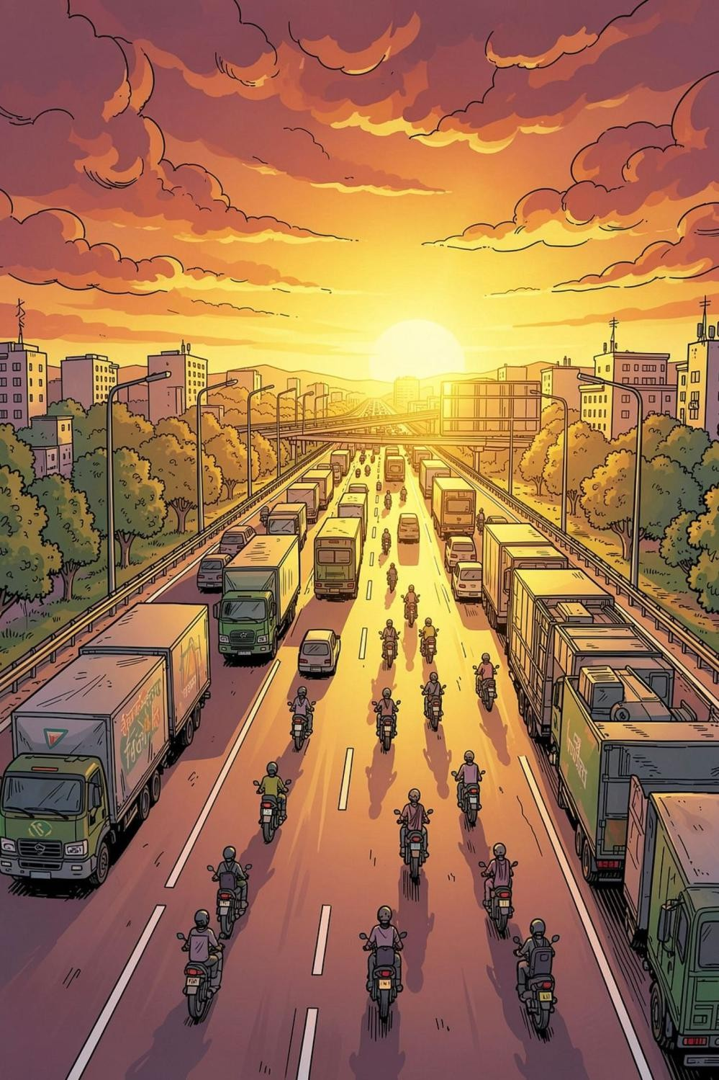

~1.7L
THE PROBLEM
India's Two-Wheeler Crisis
46.2%
Fatalities of Total Fatalities
Are Two-Wheeler Riders
The single largest share of any vehicle class
Two Wheelers Road Fatalities
2024, MoRTH — the latest official count
~20
Lives Lost Per Hour
70.8% in rural areas — EMS response is dangerously slow
Today's alerting: a single SMS event — no escalation, no family visibility, no evidence.

Slide 3
Why Existing Solutions Fail ?
Smart Helmets
Expensive ₹8k–20k
Rider-dependent
Poor adoption
Smartphone Apps
Fail when phone is damaged or battery dies
No dedicated sensors
Premium Connected Bikes
Only on ₹1.5L+ motorcycles
Excludes 95% of riders
Standard Motorcycles
Zero crash detection
No ride data
No emergency dispatch
"The gap is not another app. The gap is an always-on safety layer for every two-wheeler."

Slide 4
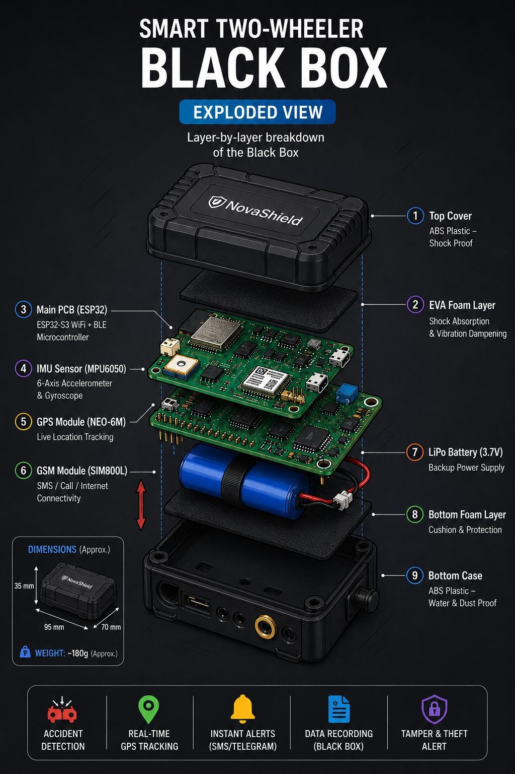
Four Pillars. One Kit.
No new sensors required.
OUR APPROACH
1
Tiered Emergency Escalation
Right responder at the right time, every time.
2
Insurance Telemetry
Pre-crash black box, UBI scoring, fraud evidence.
3
Guardian Dashboard
Consent-based family visibility, geofence alerts.
4
Trip & Journey Report
Per-ride metrics, safety trends, gamified streaks.

Slide 5


System Architecture & Hardware
ESP32S3 Pro Microcontroller
Dual-core, Wi-Fi + BLE, low-power sleep modes
MPU6050 6-Axis IMU
Accelerometer + gyroscope for impact & lean-angle sensing
NEO-6M GPS Module
±2.5m accuracy, cold start <30s, 100Hz sampling
GSM SIM800L /LTE Uplink
SMS + data emergency alerts, works without smartphone
Li-Ion 2000mAh + IP67 Housing
Autonomous operation · all-weather rated
Future Hardware Enhancements
Edge Hardware
ESP8266 + MPU6050 (6-axis IMU) + NEO-6M GPS @100Hz sampling. ESP32-CAM on
standby for visual evidence capture.
Cloud Stack
Node.js/Express hosted on Render. MongoDB Atlas for telemetry storage. Cloudinary CDN for crash footage delivery.
Block Chain
Block chain Services for the telemetry report on insurance company portal.
Calibration + Installation Steps
Mount unit on frame
Zero IMU baseline
Set lean thresholds
Run impact check
Trigger test alert
Verify cloud receipt

Slide 6
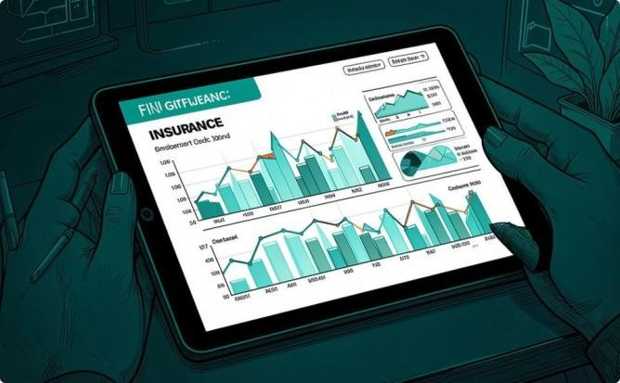
Pillars 01 & 02: Trip Report + Emergency Escalation
Tiered Emergency Escalation
1
Tier 0 — 30s Local Override
Rider can cancel alert if conscious and uninjured.
2
Tier 1 — ≥30s: Family + Ambulance
Automatic notification dispatched. Still cancellable if bike righted.
Insurance Telemetry
Rolling 30s buffer @10Hz — freezes on crash impact
Auto-generates structured claims report
Risk Score + fraud evidence
3
Tier 2 — ≥30min: Police Dispatch
Continuous GPS tracking active. Hospital lookup + SOS enabled.
Safety Score Trends
Gamified Streaks
Route History
Idle Analytics

Slide 7
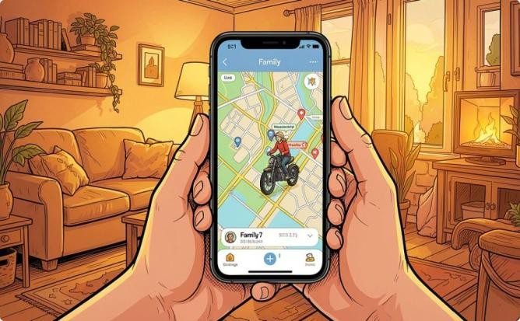
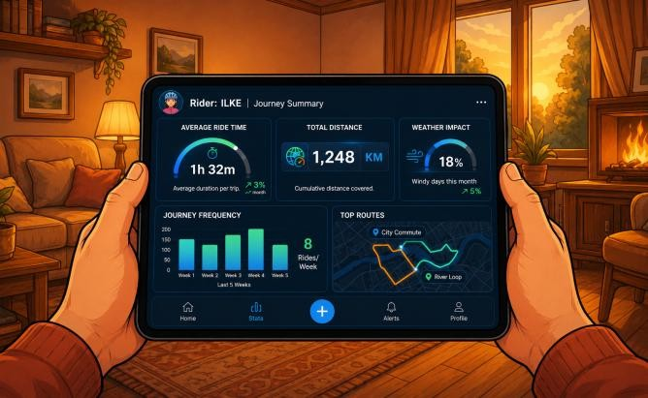
Pillars 03 & 04: Insurance + Guardian
Guardian Dashboard
Trip & Journey Report
Consent-based live speed, location & trip history
Geofence + speed threshold alerts
Curfew alerts, theft alert, multi-guardian mode
Per-trip logging: duration, distance, speed, harsh-braking events, idle time. Daily / weekly / monthly rollups.

Slide 8
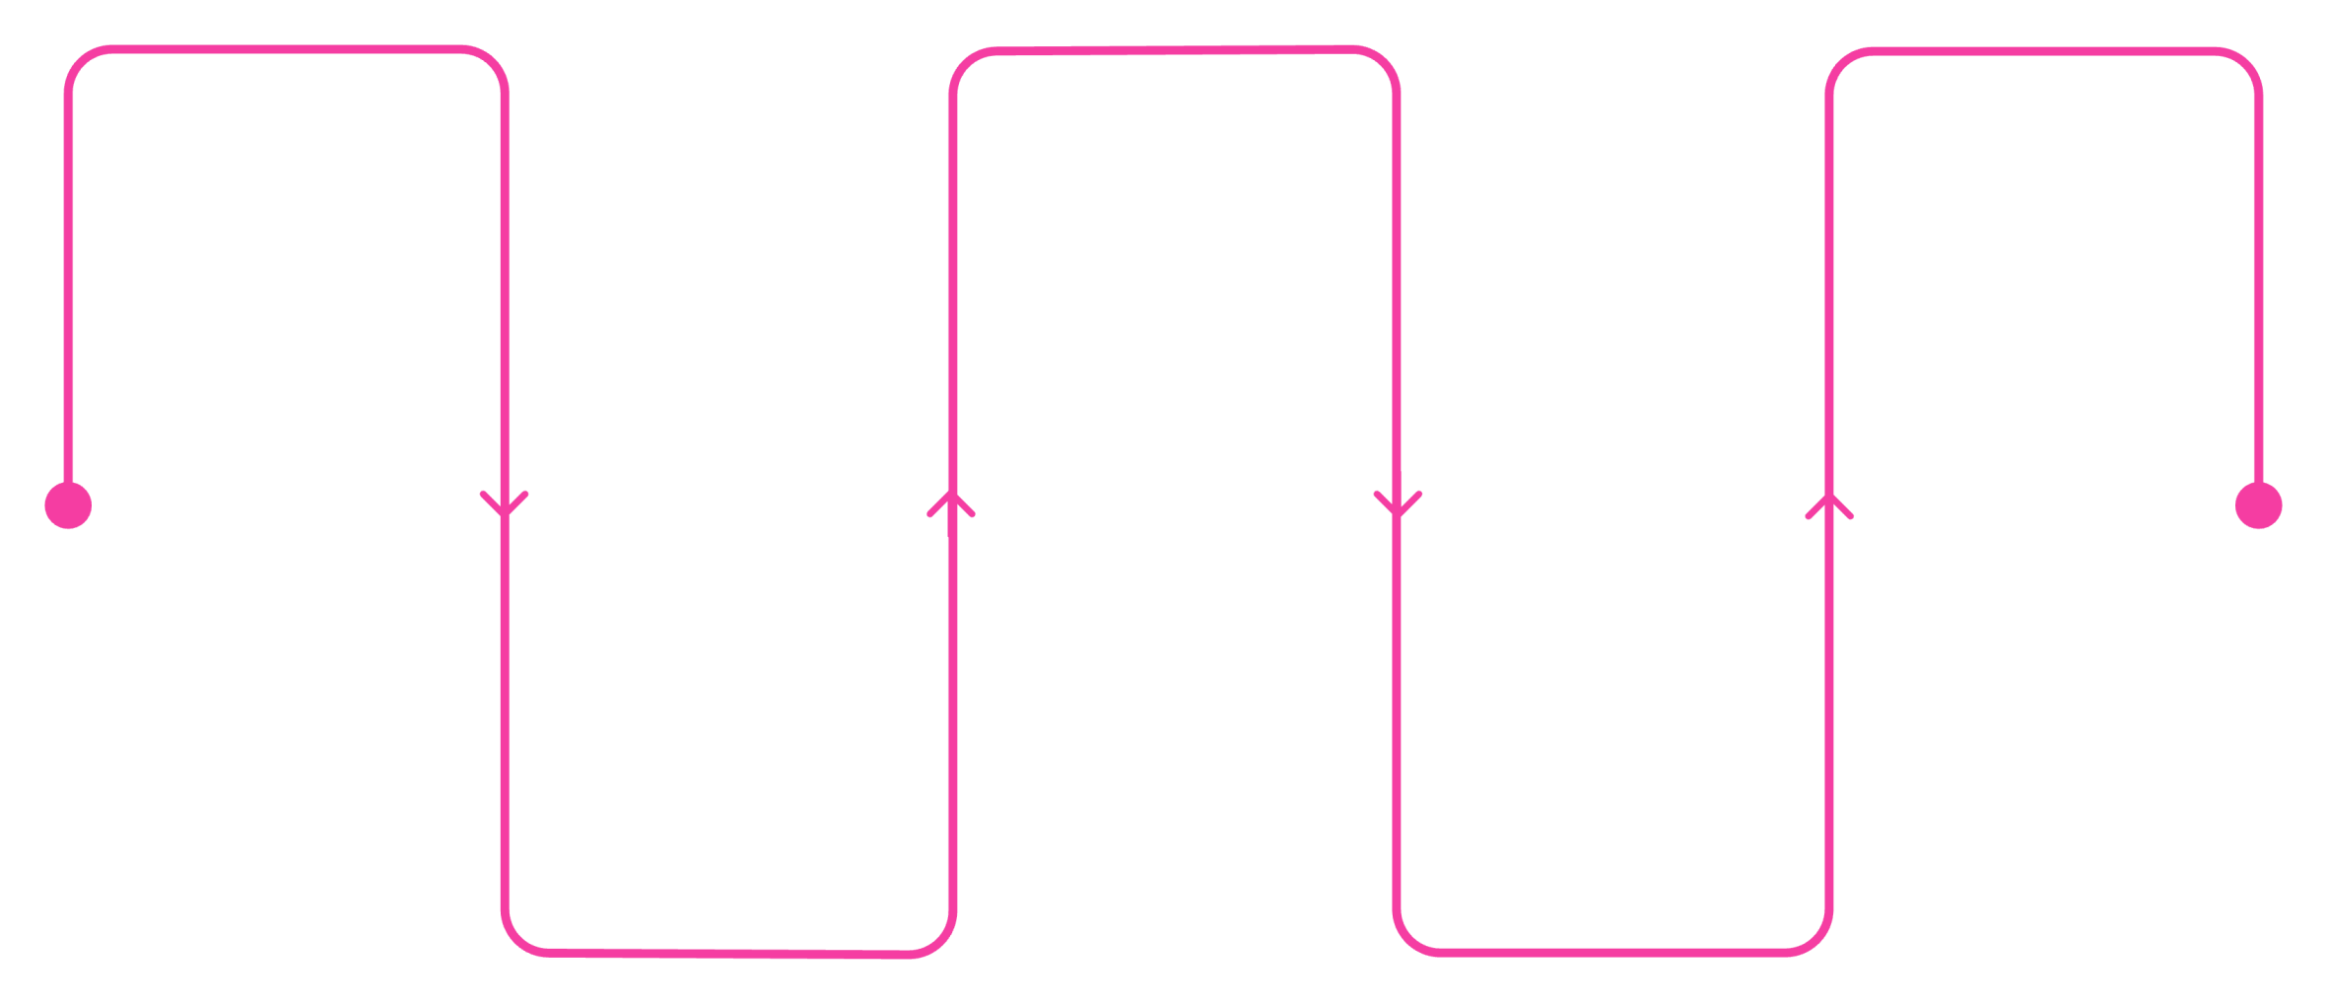
How a Crash Moves Through the System
CRASH LIFECYCLE
Crash Detected
>if the speed, lean angle and the
Gyroscropic values goes
worst then the variable threshold for 10 seconds.
Backend Logs
Tier 2 @ 30min
Police added, continuous GPS tracking
PostgreSQL
records telemetry
Evidence Captured
Tier 1 @ 30s
Last 30 seconds telemetry
Family & ambulance
details capture and send
notified, cancellable
to the insurer backend
Every second is engineered: from raw sensor threshold to multi-agency coordination, the system operates autonomously with zero manual intervention required.

Slide 9
92.6%
Validated in Controlled Testing
71.1%
Detection Accuracy
Detection Accuracy
Across 60 Simulated trials
Across 18 worst case trials
3
False Alerts
Zero false dispatches recorded
378ms
Mean Crash-to-DB Latency
Crash detected to MongoDB Atlas write
Validation Results — 60 Controlled Trials

Slide 10
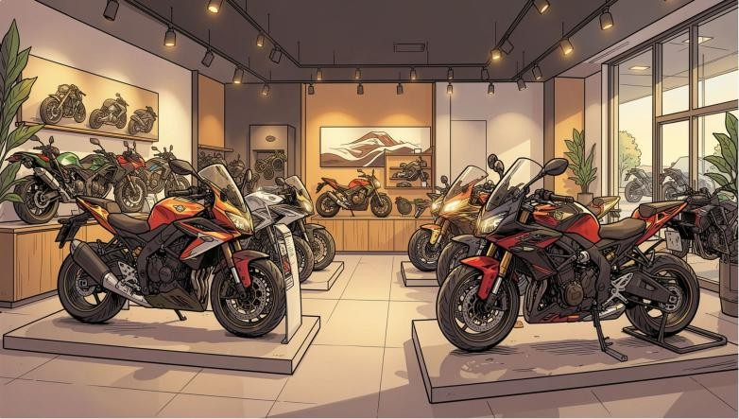
Market Opportunity Why Now?
Why NovaShields Plus Can Scale
Competitive Advantage Matrix
Feature | Smart Helmets | Phone Premium NovaShield Apps Bikes s+
Auto Crash Detection | ✗ | ✗ ✓ ✓
Live GPS Emergency Alert | ✗ | ✓ ✓ ✓
Works Without Smartphone | ✗ | ✗ ✓ ✓
Tamper-Proof Ride Logs | ✗ | ✗ ✗ ✓
Affordable (<₹3,000) | ✗ | ✓ ✗ ✓
Insurance-Ready Export | ✗ | ✗ ✗ ✓
Retrofit Any Two-Wheeler | ✗ | ✓ ✗ ✓
Tiered Escalation | ✗ | ✗ ✗ ✓
Two-wheelers = 75% of India's motorized fleet
GSM coverage >65% of highways
IRDAI pushing telematics-based insurance
TAM
25 Cr+ two-wheelers registered in India
SAM
8 Cr connected-ready riders with GSM coverage
SOM
40 L target riders in years 1–3 (metros & tier-1 cities)

Slide 11
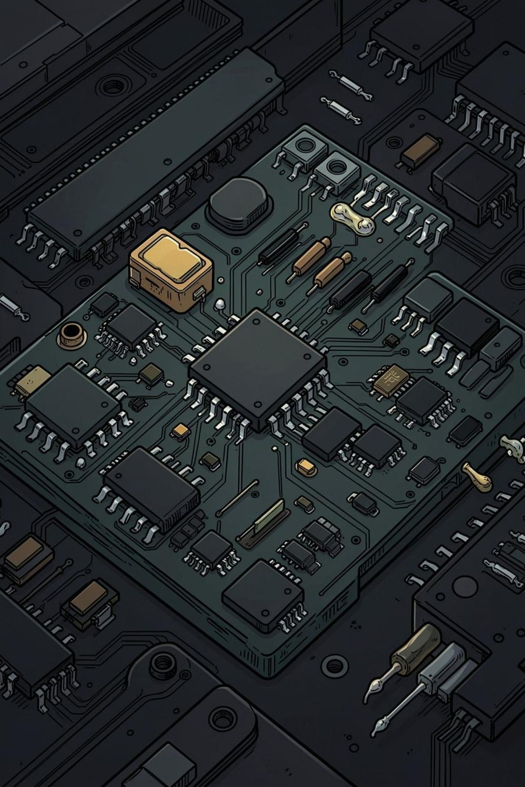
Bill of Materials — Prototype
A working prototype for under ₹3,000. Mass-production BOM projected below ₹1,500.
Component | Quantity | Unit Price | Total Price | Notes
Microcontroller board | 1 | ₹420 | ₹420 | Primary control unit
Temperature sensor | 2 | ₹85 | ₹170 | Environmental monitoring
Humidity sensor | 1 | ₹120 | ₹120 | Combined with temp sensing
Motion sensor | 1 | ₹95 | ₹95 | Detection and wake trigger
Resistor assortment | 1 | ₹60 | ₹60 | Mixed SMD values
Capacitor assortment | 1 | ₹75 | ₹75 | Decoupling and filtering
Prototype PCB | 1 | ₹180 | ₹180 | 2-layer custom board
Connectors and headers | 1 | ₹140 | ₹140 | Board-to-wire interface
Voltage regulator | 1 | ₹55 | ₹55 | Stable power conversion
Passive support components | 1 | ₹90 | ₹90 | LEDs, diodes, ferrites
Assembly and test consumables | 1 | ₹250 | ₹250 | Solder, wire, standoffs
Total Prototype BOM | 13 | ₹1,570 | ₹1,575 | Projected mass-mass-production below ₹1,500

Slide 12
Revenue, Channels & Unit Economics
Three revenue streams. Retail today. OEM and insurance tomorrow.
REVENUE STREAMS CHANNELS
Device Sale
Rs. 2,466 MRR per device
Dealership Retrofit
Bajaj, Hero, TVS Service Network
Side Telematics Subscription
Rs. 66 / month + rider app
OEM Factory-Fit
White label pilot in year 2
Insurer Data Licensing
Per-claim risk score API
Direct-to-Rider
Amazon, Flipkart — cost controlled
UNIT ECONOMICS
Rs. 2499 + Rs. 1188/yr = Rs. 3687
ARPU
46% @ 10K units
Gross Margin
12mo
Payback Period
Per rider
400K
Year 3 Target
Devices deployed
Year 3 target: 400,000 devices deployed • $148 CR revenue run rate • Break-even by month 22

Slide 13
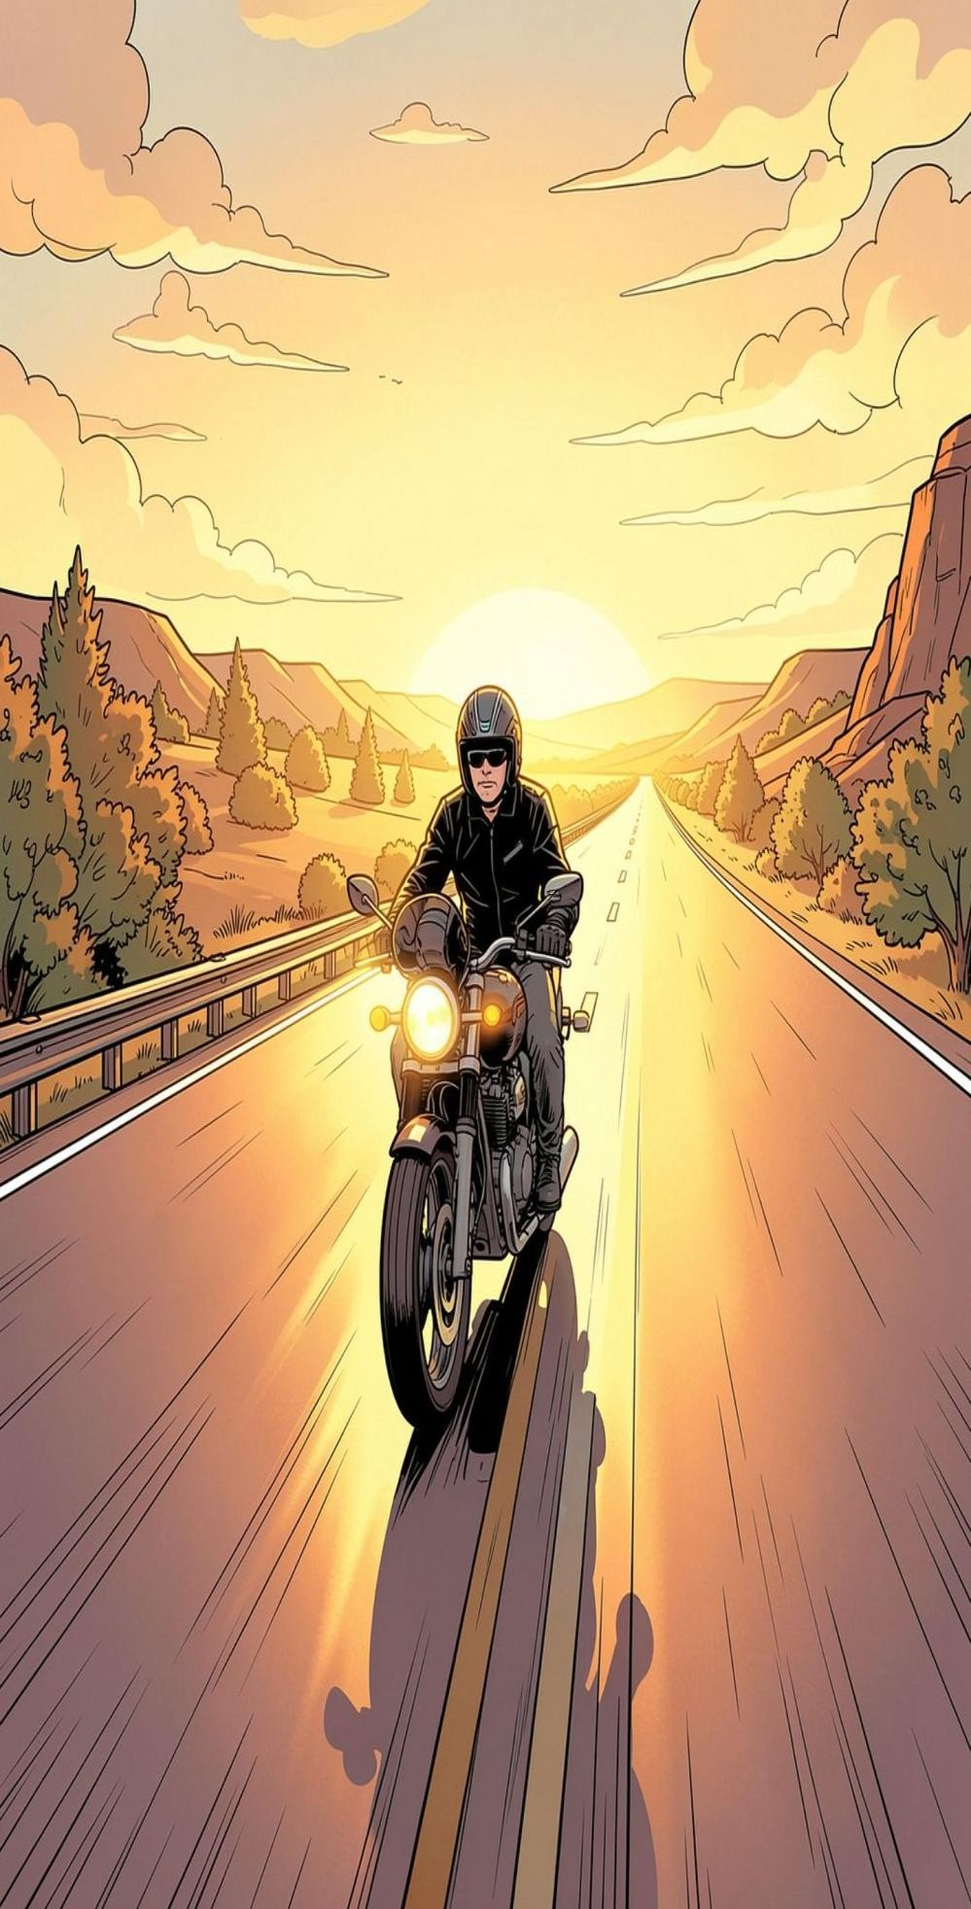
Building Safer Roads for Every Rider
KEY TAKEAWAYS
Affordable Safety
Protection engineered for every motorcycle, at every price point.
OUR VISION
"To make intelligent crash protection a standard feature on every two-wheeler — reducing injury and fatality through affordable technology."
Crash Detection & Alerts
Automatic incident detection with instant emergency notifications.
Rider Emergency Assistance
Real-time support features that respond
when riders need help most.
Valuable Ride Data
Actionable insights for riders and
insurers alike.

Slide 14
One Kit. Four Connected Safety
Experiences. Zero Extra Sensors.
Thank you for your time.
Team ID = ECF5 - 166
Team Code Catalyst · Panipat Institute of Engineering & Technology (PIET)

