Slide 1






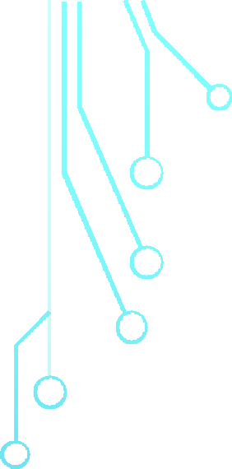

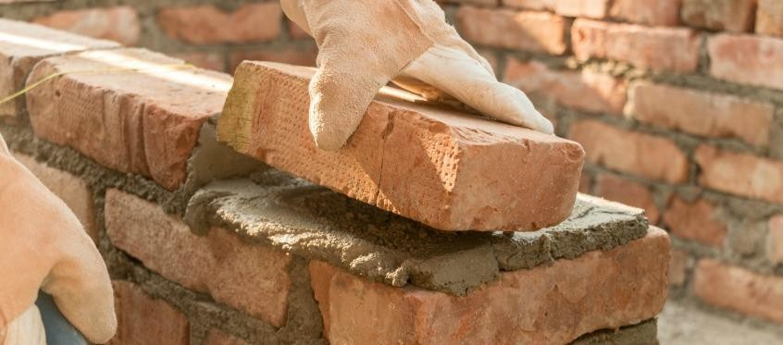




BLOCKCHAIN AS A SECURITY BRICK
Presented By: Nitish Kumar Stream: CSBS Enrollment :12020002018017(15)

Slide 2
AGENDA
Blockchain Definition (Technical/Conceptual)
Blockchain or How to clone Physical transaction to Digital transaction
Distributed Database vs Distributed Ledger
Blockchain & Internet OF VALUE
Blockchain Security Design
Blockchain Security for IOT
ICO Dapp demo

Slide 3
BLOCKCHAIN DEFINITION (TECHNICAL)
Append-only Distributed Database (Ledger) shared between multiple non- trusting writers without the need for a Trusted Central Authority.
The data integrity of the Ledger is guaranteed by a Distributed Concensys Algorithm.

Slide 4
BLOCKCHAIN SOLUTIONS
3 BASIC COMPONENTS
:
A data model that captures the current state of the ledger.
A language of transactions that changes the ledger state.
A protocol used to build consensus among participants around which transactions will be accepted, and in what order, by the ledger.

Slide 5












BLOCKCHAIN OR HOW TO CLONE PHYSICAL TRANSACTION TO DIGITAL TRANSACTION
Imen
Sami
Imen
Sami
Easily Verifiable.
No need for a third-party to validate the transaction.
Imen does not have the money anymore and Sami has it in his hands.
What if the third trusted party duplicates the asset?
He can even add to his account whenever he wants.
He can impose high commissions
What If his service is hacked : service unavailable (SPOF)
Instant transfer of the asset

Slide 6






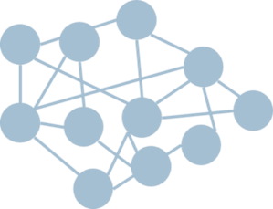








BLOCKCHAIN OR HOW TO CLONE PHYSICAL TRANSACTION TO DIGITAL TRANSACTION
Same Rules
Consensus Algorithm
Single source of Truth
Blockchain Technology
Trusted third-party
Dali
Imen
Sami
Imen
What if the third trusted party duplicates the asset?
He can even add to his account whenever he wants.
He can request high fees
What If his service is hacked : service unavailable
(SPOF)
The end user does not have the means to check by
Sami
The Ledger is no longer owned by a single entity
Validation and verification of the Ledger is no longer a monopoly
Consensus rules guarantee the security of the Ledger
himself

Slide 7
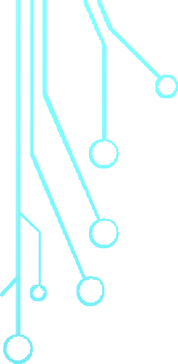



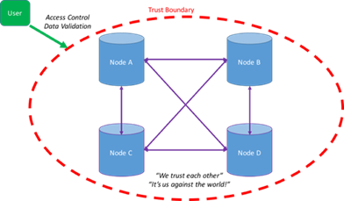

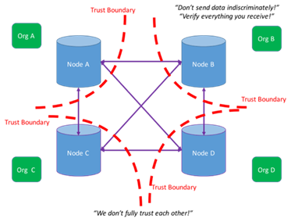




DISTRIBUTED DATABASE VS DISTRIBUTED LEDGER
Nodes of a distributed database trust each other and collaborate with each other to present a consistent, secure truth to the rest of the world.
Paxos, Raft, …
It’s All About the Trust
Distributed Database
Boundary!!!
Nodes of a distributed ledger
(Blockchain) can not trust each other and so must independently verify data they receive from
PoW,PoS,…
each other and only share data they are happy to be broadly shared.
Distributed Ledger (Blockchain)

Slide 8
BLOCKCHAIN DEFINITION (CONCEPTUAL)
Blockchain is a paradigm shift in the way we approach designing economic systems involving multiple peers with
divergent interests (~zero-sum game) but find it profitable to be part of the same system.
The traits of such systems are :
Decentralized , governed by rules but without rulers : Protocols
instead of Platforms.
Trust is derived from the network not from hierarchy (Trustless).

Slide 9
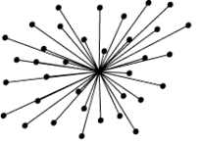
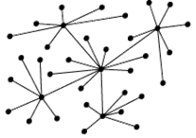
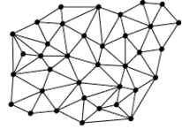


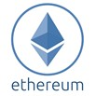






BIG SHIFT IN BUSINESS MODELS DESIGNS
Business models are increasingly based on the reduction of intermediaries
Platform Economy Sharing Economy P2P Economy
2010
2015

Slide 10
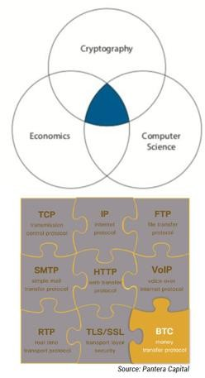
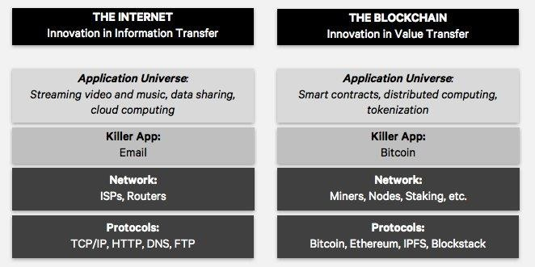
BLOCKCHAIN & INTERNET OF VALUE
s
Blockchain is the last Brick in the Internet protocol that allowed Internet to move
Value between peers

Slide 11
EMBEDDED SECURITY IN BLOCKCHAIN DESIGN
Internet was designed without security as a priority ➔ Only a resilient network!!
Blockchain protocol was designed with security EMBEDDED in its CORE (BFT in practice, identification , encrypted transactions, )
Internet security was implemented at the Application protocol Level.
Blockchain security is implemented at the low level protocol layer.

Slide 12
DAPPS SECURITY REQUIREMENTS
Identification & Authentication ➔ Cryptographic identity
Data Integrity ➔ Encrypted transactions coupled to Common Consensus mechanism
Data Confidentiality ➔ Zero-knowledge proof / Homomorphic encryption
Data Ownership/Control ➔ Distribution of Data

Slide 13
BLOCKCHAIN SECURITY FOR IOT
The Distributed character of IOT networks makes it a good candidate for
Blockchain technology
Blockchain, which is most familiar for bitcoin and Ethereum, offers an intriguing solution for IoT security. Blockchain contains strong protections against data tampering, locking access to Internet of Things devices, and allowing compromised devices in an IoT network to be shut down.

Slide 14
ICO DAPP DEMO

Slide 15
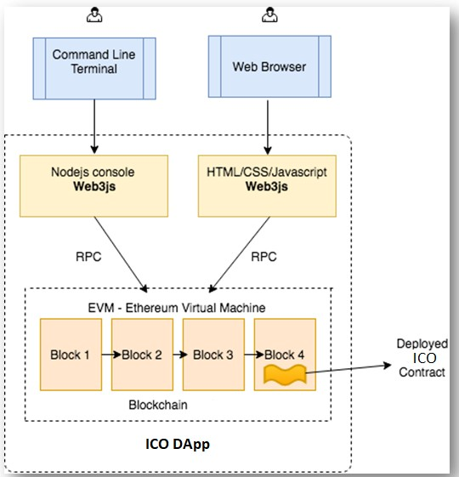
DApp reference Architecture

Slide 16
Steps
Step 1 : Setting up the environment
Step 2 : Writing the Smart Contracts
Step 3 : Compiling and deploying(migrating) the Smart Contracts
Step 4 : Testing the Smart Contracts Step 5 : Creating the Front-end Step 6: Using the DApp

Slide 17
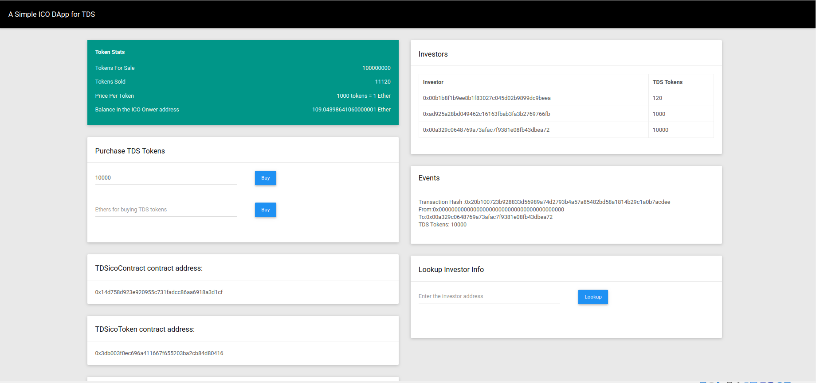
Creating the Front-end

Slide 18
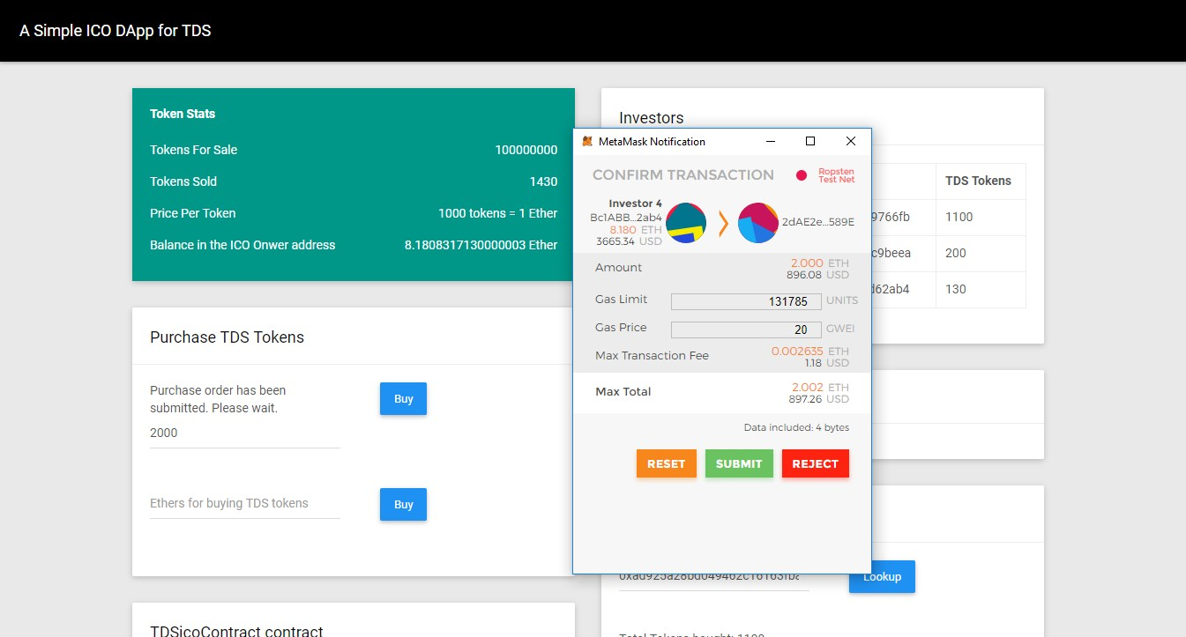
Step 6 : Interacting with the DApp
020
19

