Slide 1
Unit – II 8 Hours
State Modeling, Advanced State Modeling: State Modeling: Events, States, Transitions and Conditions; State diagrams; State diagram behavior; Advanced State Modeling: Nested state diagrams; Nested states.

Slide 2
State Modeling
UML <number>

Slide 3
Introduction
→We can understand the system by first examining its static structure –that is , the structure of its objects and their relationships to each other at a single moment in time (class model).
→Then we should examine changes to the objects and their relationship over time and it is given by state model.
→The state model describes the sequences of operations that occur in response to external stimuli.
→The state model consists of multiple state diagrams, one for each class with temporal behavior that is important to an application.
UML 56

Slide 4
State diagram is a standard computer science concept ( a graphical representation of finite state machines ) that relates events and states
Event represent external stimuli
States represent values of objects

Slide 5
Events
◆ An Event is an occurrence at a point in time, such as user depresses left button of the mouse or flight 123 departs from Chicago.
◆ Events often correspond to verbs in the past tense like
power turned on
alarm set
◆ By definition an event happens instantaneously with regard to the time scaleof an application.
UML 57

Slide 6
Events continue…
One event may logically precede or follow another, or the two events may be unrelated (concurrent; they have no effect on each other).
Ex: Flight 123 must depart chicago before it can arrive in San Francisco; the two events are causally related
Flight 123 may depart before or after flight 45 departs Rome; the two events are causally unrelated

Slide 7
Events continue…
◆ Events include error conditions as well as normal occurrences. For example
motor jammed
transaction aborted
Timeout.
There are several kinds of events but following are most common events.
signal event
change event
time event
UML 58

Slide 8
Signal Event
◆ A signal is an explicit one-way transmission of information
from one object to another.
◆ An object sending a signal to another object may expect a reply, but the reply
is a separate signal under the control of the second object, which may or may not
choose to send it.
◆ A signal event is the event of sending or receiving a signal.
◆ We are more concern about the receipt of a signal because it causes effects in the receiving object.
◆ The UML notation is the keyword signal in guillemets(<<>>) above the signal
class name in the top section of a box.
UML 59

Slide 9
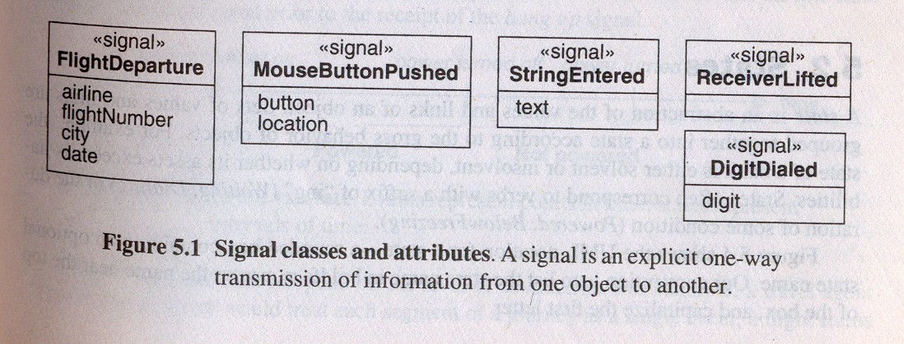
Signal Event Continue…
◆ For example, UAflight 123 departs from chicago on January 10,1991 is an instance of signal class FlightDeparture.
UML 60

Slide 10
The difference between signal and signal event
a signal is a message between objects
a signal event is an occurrence in time.

Slide 11
Change Event
◆ A change event is an event that is caused by the satisfaction of a boolean expression.
◆ The intent of a change event is that the expression is continually tested whenever the expression changes from false to true, the event happens.
◆ The UML notation for a change event is the keyword “when” followed by a parenthesized boolean expression.
Examples: When (room_temp<heating set point)
When (room_temp<coolingset point)
When (battery power < lower limit)
When (tire_pressure < min.pressure)
UML 61

Slide 12
Time Event
◆ A time event is an event caused by the occurrence of an absolute time or the elapse of a time interval.
◆ The UML notation for an absolute time is the keyword when followed by a parenthesized expression involving time.
◆ The notation for a time interval is the keyword after followed by a parenthesized expression that evaluates to a time duration.
◆ Examples:
◆ When (date=Jan 1,2000)
◆ After (10 seconds)
UML <number>

Slide 13
States
◆ A state is an abstraction of the values and links of an object.
◆ States often correspond to verbs with a suffix of “ing” (Waiting, Dialing) or the duration of some condition (Powered, BelowFreezing).
◆ UML notation for a state is a rounded box containing an optional state name,list the state name in boldface, center the name near the top of the box, capitalize the first letter.
examples:
Waiting
Dialing
Powered
BelowFreezing
UML <number>

Slide 14
States Continue…
◆ The objects in a class have a finite number of possible states (one or more)
Each object can only be in one state at a time.
◆ Objects may parade through one or more states during their lifetime.
◆ At a given moment of time, the various objects for a class can exist in a multitude of states.
◆ A state specifies the response of an object to input events.
◆ The response may include the invocation of behavior or a change of state.
◆ For example: if a digit is dialed in state Dial tone, the phone line drops the dial tone and enters state Dialing; if the receiver is replaced in Dial tone, the phone line goes dead and enters state Idle
UML <number>

Slide 15
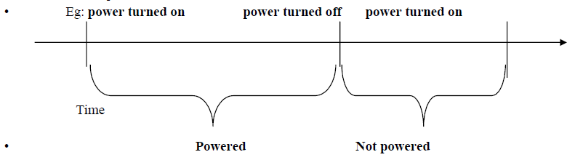
Event vs. States
➢ Event represents points in time.
➢ State represents intervals of time.
➢ A state corresponds to the interval between two events received by an object.
➢ The state of an object depends on past events.
➢ Both events and states depend on the level of abstraction

Slide 16
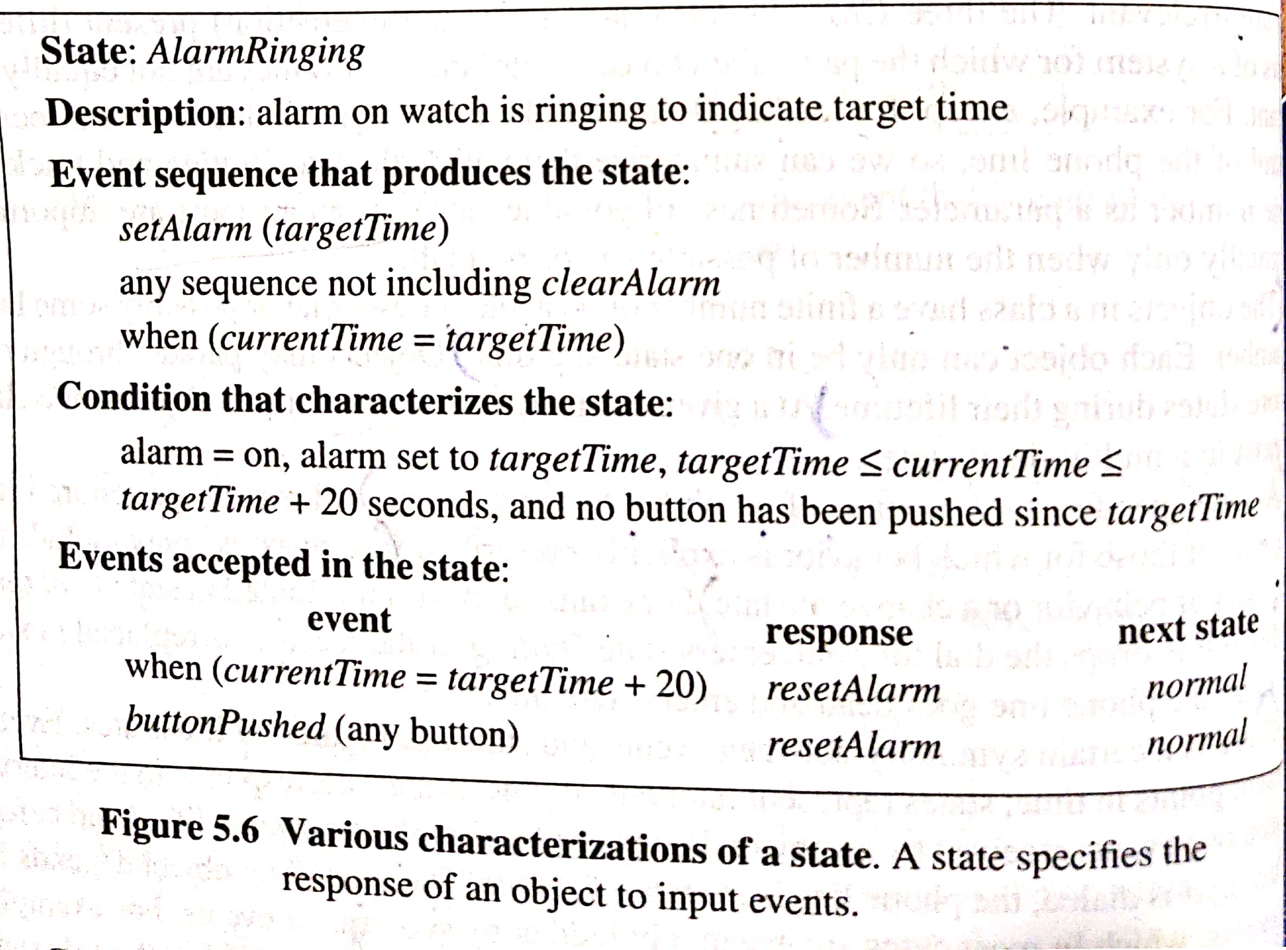

Slide 17
Transitions and conditions
◆ A transition is an instantaneous change from one state to another.
◆ For example, when a called phone is answered, the phone line transition from the Ringing state to the Connected state.
◆ The transition is said to fire upon the change from the source state o the target state. A transition fires when its event occurs
◆ The choice of the next state depends on both the original state and the event received.
◆ An event may cause multiple objects to transition ;from a conceptual point of view such transition occur concurrently.

Slide 18
Guard Condition
◆ A guard condition is a Boolean expression that must be true in order for a transition to occur.
Ex; traffic light at an intersection may change only if a road has cars waiting.
◆ A guarded transition fires when its event occurs, but only if the guard condition is true.
◆ For example "when you go out in the morning (event), if the temperature is below freezing (condition), then put on your gloves (next state).”
◆ A guard condition is checked only once, at the time the event occurs and transition fires only if the guard condition is true.
◆ A guard condition is checked only once while a change event is in effect checked continuously.

Slide 19
Guard Condition Continue…
◆ The UML notation for a transition is a line from origin state to target state.
◆ An arrowhead points to the target state.
◆ The line may consist of several line segments. An event may label the transition and be followed by an optional guard condition in square brackets.
◆ We italicize the event name and show the condition in normal font.
UML 67

Slide 20
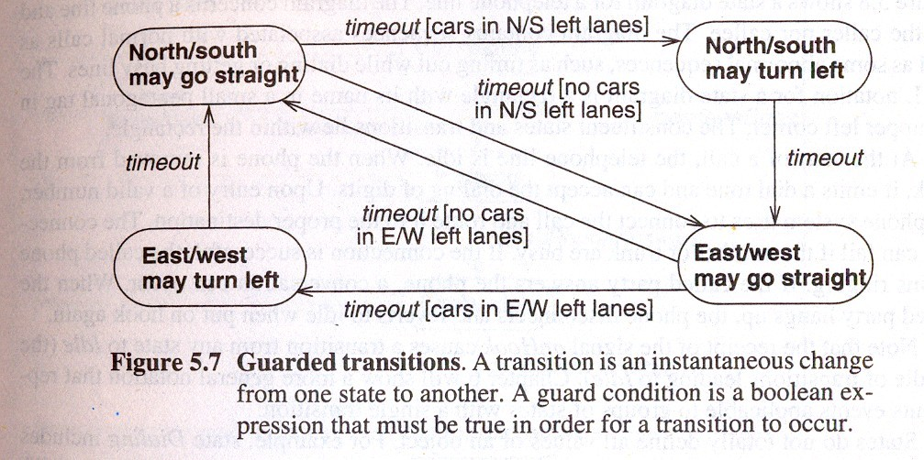
Guard Condition Continue…
→Following fig. shows guarded transitions for traffic lights at an intersection.
UML 68

Slide 21
Do -Activities
◆ A do-activity is an activity that continues for extended time.
◆ It can only occur within a state and can not be attached to a transition.
◆ For example the warning light may flash during the paper jam state for a copy machine.
◆ Do-activities include continuous operations such as displaying a picture on a television screen as well as sequential operations that terminate by themselves after an interval of time.
UML <number>

Slide 22
Do –Activities Continue…
◆ The notation “do /” denotes a do-activity that may be performed for all or part of the duration that an object is in a state.
◆ A do-activity may be interrupted by an event that is received during its execution.
Paper jam
Do / flash warning light
UML <number>

Slide 23
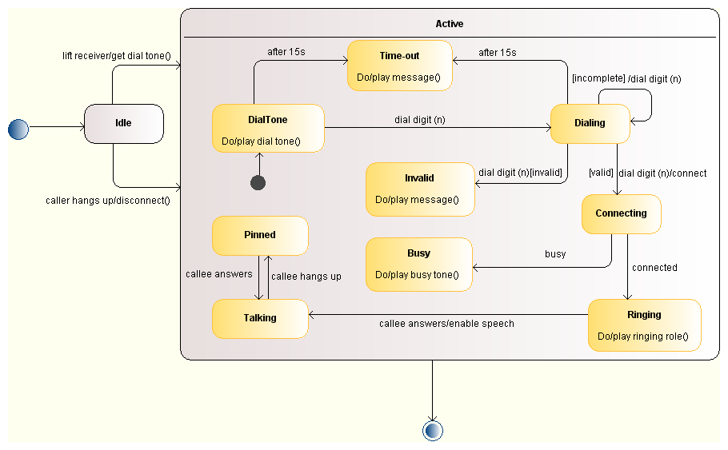
State Diagram of Telephone System
UML <number>

Slide 24
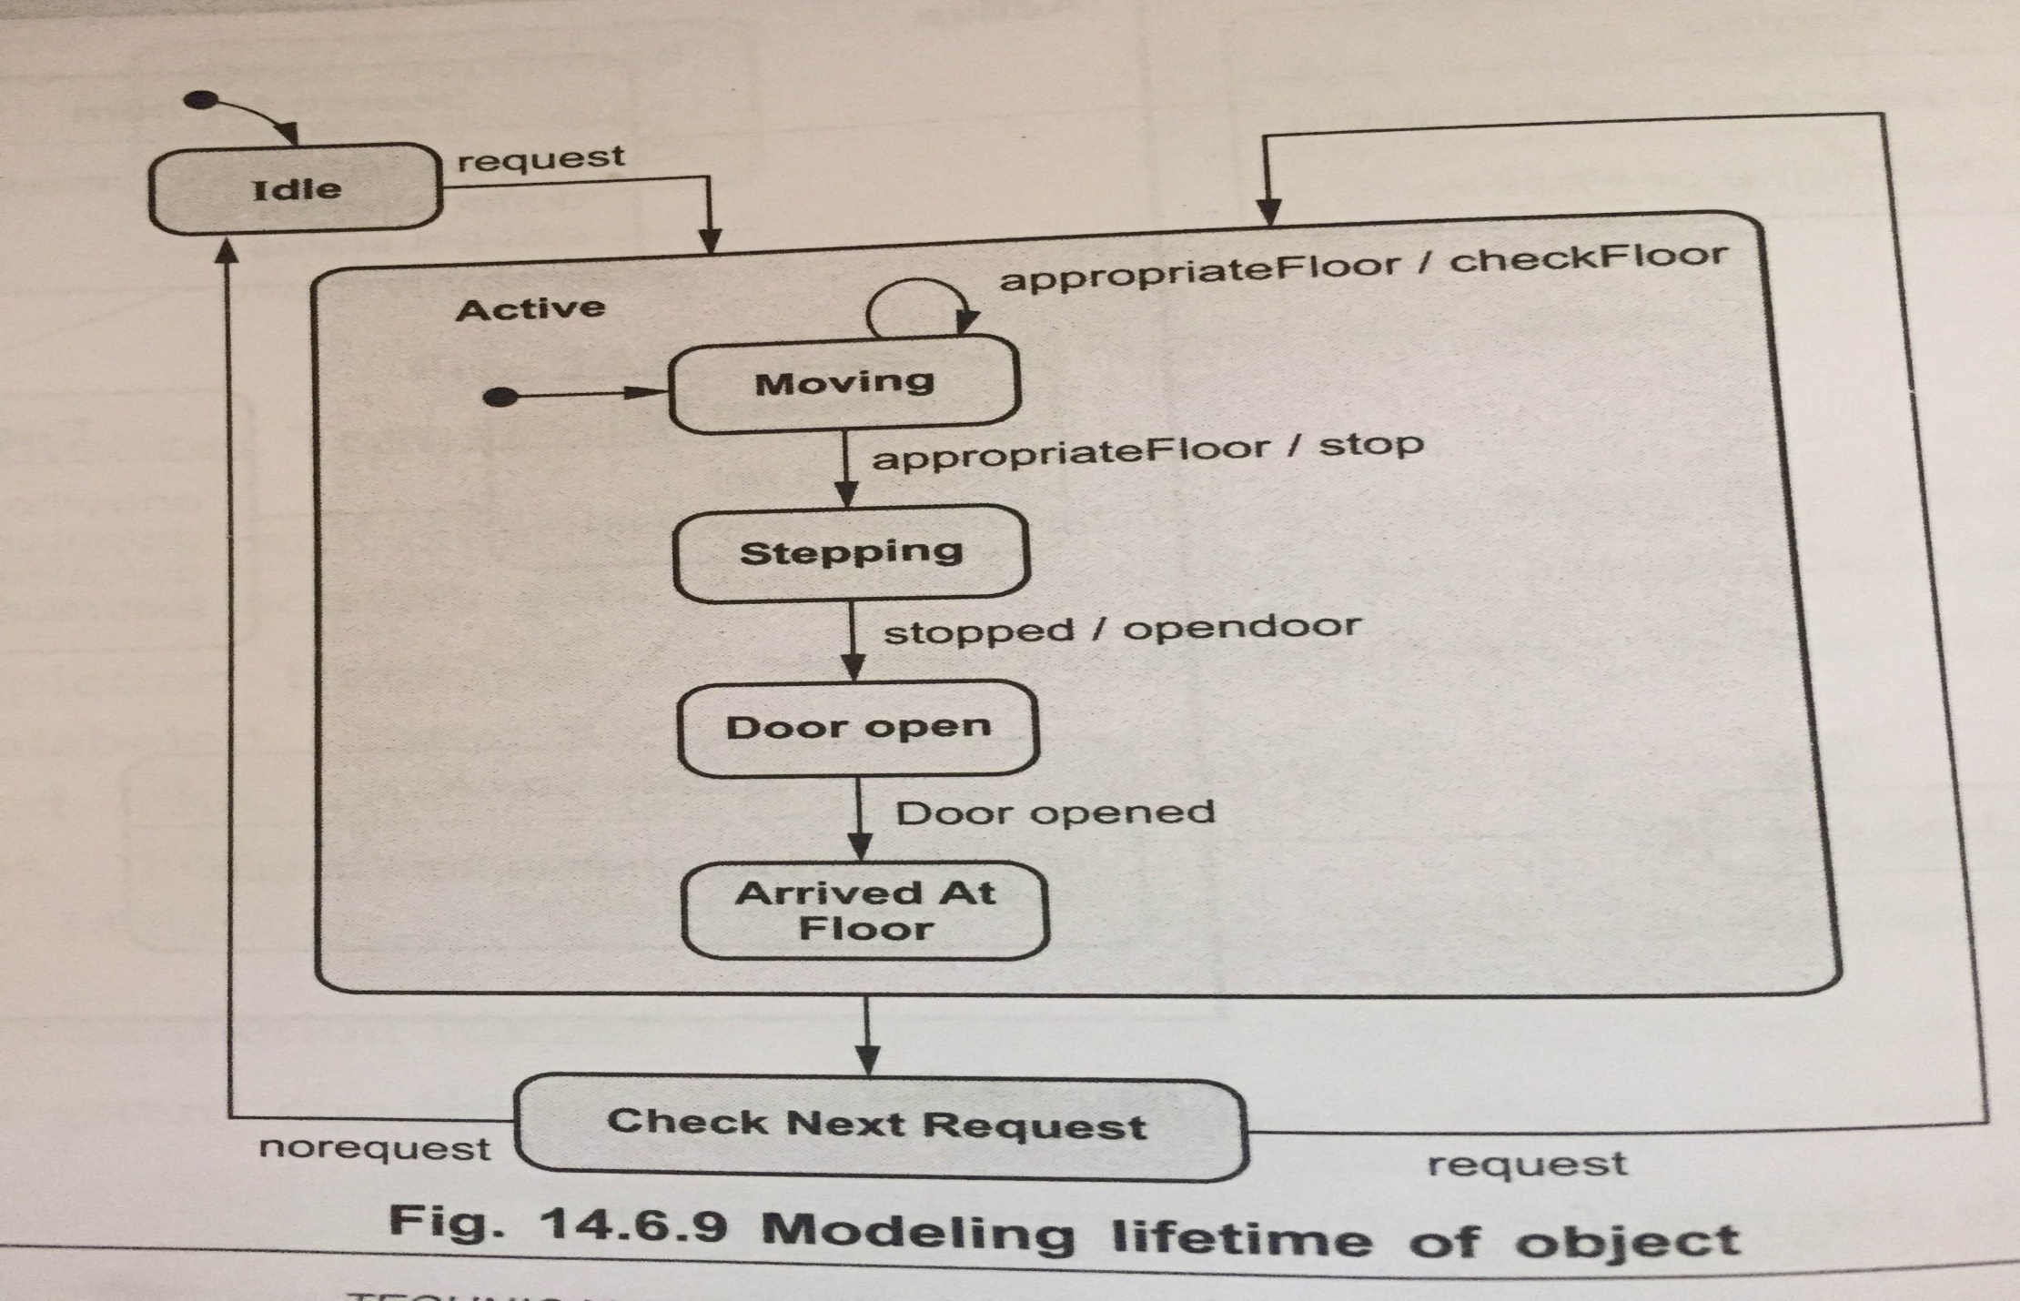
State Diagram of Elevator
UML <number>

Slide 25
INTERACTION MODELING
UML <number>

Slide 26
Introduction
→The interaction model is the third leg of the modeling tripod and describes interactions within a system.
→The class model describes the objects in a system and their relationships.
→The interaction model describes how the objects interact.
→In this chapter we will discuss following diagrams:
1)Use Case diagram 2) Sequence diagram 3)Activity diagram

Slide 27
Use Case Models
◆ Use cases describe how a system interacts with outside actors.
◆ Each use case represents a piece of functionality that a system provides to its users.
Actors:
◆ An actor is a direct external user of a system.
◆ An object or set of objects that communicates directly with the system but that is not part of the system.
◆ Each actor represents those objects that behave in a particular way toward the system.

Slide 28
Use Case Models Continue…
◆ An actor is directly connected to the system and indirectly connected to the system is not called an actor.
the object
◆ In use case diagram actor is represented by following symbol.
Actor name

Slide 29
Use Cases
◆ A use case is a coherent piece of functionality that a system can provide by interacting with actors.
◆ For example a customer actor can buy a beverage from a vending machine.
◆ Following are the use cases for the vending machine.
Buy a beverage
Perform scheduled maintenance
Make repairs
Load items

Slide 30
Use Cases
◆ Each use case involves one or more actors as well as the system itself.
◆ The use case buy a beverage involves the customer actor and the use case perform scheduled maintenance involves the repair technician actor.
◆ In a telephone system the use case make a call involves two actors a caller and a receiver.
◆ The actors need not all be persons.

Slide 31
Include Relationship
◆
The include relationship could be used:
•
to simplify large use case by splitting it into several use cases,
•
to extract common parts of the behaviours of two or more use cases.
A large use case could have some behaviours which might be detached into distinct smaller use cases to be included back into the base use case using the UML include relationship. The purpose of this action is modularization of behaviours, making them more manageable.
•

Slide 32
Extend Relationship
Extend is a directed relationship that specifies how and when the behaviour defined in usually supplementary (optional) extending use case can be inserted into the behaviour defined in the extended use case.
▪
Extend relationship is shown as a dashed line with an open arrowhead directed from the extending use case to the extended (base) use case. The arrow is labelled with the keyword «extend».
▪
UML 80

Slide 33
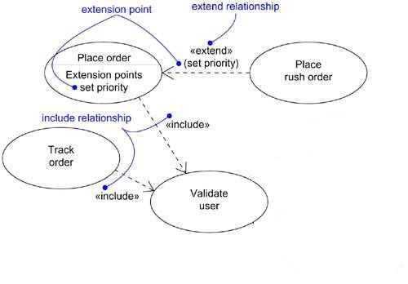
Example

Slide 34
Guidelines for Use case models
First determine the system boundary
Ensure that actors are focused
-Each actor should have a single purpose. If multiple purposes show them with separate actors.
Relate use cases and actors

Slide 35
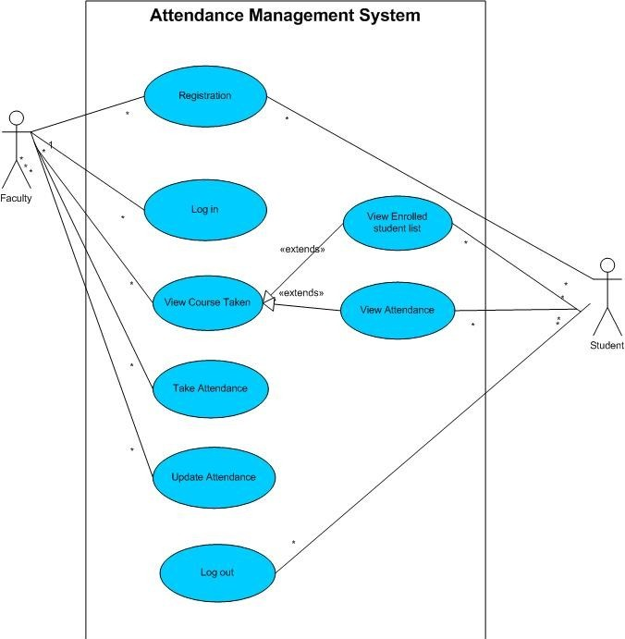
Attendance Management System

Slide 36
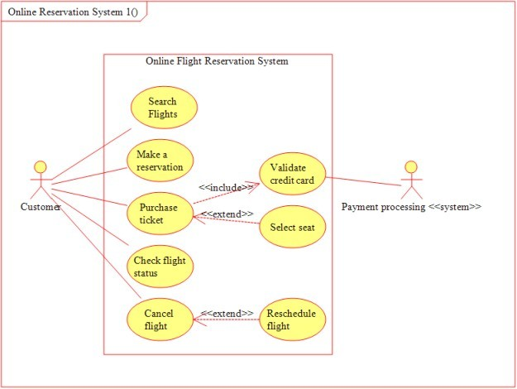
UML 84

Slide 37
Sequence Models
◆ A Sequence diagram is an interaction diagram that shows how processes operate with one another and in what order. A sequence diagram shows object interactions arranged in time sequence.
Key parts of a sequence diag.
1) participant: an object or entity that acts in the sequence diagram
◆ sequence diagram starts with an unattached "found message" arrow

Slide 38
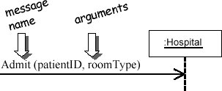
Key parts of a sequence diag
2) message: communication between participant objects the axes in a sequence diagram:
◆ horizontal: which object/participant is acting
◆ vertical: time (down -> forward in time)
◆ message (method call) indicated by horizontal arrow to other object
◆ write message name and arguments above arrow
UML 86

Slide 39
Key parts of a sequence diag
3) Focus of control (execution occurrence):
An execution occurrence (shown as tall, thin rectangle on a lifeline) represents the period during which an element is performing an operation.
The top and the bottom of the of the rectangle are aligned with the initiation and the completion time respectively.

Slide 40
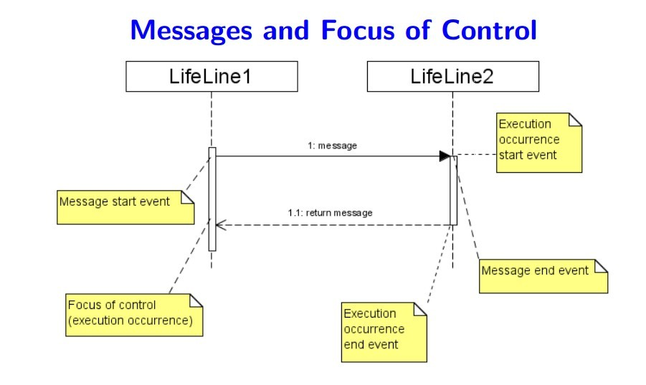
Key parts of a sequence diag.
4) Lifeline: squares with object type, optionally preceded by object name and colon
◆ write object's name if it clarifies the diagram
◆ object's "life line" represented by dashed vert. line

Slide 41
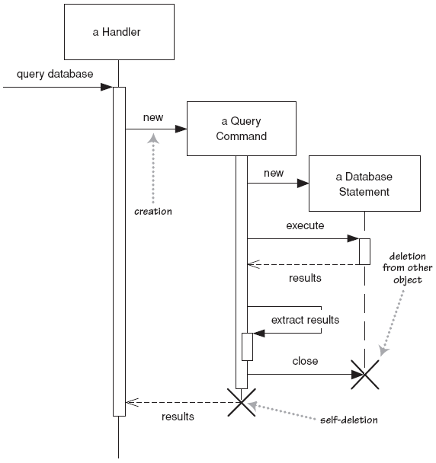
Lifetime of objects
◆ creation: arrow with 'new' written above it
◆ notice that an object created after the start of the scenario appears lower than the others
◆ deletion: an X at bottom of object's lifeline

Slide 42
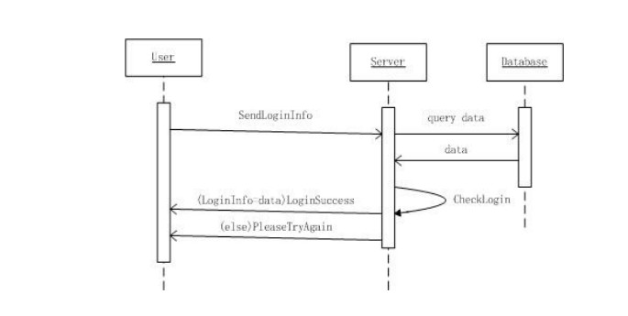
Scenarios for AMS
◆ Each scenario has a sequence of steps.
Scenario 1 : Log in

Slide 43
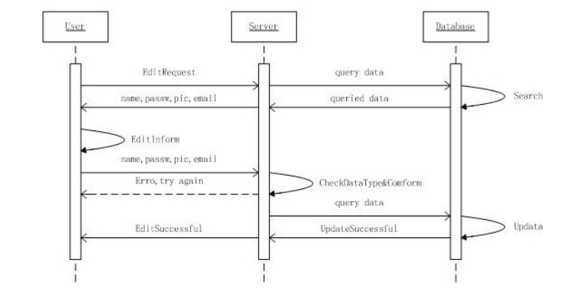
Scenarios for AMS
◆ Scenario 2 : Update Student or faculty profile.

Slide 44
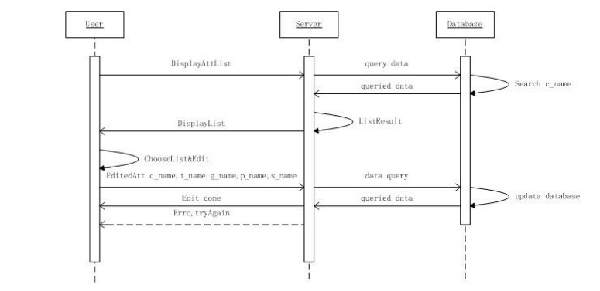
Scenarios for AMS
◆ Scenario 3 : Update Attendance

Slide 45
Guidelines for Sequence Models
◆ Prepare at least one scenario per use case:
◆ Abstract the scenarios into sequence diagrams: The seq. diagram clearly show the contribution of each actor.
◆ Divide complex interaction:
◆ Prepare a sequence diagram for each error condition.

Slide 46
Activity Diagrams
•
•
Useful to specify software or hardware system behaviour
Based on data flow models – a graphical representation (with a Directed Graph) of how data move around an information system

Slide 47
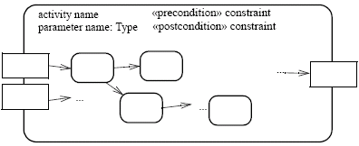
Activities
An activity is the specification of parameterized behaviour as the coordinated sequencing of subordinate units whose individual elements are actions
•
•
Uses parameters to receive and provide data to the invoker
Activity nodes
Paramet er name
Paramet er name
Activity edges
Output paramete r
Input paramete r
Paramet er name

Slide 48


Activity nodes
◆ Three type of activity nodes:
◆ Action nodes: executable activity nodes; the execution of an action represents some transformations or processes in the modeled system (already seen)
◆ Control nodes: coordinate flows in an activity diagram between other nodes

Slide 49
Forking and Joining
Use a synchronization bar to specify the forking and joining of parallel flows of control
•
A synchronization bar is rendered as a thick horizontal or vertical line.
Fork-A fork may have one incoming transitions and two or more outgoing transitions
each transition represents an independent flow of control
conceptually, the activities of each of outgoing transitions are concurrent either truly concurrent (multiple nodes) or sequential yet interleaved (one node)

Slide 50
Forking and Joining(Cont’d)
◆ A join may have two or more incoming transitions and one outgoing transition above the join, the activities associated with each of these paths continues in parallel at the join, the concurrent flows synchronize
◆ Each waits until all incoming flows have reached the join, at which point one flow of control continues on below the join

Slide 51
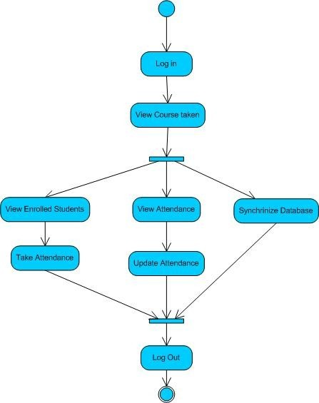
Activity Diagram of Attendance Management System

