Slide 1

Industry Specific Practices
Training Management System(TrainHub)
Presented By: Nitish S M (E0323010) Department: B-Tech CSE (AIDA)

Slide 2
Problem Definition (The SMART Criteria)
Specific: Instead of "Training is hard to manage," our focus is: "Lack of a centralized, role-based platform to manage internal employee training, course enrollments, and instructor progress.
Measurable: Currently, manual tracking via spreadsheets causes high administrative overhead and lacks real-time visibility into the exact number of employee enrollments and course completion rates.
Achievable:This problem is fully resolvable by developing a dedicated web application using the MERN stack (MongoDB, Express, React, Node.js) with automated Role-Based Access Control (RBAC).
Relevant: Directly aligns with the organizational goal of upskilling the workforce efficiently, improving employee onboarding, and maintaining accurate training compliance records.
Time-bound: Deliver a fully functional and deployed MVP of the TrainHub portal by the end of the academic project deadline.

Slide 3
Current vs. Desired State
Item | Current state | Desired state
Process followed | Manual tracking of employee training and course enrollments using disparate spreadsheets and emails. | Centralized, automated self-service portal (TrainHub) using Role-Based Access Control (RBAC) for Admins, Trainers, and Employees.
Bottlenecks | High administrative overhead, missing data, delayed reporting, and no real-time visibility into employee progress or course popularity. | Real-time analytics dashboards, seamless course creation, instant progress tracking, and zero manual data synchronization.
Impact | Wasted HR/Trainer hours, inaccurate compliance/training records, and a frustrating, disorganized learning experience for employees. | Highly efficient training management, 100% accurate compliance records, and a scalable, modern learning environment for the workforce.

Slide 4
About the Problem
Who: System Administrators, Instructors (Trainers), and Employees (Learners).
What: Inefficient manual tracking of employee training, course enrollments, and progress monitoring.
Where: Across internal HR/administrative networks and decentralized communication channels (emails/spreadsheets).
When: During onboarding, compliance training cycles, and when generating organizational learning reports.
Why: Lack of a centralized training database and automated role-based access control.
How Much : High risk of inaccurate compliance records, massive time wasted on manual data entry, and hindered employee upskilling.

Slide 5
ISO/IEC/IEEE 29148:2018
Element | Description
Context | The transition from manual, decentralized corporate training tracking to a unified, automated Learning Management System (LMS).
Stakeholders | System Administrators, Instructors (Trainers), Employees (Learners), and HR Management.
Scope Boundary | The system manages enrollments and tracking; it is not an authoring tool for creating video content, nor is it an external e-commerce platform for public users.
Success Criteria | Definition of Done (DoD): A fully deployed MERN-stack application where trainers can publish courses, employees can successfully enroll, and admins can monitor real-time completion statistics.

Slide 6
Requirements Engineering Life Cycle
Elicitation: Gathering needs directly from HR administrators and Trainers (e.g., understanding their frustration with manual spreadsheet tracking).
Analysis: Negotiating conflicts (e.g., balancing the Admins' desire for complex analytics with the need to quickly deliver a stable MERN-stack MVP) and checking technical feasibility.
Specification: Documenting the system requirements through Agile User Stories (e.g., "As a trainer, I can create a course...") and technical architectural planning.
Validation: Demoing the TrainHub React frontend and dashboards to stakeholders to confirm, "Yes, this automated system actually solves our manual tracking problem."

Slide 7
System Requirements
Software Requirements:
Component | Minimum Requirement
Operating System | Windows 10/11, macOS, or Linux
Backend Environment | Node.js (v16.0 or higher)
Database | MongoDB (Local Installation or MongoDB Atlas Cloud)
Package Manager | npm (v8.0+) or yarn
Client Interface | Modern Web Browser (Google Chrome, Firefox, Safari, Edge)

Slide 8
System Requirements
Hardware Requirements:
Component | Server-Side (Development/Hosting) | Client-Side (End User)
Processor (CPU) | Intel Core i3 / AMD Ryzen 3 (or equivalent) | Standard Mobile or Desktop Processor
Memory (RAM) | 4 GB minimum (8 GB recommended for dev) | 2 GB minimum
Storage | 10 GB available disk space | Minimal (Cached web assets only)
Network | Stable Internet Connection (Broadband recommended) | Standard Internet/Mobile Data connection

Slide 9
Categorizing Different Types of Requirements
Functional Requirements (FRs):
Dynamic Trainer Dashboard to allow Instructors to create, edit, publish, and delete training courses directly into the database.
Self-Service Employee Portal where Learners can securely browse available corporate courses and enroll with a single click.
Real-Time Admin Analytics UI to fetch and display aggregated statistics (total courses, active enrollments, and completion rates) across the organization.
Automated Role-Based Redirection must instantly route authenticated users to their specific interfaces (Admin, Trainer, or Employee) based on their assigned database role.
Non-Functional Requirements (NFRs):
Scalability: The MongoDB database and Node.js backend can seamlessly handle hundreds of concurrent employee enrollments.
Security and Compliance: Enforced via JWT (JSON Web Tokens) for secure authentication and strict Role-Based Access Control (RBAC).
Maintainability and Extensibility: A modular MERN-stack architecture makes it easy to add future features (e.g., video streaming modules).
Performance and Stress: The React frontend ensures fast, dynamic UI updates with API response times kept under optimal thresholds.

Slide 10
Requirements Traceability
Requirement Description | Requirement Type | Source / Stakeholder | Related Design / Module | Implementation (Artifact) | Status
Users must be able to securely register and login. | Functional | Employees, Trainers, Admin | Authentication Module | authController.js, userModel.js | Implemented
Instructors must be able to create, edit, and publish courses. | Functional | Instructors (Trainers) | Course Management Module | courseController.js, CreateTraining.jsx | Implemented
Employees must be able to browse courses and self-enroll. | Functional | Employees (Learners) | Enrollment Module | enrollmentRouter.js, EmployeeDashboard.jsx | Implemented
System must direct users to role-specific dashboards automatically. | Functional | All Users | UI Routing Module | App.jsx, ProtectedRoute.jsx | Implemented
Admin must be able to view real-time statistics on courses and enrollments. | Functional | Admin, HR Management | Analytics Dashboard Module | statsController.js, AdminDashboard.jsx | Implemented
System must ensure security of user data and enforce Role-Based Access Control. | Non-Functional (Security) | All Stakeholders | Security Module | authMiddleware.js, JWT, bcrypt | Implemented
System must handle multiple concurrent user enrollments with fast response times. | Non-Functional (Performance) | Employees, Management | Performance & Scalability | rateLimiter.js, MongoDB Config | Implemented

Slide 11
Change Management Criteria

Slide 12
INVEST Checklist
Letter | Principle | Red Flag (TrainHub Context)
I | Independent | "We can't start the Employee Dashboard until the Admin Dashboard is 100% done."
N | Negotiable | "The requirement says we must use Chart.js for analytics, instead of letting the developer choose the best tool."
V | Valuable | "I'm restructuring the MongoDB schema, but the end-user sees absolutely no new features or changes."
E | Estimable | "I have no idea if building the enrollment logic will take two days or two months."
S | Small | "The 'Build Course Management System' user story will likely take the entire 3-week sprint."
T | Testable | "The course enrollment process should feel 'fast' and 'intuitive'." (Instead of a testable metric like 'Loads under 2 seconds')

Slide 13
Design Engineering
High-Level Design (HLD)
System Architecture: Selected a RESTful Monolithic architecture (Node.js/Express) paired with a Single Page Application (React) for streamlined deployment and centralized API management.
Database Design: Chose NoSQL (MongoDB) for its flexible, document-based schema, allowing us to easily store varied course metadata and dynamic user roles without rigid SQL constraints.
Integration Points: Secure REST API endpoints connecting the React frontend to the Node.js backend, heavily relying on JSON Web Tokens (JWT) for secure data exchange.
Low-Level Design (LLD)
Class & Sequence Diagrams: Defining strict Mongoose Schemas (User, Course, Enrollment) and mapping the exact request/response flow for the course enrollment process.
Component Logic: Developing modular, reusable React components (e.g., CourseCard, ProtectedRoute) and contextual hooks (AuthContext) to manage client-side state.
UI/UX Design: Designing responsive, role-specific dashboards (Admin vs. Trainer vs. Employee) featuring modern, accessible styling and dynamic DOM manipulation.

Slide 14
Cohesion & Coupling
Design Goal: High Cohesion & Low Coupling
High Cohesion: Every module in our system has a single, well-defined responsibility. For example, our courseController strictly handles course logic, while authMiddleware strictly manages security and JWT validation.
Low Coupling: The React frontend and Node.js backend are loosely coupled. They operate independently and communicate solely via RESTful APIs using JSON, meaning we can update the UI without breaking backend logic.
Arriving at the Number of Modules for the Project:
By adhering to these principles, we logically divided TrainHub into Four Core Modules:
Authentication & Security Module: (User Registration, Login, RBAC)
Course Management Module: (Trainers creating and publishing content)
Enrollment Tracking Module: (Employees joining courses and tracking progress)
Admin Analytics Module: (System-wide statistics and reporting)

Slide 15
Design Pattern Usage
MVC (Model-View-Controller) pattern used in the backend to separate database schemas, routing logic, and API responses.
Middleware pattern used in Express.js for JWT authentication, rate limiting, and role-based access control (RBAC).
Provider pattern via React Context API (AuthContext) for global state management without prop-drilling.
Proxy pattern via Higher-Order Components (ProtectedRoute.jsx) to secure frontend routes based on user roles.

Slide 16
Architectural Styles
RESTful Monolithic architecture (Node.js/Express backend)
Suitable for small to medium corporate applications
Can be extended to microservices in the future (e.g., separating the Analytics module)

Slide 17
Technology Stack
Frontend (Client-Side):
React.js: For building a dynamic, component-based Single Page Application (SPA).
Vite: Used as the blazing-fast build tool and development server.
Vanilla CSS: For custom, lightweight styling and responsive layouts.
Backend (Server-Side):
Node.js: JavaScript runtime environment for executing server code.
Express.js: Web application framework for building RESTful APIs and handling routes.
Database (Data Layer):
MongoDB: NoSQL document database for flexible data storage.
Mongoose ODM: Object Data Modeling library for strict schema validation.
Security & Authentication:
JSON Web Tokens (JWT): For stateless, secure user authentication.
bcrypt: For cryptographic hashing of user passwords.

Slide 18
Interface Design
API Design:
RESTful APIs utilizing JSON for seamless, stateless communication between the React frontend and Node.js backend.
UI/UX:
Role-specific, dashboard-based interfaces (Admin, Trainer, and Employee views).
Responsive, modern design utilizing custom CSS (featuring Glassmorphism and dark-mode aesthetics) for an optimal user experience across all devices.

Slide 19
Coding Practices
Defensive Programming:
Input Validation: Using express-validator and mongoose schemas to sanitize frontend inputs before hitting the database.
Error Handling: Implementing centralized, global error-handling middleware in Node.js to prevent server crashes.
Documentation and Tooling:
Comments that explain "Why" a decision was made, not "What" the code is doing.
Automated Linting: Enforcing code quality and formatting consistency using ESLint.
Structuring React applications with modular, single-responsibility components.
Using clear, self-documenting variables and functions (e.g., fetchCourseEnrollments instead of getCE).
Utilizing reusable UI components (like CourseCard or ProtectedRoute) and a centralized api.js Axios instance to eliminate redundant fetch logic.
Prioritizing clear, straightforward logic (like using React Context for auth state) instead of over-engineering with heavy tools like Redux prematurely.

Slide 20
CODE ANALYSIS & TOOLING
Static Code Analysis: Utilization of linters (e.g., ESLint for JavaScript/React) during the development lifecycle to ensure high code quality, consistent formatting, and early bug detection.
Dynamic Application Security Testing (DAST): System architecture is designed to be compatible with DAST tools like OWASP ZAP to actively inspect for Cross-Site Scripting (XSS) and broken authentication vulnerabilities in the live environment.
Postman API Testing: Thorough endpoint testing for all Role-Based Access Control (RBAC) route restrictions (Admin vs. Trainer vs. Employee access) before frontend integration.

Slide 21
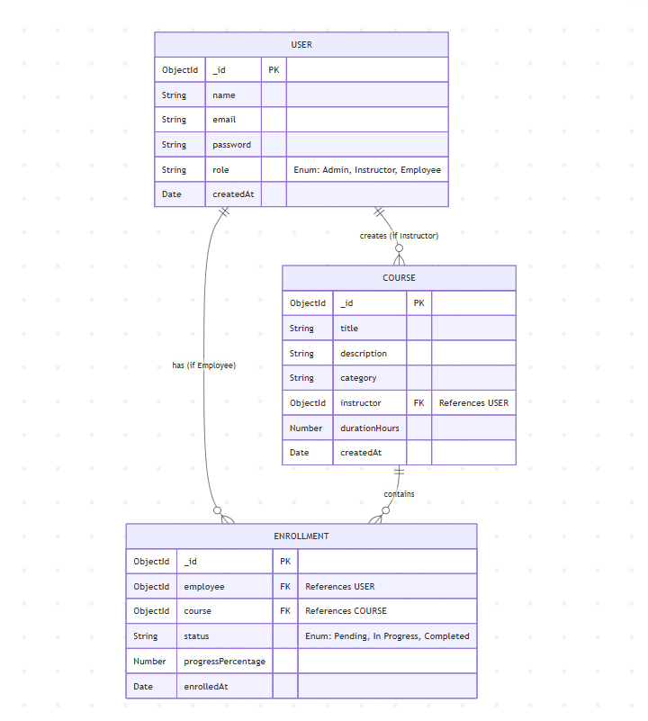
Requirments mapping
Entity-Relationship Diagram (ERD)

Slide 22
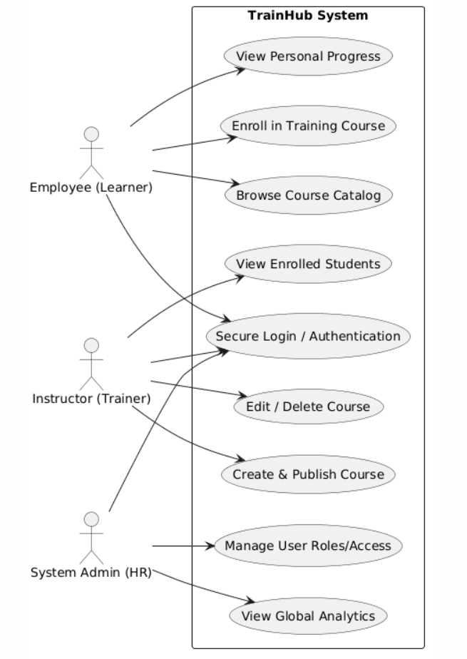
Requirments mapping
User Case and Sequence:

Slide 23
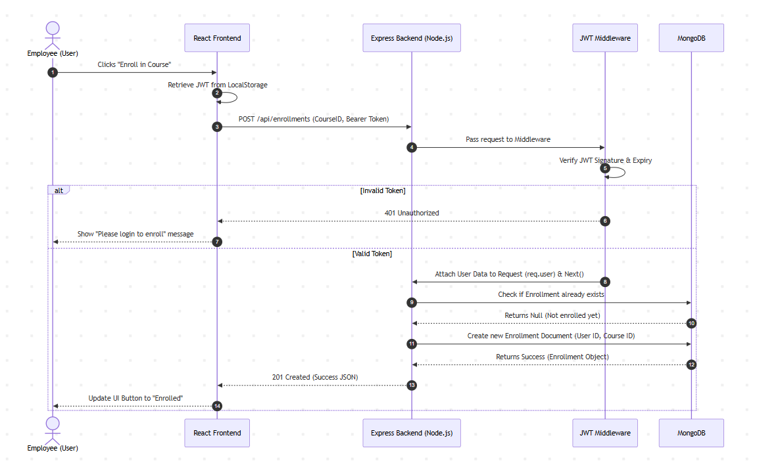
Requirments mapping
User Case and Sequence:

