Slide 1
Color detection using python
Dobariya Dev – 200050131057
Nitish Prasad - 200050131008

Slide 2
Color detection from image
Introduction
Description
Data Set
Results
Conclusion

Slide 3
INTRODUCTION
In this color detection Python project, we are going to build an application through which you can automatically get the name of the color by clicking on them.

Slide 4
Description
So for this project, we will have a data file that contains the color name and its values. Then we will calculate the distance from each color and find the shortest one.

Slide 5
Data set
Colors are made up of 3 primary colors; red, green, and blue. In computers, we define each color value within a range of 0 to 255. So in how many ways we can define a color? The answer is 256*256*256 = 16,581,375. There are approximately 16.5 million different ways to represent a color. In our dataset, we need to map each color’s values with their corresponding names. But don’t worry, we don’t need to map all the values. We will be using a dataset that contains RGB values with their corresponding names.

Slide 6
Results
Following are the outcomes of the project which shows the color of the element it is worked upon.

Slide 7
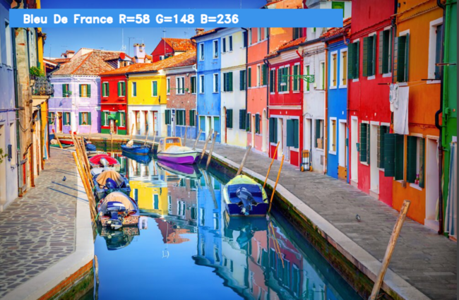

Slide 8
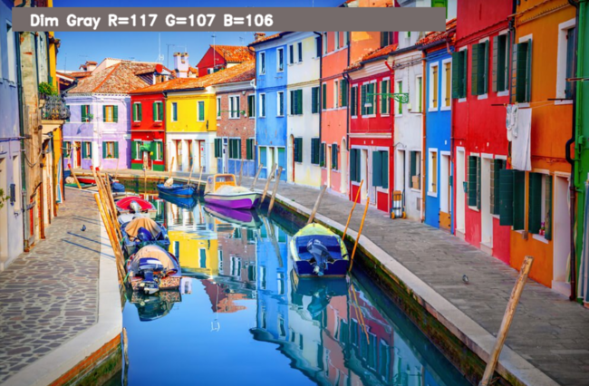

Slide 9
conclusion
In this Python project with source code, we learned about colors and how we can extract color RGB values and the color name of a pixel. We learned how to handle events like double-clicking on the window and saw how to read CSV files with pandas and perform operations on data. This is used in numerous image editing and drawing apps.

Slide 10
THANK YOU

